Slide 1
CS 4301 Numerical Methods in Machine Learning and Data Science
Nicholas Ruozzi
University of Texas at Dallas

Slide 2
Course Info.
Instructor: Nicholas Ruozzi
Office: ECSS 3.409 (online this semester)
Office hours: M 11:30-12:30, W 12:30pm-1:30pm
TA: TBD
Office hours and location: TBD
Course website: www.utdallas.edu/~nicholas.ruozzi/cs4301/2020fa/
Book: none required
Piazza (online forum): sign-up link on eLearning

Slide 3
Prerequisites
CS3345, Data Structures and Algorithms
“Mathematical sophistication”
Linear algebra: eigenvalues/vectors, matrices, vectors, etc.
Multivariate calculus: derivatives, gradients, etc.
Take prerequisite “quiz” on eLearning (coming soon)

Slide 4
Grading
5-6 problem sets (70%)
See collaboration policy on the web
Mix of theory and programming (in Python)
Available and turned in on eLearning
Approximately one assignment every two weeks
2 Exams (30%)
Attendance policy?
-subject to change-

Slide 5
What this course is about...
Problem solving using techniques from continuous optimization
Growth of AI, ML, and Data Science means that you are likely to encounter these problems in the real-world
Understand how continuous optimization techniques work and how to interpret their outputs
Emphasis is on understanding how to formulate problems and apply existing tools to (approximately) solve them
We’ll see a bit of the theory behind these methods too, but the emphasis will be on applying them

Slide 6
Course Topics
Part 1: Numerical Optimization
Unconstrained optimization (partial derivatives, gradients, local versus global optimality)
Convex functions and gradient descent
Linear programming
Constrained convex optimization problems
Method of Lagrange multipliers
Projected gradient methods
Frank-Wolfe/Method of conditional gradients
Part 2: Numerical Methods in Linear Algebra
Linear algebra review (matrices, vectors, dot products, inverses, rank)
Least squares regression (via gradient descent)
Matrix and vector norms
Eigenvalues and eigenvectors (Courant-Fisher Theorem and power iteration)
Singular value decomposition (SVD as a convex optimization problem)
Nonnegative matrix factorization (CUR decomposition, convex combinations)

Slide 7
Today: Calculus Refresher

Slide 8
Univariate Calculus Review
Given a differentiable function $f:\text{ℝ}→\text{ℝ}$, how do you find its global minimum?

Slide 9
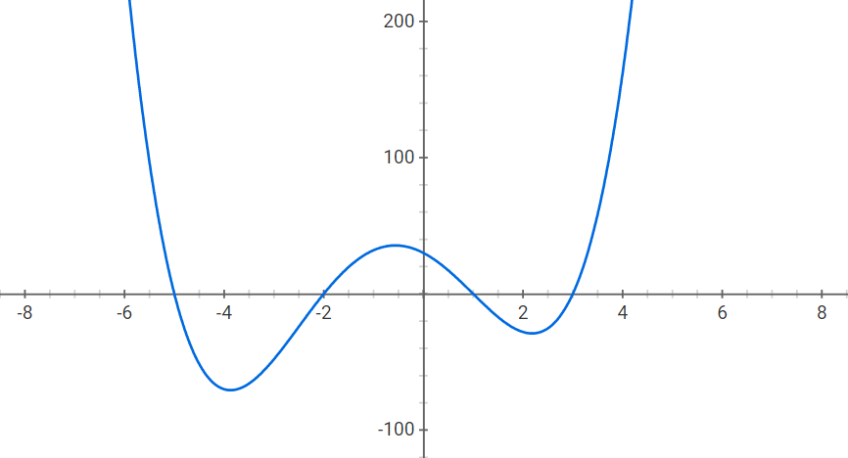
Univariate Calculus Review
Given a differentiable function $f:\text{ℝ}→\text{ℝ}$, how do you find its global minimum?

Slide 10
Univariate Calculus Review
Given a differentiable function $f:\text{ℝ}→\text{ℝ}$, how do you find its global minimum?
The global minimum can only occur in one of three places:
An $x$ such that $f^{′}\left(x\right)=0$
In the $\lim_{x→∞} f(x)$
In the $\lim_{x→−∞} f(x)$

Slide 11
Univariate Calculus Review
Given a differentiable function $f:\text{ℝ}→\text{ℝ}$, how do you find its global minimum?
The global minimum can only occur in one of three places:
An $x$ such that $f^{′}\left(x\right)=0$
In the $\lim_{x→∞} f(x)$
In the $\lim_{x→−∞} f(x)$
Note that in the last two cases, the global minimum need not be achievable at any finite $x$

Slide 12
Simple Derivatives
To find the places where the derivative is equal to zero, we can employ the standard derivative rules from calculus:
$\frac{d}{dx}x^{p}=px^{p−1}$ for any $p≠0$
$\frac{d}{dx}e^{x}=\frac{d}{dx}\exp\left(x\right)=e^{x}=exp⁡(x)$
$\frac{d}{dx}ln\left(x\right)=\frac{1}{x}$
$\frac{d}{dx}f\left(g\left(x\right)\right)=f^{′}\left(g\left(x\right)\right)g′(x)$
$\frac{d}{dx}f\left(x\right)g\left(x\right)=f^{′}\left(x\right)g\left(x\right)+f\left(x\right)g′(x)$

Slide 13
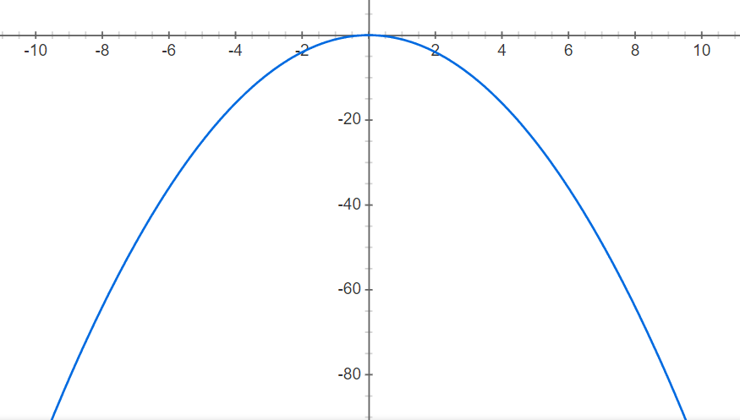
Min vs. Inf
The global minimum may also not exist!
For example, consider the function $f\left(x\right)=−x^{2}$

Slide 14
Min vs. Inf
The global minimum may also not exist!
For example, consider the function $f\left(x\right)=−x^{2}$
This function has no finite minimum
In this case, it doesn’t make sense to write $\min_{x∈\text{ℝ}}{x^{2}}$
The infimum of a function $f(x)$ over $\text{ℝ}$ is defined to be the largest value $y∈\text{ℝ}$ such that $f\left(x\right)≥y$ for all $x∈\text{ℝ}$ or $−∞$ if no such number exists
This allows us to write $inf_{x∈\text{ℝ}}{x^{2}}=−∞$
Similarly, $inf_{x∈\text{ℝ}}{\frac{1}{x^{2}}}=0$

Slide 15
Min vs. Inf
Infimums are always well-defined even if the function is unbounded from below
The analogous concept for maximization is called the supremum, i.e., the smallest upper bound
For example, $\sup_{x∈\text{ℝ}}\left(1−\frac{1}{x^{2}}\right)=1$
$\sup_{x∈\text{ℝ}}{x^{2}}=∞$
Note that $\sup_{x∈\text{ℝ}}{f(x)}=−\inf_{x∈\text{ℝ}}{−f(x)}$
As a result, we can always talk about minimizing functions even if we want to maximize one

Slide 16
Optima Under Simple Constraints
Given a differentiable function $f:{\text{ℝ}}^{n}→\text{ℝ}$, how do you find its minimum on $[a,b]$?

Slide 17
Optima Under Simple Constraints
Given a differentiable function $f:{\text{ℝ}}^{n}→\text{ℝ}$, how do you find its minimum on $[a,b]$?
The minimum of $f$ on $[a,b]$ can occur in one of three places:
An $x∈[a,b]$ such that $f^{′}\left(x\right)=0$
At the lower boundary $f(a)$
At the upper boundary $f(b)$

Slide 18
Optima Under Simple Constraints
Given a differentiable function $f:{\text{ℝ}}^{n}→\text{ℝ}$, how do you find its minimum on $[a,b]$?
The minimum of $f$ on $[a,b]$ can occur in one of three places:
An $x∈[a,b]$ such that $f^{′}\left(x\right)=0$
At the lower boundary $f(a)$
At the upper boundary $f(b)$
The optimization problem becomes much more challenging with more complex constraints!

Slide 19
Multivariable Calculus Review
Given a differentiable function $f:{\text{ℝ}}^{n}→\text{ℝ}$, how do you find its global minimum?

Slide 20
Vectors and Matrices
A vector $x∈{\text{ℝ}}^{n}$ is a tuple of $n$ real numbers where $x_{i}$ for $i∈\{1,…,n\}$ denotes the $i^{th}$ element of the tuple
Similarly, a matrix $M∈{\text{ℝ}}^{m×n}$ is indexed by a pair $i∈\{1,…,m\}$ and $j∈\{1,…,n\}$
All vectors $x∈{\text{ℝ}}^{n}$will be treated as column vectors, i.e., they can be thought of as matrices with $n$ rows and 1 column
$x∈{\text{ℝ}}^{n}$, $x^{T}$ denotes the transpose of $x$, which is a $1×n$ row vector
$x,y∈{\text{ℝ}}^{n}$, then $x^{T}y=y^{T}x=\sum_{i=1}^{n}{x_{i}⋅y_{i}}$ is the dot product between $x$ and $y$

Slide 21
Partial Derivatives
The partial derivative of a multivariate function $f$ with respect to $x_{i}$ is the derivative of $f$ with respect to $x_{i}$ assuming that all of the remaining variables are treated as constants
$\frac{∂}{∂x}\left(x^{2}y\right)=2xy$
$\frac{∂}{∂x}\left(y+\frac{x}{y}\right)=\frac{1}{y}$
$\frac{∂^{2}}{∂x∂y}\left(x^{2}y\right)=\frac{∂}{∂y}2xy=2x=\frac{∂}{∂x}x^{2}$

Slide 22
Multivariate Chain Rule
Let $x:\text{ℝ}→\text{ℝ}$, $y:\text{ℝ}→\text{ℝ}$, $f:{\text{ℝ}}^{2}→\text{ℝ}$, be differentiable functions, then
$$\frac{d}{dt}f\left(x\left(t\right),y\left(t\right)\right)=\frac{∂f}{∂x}⋅\frac{dx}{dt}+\frac{∂f}{∂y}⋅\frac{dy}{dt}$$
Applies, in the same way, to functions of more than two variables as well
Example, $x\left(t\right)=1+t$, $y\left(t\right)=t^{2}$, $f\left(x,y\right)=xy$
$$\frac{d}{dt}f\left(x\left(t\right),y\left(t\right)\right)=y\left(t\right)+2t⋅x\left(t\right)=3t^{2}+2t$$

Slide 23
Gradients
The gradient of $f$ at $\hat{x}$is the vector of partial derivatives, denoted $∇f(\hat{x}$), whose $i^{th}$ entry is $\frac{∂f}{∂x_{i}}\left(\hat{x}\right)$
$$∇f(\hat{x})=\left[\begin{matrix}\frac{∂f}{∂x_{1}}\left(\hat{x}\right) \\ ⋮ \\ \frac{∂f}{∂x_{n}}\left(\hat{x}\right)\end{matrix}\right]$$

Slide 24
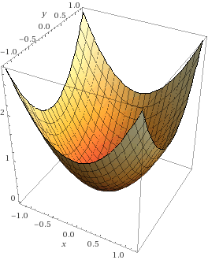
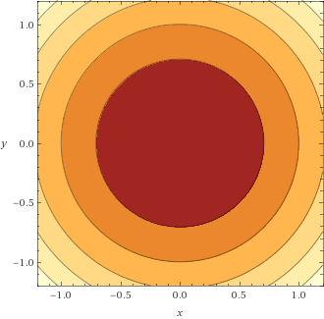
Directional Derivatives
Unlike functions of a single variable, there is not a single derivative that describes the rate of change at the point $\hat{x}$

Slide 25
Directional Derivatives
Unlike functions of a single variable, there is not a single derivative that describes the rate of change at the point $\hat{x}$
Consider $f\left(x\right)=x_{1}^{2}+2x_{1}x_{2}+x_{2}^{2}$
Let $g\left(x_{1}\right)=x_{1}^{2}+2x_{1}x_{2}^{′}+{x_{2}^{′}}^{2}$
$\frac{∂f}{∂x_{1}}\left(x^{′}\right)=\frac{dg}{dx_{1}}(x_{1}^{′})$, which is the slope of $g$ at the point $x_{1}^{′}$
This means that $\frac{∂f}{∂x_{i}}(x^{′})$ is the slope of the function $f$ when considered only as a function of $x_{i}$
Equivalently, this is the slope of $f$ in the direction $v$ where $v_{i}=1$ and all other entries of $v$ are zero

Slide 26
Directional Derivatives
The directional derivative of a differentiable function $f:{\text{ℝ}}^{n}→\text{ℝ}$ at $\hat{x}∈{\text{ℝ}}^{n}$ along the vector $d∈{\text{ℝ}}^{n}$ is given by $\frac{dg}{dt}(0)$, where $g\left(t\right)=f(\hat{x}+td)$
Equivalently, by the multivariate chain rule, $\frac{dg}{dt}\left(0\right)= ∇f{\left(\hat{x}\right)}^{T}d$
Example: $f\left(x\right)=x_{1}^{2}+2x_{1}x_{2}+x_{2}^{2}$, $d=\left[\begin{matrix}1 \\ 1\end{matrix}\right]$ $∇f{\left(\hat{x}\right)}^{T}d=4x_{1}+4x_{2}$

Slide 27
Directional Derivatives
For differentiable functions, the gradient gives the direction of steepest ascent in ${\text{ℝ}}^{n}$
It maximizes the directional derivative, $∇f{\left(\hat{x}\right)}^{T}d$, over all possible unit length directions
Recall that $x^{T}y={\left\|x\right\|}_{2}{\left\|y\right\|}_{2}\cos{θ}$ where ${\left\|x\right\|}_{2}=\sqrt{x^{T}x}$ and $θ$ is the angle between the two vectors (in the 2d-plane that contains them both)
$d$ is unit length if ${\left\|d\right\|}_{2}=1$
So, $∇f{\left(\hat{x}\right)}^{T}d≤{\left\|∇f(\hat{x})\right\|}_{2}{\left\|d\right\|}_{2}={\left\|∇f(\hat{x})\right\|}_{2}$
Choosing $d=\frac{∇f\left(\hat{x}\right)}{{\left\|∇f\left(\hat{x}\right)\right\|}_{2}}$ attains this upper bound

Slide 28
Directional Derivatives
If the directional derivative of a differentiable function $f:{\text{ℝ}}^{n}→\text{ℝ}$ at$\hat{x}∈{\text{ℝ}}^{n}$ in the direction $d∈{\text{ℝ}}^{n}$ is equal to zero for all $d∈{\text{ℝ}}^{n}$, then we say that $x$ is a critical point
This can only happen when $∇f\left(\hat{x}\right)=\vec{0}$
Local maxima and minima of differentiable functions can only occur at places in which the gradient is zero

Slide 29
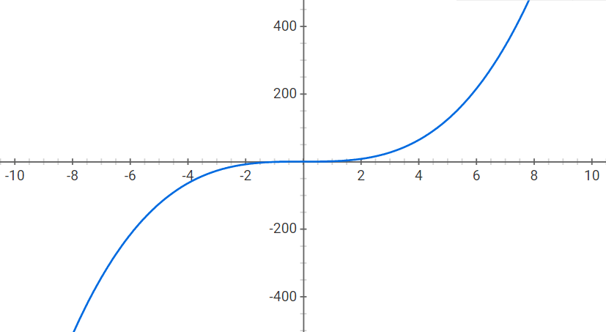
Local Optima
Critical points can be local minima, local maxima, or saddle points

Slide 30
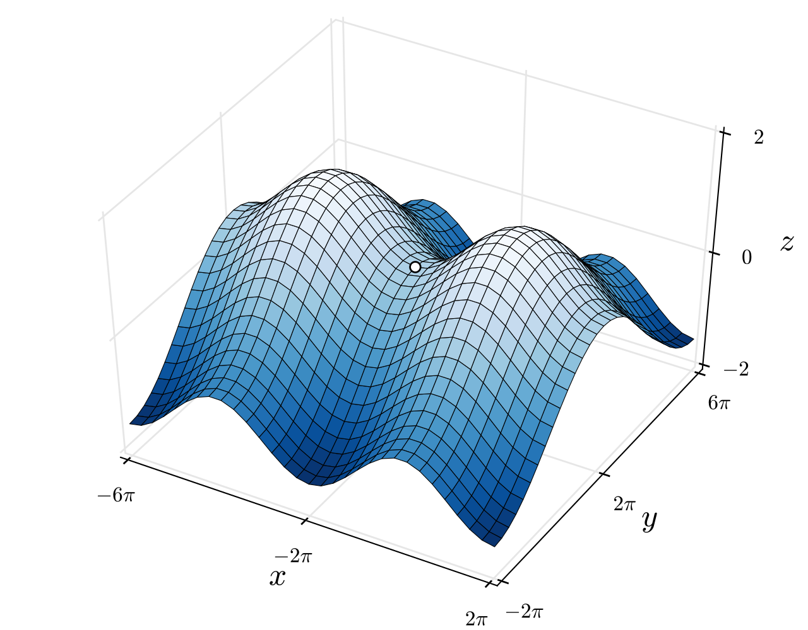
Local Optima
Critical points can be local minima, local maxima, or saddle points
source: Wikipedia

Slide 31
Multivariable Calculus Review
Given a differentiable function $f:{\text{ℝ}}^{n}→\text{ℝ}$, how do you find its global minimum?
The global minimum can only occur in one of two places:
An $x$ such that $∇f\left(x\right)=\vec{0}$
In the $\lim_{t→∞} f(td)$ for some direction $d∈ℝ^{n}$
Note that we have to look along all possible directions in the limiting cases

Slide 32
Hessian Matrix
The Hessian is the matrix of second partial derivatives, denoted $H_{f}\left(\hat{x}\right)$, whose $i^{th},j^{th}$ entry is $\frac{∂^{2}f}{∂x_{i}∂x_{j}}\left(\hat{x}\right)$
$$H_{f}\left(\hat{x}\right)=\left[\begin{matrix}\frac{∂^{2}f}{∂x_{1}^{2}}\left(\hat{x}\right) & … & \frac{∂^{2}f}{∂x_{1}∂x_{n}}\left(\hat{x}\right) \\ ⋮ & ⋱ & ⋮ \\ \frac{∂^{2}f}{∂x_{n}∂x_{1}}\left(\hat{x}\right) & … & \frac{∂^{2}f}{∂x_{n}^{2}}\left(\hat{x}\right)\end{matrix}\right]$$
For twice differentiable functions, the Hessian describes the local curvature of the function

Slide 33
Hessian Matrix
The Hessian is the matrix of second partial derivatives, denoted $H_{f}\left(\hat{x}\right)$, whose $i^{th},j^{th}$ entry is $\frac{∂^{2}f}{∂x_{i}∂x_{j}}\left(\hat{x}\right)$
$$H_{f\left(x,y\right)=x^{2}y}(x′,y′)=\left[\begin{matrix}2y′ & 2x′y′ \\ 2x′y′ & 0\end{matrix}\right]$$
For twice differentiable functions, the Hessian is always a symmetric matrix, i.e., $H_{ij}=H_{ji}$

Slide 34
Constrained Optimization
How do we minimize a multivariate function with respect to simple constraints, e.g., minimize $f(x,y)$ subject to $x∈[a,b]$ and $y∈[c,d]$?

Slide 35
Constrained Optimization
How do we minimize a multivariate function with respect to simple constraints, e.g., minimize $f(x,y)$ subject to $x∈[a,b]$ and $y∈[c,d]$?
This is much more challenging than the univariate case!
The optima can occur at a critical point, $∇f=0$, or anywhere on the boundary of the rectangle determined by $a,b,c,d$!
d
c
a
b

