Slide 1
Gradient Descent
Nicholas Ruozzi
University of Texas at Dallas

Slide 2
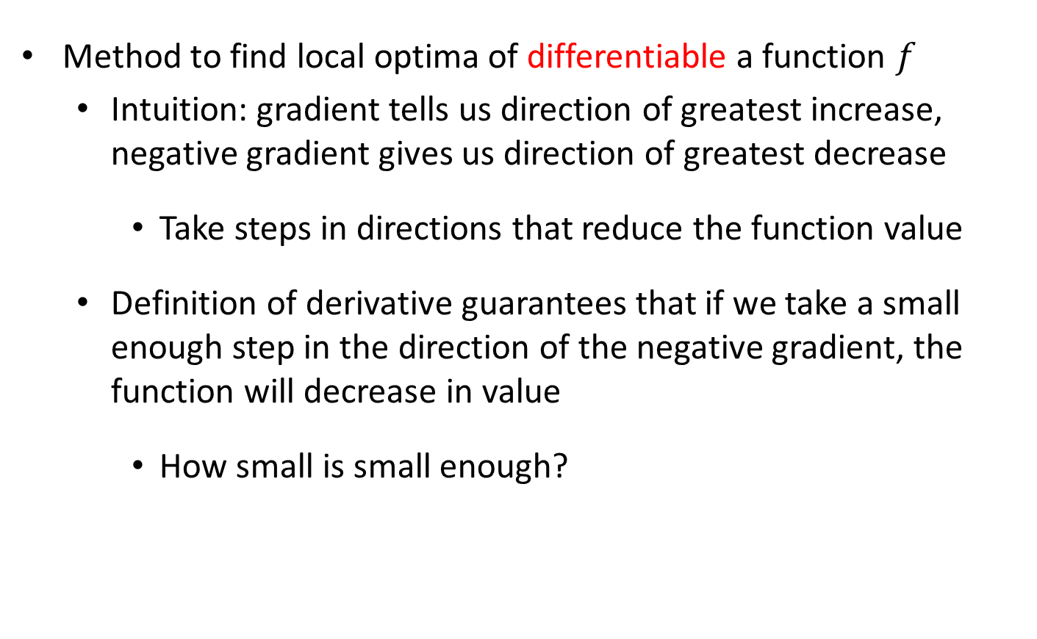
Gradient Descent
Method to find local optima of differentiable a function $f$
  Intuition: gradient tells us direction of greatest increase, negative gradient gives us direction of greatest decrease
    Take steps in directions that reduce the function value
  Definition of derivative guarantees that if we take a small enough step in the direction of the negative gradient, the function will decrease in value
    How small is small enough?

Slide 3

Gradient Descent
Gradient Descent Algorithm:
Pick an initial point $x_{0}$
Iterate until convergence
$$x_{t+1}=x_{t}−γ_{t}∇f(x_{t})$$
where $γ_{t}$ is the $t^{th}$ step size (sometimes called learning rate)

Slide 4
Gradient Descent
Gradient Descent Algorithm:
Pick an initial point $x_{0}$
Iterate until convergence
$$x_{t+1}=x_{t}−γ_{t}∇f(x_{t})$$
where $γ_{t}$ is the $t^{th}$ step size (sometimes called learning rate)
When do we stop?

Slide 5


Gradient Descent
Gradient Descent Algorithm:
Pick an initial point $x_{0}$
Iterate until convergence
$$x_{t+1}=x_{t}−γ_{t}∇f(x_{t})$$
where $γ_{t}$ is the $t^{th}$ step size (sometimes called learning rate)
Possible Stopping Criteria: iterate until $\left\|∇f(x_{t})\right\|≤ε$ for some $ε>0$
How small should $ε$ be?

Slide 6
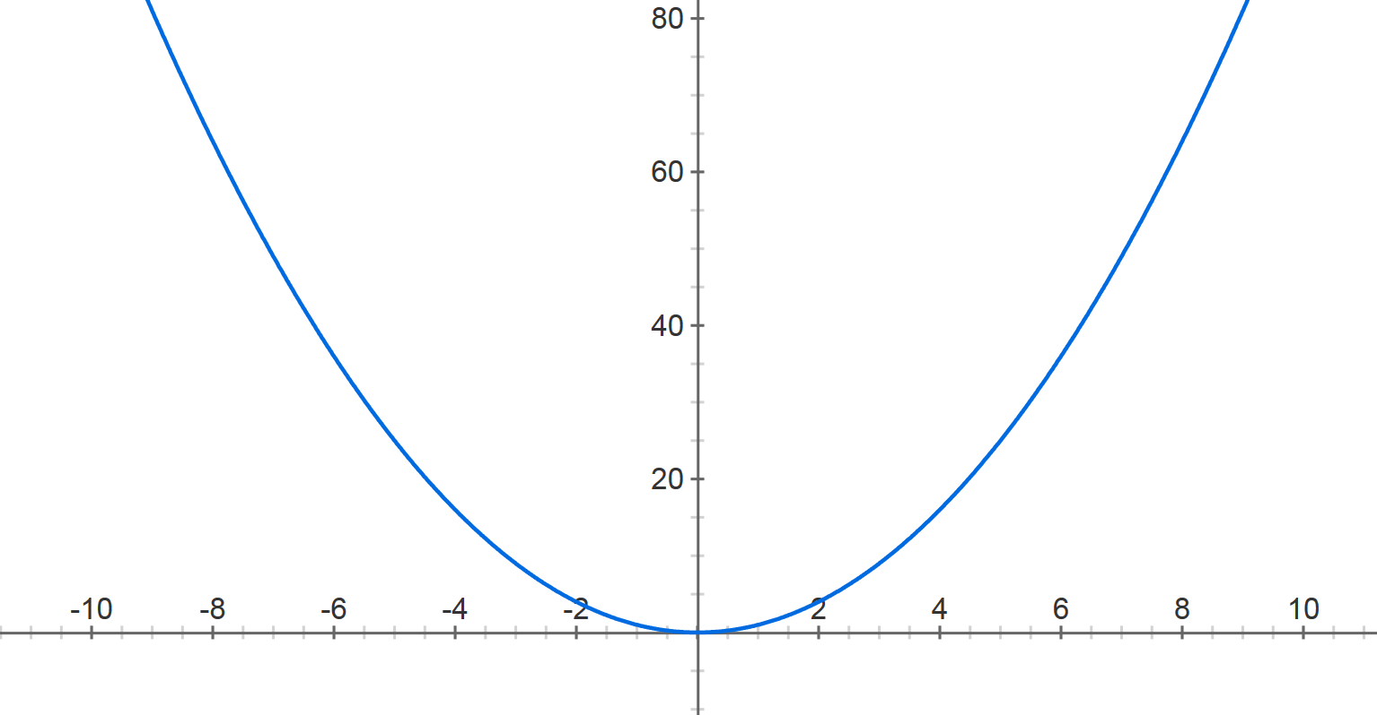



Gradient Descent
$$f\left(x\right)=x^{2}$$
Step size: $.8$
$$x^{(0)}=−4$$

Slide 7


Gradient Descent
$$f\left(x\right)=x^{2}$$
Step size: $.8$
$$x^{(0)}=−4$$
$$x^{(1)}=−4− .8⋅2⋅(−4)$$

Slide 8

Gradient Descent
$$f\left(x\right)=x^{2}$$
Step size: $.8$
$$x^{(0)}=−4$$
$$x^{(1)}=2.4$$

Slide 9



Gradient Descent
$$f\left(x\right)=x^{2}$$
Step size: $.8$
$$x^{(0)}=−4$$
$$x^{(1)}=2.4$$
$$x^{(2)}=2.4− .8⋅2⋅2.4$$
$$x^{(1)}=0.4$$

Slide 10

Gradient Descent
$$f\left(x\right)=x^{2}$$
Step size: $.8$
$$x^{(0)}=−4$$
$$x^{(1)}=2.4$$
$$x^{(2)}=−1.44$$

Slide 11





Gradient Descent
$$f\left(x\right)=x^{2}$$
Step size: $.8$
$$x^{(0)}=−4$$
$$x^{(1)}=2.4$$
$x^{(2)}=−$1.44
$$x^{(3)}=.864$$
$$x^{(4)}=−0.5184$$
$$x^{(5)}=0.31104$$
$$x^{(30)}=−8.84296e−07$$

Slide 12
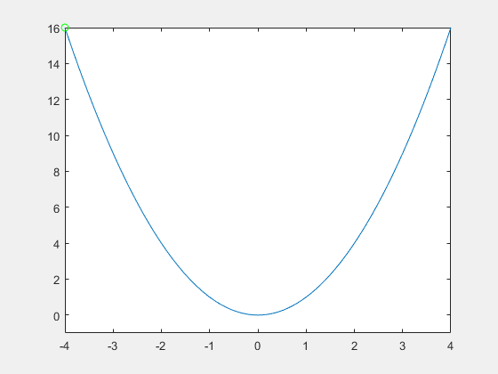
Gradient Descent
Step size: .9

Slide 13

Gradient Descent
Step size: .2

Slide 14
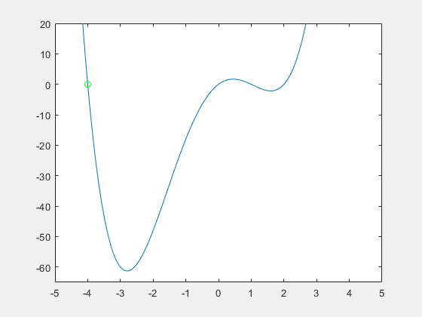
Gradient Descent
Step size matters!

Slide 15
Gradient Descent
Step size matters!

Slide 16
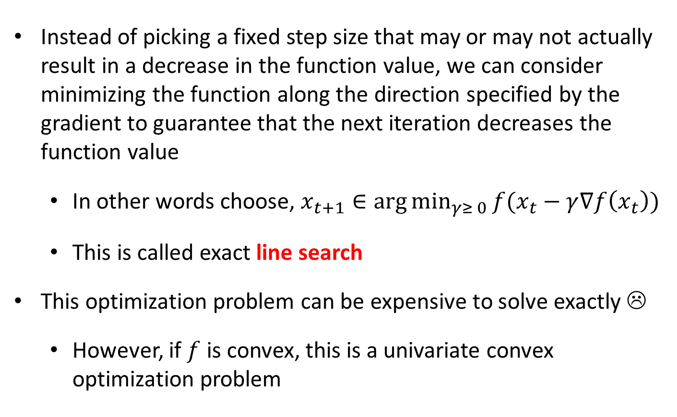
Line Search
Instead of picking a fixed step size that may or may not actually result in a decrease in the function value, we can consider minimizing the function along the direction specified by the gradient to guarantee that the next iteration decreases the function value
  In other words choose, $x_{t+1}∈\arg{\min_{γ≥ 0}{f(x_{t}−γ∇f\left(x_{t}\right))}}$
  This is called exact line search
This optimization problem can be expensive to solve exactly ☹
  However, if $f$ is convex, this is a univariate convex optimization problem

Slide 17
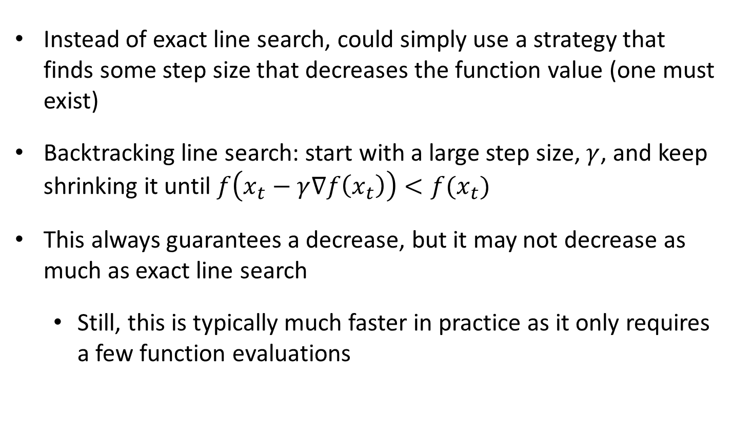
Backtracking Line Search
Instead of exact line search, could simply use a strategy that finds some step size that decreases the function value (one must exist)
Backtracking line search: start with a large step size, $γ$, and keep shrinking it until $f\left(x_{t}−γ∇f\left(x_{t}\right)\right)<f(x_{t})$
This always guarantees a decrease, but it may not decrease as much as exact line search
  Still, this is typically much faster in practice as it only requires a few function evaluations

Slide 18

Backtracking Line Search
To implement backtracking line search, choose two parameters $α∈\left(0,.5\right), β∈(0,1)$
Set $γ=1$
While $f\left(x_{t} −γ∇f\left(x_{t}\right)\right)> f\left(x_{t}\right)− α⋅γ⋅{\left\|∇f\left(x_{t}\right)\right\|}^{2}$
  $γ=βγ$
Set $x_{t+1}=x_{t} −γ∇f\left(x_{t}\right)$
Iterations continue until a step size is found that decreases the function “enough”

Slide 19
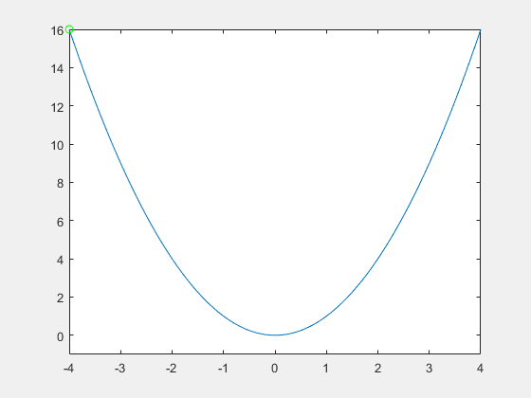

Backtracking Line Search
$$α=.2, β=.99$$

Slide 20

Backtracking Line Search
$$α=.1, β=.3$$

Slide 21
Gradient Descent: Convex Functions
For convex functions, local optima are always global optima (this follows from the definition of convexity)
  If gradient descent converges to a critical point, then the result is a global minimizer
Not all convex functions are differentiable, can we still apply gradient descent?

Slide 22

Gradients of Convex Functions
For a differentiable convex function $g(x)$ its gradients yield linear underestimators
$$g(x)$$
$$x$$

Slide 23
Gradients of Convex Functions
For a differentiable convex function $g(x)$ its gradients yield linear underestimators
$$g(x)$$
$$x$$

Slide 24

Gradients of Convex Functions
For a differentiable convex function $g(x)$ its gradients yield linear underestimators: zero gradient corresponds to a global optimum
$$g(x)$$
$$x$$

Slide 25

Subgradients
For a convex function $g(x)$, a subgradient at a point $x^{0}$ is given by any line, $l,$ such that $l\left(x^{0}\right)=g(x^{0})$ and $l\left(x\right)≤g(x)$ for all $x$, i.e., it is a linear underestimator
$$g(x)$$
$$x$$
$$x^{0}$$

Slide 26
Subgradients
For a convex function $g(x)$, a subgradient at a point $x^{0}$ is given by any line, $l,$ such that $l\left(x^{0}\right)=g(x^{0})$ and $l\left(x\right)≤g(x)$ for all $x$, i.e., it is a linear underestimator
$$g(x)$$
$$x$$
$$x^{0}$$

Slide 27
Subgradients
For a convex function $g(x)$, a subgradient at a point $x^{0}$ is given by any line, $l,$ such that $l\left(x^{0}\right)=g(x^{0})$ and $l\left(x\right)≤g(x)$ for all $x$, i.e., it is a linear underestimator
$$g(x)$$
$$x$$
$$x^{0}$$

Slide 28
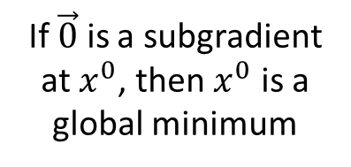
Subgradients
For a convex function $g(x)$, a subgradient at a point $x^{0}$ is given by any line, $l,$ such that $l\left(x^{0}\right)=g(x^{0})$ and $l\left(x\right)≤g(x)$ for all $x$, i.e., it is a linear underestimator
$$g(x)$$
If $\vec{0}$ is a subgradient at $x^{0}$, then $x^{0}$ is a global minimum
$$x$$
$$x^{0}$$

Slide 29
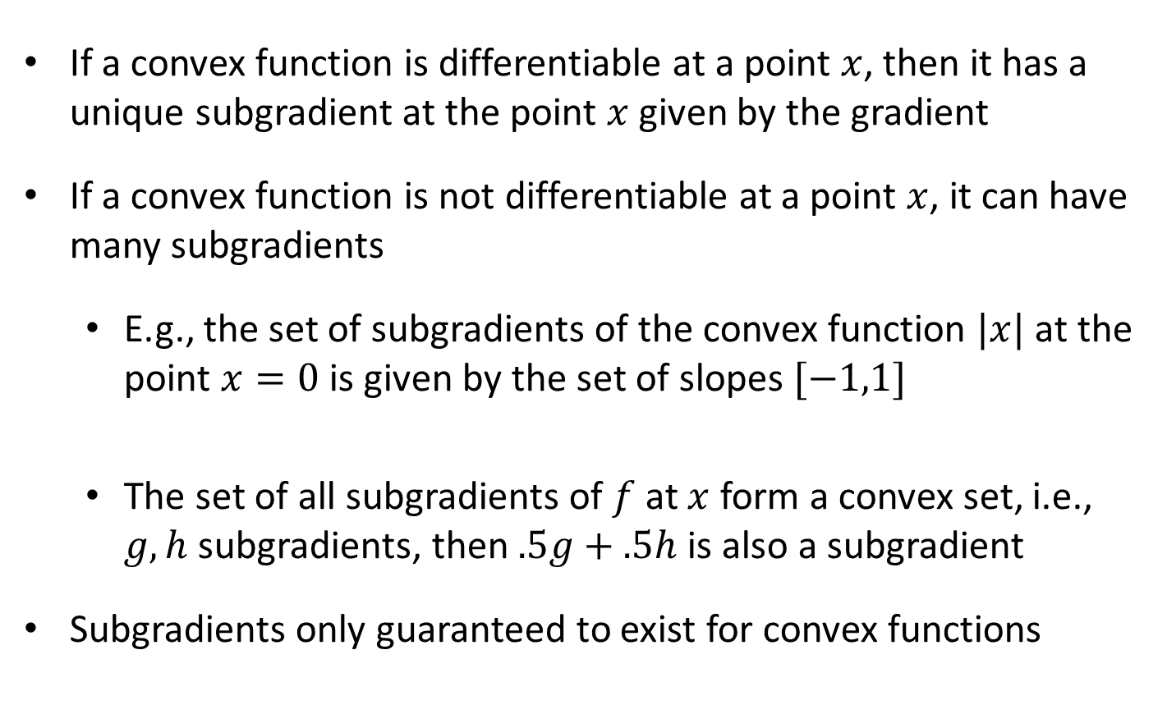
Subgradients
If a convex function is differentiable at a point $x$, then it has a unique subgradient at the point $x$ given by the gradient
If a convex function is not differentiable at a point $x$, it can have many subgradients
  E.g., the set of subgradients of the convex function $|x|$ at the point $x=0$ is given by the set of slopes $[−1,1]$
  The set of all subgradients of $f$ at $x$ form a convex set, i.e., $g,h$ subgradients, then $.5g+.5h$ is also a subgradient
Subgradients only guaranteed to exist for convex functions

Slide 30

Subgradient Example
Subgradient of $g\left(x\right)=\max{(f_{1}\left(x\right), f_{2}\left(x\right))}$ for $f_{1},f_{2}$ convex functions?

Slide 31
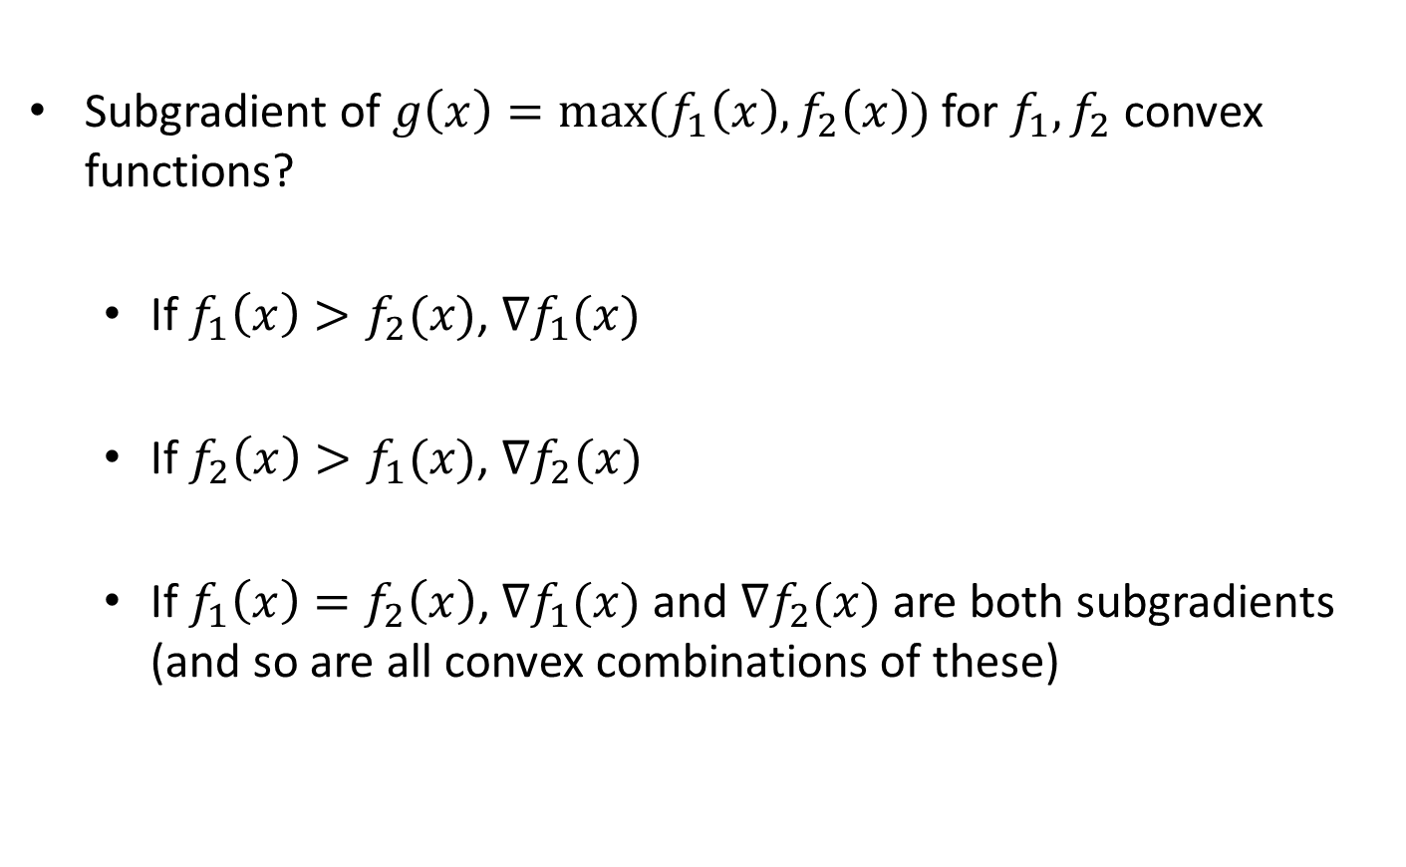
Subgradient Example
Subgradient of $g\left(x\right)=\max{(f_{1}\left(x\right), f_{2}\left(x\right))}$ for $f_{1},f_{2}$ convex functions?
  If $f_{1}\left(x\right)>f_{2}(x)$, $∇f_{1}(x)$
  If $f_{2}\left(x\right)>f_{1}(x)$, $∇f_{2}(x)$
  $\text{If} f_{1}\left(x\right)=f_{2}\left(x\right)\text{, }∇f_{1}(x)$ and $∇f_{2}(x)$ are both subgradients (and so are all convex combinations of these)

Slide 32

Subgradient Descent
Subgradient Descent Algorithm:
Pick an initial point $x_{0}$
Iterate until convergence
$$x_{t+1}=x_{t}−γ_{t}s_{f}(x_{t})$$
where $γ_{t}$ is the $t^{th}$ step size and $s_{f}(x_{t})$ is a subgradient of $f$ at
$x_{t}$

Slide 33
Subgradient Descent
Subgradient Descent Algorithm:
Pick an initial point $x_{0}$
Iterate until convergence
$$x_{t+1}=x_{t}−γ_{t}s_{f}(x_{t})$$
where $γ_{t}$ is the $t^{th}$ step size and $s_{f}(x_{t})$ is a subgradient of $f$ at
$x_{t}$
Can you use line search here?

Slide 34
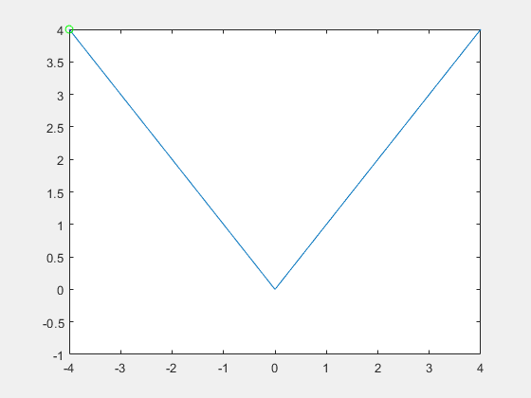
Subgradient Descent
Step Size: .9

Slide 35
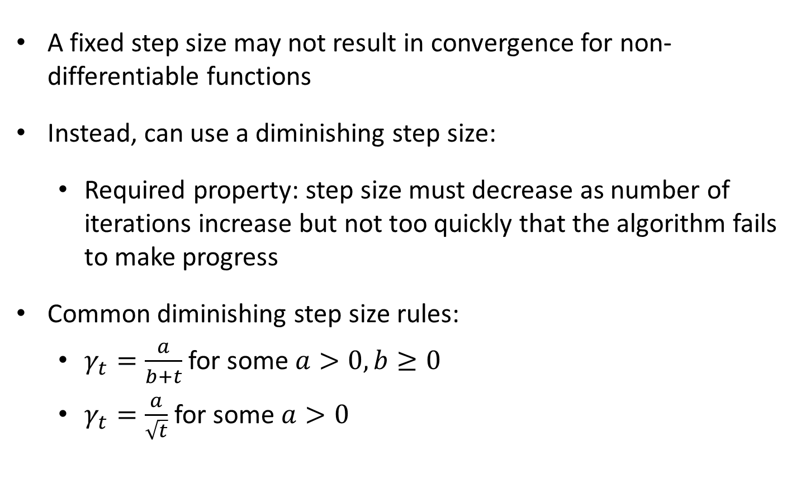
Diminishing Step Size Rules
A fixed step size may not result in convergence for non-differentiable functions
Instead, can use a diminishing step size:
  Required property: step size must decrease as number of iterations increase but not too quickly that the algorithm fails to make progress
Common diminishing step size rules:
  $γ_{t}=\frac{a}{b+t}$ for some $a>0,b≥0$
  $γ_{t}=\frac{a}{\sqrt{t}}$ for some $a>0$

Slide 36
Subgradient Descent
Diminishing Step Size

Slide 37
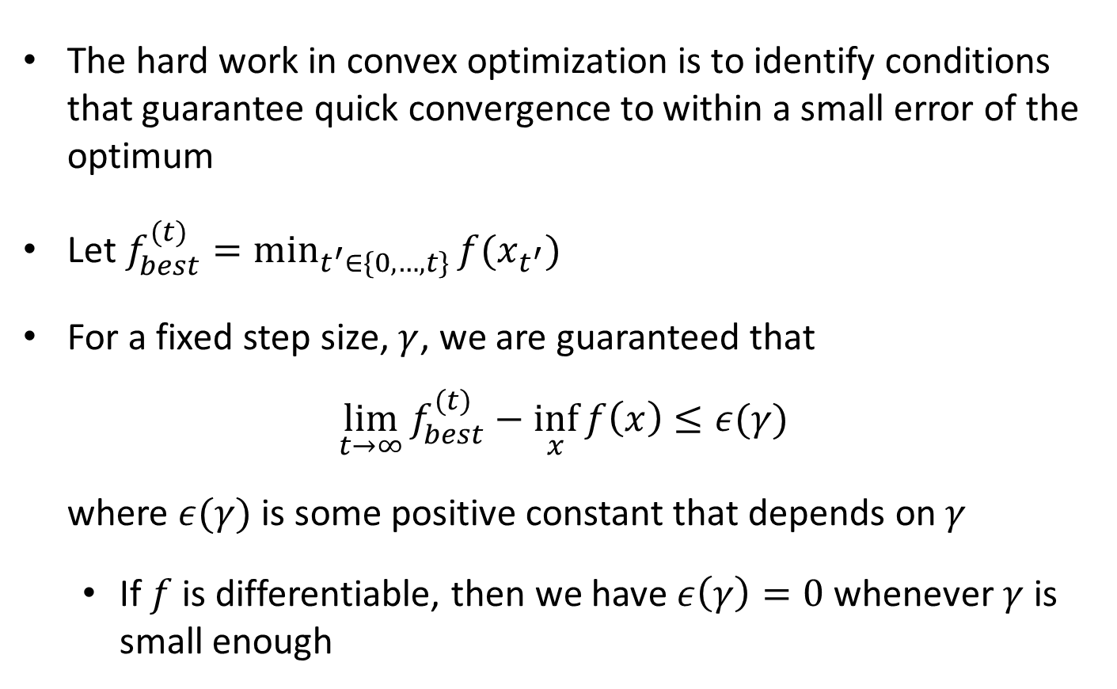
Theoretical Guarantees
The hard work in convex optimization is to identify conditions that guarantee quick convergence to within a small error of the optimum
Let $f_{best}^{(t)}=\min_{t^{′}∈\{0,…,t\}}{f(x_{t^{′}})}$
For a fixed step size, $γ$, we are guaranteed that
$$\lim_{t→∞}{f_{best}^{(t)}−\inf_{x}{f\left(x\right)}}≤ε(γ)$$
where $ε(γ)$ is some positive constant that depends on $γ$
  If $f$ is differentiable, then we have $ε\left(γ\right)=0$ whenever $γ$ is small enough

