Slide 1
Convex Optimization
Nicholas Ruozzi
University of Texas at Dallas

Slide 2
General Optimization
$$\min_{x∈ℝ^{n}}{f_{0}(x)}$$
subject to:
$$f_{i}\left(x\right)≤0, i=1,…,m$$
$$h_{i}\left(x\right)=0, i=1,…,p$$

Slide 3

General Optimization
$$\min_{x∈ℝ^{n}}{f_{0}(x)}$$
subject to:
$$f_{i}\left(x\right)≤0, i=1,…,m$$
$$h_{i}\left(x\right)=0, i=1,…,p$$
$f_{0}$ is not necessarily convex

Slide 4
General Optimization
$$\min_{x∈ℝ^{n}}{f_{0}(x)}$$
subject to:
$$f_{i}\left(x\right)≤0, i=1,…,m$$
$$h_{i}\left(x\right)=0, i=1,…,p$$
Constraints do not need to be linear

Slide 5

Example
$$\max_{x∈ℝ^{2}}{−x_{1}\log{x_{1}}−x_{2}\log{x_{2}}}$$
subject to:
$$x_{1}+x_{2}=1$$
$$x_{1}≥0$$
$$x_{2}≥0$$

Slide 6

Example
$$\min_{x∈ℝ^{2}}{x_{1}\log{x_{1}}+x_{2}\log{x_{2}}}$$
subject to:
$$1−x_{1}−x_{2}=0$$
$$−x_{1}≤0$$
$$−x_{2}≤0$$

Slide 7

Convex Optimization
$$\min_{x∈ℝ^{n}}{f_{0}(x)}$$
subject to:
$$f_{i}\left(x\right)≤0, i=1,…,m$$
$$h_{i}\left(x\right)=0, i=1,…,p$$
In a convex optimization problem $f_{0},f_{1},…,f_{m}$ must be convex and $h_{1},…,h_{p}$ must be affine, i.e., $h_{i}\left(x\right)=w^{T}x+b$

Slide 8
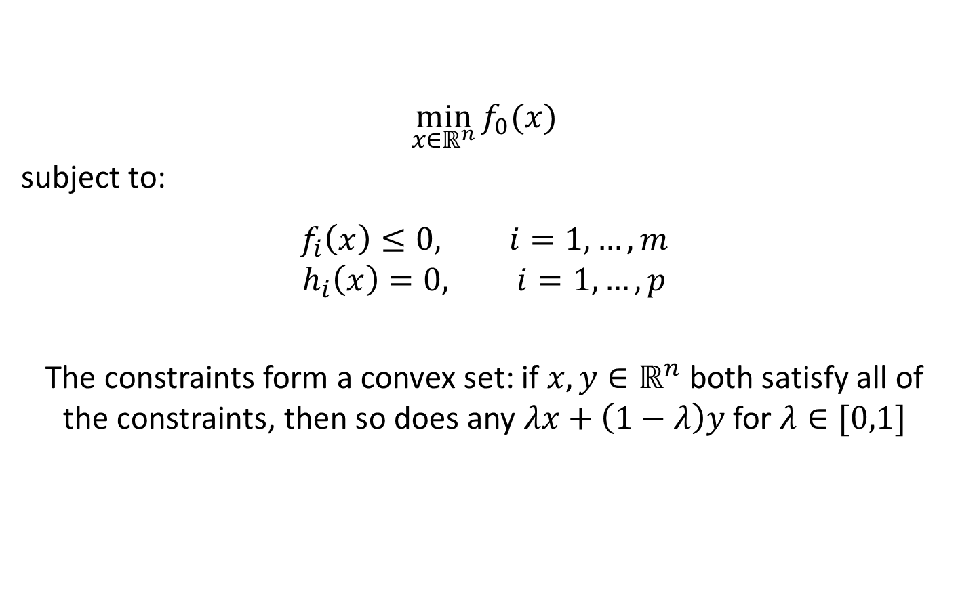
Convex Optimization
$$\min_{x∈ℝ^{n}}{f_{0}(x)}$$
subject to:
$$f_{i}\left(x\right)≤0, i=1,…,m$$
$$h_{i}\left(x\right)=0, i=1,…,p$$
The constraints form a convex set: if $x,y∈ℝ^{n}$ both satisfy all of the constraints, then so does any $λx+\left(1−λ\right)y$ for $λ∈[0,1]$

Slide 9




Local and Global Optima
Every local optimum of a convex optimization problem is a global optimum: let $x$ be a local minimum, $y$ a global minimum, and $f\left(x\right)>f(y)$
$$y$$
$$R$$
$$x$$

Slide 10

Local and Global Optima
Every local optimum of a convex optimization problem is a global optimum: let $x$ be a local minimum, $y$ a global minimum, and $f\left(x\right)>f(y)$
$x$ is a local minimum implies that there exists a radius $R$ such that for all points $x′$within the ball of radius $R$ of $x$,
$f\left(x\right)≤f(x′)$
$$y$$
$$R$$
$$x$$

Slide 11


Local and Global Optima
Every local optimum of a convex optimization problem is a global optimum: let $x$ be a local minimum, $y$ a global minimum, and $f\left(x\right)>f(y)$
Let $z=θx+\left(1−θ\right)y$
$$θ=\frac{R}{2{\left\|x−y\right\|}_{2}}$$
then
$${\left\|x−z\right\|}_{2}=\left(1−θ\right){\left\|x−y\right\|}_{2}$$
$$=\frac{R}{2}$$
$$y$$
$$R$$
$$z$$
$$x$$

Slide 12
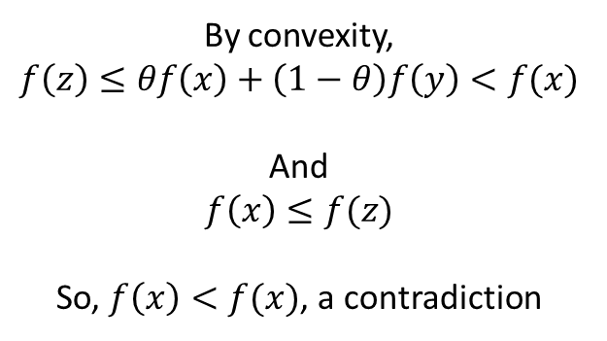
Local and Global Optima
Every local optimum of a convex optimization problem is a global optimum: let $x$ be a local minimum, $y$ a global minimum, and $f\left(x\right)>f(y)$
By convexity,
$$f\left(z\right)≤θf\left(x\right)+\left(1−θ\right)f\left(y\right)<f(x)$$
And
$$f\left(x\right)≤f(z)$$
So, $f\left(x\right)<f(x)$, a contradiction
$$y$$
$$R$$
$$z$$
$$x$$

Slide 13
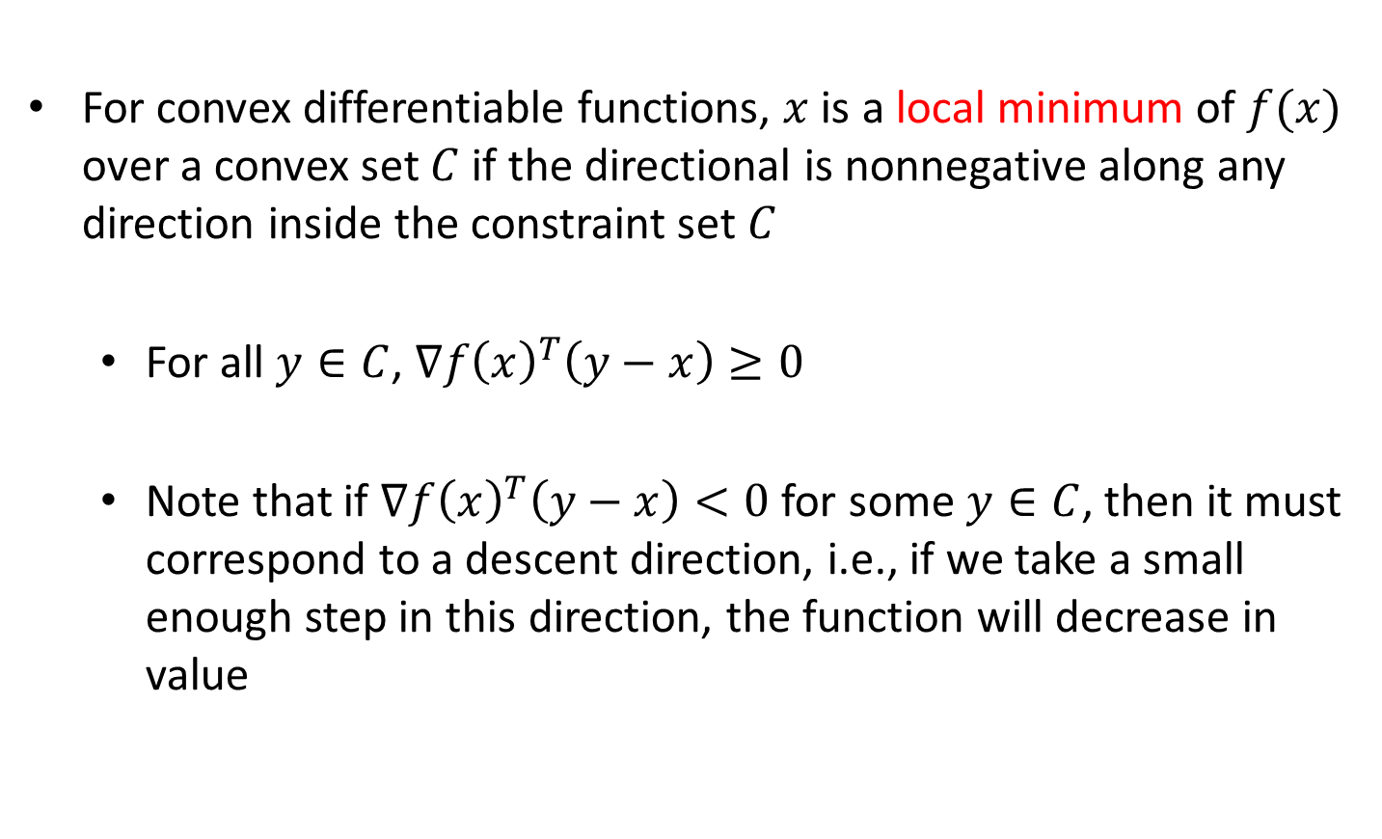
Local Optima
For convex differentiable functions, $x$ is a local minimum of $f(x)$ over a convex set $C$ if the directional is nonnegative along any direction inside the constraint set $C$
  For all $y∈C$, $∇f{\left(x\right)}^{T}\left(y−x\right)≥0$
  Note that if $∇f{\left(x\right)}^{T}\left(y−x\right)<0$ for some $y∈C$, then it must correspond to a descent direction, i.e., if we take a small enough step in this direction, the function will decrease in value

Slide 14

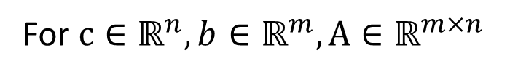
Linear Programming Problems
$$\min_{x∈ℝ^{n}}{c^{T}x}$$
subject to: $Ax≤b$
For $c∈ℝ^{n}, b∈ℝ^{m},A∈ℝ^{m×n}$

Slide 15



Quadratic Programming Problems
$$\min_{x∈ℝ^{n}}{{\frac{1}{2}x}^{T}Qx+c^{T}x}$$
subject to: $Ax≤b$
For $Q∈ℝ^{n×n}, c∈ℝ^{n}, b∈ℝ^{m},A∈ℝ^{m×n}$
Recall $Q$ must be positive semidefinite for this to be a convex optimization problem

Slide 16



Least Squares Regression
Given data points $x^{(1)},…,x^{\left(M\right)}∈ℝ$ and $y^{(1)},…,y^{\left(M\right)}∈ℝ$, find the best fit line
$$y$$
$$x$$

Slide 17

Least Squares Regression
Given data points $x^{(1)},…,x^{\left(M\right)}∈ℝ$ and $y^{(1)},…,y^{\left(M\right)}∈ℝ$, find the best fit line
$$\min_{a,b∈ℝ}{\sum_{i=1}^{M}{{\left(y^{\left(i\right)}−ax^{\left(i\right)}+b\right)}^{2}}}$$
This is a convex optimization problem, why?

Slide 18

Least Squares Regression
Given data points $x^{(1)},…,x^{\left(M\right)}∈ℝ$ and $y^{(1)},…,y^{\left(M\right)}∈ℝ$, find the best fit polynomial of degree $d$
$$\min_{a,b∈ℝ}{\sum_{i=1}^{M}{{\left(y^{\left(i\right)}−\sum_{k=0}^{d}{c_{k}{x^{\left(i\right)}}^{k}}\right)}^{2}}}$$
This is a convex optimization problem, why?

Slide 19



Projections
Given a set $C⊆ℝ^{n}$, the projection of a point $x∈ℝ^{n}$ onto $C$ is the point $z∈C$ such that the distance between $x$ and $z$ is less than or equal to the distance between $x$ and any other $z^{′}∈C$
$$z$$
$$x$$

Slide 20
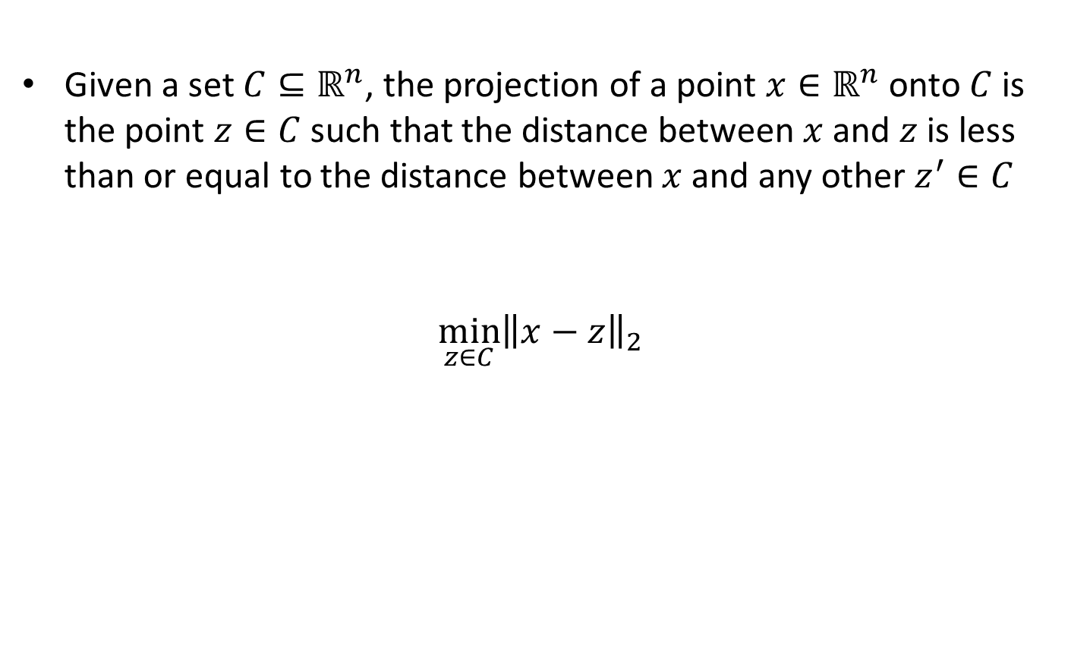
Projections
Given a set $C⊆ℝ^{n}$, the projection of a point $x∈ℝ^{n}$ onto $C$ is the point $z∈C$ such that the distance between $x$ and $z$ is less than or equal to the distance between $x$ and any other $z^{′}∈C$
$$\min_{z∈C}{{\left\|x−z\right\|}_{2}}$$

Slide 21
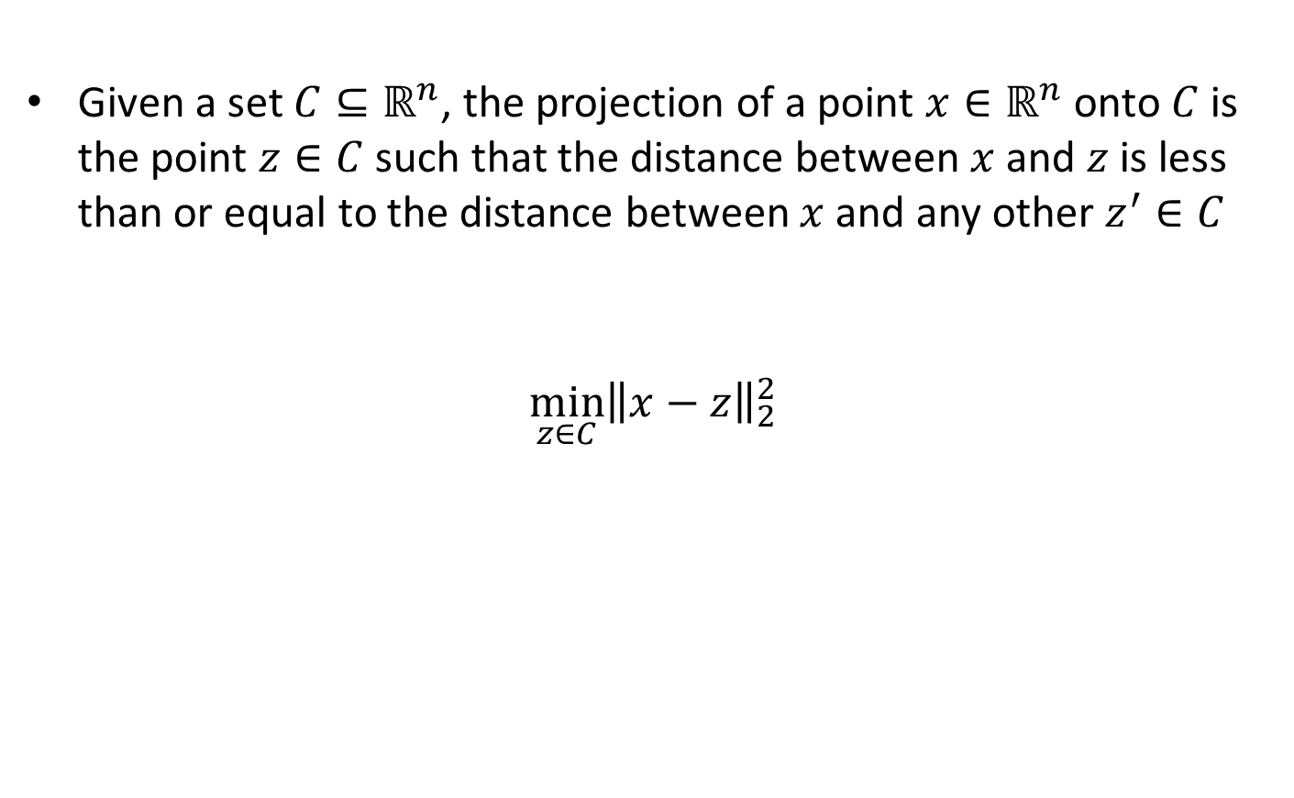
Projections
Given a set $C⊆ℝ^{n}$, the projection of a point $x∈ℝ^{n}$ onto $C$ is the point $z∈C$ such that the distance between $x$ and $z$ is less than or equal to the distance between $x$ and any other $z^{′}∈C$
$$\min_{z∈C}{{\left\|x−z\right\|}_{2}^{2}}$$
Convex if $C$ is a convex set, e.g., $C$ is a line or a plane

Slide 22
Projections
Given a set $C⊆ℝ^{n}$, the projection of a point $x∈ℝ^{n}$ onto $C$ is the point $z∈C$ such that the distance between $x$ and $z$ is less than or equal to the distance between $x$ and any other $z^{′}∈C$
$$\min_{z∈C}{{\left\|x−z\right\|}_{2}^{2}}$$
Can project under different notions of distance as well

Slide 23

Smallest Enclosing Ball
Find the ball of smallest radius that encloses a collection of points $x^{(1)},…,x^{\left(M\right)}∈ℝ^{n}$

Slide 24

Smallest Enclosing Ball
Find the ball of smallest radius that encloses a collection of points $x^{(1)},…,x^{\left(M\right)}∈ℝ^{n}$
$$\min_{x∈ℝ^{n},c∈ℝ}{c}$$
such that ${\left\|x^{\left(i\right)}−x\right\|}_{2}^{2}≤c$ for $i=1,…,M$
and $c≥0$

