Slide 1
Gradient Descent with Constraints
Nicholas Ruozzi
University of Texas at Dallas

Slide 2

Convex Optimization
$$\min_{x∈ℝ^{n}}{f_{0}(x)}$$
subject to:
$$f_{i}\left(x\right)≤0, i=1,…,m$$
$$h_{i}\left(x\right)=0, i=1,…,p$$
In a convex optimization problem $f_{0},f_{1},…,f_{m}$ must be convex and $h_{1},…,h_{p}$ must be affine, i.e., $h_{i}\left(x\right)=w^{T}x+b$

Slide 3
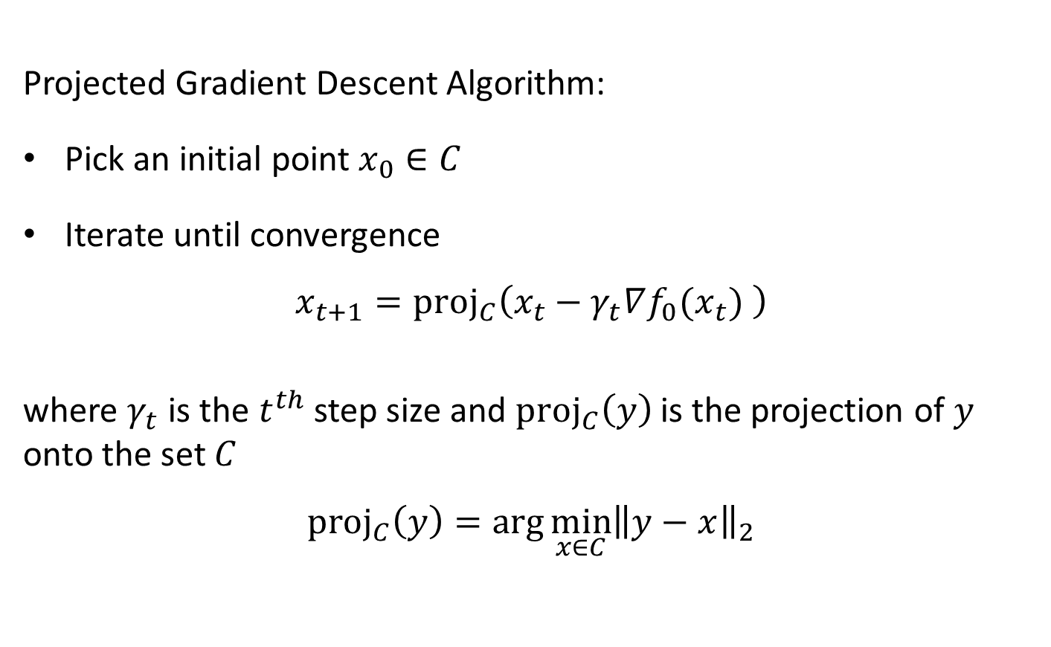
Projected Gradient Descent
Projected Gradient Descent Algorithm:
Pick an initial point $x_{0}∈C$
Iterate until convergence
$$x_{t+1}=proj_{C}\left(x_{t}−γ_{t}∇f_{0}(x_{t}) \right)$$
where $γ_{t}$ is the $t^{th}$ step size and $proj_{C}\left(y\right)$ is the projection of $y$ onto the set $C$
$$proj_{C}\left(y\right)=\arg{\min_{x∈C}{{\left\|y−x\right\|}_{2}}}$$

Slide 4
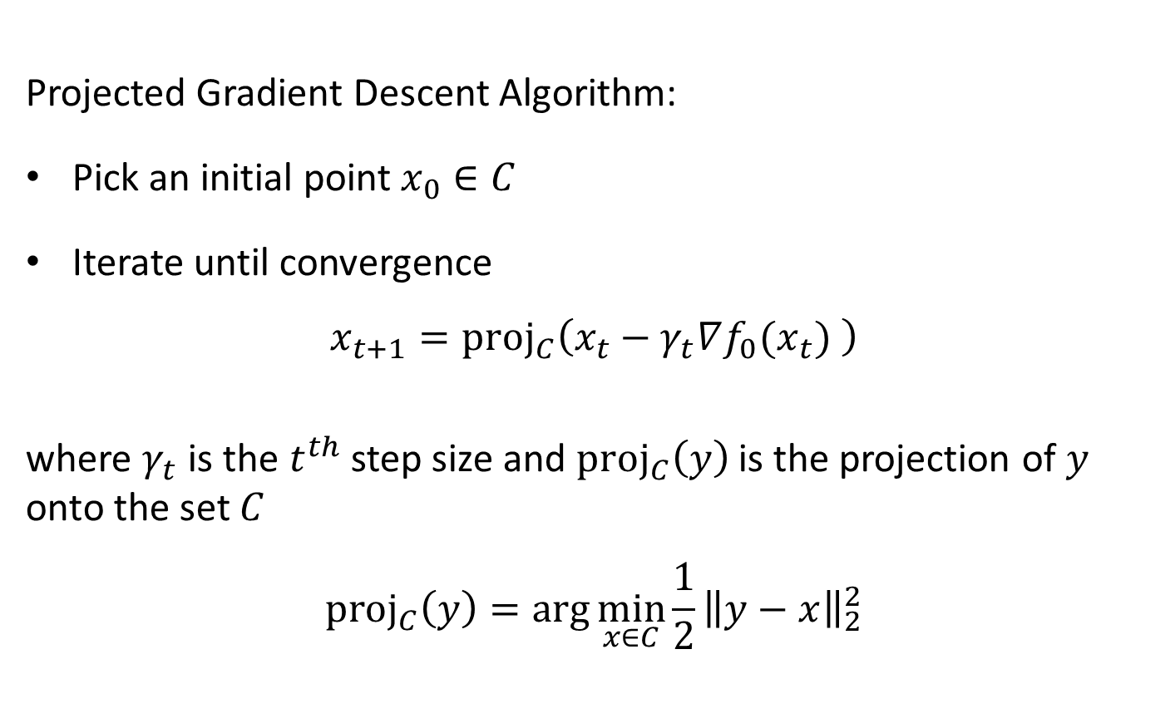
Projected Gradient Descent
Projected Gradient Descent Algorithm:
Pick an initial point $x_{0}∈C$
Iterate until convergence
$$x_{t+1}=proj_{C}\left(x_{t}−γ_{t}∇f_{0}(x_{t}) \right)$$
where $γ_{t}$ is the $t^{th}$ step size and $proj_{C}\left(y\right)$ is the projection of $y$ onto the set $C$
$$proj_{C}\left(y\right)=\arg{\min_{x∈C}{\frac{1}{2}{\left\|y−x\right\|}_{2}^{2}}}$$

Slide 5



Projected Gradient Descent
$$C$$
$$x_{t}$$
$$x_{t+1}$$

Slide 6

Examples of Projections
Project on to $C=\{x:x≤0\}$?
  $proj_{C}{\left(x\right)}_{i}=\left\{\begin{matrix}x_{i}, if x_{i}≤0 \\ 0, otherwise\end{matrix}\right.$
Project on to $C=\{x:{\left\|x\right\|}_{2}≤1\}$?
  $proj_{C}(x)=\left\{\begin{matrix}x, if {\left\|x\right\|}_{2}≤1 \\ \frac{x}{{\left\|x\right\|}_{2}}, otherwise\end{matrix}\right.$

Slide 7
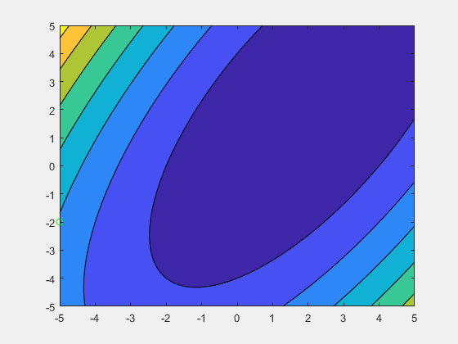
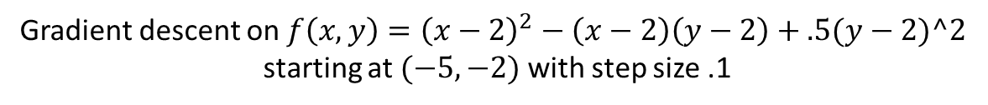
Example of PGD
Gradient descent on $f\left(x,y\right)={\left(x−2\right)}^{2}−\left(x−2\right)\left(y−2\right)+.5(y−2)^2$
starting at $(−5,−2)$ with step size .1

Slide 8

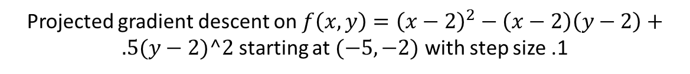

Example of PGD
Constraint $x≤0,y≤0$
Projected gradient descent on $f\left(x,y\right)={\left(x−2\right)}^{2}−\left(x−2\right)\left(y−2\right)+.5(y−2)^2$ starting at $(−5,−2)$ with step size .1

Slide 9
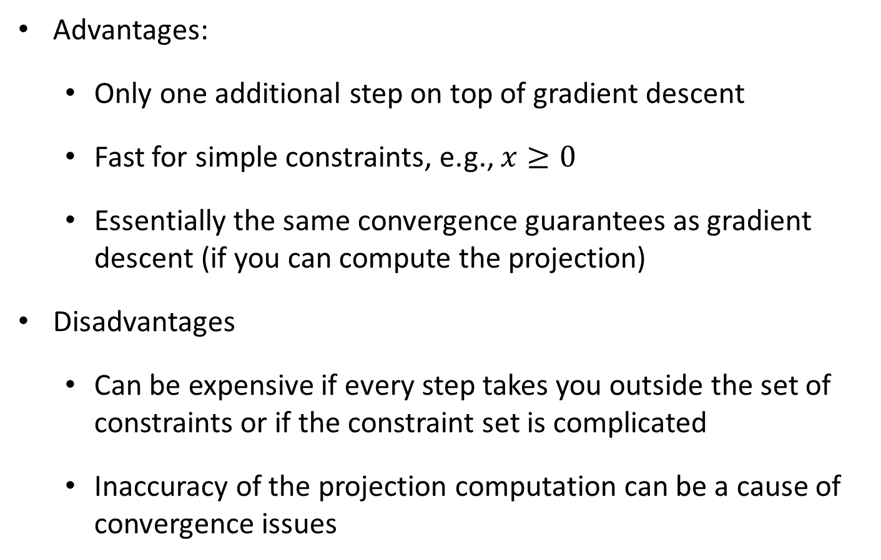
Projected Gradient Descent
Advantages:
  Only one additional step on top of gradient descent
  Fast for simple constraints, e.g., $x≥0$
  Essentially the same convergence guarantees as gradient descent (if you can compute the projection)
Disadvantages
  Can be expensive if every step takes you outside the set of constraints or if the constraint set is complicated
  Inaccuracy of the projection computation can be a cause of convergence issues

Slide 10
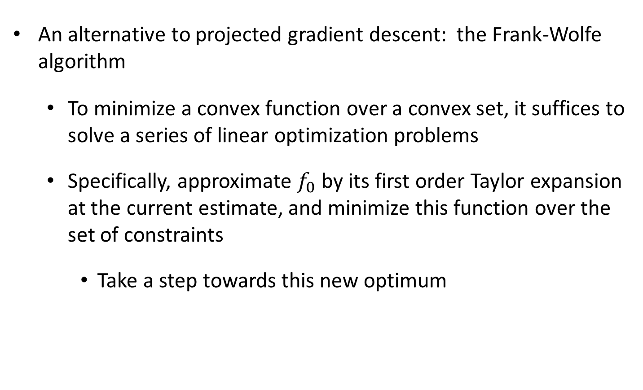
Conditional Gradients (Franke-Wolfe)
An alternative to projected gradient descent: the Frank-Wolfe algorithm
  To minimize a convex function over a convex set, it suffices to solve a series of linear optimization problems
  Specifically, approximate $f_{0}$ by its first order Taylor expansion at the current estimate, and minimize this function over the set of constraints
    Take a step towards this new optimum

Slide 11





Conditional Gradients (Franke-Wolfe)
Formally, $f_{0}\left(x\right)≈f_{0}\left(x_{t}\right)+∇f_{0}{\left(x_{t}\right)}^{T}(x−x_{t})$
  Compute $s_{t}∈\arg{\min_{x∈C}{f_{0}\left(x_{t}\right)+∇f_{0}{\left(x_{t}\right)}^{T}(x−x_{t})}}$
  Set $x_{t+1}=x_{t}+α(s_{t}−x_{t})$
$$C$$
$$x_{t}$$
$$x_{t+1}$$
$$s_{t}$$

Slide 12

Conditional Gradients (Franke-Wolfe)
Formally, $f_{0}\left(x\right)≈f_{0}\left(x_{t}\right)+∇f_{0}{\left(x_{t}\right)}^{T}(x−x_{t})$
  Compute $s_{t}∈\arg{\min_{x∈C}{∇f_{0}{\left(x_{t}\right)}^{T}x}}$
  Set $x_{t+1}=x_{t}+α(s_{t}−x_{t})$
Note: this only makes sense for constrained problems for which the minimum exists!

Slide 13
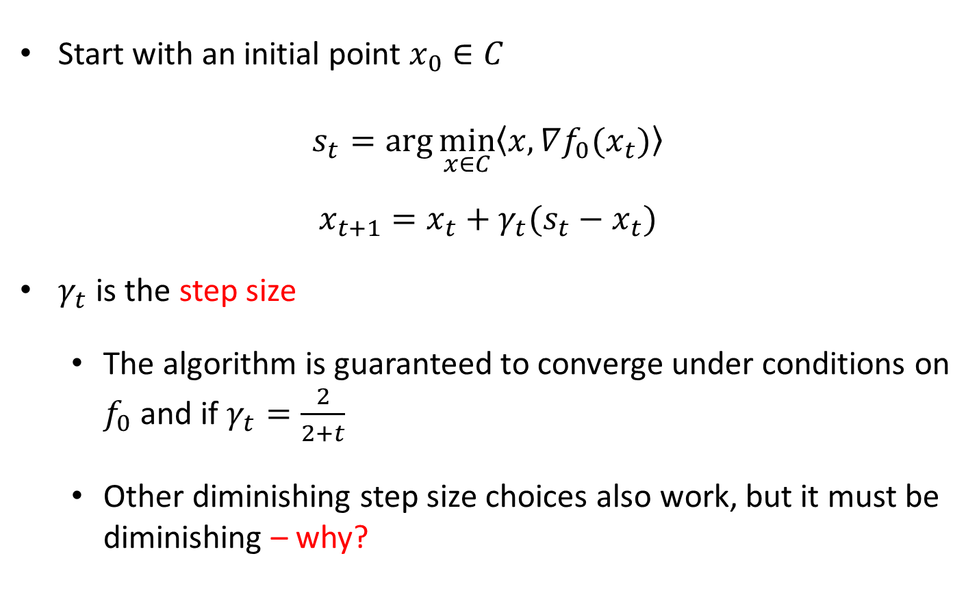
Conditional Gradients (Franke-Wolfe)
Start with an initial point $x_{0}∈C$
$$s_{t}=\arg{\min_{x∈C}\left\langle x,∇f_{0}(x_{t})\right\rangle }$$
$$x_{t+1}=x_{t}+γ_{t}(s_{t}−x_{t})$$
$γ_{t}$ is the step size
  The algorithm is guaranteed to converge under conditions on $f_{0}$ and if $γ_{t}=\frac{2}{2+t}$
  Other diminishing step size choices also work, but it must be diminishing – why?

Slide 14
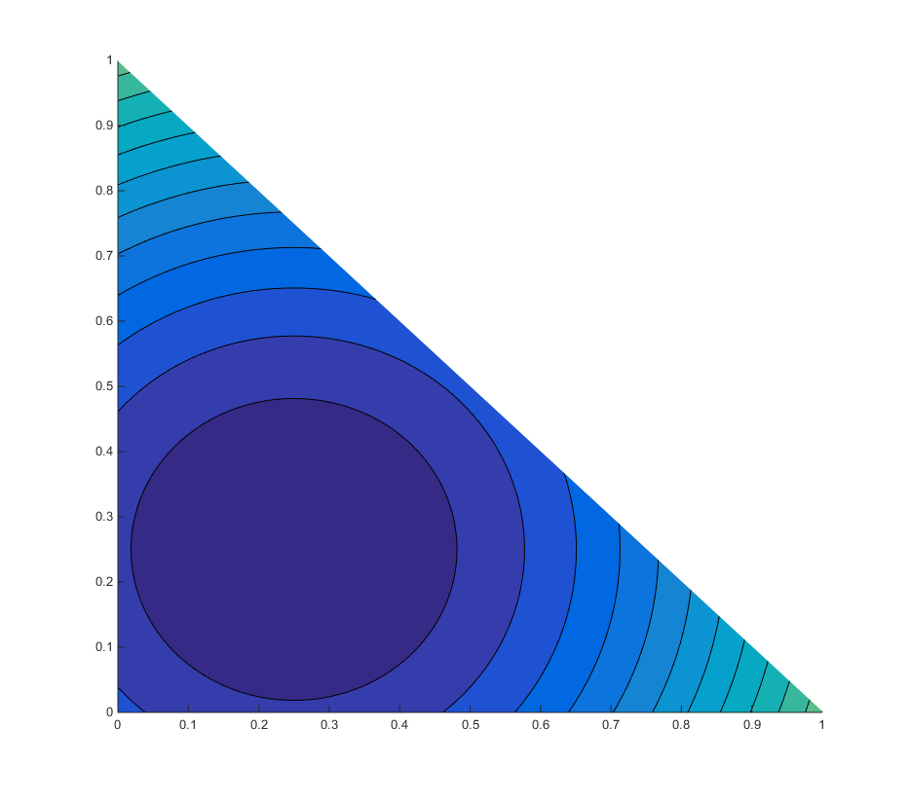

Conditional Gradients (Franke-Wolfe)
$$(x_{0},y_{0})=(.1,.7)$$
$$\min_{x,y}{{\left(x−.25\right)}^{2}+{\left(y−.25\right)}^{2} }$$
such that
$$x+y≤1$$
$$0≤x,y≤1$$

Slide 15
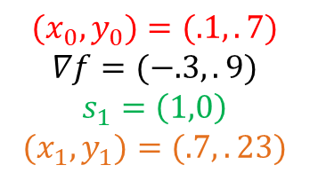
Conditional Gradients (Franke-Wolfe)
$$(x_{0},y_{0})=(.1,.7)$$
$$∇f=(−.3,.9)$$
$$s_{1}=\left(1,0\right)$$
$$(x_{1},y_{1})=(.7,.23)$$
$$\min_{x,y}{{\left(x−.25\right)}^{2}+{\left(y−.25\right)}^{2} }$$
such that
$$x+y≤1$$
$$0≤x,y≤1$$

Slide 16
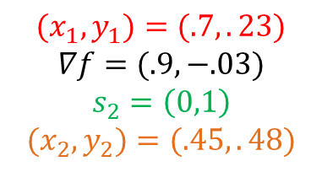
Conditional Gradients (Franke-Wolfe)
$$(x_{1},y_{1})=(.7,.23)$$
$$∇f=(.9,−.03)$$
$$s_{2}=\left(0,1\right)$$
$$(x_{2},y_{2})=(.45,.48)$$
$$\min_{x,y}{{\left(x−.25\right)}^{2}+{\left(y−.25\right)}^{2} }$$
such that
$$x+y≤1$$
$$0≤x,y≤1$$

Slide 17
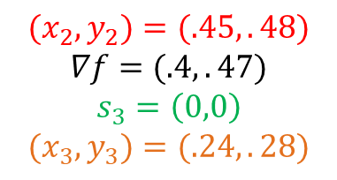
Conditional Gradients (Franke-Wolfe)
$$(x_{2},y_{2})=(.45,.48)$$
$$∇f=(.4,.47)$$
$$s_{3}=\left(0,0\right)$$
$$(x_{3},y_{3})=(.24,.28)$$
$$\min_{x,y}{{\left(x−.25\right)}^{2}+{\left(y−.25\right)}^{2} }$$
such that
$$x+y≤1$$
$$0≤x,y≤1$$

Slide 18

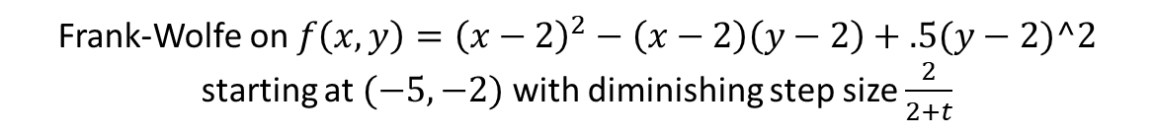

Example of PGD
Constraint $−5≤x≤0,−5≤y≤0$
Frank-Wolfe on $f\left(x,y\right)={\left(x−2\right)}^{2}−\left(x−2\right)\left(y−2\right)+.5(y−2)^2$ starting at $(−5,−2)$ with diminishing step size $\frac{2}{2+t}$

Slide 19
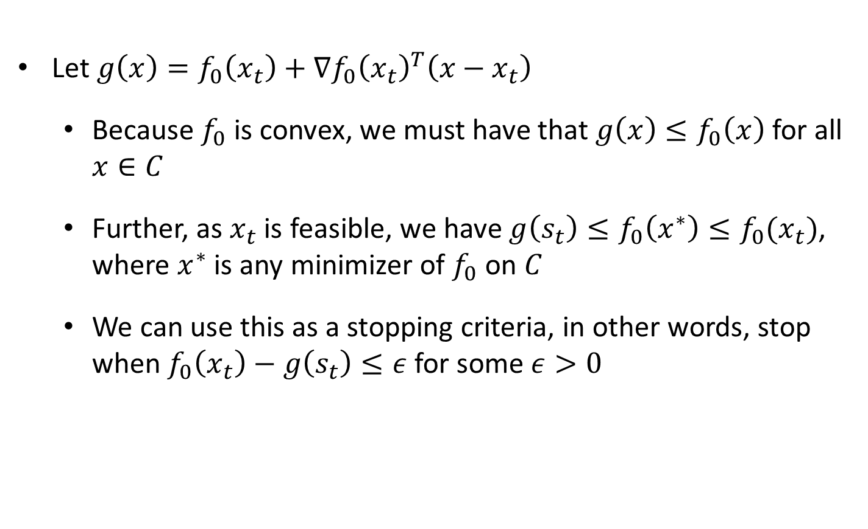
Stopping Criteria
Let $g\left(x\right)=f_{0}\left(x_{t}\right)+∇f_{0}{\left(x_{t}\right)}^{T}\left(x−x_{t}\right)$
  Because $f_{0}$ is convex, we must have that $g\left(x\right)≤f_{0}\left(x\right)$ for all $x∈C$
  Further, as $x_{t}$ is feasible, we have $g\left(s_{t}\right)≤f_{0}\left(x^{∗}\right)≤f_{0}(x_{t})$, where $x^{∗}$ is any minimizer of $f_{0}$ on $C$
  We can use this as a stopping criteria, in other words, stop when $f_{0}\left(x_{t}\right)−g\left(s_{t}\right)≤ε$ for some $ε>0$

Slide 20
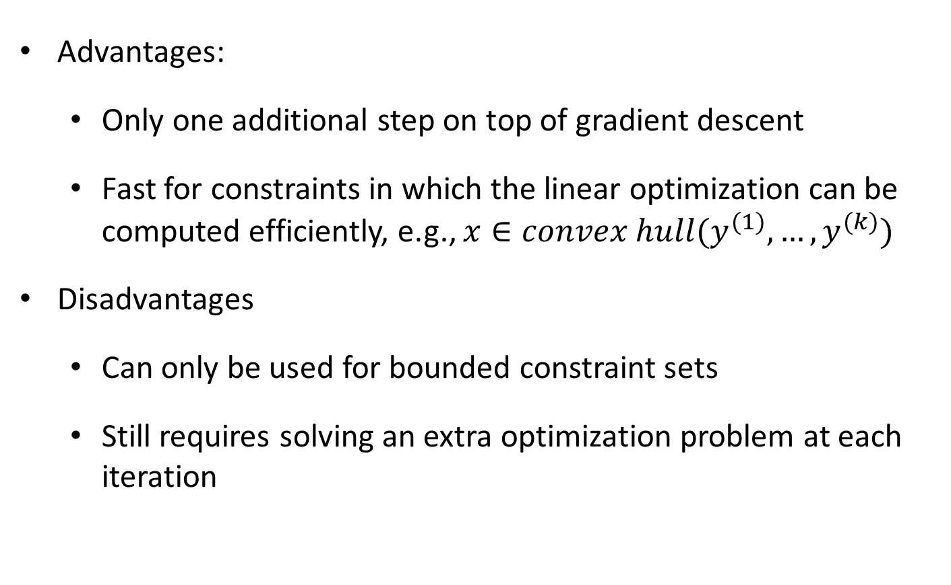
Conditional Gradients (Franke-Wolfe)
Advantages:
  Only one additional step on top of gradient descent
  Fast for constraints in which the linear optimization can be computed efficiently, e.g., $x∈convex hull(y^{(1)},…,y^{(k)})$
Disadvantages
  Can only be used for bounded constraint sets
  Still requires solving an extra optimization problem at each iteration

