Slide 1
Lecture 6: Duality and Lagrange Multipliers
Nicholas Ruozzi
University of Texas at Dallas

Slide 2
General Optimization
$$\min_{x∈ℝ^{n}}{f_{0}(x)}$$
subject to:
$$f_{i}\left(x\right)≤0, i=1,…,m$$
$$h_{i}\left(x\right)=0, i=1,…,p$$

Slide 3
Lagrangian
$$L\left(x,λ,ν\right)=f_{0}\left(x\right)+\sum_{i=1}^{m}{λ_{i}f_{i}\left(x\right)}+\sum_{i=1}^{p}{ν_{i}h_{i}(x)}$$
Incorporate constraints into a new objective function
$λ≥0$ and $ν$ are vectors of Lagrange multipliers
The Lagrange multipliers can be thought of as enforcing soft constraints

Slide 4

Example
$$\max_{x,y∈ℝ}{xy}$$
subject to:
$$x+y=1$$

Slide 5

Example
$$\max_{x,y∈ℝ}{xy}$$
subject to:
$$x+y=1$$
$$L\left(x,y,ν_{1}\right)=−xy+ν_{1}⋅\left(1−x−y\right)$$

Slide 6

Example
$$\max_{x,y∈ℝ}{xy}$$
subject to:
$$x+y=1$$
$$L\left(x,y,ν_{1}\right)=−xy+ν_{1}⋅\left(1−x−y\right)$$
$$\frac{∂L}{x}=−y−ν_{1}=0$$
$$\frac{∂L}{y}=−x−ν_{1}=0$$
$$\frac{∂L}{ν_{1}}=1−x−y=0$$

Slide 7

Example
$$\max_{x,y∈ℝ}{xy}$$
subject to:
$$x+y=1$$
$$L\left(x,y,ν_{1}\right)=−xy+ν_{1}⋅\left(1−x−y\right)$$
$$x=y$$
$$x+y=1$$

Slide 8

Example
$$\max_{x,y∈ℝ}{xy}$$
subject to:
$$x+y=1$$
$$L\left(x,y,ν_{1}\right)=−xy+ν_{1}⋅\left(1−x−y\right)$$
$$x=y$$
$$x+y=1$$
$$x=y=.5$$
is the only critical point of $L$

Slide 9
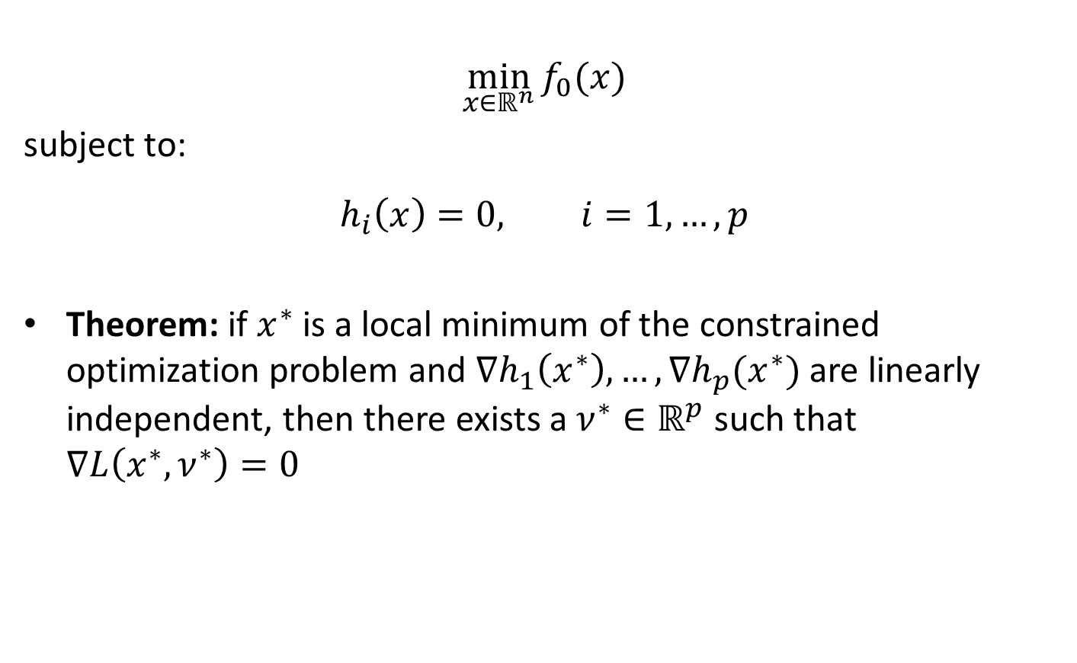
Necessary Conditions
$$\min_{x∈ℝ^{n}}{f_{0}(x)}$$
subject to:
$$h_{i}\left(x\right)=0, i=1,…,p$$
Theorem: if $x^{∗}$ is a local minimum of the constrained optimization problem and $∇h_{1}\left(x^{∗}\right),…,∇h_{p}(x^{∗})$ are linearly independent, then there exists a $ν^{∗}∈ℝ^{p}$ such that $∇L\left(x^{∗},ν^{∗}\right)=0$

Slide 10
Duality
Construct a dual function by minimizing the Lagrangian over the primal variables
$$g\left(λ,ν\right)=\inf_{x}{L(x,λ,ν)}$$
$g\left(λ,ν\right)=−∞$ whenever the Lagrangian is not bounded from below for a fixed $λ$ and $ν$

Slide 11

Example: Projection
Projection of the point $p∈ℝ^{n}$onto box constraints
$$\min_{x∈ℝ^{n}}{\frac{1}{2}{\left\|x−p\right\|}_{2}^{2}}$$
subject to:
$$x≤u$$
$$x≥l$$

Slide 12
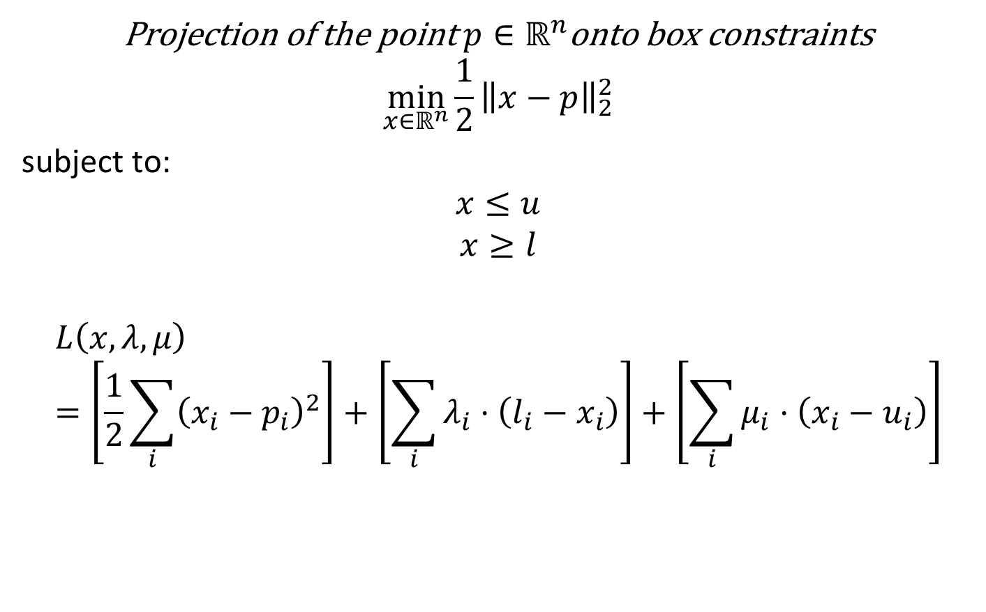
Example: Projection
Projection of the point $p∈ℝ^{n}$onto box constraints
$$\min_{x∈ℝ^{n}}{\frac{1}{2}{\left\|x−p\right\|}_{2}^{2}}$$
subject to:
$$x≤u$$
$$x≥l$$
$$L\left(x,λ,μ\right)=\left[\frac{1}{2}\sum_{i}{{\left(x_{i}−p_{i}\right)}^{2}}\right]+\left[\sum_{i}{λ_{i}⋅\left(l_{i}−x_{i}\right)}\right]+\left[\sum_{i}{μ_{i}⋅\left(x_{i}−u_{i}\right)}\right]$$

Slide 13
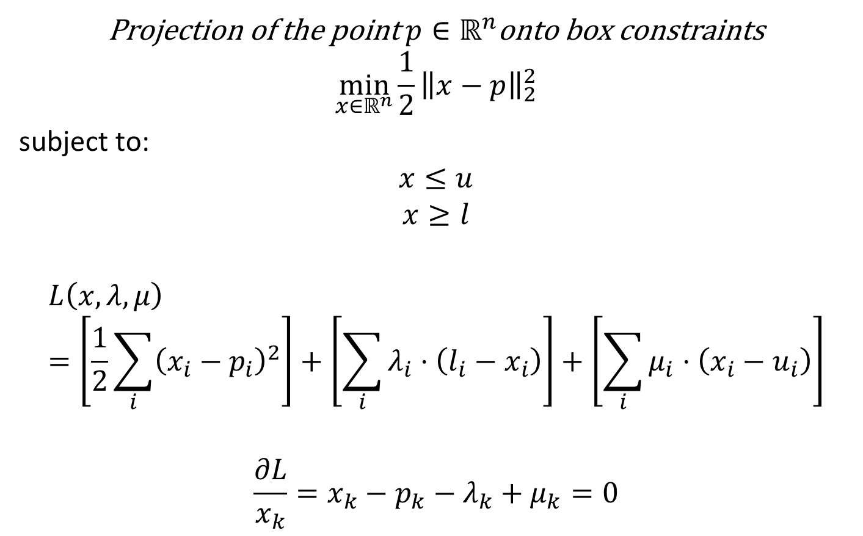
Example: Projection
Projection of the point $p∈ℝ^{n}$onto box constraints
$$\min_{x∈ℝ^{n}}{\frac{1}{2}{\left\|x−p\right\|}_{2}^{2}}$$
subject to:
$$x≤u$$
$$x≥l$$
$$L\left(x,λ,μ\right)=\left[\frac{1}{2}\sum_{i}{{\left(x_{i}−p_{i}\right)}^{2}}\right]+\left[\sum_{i}{λ_{i}⋅\left(l_{i}−x_{i}\right)}\right]+\left[\sum_{i}{μ_{i}⋅\left(x_{i}−u_{i}\right)}\right]$$
$$\frac{∂L}{x_{k}}=x_{k}−p_{k}−λ_{k}+μ_{k}=0$$

Slide 14
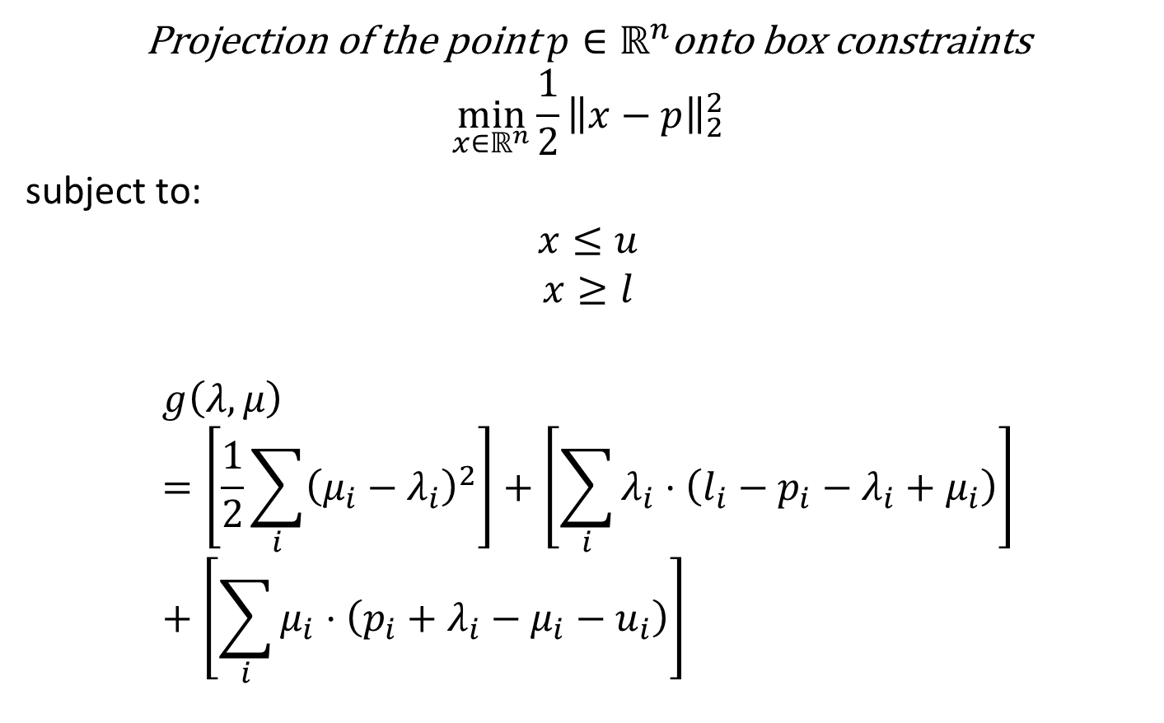
Example: Projection
Projection of the point $p∈ℝ^{n}$onto box constraints
$$\min_{x∈ℝ^{n}}{\frac{1}{2}{\left\|x−p\right\|}_{2}^{2}}$$
subject to:
$$x≤u$$
$$x≥l$$
$$g\left(λ,μ\right)=\left[\frac{1}{2}\sum_{i}{{\left(μ_{i}−λ_{i}\right)}^{2}}\right]+\left[\sum_{i}{λ_{i}⋅\left(l_{i}−p_{i}−λ_{i}+μ_{i}\right)}\right]+\left[\sum_{i}{μ_{i}⋅\left(p_{i}+λ_{i}−μ_{i}−u_{i}\right)}\right]$$

Slide 15
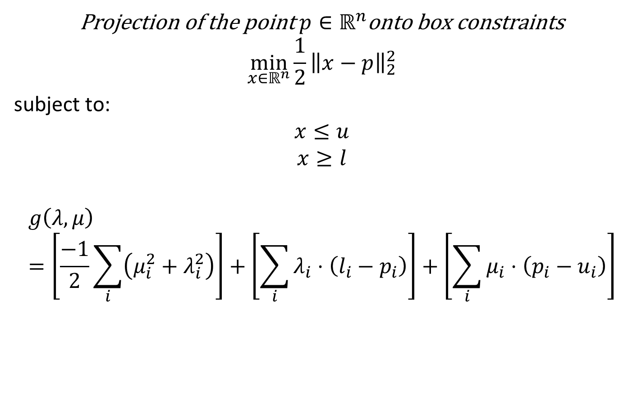
Example: Projection
Projection of the point $p∈ℝ^{n}$onto box constraints
$$\min_{x∈ℝ^{n}}{\frac{1}{2}{\left\|x−p\right\|}_{2}^{2}}$$
subject to:
$$x≤u$$
$$x≥l$$
$$g\left(λ,μ\right)=\left[\frac{−1}{2}\sum_{i}{\left(μ_{i}^{2}+λ_{i}^{2}\right)}\right]+\left[\sum_{i}{λ_{i}⋅\left(l_{i}−p_{i}\right)}\right]+\left[\sum_{i}{μ_{i}⋅\left(p_{i}−u_{i}\right)}\right]$$

Slide 16
The Primal Problem
$$\min_{x∈ℝ^{n}}{f_{0}(x)}$$
subject to:
$$f_{i}\left(x\right)≤0, i=1,…,m$$
$$h_{i}\left(x\right)=0, i=1,…,p$$
Equivalently,
$$\inf_{x}{\sup_{λ≥0,ν}{L(x,λ,ν)}}$$
Why are these equivalent?

Slide 17
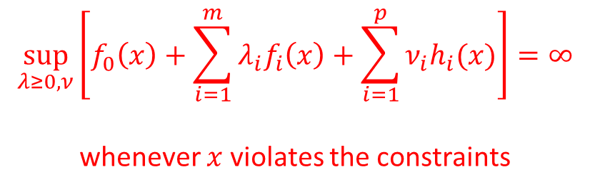
The Primal Problem
$$\min_{x∈ℝ^{n}}{f_{0}(x)}$$
subject to:
$$f_{i}\left(x\right)≤0, i=1,…,m$$
$$h_{i}\left(x\right)=0, i=1,…,p$$
Equivalently,
$$\inf_{x}{\sup_{λ≥0,ν}{L(x,λ,ν)}}$$
$$\sup_{λ≥0,ν}\left[f_{0}\left(x\right)+\sum_{i=1}^{m}{λ_{i}f_{i}\left(x\right)}+\sum_{i=1}^{p}{ν_{i}h_{i}(x)}\right]=∞$$
whenever $x$ violates the constraints

Slide 18
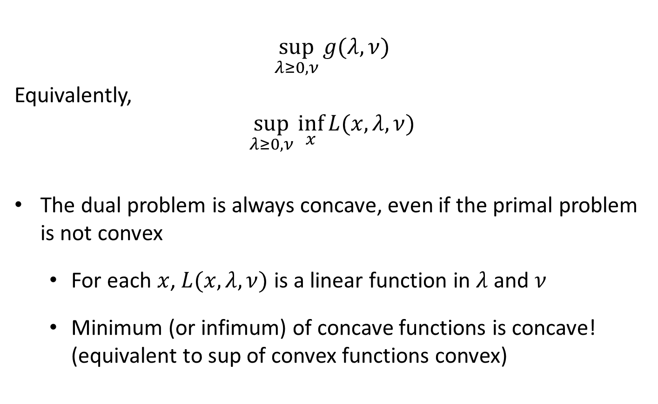
The Dual Problem
$$\sup_{λ≥0, ν}{g(λ, ν)}$$
Equivalently,
$$\sup_{λ≥0, ν}{\inf_{x}{L(x,λ,ν)}}$$
The dual problem is always concave, even if the primal problem is not convex
  For each $x$, $L(x,λ,ν)$ is a linear function in $λ$ and $ν$
  Minimum (or infimum) of concave functions is concave!
  (equivalent to sup of convex functions convex)

Slide 19

Primal vs. Dual
Dual bounded from above by Primal
$$\sup_{λ≥0, ν}{\inf_{x}{L(x,λ,ν)}}≤\inf_{x}{\sup_{λ≥0,ν}{L(x,λ,ν)}}$$
Proof:
  $g\left(λ,ν\right)=\inf_{x^{′}}{L(x′,λ,ν)}≤L(x,λ, ν)$ for all $x$

Slide 20
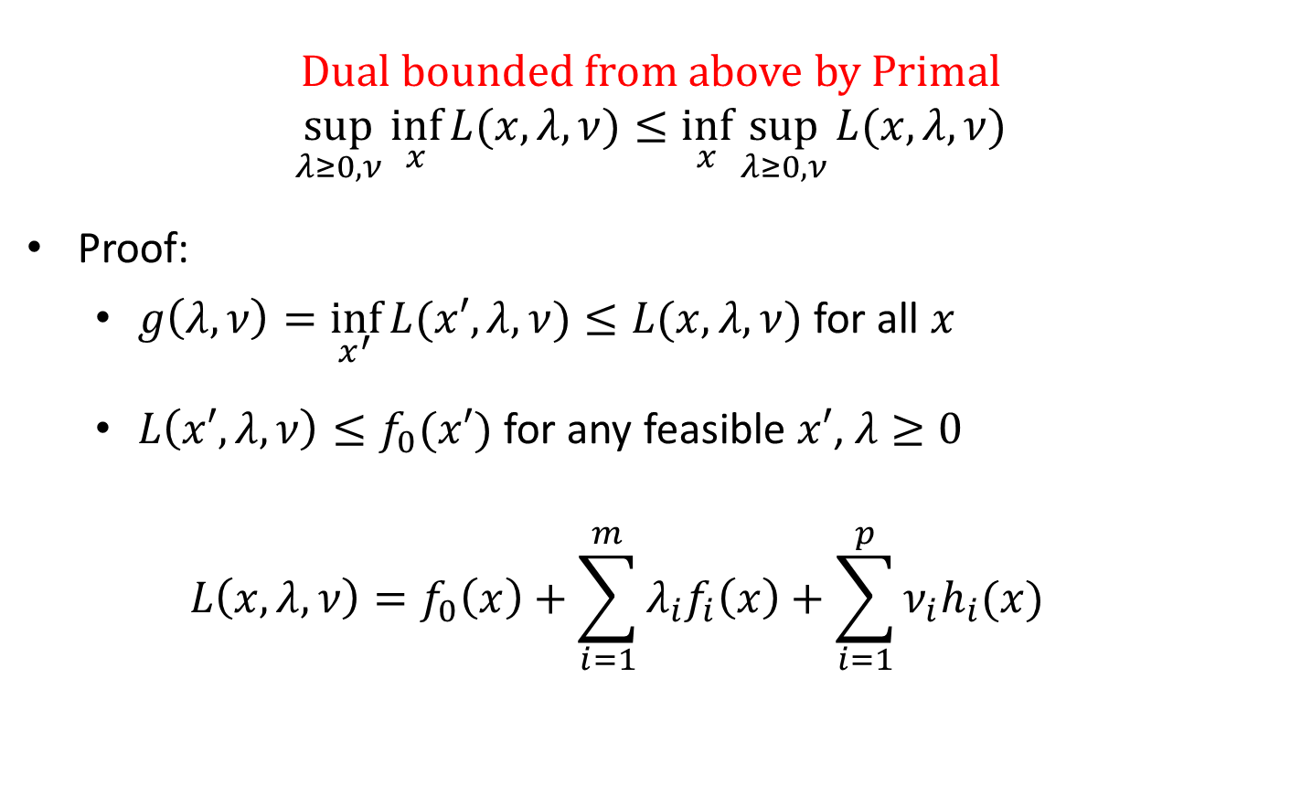
Primal vs. Dual
Dual bounded from above by Primal
$$\sup_{λ≥0, ν}{\inf_{x}{L(x,λ,ν)}}≤\inf_{x}{\sup_{λ≥0,ν}{L(x,λ,ν)}}$$
Proof:
  $g\left(λ,ν\right)=\inf_{x^{′}}{L(x′,λ,ν)}≤L(x,λ, ν)$ for all $x$
  $L\left(x′,λ,ν\right)≤f_{0}(x′)$ for any feasible $x′$, $λ≥0$
  $$L\left(x,λ,ν\right)=f_{0}\left(x\right)+\sum_{i=1}^{m}{λ_{i}f_{i}\left(x\right)}+\sum_{i=1}^{p}{ν_{i}h_{i}(x)}$$

Slide 21


Primal vs. Dual
Dual bounded from above by Primal
$$\sup_{λ≥0, ν}{\inf_{x}{L(x,λ,ν)}}≤\inf_{x}{\sup_{λ≥0,ν}{L(x,λ,ν)}}$$
Proof:
  $g\left(λ,ν\right)=\inf_{x^{′}}{L(x′,λ,ν)}≤L(x,λ, ν)$ for all $x$
  $L\left(x′,λ,ν\right)≤f_{0}(x′)$ for any feasible $x′$, $λ≥0$
  $$L\left(x,λ,ν\right)=f_{0}\left(x\right)+\sum_{i=1}^{m}{λ_{i}f_{i}\left(x\right)}+\sum_{i=1}^{p}{ν_{i}h_{i}(x)}$$
$$≤0$$
$$0$$

Slide 22

Primal vs. Dual
Dual bounded from above by Primal
$$\sup_{λ≥0, ν}{\inf_{x}{L(x,λ,ν)}}≤\inf_{x}{\sup_{λ≥0,ν}{L(x,λ,ν)}}$$
Proof:
  $g\left(λ,ν\right)=\inf_{x^{′}}{L(x′,λ,ν)}≤L(x,λ, ν)$ for all $x$
  $L\left(x′,λ,ν\right)≤f_{0}(x′)$ for any feasible $x′$, $λ≥0$
  Let $x^{∗}$ be the optimal solution to the primal problem and $λ≥0$
$$g\left(λ,ν\right)≤L\left(x^{∗},λ, ν\right)≤f_{0}\left(x^{∗}\right)$$

Slide 23
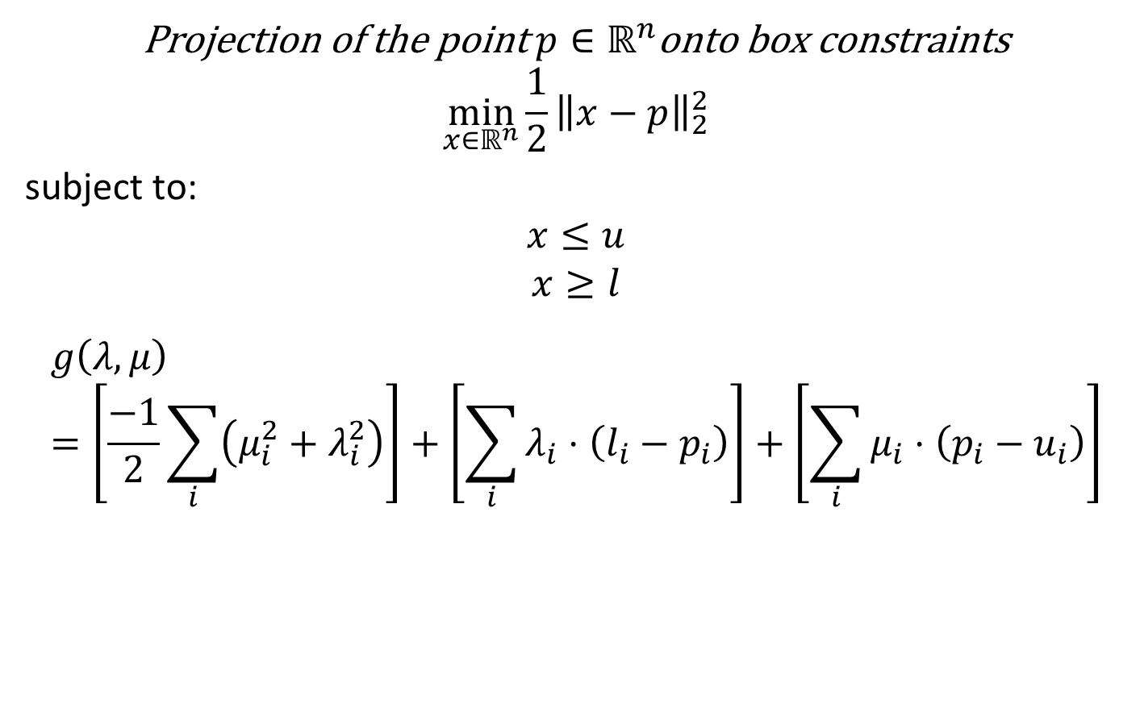
Example: Projection
Projection of the point $p∈ℝ^{n}$onto box constraints
$$\min_{x∈ℝ^{n}}{\frac{1}{2}{\left\|x−p\right\|}_{2}^{2}}$$
subject to:
$$x≤u$$
$$x≥l$$
$$g\left(λ,μ\right)=\left[\frac{−1}{2}\sum_{i}{\left(μ_{i}^{2}+λ_{i}^{2}\right)}\right]+\left[\sum_{i}{λ_{i}⋅\left(l_{i}−p_{i}\right)}\right]+\left[\sum_{i}{μ_{i}⋅\left(p_{i}−u_{i}\right)}\right]$$

Slide 24
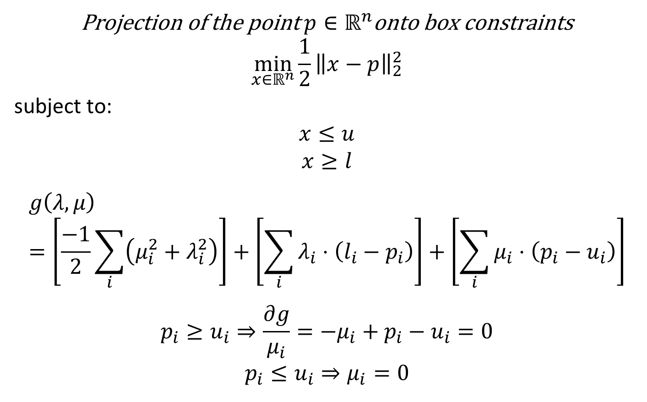
Example: Projection
Projection of the point $p∈ℝ^{n}$onto box constraints
$$\min_{x∈ℝ^{n}}{\frac{1}{2}{\left\|x−p\right\|}_{2}^{2}}$$
subject to:
$$x≤u$$
$$x≥l$$
$$g\left(λ,μ\right)=\left[\frac{−1}{2}\sum_{i}{\left(μ_{i}^{2}+λ_{i}^{2}\right)}\right]+\left[\sum_{i}{λ_{i}⋅\left(l_{i}−p_{i}\right)}\right]+\left[\sum_{i}{μ_{i}⋅\left(p_{i}−u_{i}\right)}\right]$$
$$p_{i}≥u_{i}⇒\frac{∂g}{μ_{i}}=−μ_{i}+p_{i}−u_{i}=0$$
$$p_{i}≤u_{i}⇒μ_{i}=0$$

Slide 25
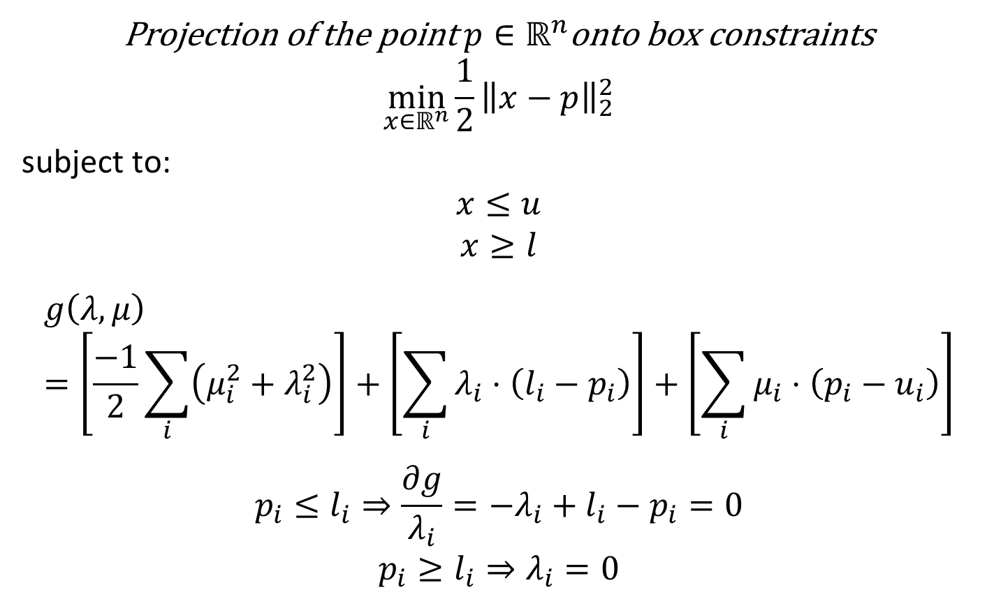
Example: Projection
Projection of the point $p∈ℝ^{n}$onto box constraints
$$\min_{x∈ℝ^{n}}{\frac{1}{2}{\left\|x−p\right\|}_{2}^{2}}$$
subject to:
$$x≤u$$
$$x≥l$$
$$g\left(λ,μ\right)=\left[\frac{−1}{2}\sum_{i}{\left(μ_{i}^{2}+λ_{i}^{2}\right)}\right]+\left[\sum_{i}{λ_{i}⋅\left(l_{i}−p_{i}\right)}\right]+\left[\sum_{i}{μ_{i}⋅\left(p_{i}−u_{i}\right)}\right]$$
$$p_{i}≤l_{i}⇒\frac{∂g}{λ_{i}}=−λ_{i}+l_{i}−p_{i}=0$$
$$p_{i}≥l_{i}⇒λ_{i}=0$$

Slide 26
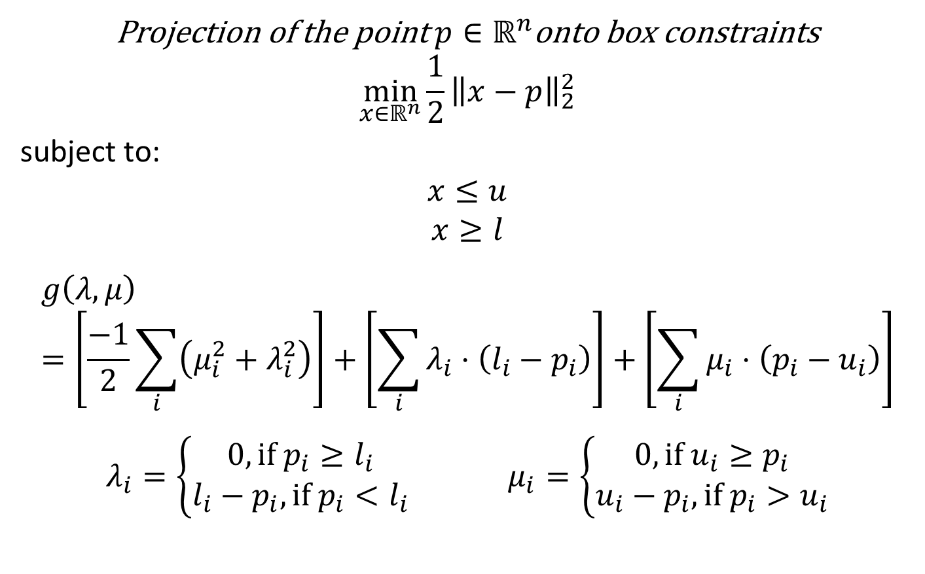
Example: Projection
Projection of the point $p∈ℝ^{n}$onto box constraints
$$\min_{x∈ℝ^{n}}{\frac{1}{2}{\left\|x−p\right\|}_{2}^{2}}$$
subject to:
$$x≤u$$
$$x≥l$$
$$g\left(λ,μ\right)=\left[\frac{−1}{2}\sum_{i}{\left(μ_{i}^{2}+λ_{i}^{2}\right)}\right]+\left[\sum_{i}{λ_{i}⋅\left(l_{i}−p_{i}\right)}\right]+\left[\sum_{i}{μ_{i}⋅\left(p_{i}−u_{i}\right)}\right]$$
$$λ_{i}=\left\{\begin{matrix}0, if p_{i}≥l_{i} \\ l_{i}−p_{i}, if p_{i}<l_{i}\end{matrix}\right. μ_{i}=\left\{\begin{matrix}0, if u_{i}≥p_{i} \\ u_{i}−p_{i}, if p_{i}>u_{i}\end{matrix}\right.$$

Slide 27
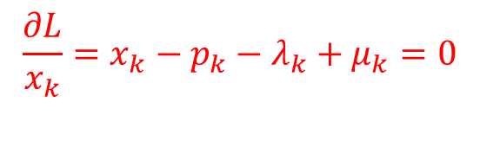
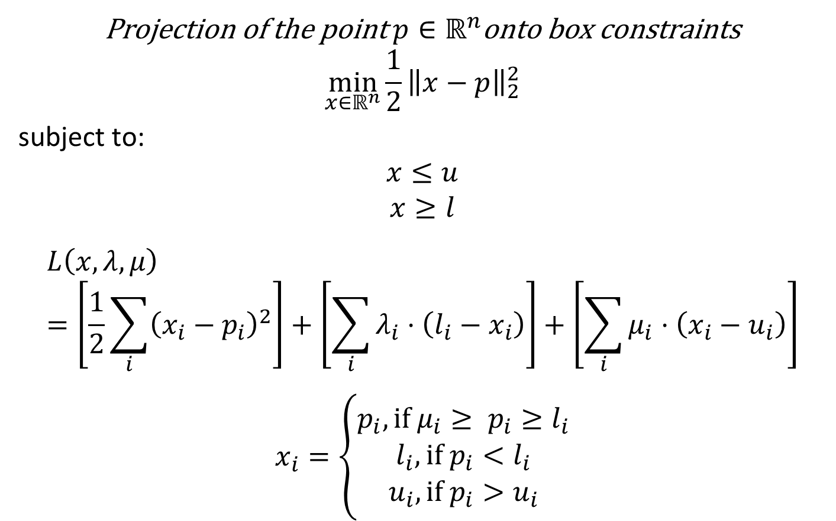
Example: Projection
Projection of the point $p∈ℝ^{n}$onto box constraints
$$\min_{x∈ℝ^{n}}{\frac{1}{2}{\left\|x−p\right\|}_{2}^{2}}$$
subject to:
$$x≤u$$
$$x≥l$$
$$L\left(x,λ,μ\right)=\left[\frac{1}{2}\sum_{i}{{\left(x_{i}−p_{i}\right)}^{2}}\right]+\left[\sum_{i}{λ_{i}⋅\left(l_{i}−x_{i}\right)}\right]+\left[\sum_{i}{μ_{i}⋅\left(x_{i}−u_{i}\right)}\right]$$
$$x_{i}=\left\{\begin{matrix}p_{i}, if μ_{i}≥ p_{i}≥l_{i} \\ \begin{aligned}l_{i}, if p_{i}<l_{i} \\ u_{i}, if p_{i}>u_{i}\end{aligned}\end{matrix}\right.$$
$$\frac{∂L}{x_{k}}=x_{k}−p_{k}−λ_{k}+μ_{k}=0$$

Slide 28

Example: LP Duality
$$\max_{x∈ℝ^{n}}{c^{T}x}$$
subject to:
$$Ax≤b$$
$$x≥0$$

Slide 29

$$\max_{x∈ℝ^{n}}{c^{T}x}$$
subject to:
$$Ax≤b$$
$$x≥0$$

Slide 30
$$\max_{x∈ℝ^{n}}{c^{T}x}$$
subject to:
$$Ax≤b$$
$$x≥0$$

Slide 31

Example: Project on a Line
Projection of the point $p∈ℝ^{n}$onto $g(t)=x+td$
$$\min_{y∈ℝ^{n},t∈ℝ}{\frac{1}{2}{\left\|y−p\right\|}_{2}^{2}}$$
subject to:
$$y=x+td$$

Slide 32

Projection of the point $p∈ℝ^{n}$onto $g(t)=x+td$
$$\min_{y∈ℝ^{n},t∈ℝ}{\frac{1}{2}{\left\|y−p\right\|}_{2}^{2}}$$
subject to:
$$y=x+td$$

Slide 33
Projection of the point $p∈ℝ^{n}$onto $g(t)=x+td$
$$\min_{y∈ℝ^{n},t∈ℝ}{\frac{1}{2}{\left\|y−p\right\|}_{2}^{2}}$$
subject to:
$$y=x+td$$

Slide 34




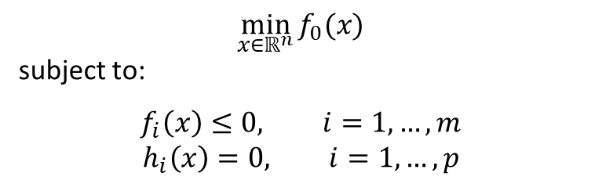
Quick Recap
Primal:
Lagrangian:
$$L\left(x,λ,ν\right)=f_{0}\left(x\right)+\sum_{i=1}^{m}{λ_{i}f_{i}\left(x\right)}+\sum_{i=1}^{p}{ν_{i}h_{i}(x)}$$
Dual:
$$g\left(λ,ν\right)=\inf_{x} L(x,λ,ν)$$
Weak Duality:
$$\sup_{λ≥0,ν}{\inf_{x} L\left(x,λ,ν\right)}≤\inf_{x}{\sup_{λ≥0,ν}{L(x,λ,ν)} }$$
$$\min_{x∈ℝ^{n}}{f_{0}(x)}$$
subject to:
$$f_{i}\left(x\right)≤0, i=1,…,m$$
$$h_{i}\left(x\right)=0, i=1,…,p$$
$$↔$$
$$\inf_{x}{\sup_{λ≥0,ν}{L(x,λ,ν)} }$$
, $λ≥0$

Slide 35
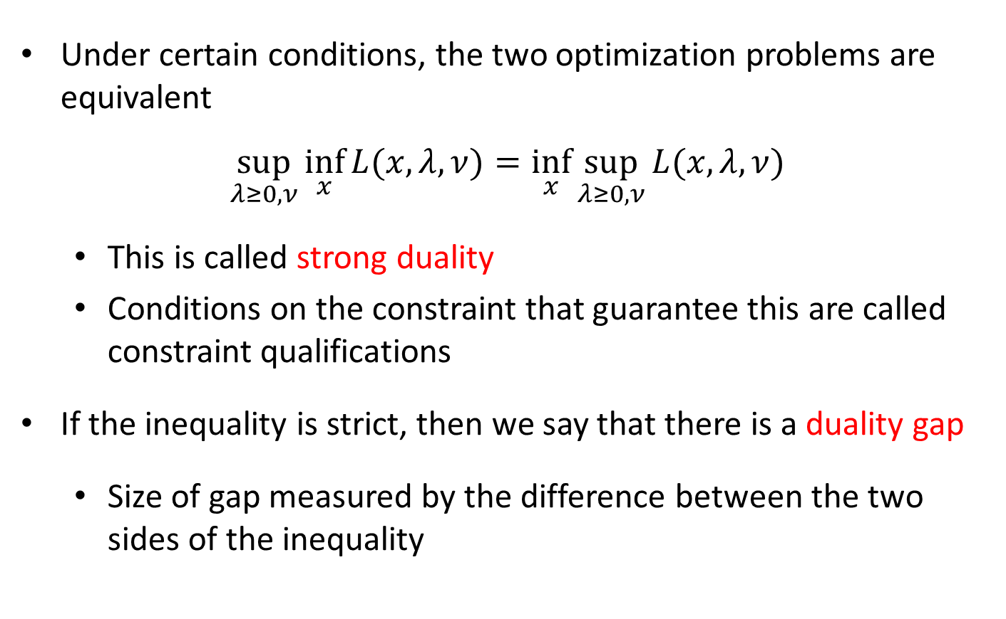
Strong Duality
Under certain conditions, the two optimization problems are equivalent
$$\sup_{λ≥0, ν}{\inf_{x}{L(x,λ,ν)}}=\inf_{x}{\sup_{λ≥0,ν}{L(x,λ,ν)}}$$
  This is called strong duality
  Conditions on the constraint that guarantee this are called constraint qualifications
If the inequality is strict, then we say that there is a duality gap
  Size of gap measured by the difference between the two sides of the inequality

Slide 36
Slater’s Condition
For any optimization problem of the form
$$\min_{x∈ℝ^{n}}{f_{0}(x)}$$
subject to:
$$f_{i}\left(x\right)≤0, i=1,…,m$$
$$Ax=b$$
where $f_{0},…,f_{m}$ are convex functions, strong duality holds if there exists an $x$ such that
$$f_{i}\left(x\right)<0, i=1,…,m$$
$$Ax=b$$

Slide 37
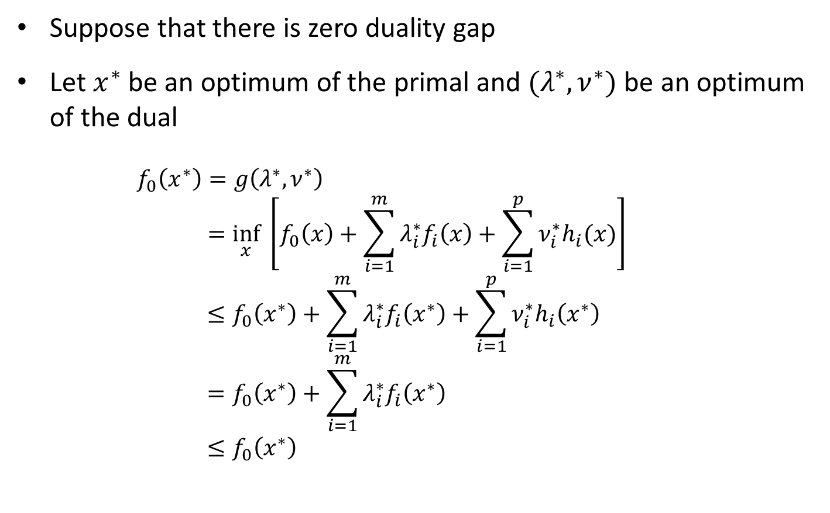
Complementary Slackness
Suppose that there is zero duality gap
Let $x^{∗}$ be an optimum of the primal and $(λ^{∗},ν^{∗})$ be an optimum of the dual
$$f_{0}\left(x^{∗}\right)=g\left(λ^{∗},ν^{∗}\right)$$
$$=\inf_{x} \left[f_{0}\left(x\right)+\sum_{i=1}^{m}{λ_{i}^{∗}f_{i}\left(x\right)}+\sum_{i=1}^{p}{ν_{i}^{∗}h_{i}(x)}\right]$$
$$≤f_{0}\left(x^{∗}\right)+\sum_{i=1}^{m}{λ_{i}^{∗}f_{i}\left(x^{∗}\right)}+\sum_{i=1}^{p}{ν_{i}^{∗}h_{i}\left(x^{∗}\right)} \\ =f_{0}\left(x^{∗}\right)+\sum_{i=1}^{m}{λ_{i}^{∗}f_{i}\left(x^{∗}\right)} \\ ≤f_{0}\left(x^{∗}\right)$$

Slide 38
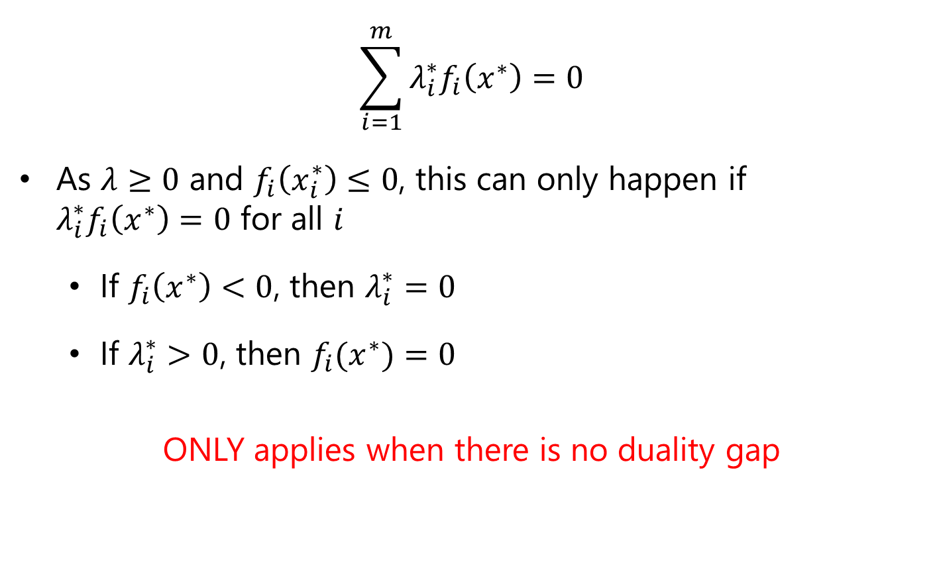
Complementary Slackness
$$\sum_{i=1}^{m}{λ_{i}^{∗}f_{i}\left(x^{∗}\right)}=0$$
As $λ≥0$ and $f_{i}\left(x_{i}^{∗}\right)≤0$, this can only happen if
$λ_{i}^{∗}f_{i}\left(x^{∗}\right)=0$ for all $i$
  If $f_{i}\left(x^{∗}\right)<0$, then $λ_{i}^{∗}=0$
  If $λ_{i}^{∗}>0$, then $f_{i}(x^{∗})=0$
ONLY applies when there is no duality gap

Slide 39

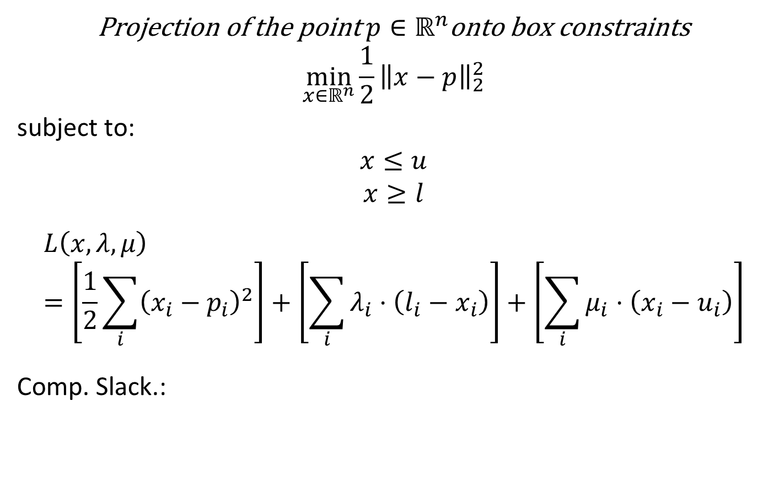

Example: Projection
Projection of the point $p∈ℝ^{n}$onto box constraints
$$\min_{x∈ℝ^{n}}{\frac{1}{2}{\left\|x−p\right\|}_{2}^{2}}$$
subject to:
$$x≤u$$
$$x≥l$$
$$L\left(x,λ,μ\right)=\left[\frac{1}{2}\sum_{i}{{\left(x_{i}−p_{i}\right)}^{2}}\right]+\left[\sum_{i}{λ_{i}⋅\left(l_{i}−x_{i}\right)}\right]+\left[\sum_{i}{μ_{i}⋅\left(x_{i}−u_{i}\right)}\right]$$
Comp. Slack.:
$$μ_{i}>0⇒x_{i}=u_{i}$$
$$λ_{i}>0⇒x_{i}=l_{i}$$
$$x_{i}<u_{i}⇒μ_{i}=0$$
$$x_{i}>l_{i}⇒λ_{i}=0$$

Slide 40

Example: Slack Variables
$$\min_{x,y}{x^{2}+y^{2}}$$
subject to:
$$x+y≤1$$

Slide 41

Example: Slack Variables
$$\min_{x,y,ε}{x^{2}+y^{2}}$$
subject to:
$$x+y=1−ε$$
$$ε≥0$$

Slide 42

$$\min_{x,y,ε}{x^{2}+y^{2}}$$
subject to:
$$x+y=1−ε$$
$$ε≥0$$

Slide 43

Example: Comp. Slack. Utility
$$\min_{y∈ℝ,w∈ℝ^{n}}{y}$$
subject to:
$$y≥b$$
$$x≥0$$

Slide 44
Other Duality Notes
Strong duality always holds for linear programming problems (with finite solutions)!
  Max-flow is dual to minimum cut (from algorithms)
  Bipartite matching is dual to bipartite vertex cover (Konig’s Theorem)

Slide 45
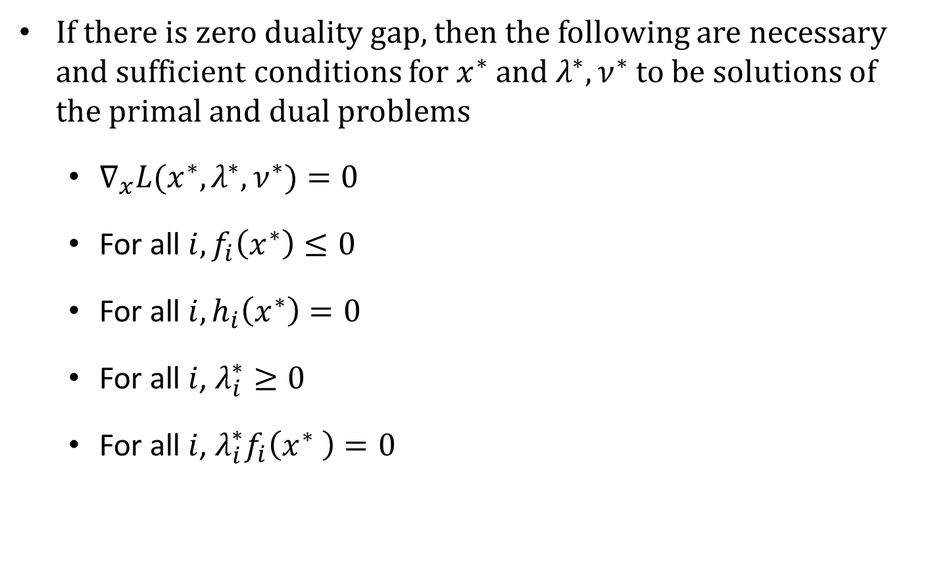
Karush-Kuhn-Tucker Conditions
If there is zero duality gap, then the following are necessary and sufficient conditions for $x^{∗}$ and $λ^{∗},ν^{∗}$ to be solutions of the primal and dual problems
  $∇_{x}L(x^{∗},λ^{∗},ν^{∗})=0$
  For all $i, f_{i}\left(x^{∗}\right)≤0$
  For all $i, h_{i}\left(x^{∗}\right)=0$
  For all $i$, $λ_{i}^{∗}≥0$
  For all $i$, $λ_{i}^{∗}f_{i}\left(x^{∗} \right)=0$
critical point of Lagrangian
primal feasibility
dual feasibility
complementary slackness

Slide 46
Karush-Kuhn-Tucker Conditions
If there is zero duality gap, then the following are necessary and sufficient conditions for $x^{∗}$ and $λ^{∗},ν^{∗}$ to be solutions of the primal and dual problems
  $∇_{x}L(x^{∗},λ^{∗},ν^{∗})=0$
  For all $i, f_{i}\left(x^{∗}\right)≤0$
  For all $i, h_{i}\left(x^{∗}\right)=0$
  For all $i$, $λ_{i}^{∗}≥0$
  For all $i$, $λ_{i}^{∗}f_{i}\left(x^{∗} \right)=0$
can be replaced with the requirement that zero be an element of the subgradient for nondifferentiable functions

Slide 47

Example: Quadratic Minimization
$$\min_{x∈ℝ^{n}}{\frac{1}{2}x^{T}Qx+c^{T}x}$$
subject to:
$$Ax=b$$
Convex and strong duality as long as there exists a feasible point and $Q$ is positive semidefinite (from Slater’s condition)

Slide 48
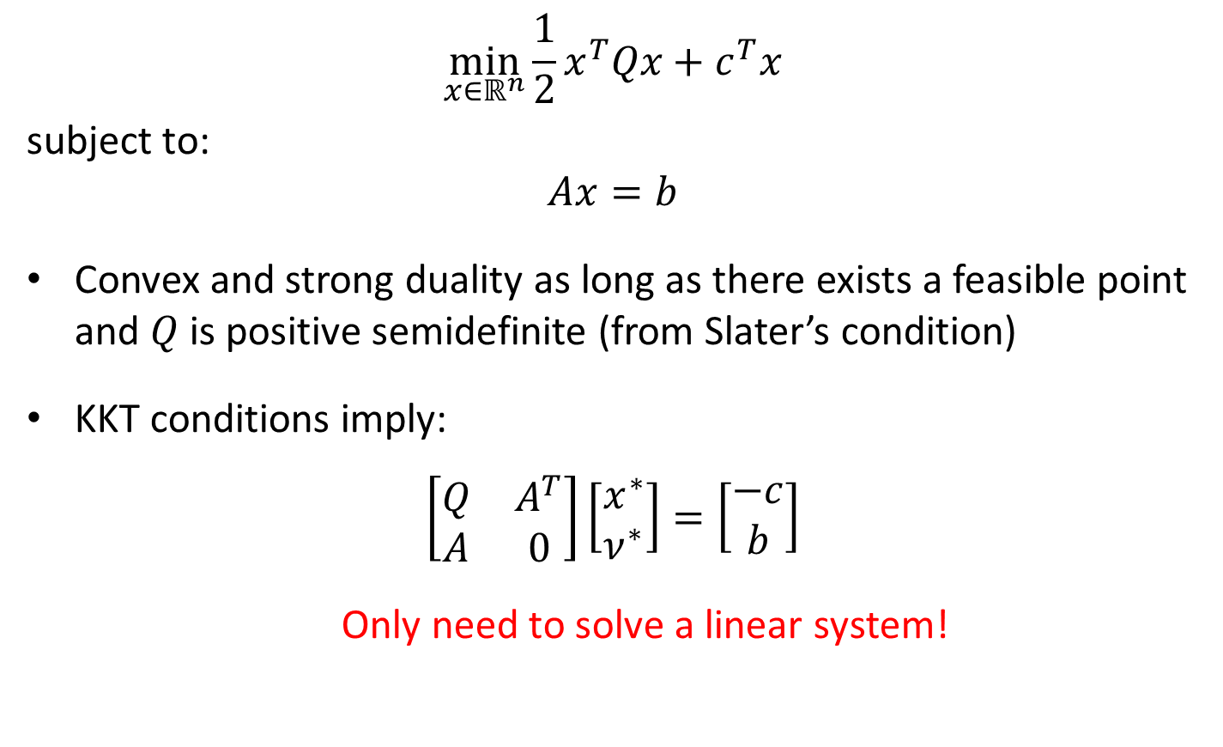
Example: Quadratic Minimization
$$\min_{x∈ℝ^{n}}{\frac{1}{2}x^{T}Qx+c^{T}x}$$
subject to:
$$Ax=b$$
Convex and strong duality as long as there exists a feasible point and $Q$ is positive semidefinite (from Slater’s condition)
KKT conditions imply:
$$\left[\begin{matrix}Q & A^{T} \\ A & 0\end{matrix}\right]\left[\begin{matrix}x^{∗} \\ ν^{∗}\end{matrix}\right]=\left[\begin{matrix}−c \\ b\end{matrix}\right]$$
Only need to solve a linear system!

Slide 49
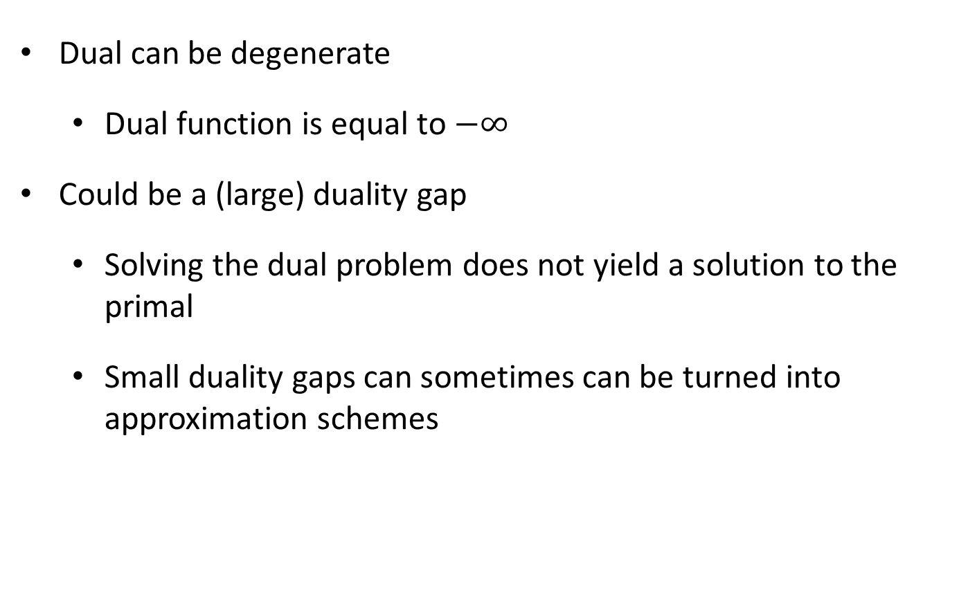
What Can Go Wrong?
Dual can be degenerate
  Dual function is equal to $−∞$
Could be a (large) duality gap
  Solving the dual problem does not yield a solution to the primal
  Small duality gaps can sometimes can be turned into approximation schemes

Slide 50

Example: Degenerate Dual
$$\min_{x,y∈ℝ}{{−x}^{2}−y^{2}}$$
subject to:
$$1≥x≥−1$$
$$1≥y≥−1$$

Slide 51

Example: Degenerate Dual
$$\min_{x,y∈ℝ}{{−x}^{2}−y^{2}}$$
subject to:
$$x^{2}≤1$$
$$y^{2}≤1$$
Does this fix the problem?

Slide 52

Example: Duality Gap
$$\min_{x,y∈ℝ}{\exp\left(−y\right)}$$
subject to:
$$\sqrt{x^{2}+y^{2}}≤x$$

Slide 53

Example: Easier Duals
$$\min_{x∈ℝ^{n}}{\sum_{i=1}^{n}{x_{i}\log{x_{i}}}}$$
subject to:
$$x≥0$$
$$\sum_{i=1}^{n}{x_{i}}=1$$

Slide 54
Convex Duality in Practice
Often used to construct nicer optimizations problems or to solve a constrained optimization problem by hand
Sometimes the dual has special properties that make it more useful than the primal problem, e.g., for support vector machines in ML, or make it easier to solve
Often the dual perspective gives new insights into the primal problem and its solution
For convex problems with zero duality gap, if we solve the primal and dual problems simultaneously, distance between best primal and dual values gives an upper bound on the error

Slide 55
Optimizing with the Dual
A variety of different ways to use the dual in different algorithmic approaches
  Can always just perform gradient ascent in the dual if it has a closed form
  If there isn’t a closed form dual, can still use techniques that we’ve seen so far to maximize the dual

Slide 56
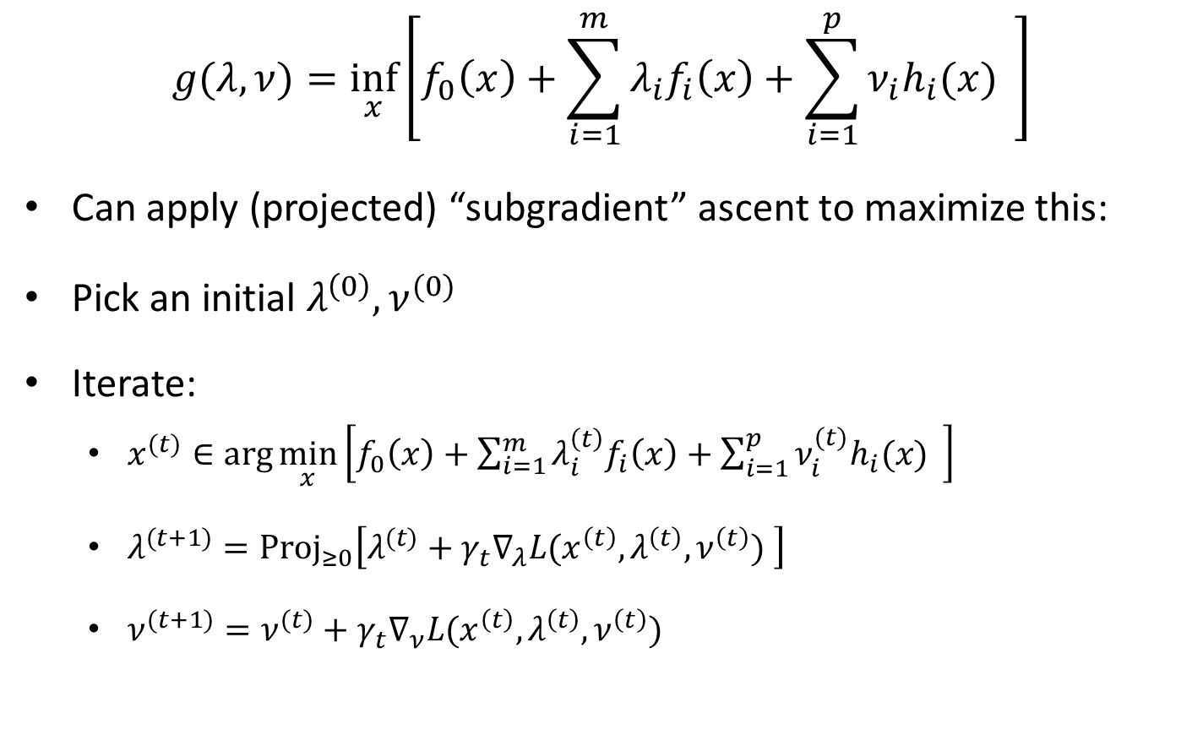
Subgradient Ascent in the Dual
$$g(λ,ν)=\inf_{x}\left[f_{0}\left(x\right)+\sum_{i=1}^{m}{λ_{i}f_{i}\left(x\right)}+\sum_{i=1}^{p}{ν_{i}h_{i}(x)} \right]$$
Can apply (projected) “subgradient” ascent to maximize this:
Pick an initial $λ^{\left(0\right)},ν^{(0)}$
Iterate:
  $x^{(t)}∈\arg{\min_{x}\left[f_{0}\left(x\right)+\sum_{i=1}^{m}{λ_{i}^{\left(t\right)}f_{i}\left(x\right)}+\sum_{i=1}^{p}{ν_{i}^{(t)}h_{i}(x)} \right]}$
  $λ^{(t+1)}=Proj_{≥0}\left[λ^{(t)}+γ_{t}∇_{λ}L(x^{\left(t\right)},λ^{\left(t\right)},ν^{\left(t\right)}) \right]$
  $ν^{(t+1)}=ν^{(t)}+γ_{t}∇_{ν}L(x^{\left(t\right)},λ^{\left(t\right)},ν^{\left(t\right)})$

Slide 57

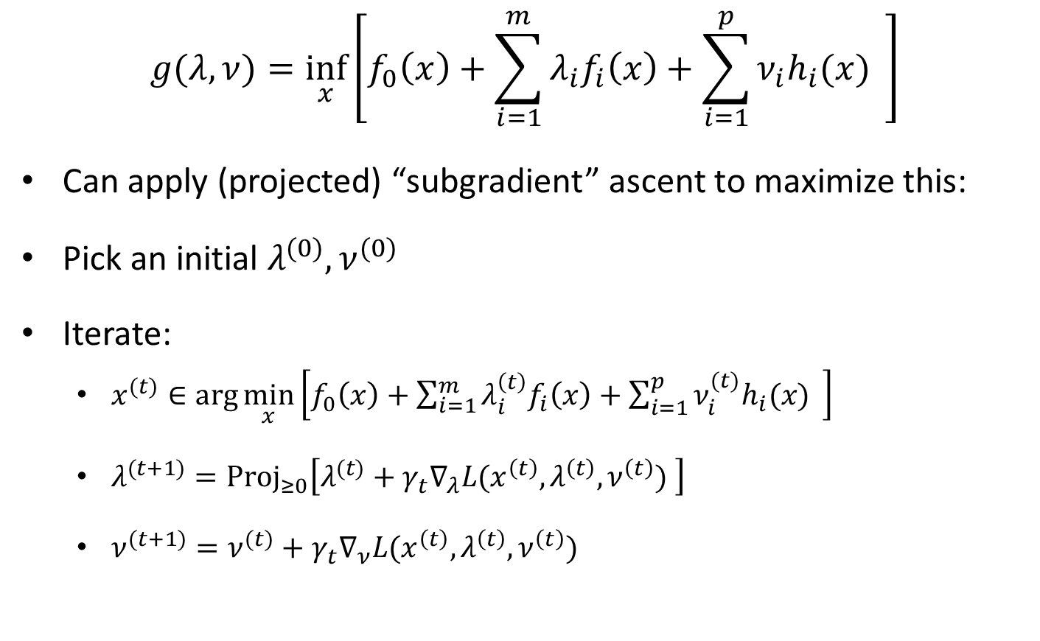
Subgradient Ascent in the Dual
$$g(λ,ν)=\inf_{x}\left[f_{0}\left(x\right)+\sum_{i=1}^{m}{λ_{i}f_{i}\left(x\right)}+\sum_{i=1}^{p}{ν_{i}h_{i}(x)} \right]$$
Can apply (projected) “subgradient” ascent to maximize this:
Pick an initial $λ^{(0)},ν^{(0)}$
Iterate:
  $x^{(t)}∈\arg{\min_{x}\left[f_{0}\left(x\right)+\sum_{i=1}^{m}{λ_{i}^{\left(t\right)}f_{i}\left(x\right)}+\sum_{i=1}^{p}{ν_{i}^{(t)}h_{i}(x)} \right]}$
  $λ^{(t+1)}=Proj_{≥0}\left[λ^{(t)}+γ_{t}∇_{λ}L(x^{\left(t\right)},λ^{\left(t\right)},ν^{\left(t\right)}) \right]$
  $ν^{(t+1)}=ν^{(t)}+γ_{t}∇_{ν}L(x^{\left(t\right)},λ^{\left(t\right)},ν^{\left(t\right)})$
Note: requires $L$ to be bounded

Slide 58

Subgradient Ascent in the Dual
$$g(λ,ν)=\inf_{x}\left[f_{0}\left(x\right)+\sum_{i=1}^{m}{λ_{i}f_{i}\left(x\right)}+\sum_{i=1}^{p}{ν_{i}h_{i}(x)} \right]$$
Can apply (projected) “subgradient” ascent to maximize this:
Pick an initial $λ^{(0)},ν^{(0)}$
Iterate:
  $x^{(t)}∈\arg{\min_{x}\left[f_{0}\left(x\right)+\sum_{i=1}^{m}{λ_{i}^{\left(t\right)}f_{i}\left(x\right)}+\sum_{i=1}^{p}{ν_{i}^{(t)}h_{i}(x)} \right]}$
  $λ^{(t+1)}=Proj_{≥0}\left[λ^{(t)}+γ_{t}∇_{λ}L(x^{\left(t\right)},λ^{\left(t\right)},ν^{\left(t\right)}) \right]$
  $ν^{(t+1)}=ν^{(t)}+γ_{t}∇_{ν}L(x^{\left(t\right)},λ^{\left(t\right)},ν^{\left(t\right)})$
Note: $x^{(t)}$ is not necessarily feasible!

Slide 59
Subgradient Ascent in the Dual
$$g(λ,ν)=\inf_{x}\left[f_{0}\left(x\right)+\sum_{i=1}^{m}{λ_{i}f_{i}\left(x\right)}+\sum_{i=1}^{p}{ν_{i}h_{i}(x)} \right]$$
Can apply (projected) “subgradient” ascent to maximize this:
Pick an initial $λ^{(0)},ν^{(0)}$
Iterate:
  $x^{(t)}∈\arg{\min_{x}\left[f_{0}\left(x\right)+\sum_{i=1}^{m}{λ_{i}^{\left(t\right)}f_{i}\left(x\right)}+\sum_{i=1}^{p}{ν_{i}^{(t)}h_{i}(x)} \right]}$
  $λ^{(t+1)}=Proj_{≥0}\left[λ^{(t)}+γ_{t}∇_{λ}L(x^{\left(t\right)},λ^{\left(t\right)},ν^{\left(t\right)}) \right]$
  $ν^{(t+1)}=ν^{(t)}+γ_{t}∇_{ν}L(x^{\left(t\right)},λ^{\left(t\right)},ν^{\left(t\right)})$
Stopping Criteria?

Slide 60
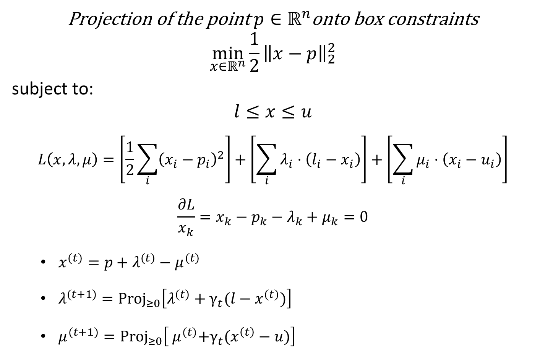
Example: Dual SG
Projection of the point $p∈ℝ^{n}$onto box constraints
$$\min_{x∈ℝ^{n}}{\frac{1}{2}{\left\|x−p\right\|}_{2}^{2}}$$
subject to:
$$l≤x≤u$$
$$L\left(x,λ,μ\right)=\left[\frac{1}{2}\sum_{i}{{\left(x_{i}−p_{i}\right)}^{2}}\right]+\left[\sum_{i}{λ_{i}⋅\left(l_{i}−x_{i}\right)}\right]+\left[\sum_{i}{μ_{i}⋅\left(x_{i}−u_{i}\right)}\right]$$
$$\frac{∂L}{x_{k}}=x_{k}−p_{k}−λ_{k}+μ_{k}=0$$
  $x^{(t)}=p+λ^{(t)}−μ^{(t)}$
  $λ^{(t+1)}=Proj_{≥0}\left[λ^{(t)}+γ_{t}(l−x^{(t)})\right]$
  $μ^{(t+1)}=Proj_{≥0}\left[{ μ}^{(t)}+γ_{t}(x^{\left(t\right)}−u)\right]$

Slide 61

Example: Dual SG
Suppose $p=\left[\begin{matrix}2 \\ −1\end{matrix}\right],l=\left[\begin{matrix}0 \\ 0\end{matrix}\right], u=\left[\begin{matrix}1 \\ 1\end{matrix}\right],γ_{t}=.5$
  $x^{(t)}=p+λ^{(t)}−μ^{(t)}$
  $λ^{(t+1)}=Proj_{≥0}\left[λ^{(t)}+γ_{t}(l−x^{(t)})\right]$
  $μ^{(t+1)}=Proj_{≥0}\left[μ^{(t)}+γ_{t}(x^{\left(t\right)}−u)\right]$
$λ^{(0)}=\left[\begin{matrix}0 \\ 0\end{matrix}\right], μ^{0}=\left[\begin{matrix}0 \\ 0\end{matrix}\right],x^{(0)}=?$

Slide 62

Example: Dual SG
Suppose $p=\left[\begin{matrix}2 \\ −1\end{matrix}\right],l=\left[\begin{matrix}0 \\ 0\end{matrix}\right], u=\left[\begin{matrix}1 \\ 1\end{matrix}\right],γ_{t}=.5$
  $x^{(t)}=p+λ^{(t)}−μ^{(t)}$
  $λ^{(t+1)}=Proj_{≥0}\left[λ^{(t)}+γ_{t}(l−x^{(t)})\right]$
  $μ^{(t+1)}=Proj_{≥0}\left[μ^{(t)}+γ_{t}(x^{\left(t\right)}−u)\right]$
$λ^{(0)}=\left[\begin{matrix}0 \\ 0\end{matrix}\right], μ^{(0)}=\left[\begin{matrix}0 \\ 0\end{matrix}\right],x^{(0)}=\left[\begin{matrix}2 \\ −1\end{matrix}\right]$
$λ^{(1)}=\left[\begin{matrix}0 \\ 0.5\end{matrix}\right], μ^{(1)}=\left[\begin{matrix}0.5 \\ 0\end{matrix}\right],x^{(1)}= ?$

Slide 63
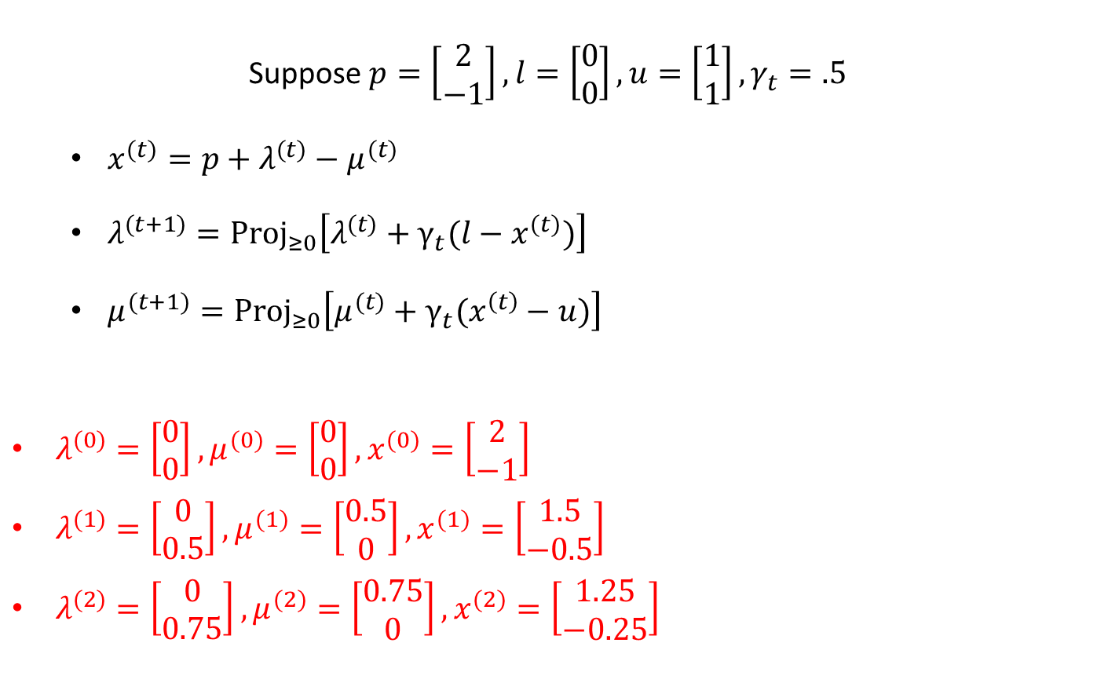
Example: Dual SG
Suppose $p=\left[\begin{matrix}2 \\ −1\end{matrix}\right],l=\left[\begin{matrix}0 \\ 0\end{matrix}\right], u=\left[\begin{matrix}1 \\ 1\end{matrix}\right],γ_{t}=.5$
  $x^{(t)}=p+λ^{(t)}−μ^{(t)}$
  $λ^{(t+1)}=Proj_{≥0}\left[λ^{(t)}+γ_{t}(l−x^{(t)})\right]$
  $μ^{(t+1)}=Proj_{≥0}\left[μ^{(t)}+γ_{t}(x^{\left(t\right)}−u)\right]$
$λ^{(0)}=\left[\begin{matrix}0 \\ 0\end{matrix}\right], μ^{(0)}=\left[\begin{matrix}0 \\ 0\end{matrix}\right],x^{(0)}=\left[\begin{matrix}2 \\ −1\end{matrix}\right]$
$λ^{(1)}=\left[\begin{matrix}0 \\ 0.5\end{matrix}\right], μ^{(1)}=\left[\begin{matrix}0.5 \\ 0\end{matrix}\right],x^{(1)}=\left[\begin{matrix}1.5 \\ −0.5\end{matrix}\right]$
$λ^{(2)}=\left[\begin{matrix}0 \\ 0.75\end{matrix}\right], μ^{(2)}=\left[\begin{matrix}0.75 \\ 0\end{matrix}\right],x^{(2)}=\left[\begin{matrix}1.25 \\ −0.25\end{matrix}\right]$

Slide 64

Augmented Lagrangian
$$\min_{x∈ℝ^{n}}{f_{0}(x)}$$
subject to:
$$Ax=b$$
$$L\left(x,ν\right)=f_{0}\left(x\right)+\sum_{i}{ν_{i}\sum_{j}{\left[A_{ij}x_{j}−b_{i}\right]}}$$

Slide 65


Augmented Lagrangian
$$\min_{x∈ℝ^{n}}{f_{0}\left(x\right)+ρ{\left\|Ax−b\right\|}_{2}^{2}}$$
subject to:
$$Ax=b$$
$$L\left(x,ν\right)=f_{0}\left(x\right)+ρ{\left\|Ax−b\right\|}_{2}^{2}+\sum_{i}{ν_{i}\sum_{j}{\left[A_{ij}x_{j}−b_{i}\right]}}$$
Doesn’t change the optimization problem
for $ρ≥0$

Slide 66


Augmented Lagrangian
$$\min_{x∈ℝ^{n}}{f_{0}\left(x\right)+ρ{\left\|Ax−b\right\|}_{2}^{2}}$$
subject to:
$$Ax=b$$
$$L\left(x,ν\right)=f_{0}\left(x\right)+ρ{\left\|Ax−b\right\|}_{2}^{2}+\sum_{i}{ν_{i}\sum_{j}{\left[A_{ij}x_{j}−b_{i}\right]}}$$
Perform gradient descent/ascent simultaneously:
  $x^{(t+1)}=x^{(t)}−γ_{t}∇_{x}L(x^{\left(t\right)},ν^{\left(t\right)})$
  $ν^{(t+1)}=x^{(t)}+γ_{t}∇_{ν}L(x^{\left(t\right)},ν^{\left(t\right)})$
Doesn’t require us to minimize the Lagrangian explicitly over $x$

Slide 67
Augmented Lagrangian
$$\min_{x∈ℝ^{n}}{f_{0}\left(x\right)+ρ{\left\|Ax−b\right\|}_{2}^{2}}$$
subject to:
$$Ax=b$$
$$L\left(x,ν\right)=f_{0}\left(x\right)+ρ{\left\|Ax−b\right\|}_{2}^{2}+\sum_{i}{ν_{i}\sum_{j}{\left[A_{ij}x_{j}−b_{i}\right]}}$$
Perform gradient descent/ascent simultaneously:
  $x^{(t+1)}=x^{(t)}−γ_{t}∇_{x}L(x^{\left(t\right)},ν^{\left(t\right)})$
  $ν^{(t+1)}=x^{(t)}+γ_{t}∇_{ν}L(x^{\left(t\right)},ν^{\left(t\right)})$
“augmented” piece helps improve convergence

Slide 68
Augmented Lagrangian
$$\min_{x∈ℝ^{n}}{f_{0}\left(x\right)+ρ{\left\|Ax−b\right\|}_{2}^{2}}$$
subject to:
$$Ax=b$$
$$L\left(x,ν\right)=f_{0}\left(x\right)+ρ{\left\|Ax−b\right\|}_{2}^{2}+\sum_{i}{ν_{i}\sum_{j}{\left[A_{ij}x_{j}−b_{i}\right]}}$$
Perform gradient descent/ascent simultaneously:
  $x^{(t+1)}=x^{(t)}−γ_{t}∇_{x}L(x^{\left(t\right)},ν^{\left(t\right)})$
  $ν^{(t+1)}=x^{(t)}+γ_{t}∇_{ν}L(x^{\left(t\right)},ν^{\left(t\right)})$
Stopping Criteria?

