Slide 1
Lecture 8: Applications in ML
Nicholas Ruozzi
University of Texas at Dallas

Slide 2
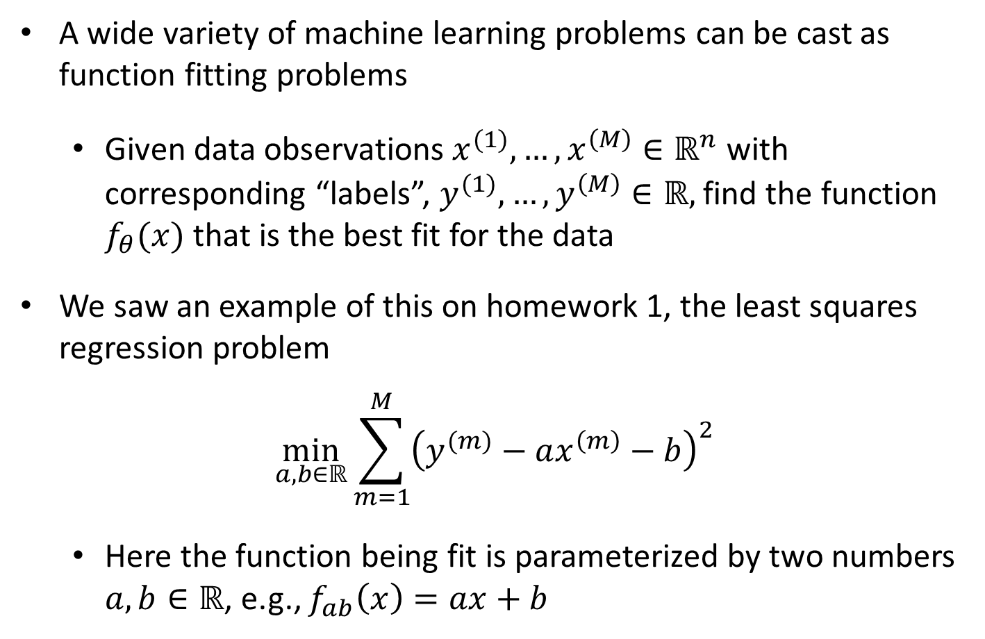
Function Fitting: ML Applications
A wide variety of machine learning problems can be cast as function fitting problems
  Given data observations $x^{(1)},…,x^{\left(M\right)}∈ℝ^{n}$ with corresponding “labels”, $y^{(1)},…,y^{\left(M\right)}∈ℝ,$ find the function $f_{θ}(x)$ that is the best fit for the data
We saw an example of this on homework 1, the least squares regression problem
$$\min_{a,b∈ℝ}{\sum_{m=1}^{M}{{\left(y^{(m)}−ax^{\left(m\right)}−b\right)}^{2}}}$$
  Here the function being fit is parameterized by two numbers $a,b∈ℝ$, e.g., $f_{ab}\left(x\right)=ax+b$

Slide 3

L1 Regression
Suppose that instead of a squared error, we wanted to minimize the absolute error?
$$\min_{a,b∈ℝ}{\sum_{m=1}^{M}{\left|y^{(m)}−ax^{\left(m\right)}−b\right|}}$$
What optimization procedure should we use?

Slide 4
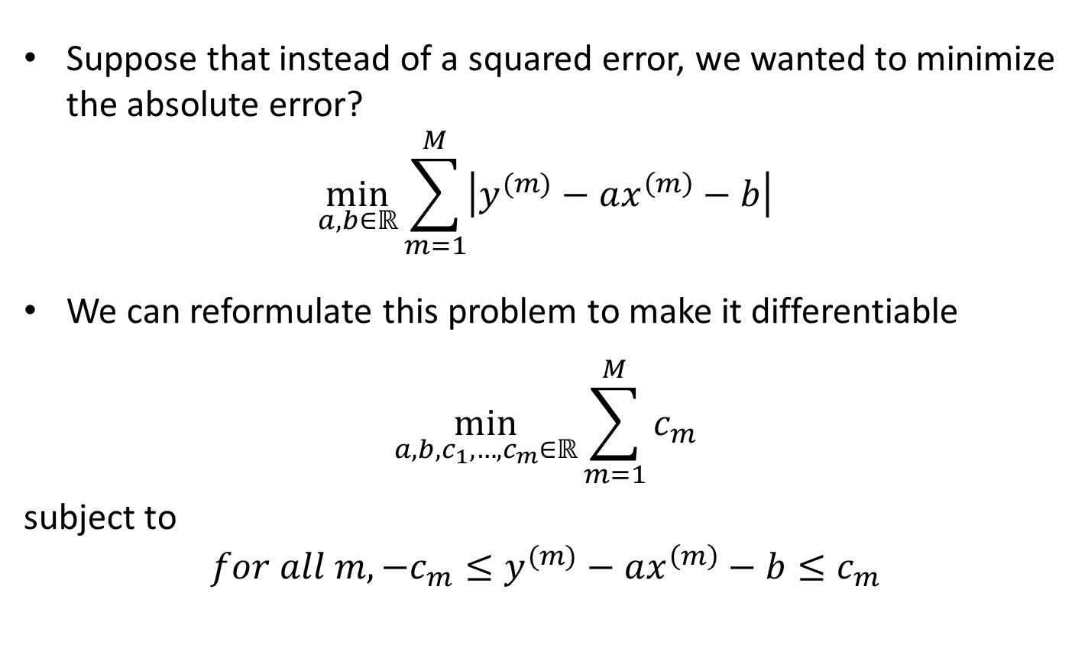
L1 Regression
Suppose that instead of a squared error, we wanted to minimize the absolute error?
$$\min_{a,b∈ℝ}{\sum_{m=1}^{M}{\left|y^{(m)}−ax^{\left(m\right)}−b\right|}}$$
We can reformulate this problem to make it differentiable
$$\min_{a,b,c_{1},…,c_{m}∈ℝ}{\sum_{m=1}^{M}{c_{m}}}$$
subject to
$$for all m, −c_{m}≤y^{(m)}−ax^{\left(m\right)}−b≤c_{m}$$
(apply existing LP solvers!)

Slide 5
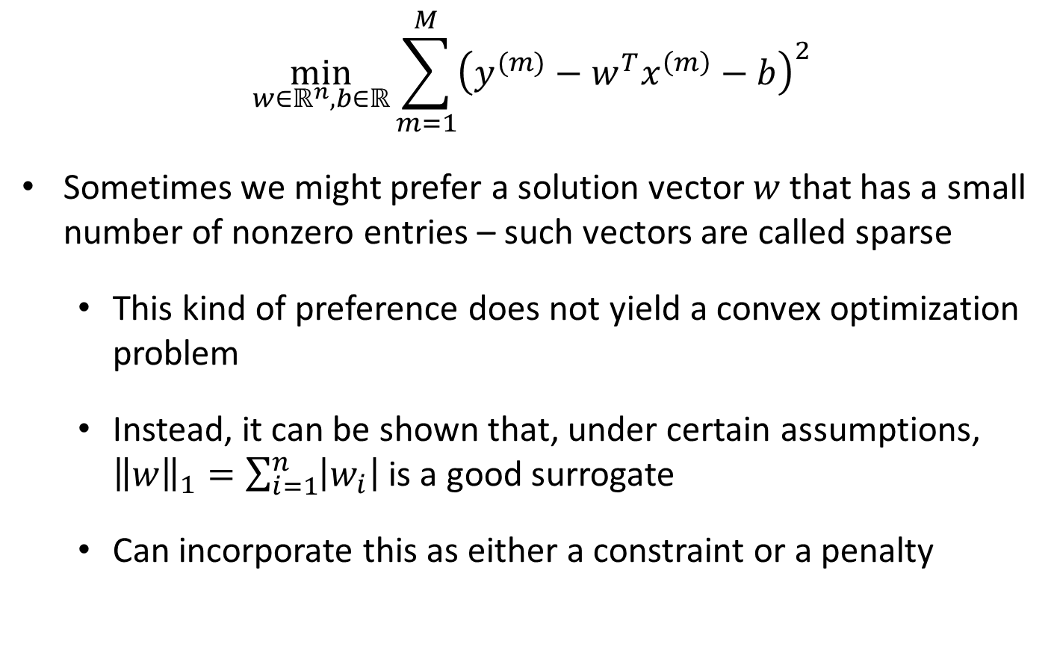
Sparse Least Squares Regression
$$\min_{w∈ℝ^{n},b∈ℝ}{\sum_{m=1}^{M}{{\left(y^{(m)}−w^{T}x^{\left(m\right)}−b\right)}^{2}}}$$
Sometimes we might prefer a solution vector $w$ that has a small number of nonzero entries – such vectors are called sparse
  This kind of preference does not yield a convex optimization problem
  Instead, it can be shown that, under certain assumptions, ${\left\|w\right\|}_{1}=\sum_{i=1}^{n}{\left|w_{i}\right|}$ is a good surrogate
  Can incorporate this as either a constraint or a penalty

Slide 6
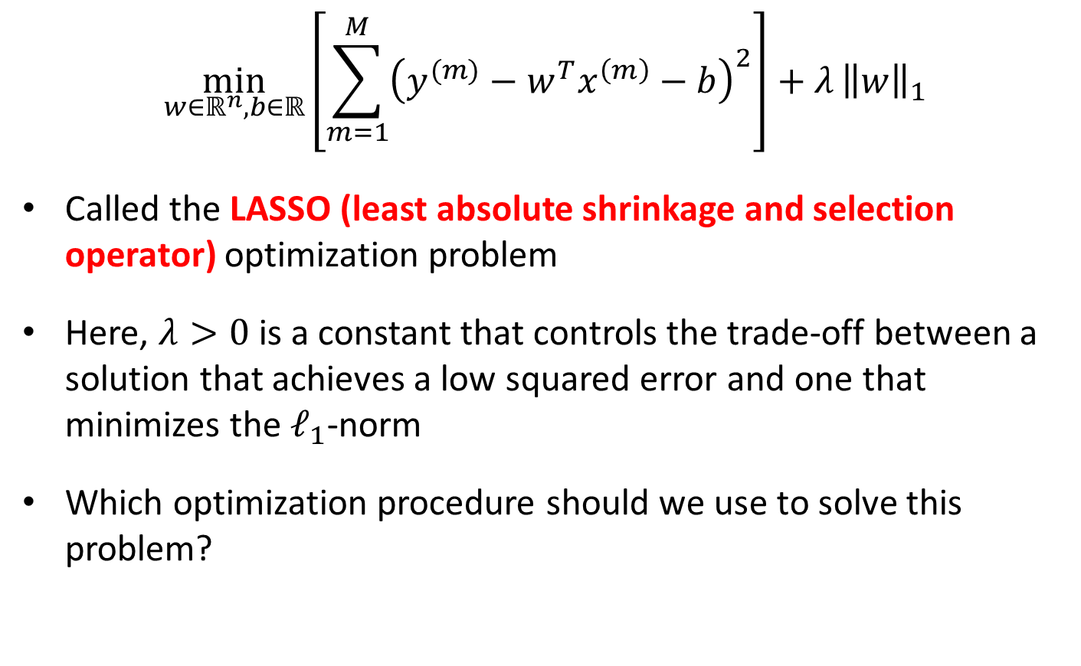
Sparse Least Squares Regression
$$\min_{w∈ℝ^{n},b∈ℝ}\left[\sum_{m=1}^{M}{{\left(y^{(m)}−w^{T}x^{\left(m\right)}−b\right)}^{2}}\right]+λ{\left\|w\right\|}_{1}$$
Called the LASSO (least absolute shrinkage and selection operator) optimization problem
Here, $λ>0$ is a constant that controls the trade-off between a solution that achieves a low squared error and one that minimizes the $ℓ_{1}$-norm
Which optimization procedure should we use to solve this problem?

Slide 7
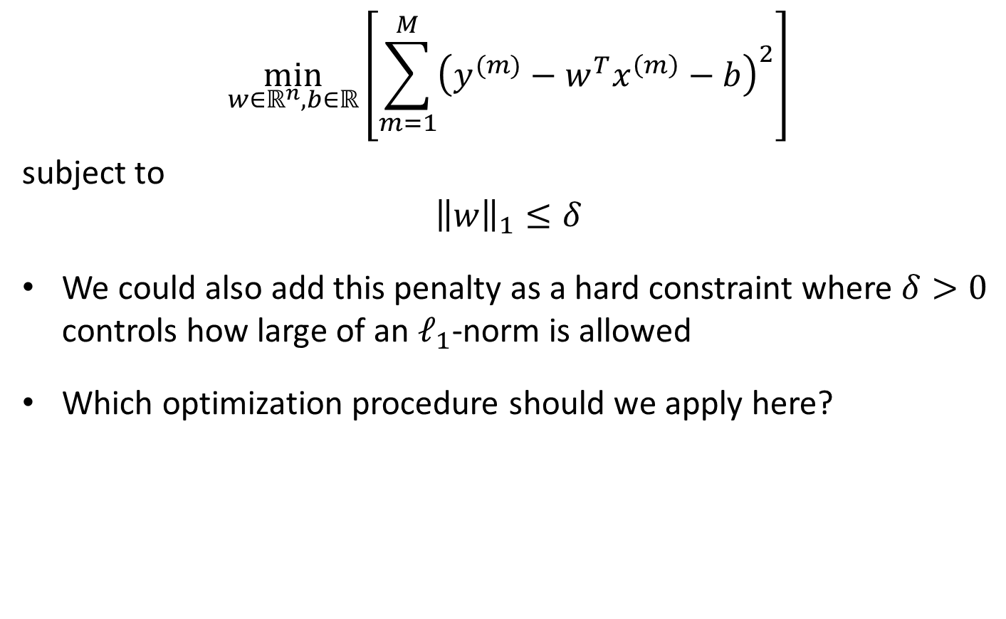
Sparse Least Squares Regression
$$\min_{w∈ℝ^{n},b∈ℝ}\left[\sum_{m=1}^{M}{{\left(y^{(m)}−w^{T}x^{\left(m\right)}−b\right)}^{2}}\right]$$
subject to
$${\left\|w\right\|}_{1}≤δ$$
We could also add this penalty as a hard constraint where $δ>0$ controls how large of an $ℓ_{1}$-norm is allowed
Which optimization procedure should we apply here?

Slide 8
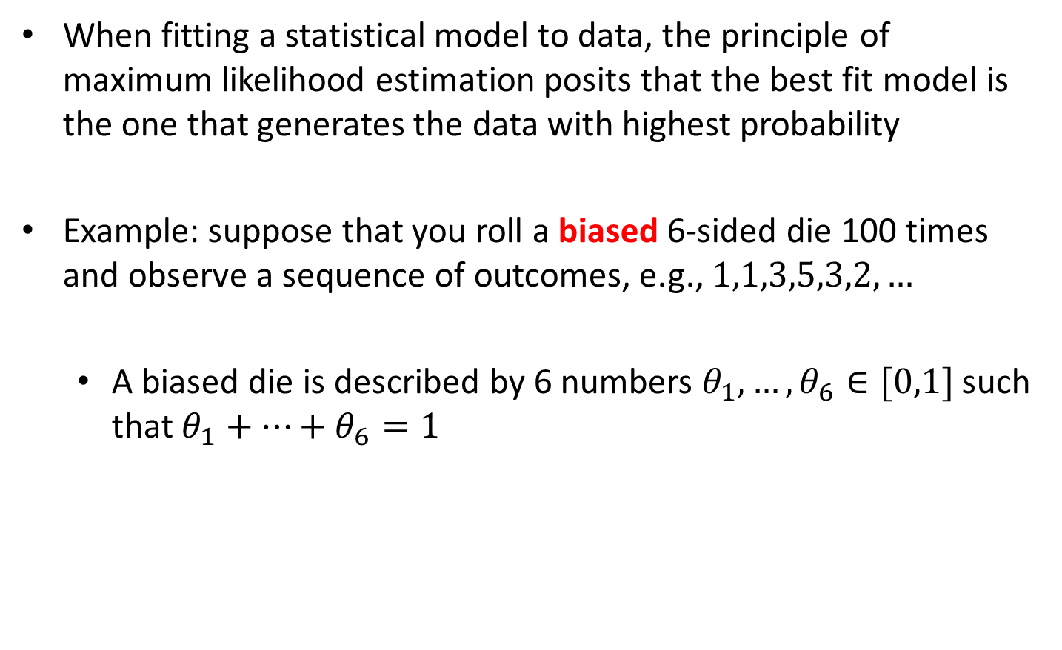
Maximum Likelihood Estimation
When fitting a statistical model to data, the principle of maximum likelihood estimation posits that the best fit model is the one that generates the data with highest probability
Example: suppose that you roll a biased 6-sided die 100 times and observe a sequence of outcomes, e.g., $1,1,3,5,3,2,…$
  A biased die is described by 6 numbers $θ_{1},…,θ_{6}∈[0,1]$ such that $θ_{1}+…+θ_{6}=1$

Slide 9
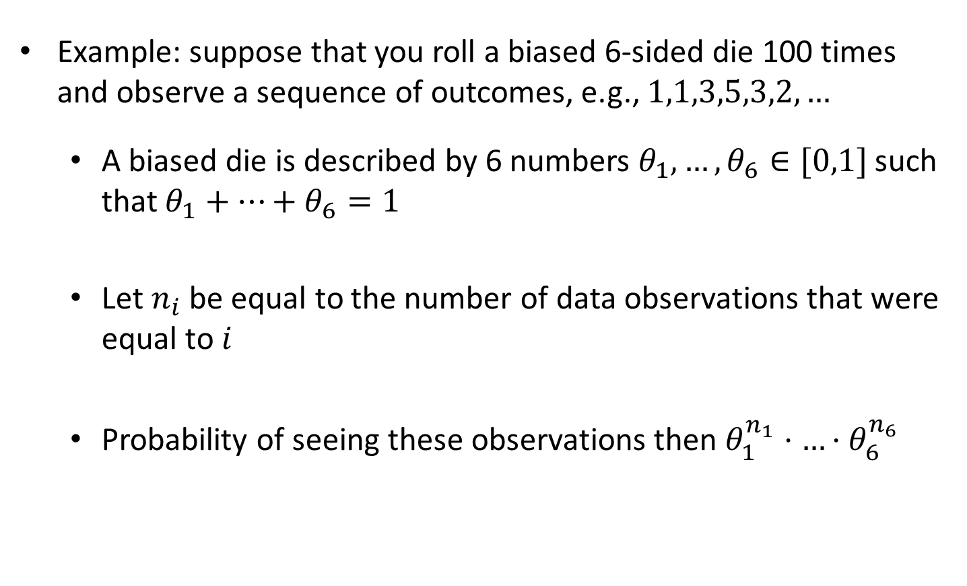
Maximum Likelihood Estimation
Example: suppose that you roll a biased 6-sided die 100 times and observe a sequence of outcomes, e.g., $1,1,3,5,3,2,…$
  A biased die is described by 6 numbers $θ_{1},…,θ_{6}∈[0,1]$ such that $θ_{1}+…+θ_{6}=1$
  Let $n_{i}$ be equal to the number of data observations that were equal to $i$
  Probability of seeing these observations then $θ_{1}^{n_{1}}⋅…⋅θ_{6}^{n_{6}}$

Slide 10

Maximum Likelihood Estimation
  $$\max_{θ_{1},…,θ_{6}∈ℝ}{θ_{1}^{n_{1}}}⋅…⋅θ_{6}^{n_{6}}$$
  subject to
  $$θ_{1}+…+θ_{6}=1$$
  $$θ≥0$$

Slide 11

Maximum Likelihood Estimation
  $$\max_{θ_{1},…,θ_{6}∈ℝ}{\log\left(θ_{1}^{n_{1}}⋅…⋅θ_{6}^{n_{6}}\right)}$$
  subject to
  $$θ_{1}+…+θ_{6}=1$$
  $$θ≥0$$

Slide 12

Maximum Likelihood Estimation
  $$\max_{θ_{1},…,θ_{6}∈ℝ}{n_{1}\log\left(θ_{1}\right)}+…+n_{6}\log\left(θ_{6}\right)$$
  subject to
  $$θ_{1}+…+θ_{6}=1$$
  $$θ≥0$$
Has a closed form solution, but...

Slide 13
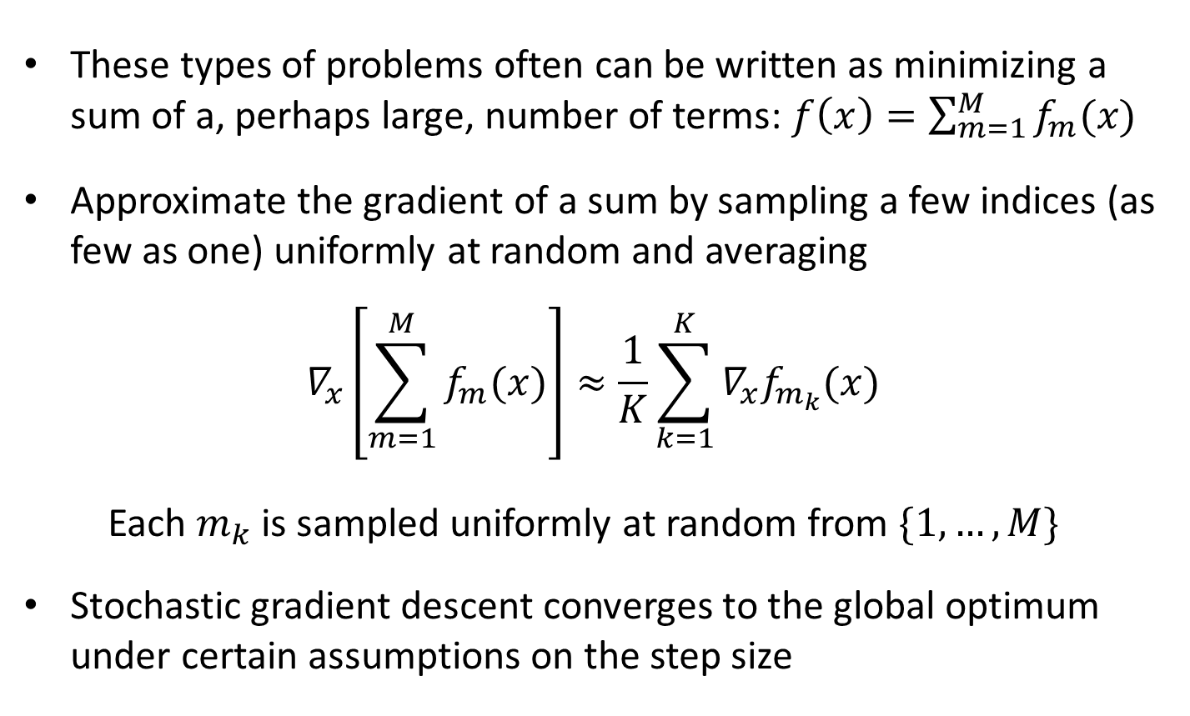
Stochastic Gradient Descent
These types of problems often can be written as minimizing a sum of a, perhaps large, number of terms: $f\left(x\right)=\sum_{m=1}^{M}{f_{m}(x)}$
Approximate the gradient of a sum by sampling a few indices (as few as one) uniformly at random and averaging
$$∇_{x}\left[\sum_{m=1}^{M}{f_{m}(x)}\right]≈\frac{1}{K}\sum_{k=1}^{K}{∇_{x}f_{m_{k}}(x)}$$
Each $m_{k}$ is sampled uniformly at random from $\{1,…,M\}$
Stochastic gradient descent converges to the global optimum under certain assumptions on the step size

Slide 14
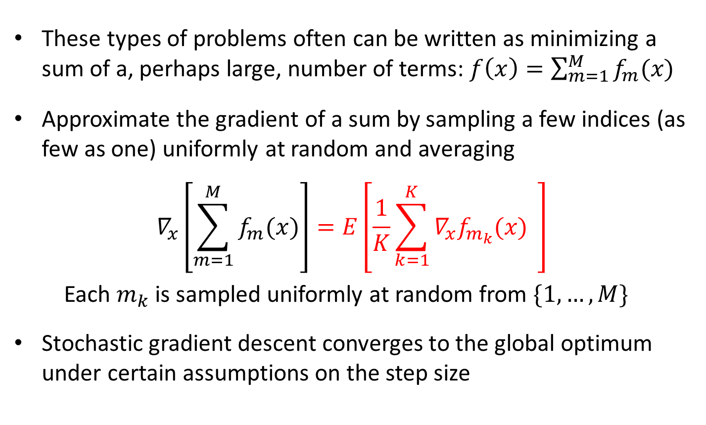
Stochastic Gradient Descent
These types of problems often can be written as minimizing a sum of a, perhaps large, number of terms: $f\left(x\right)=\sum_{m=1}^{M}{f_{m}(x)}$
Approximate the gradient of a sum by sampling a few indices (as few as one) uniformly at random and averaging
$$∇_{x}\left[\sum_{m=1}^{M}{f_{m}(x)}\right]=E\left[\frac{1}{K}\sum_{k=1}^{K}{∇_{x}f_{m_{k}}(x)} \right]$$
Each $m_{k}$ is sampled uniformly at random from $\{1,…,M\}$
Stochastic gradient descent converges to the global optimum under certain assumptions on the step size
Expectation taken over the random samples

Slide 15
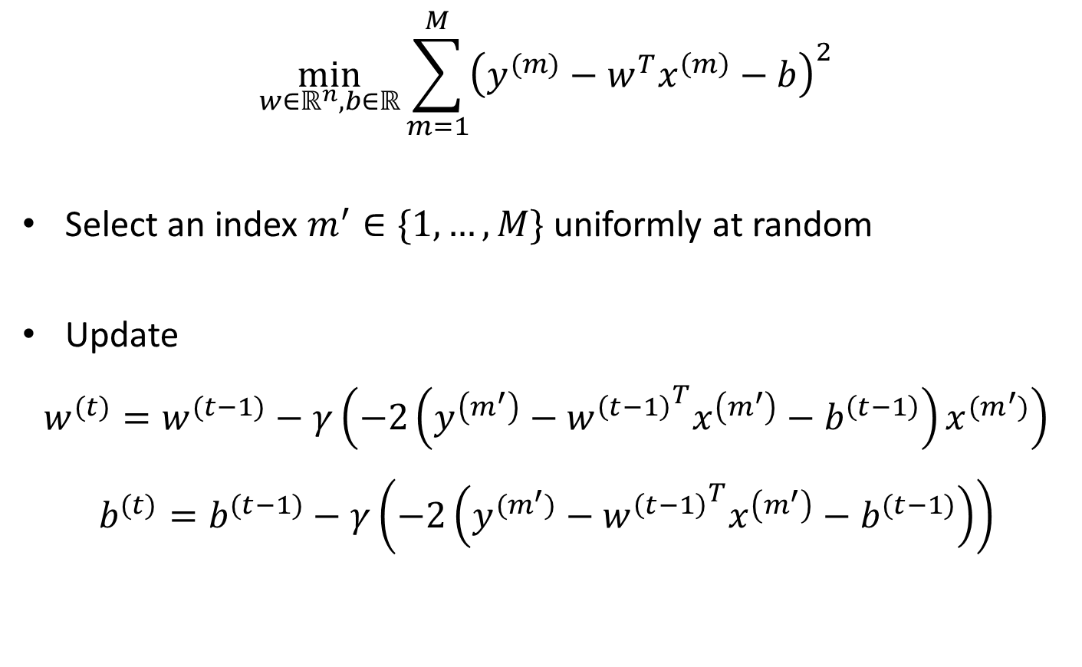
SGD for Least Squares
$$\min_{w∈ℝ^{n},b∈ℝ}{\sum_{m=1}^{M}{{\left(y^{(m)}−w^{T}x^{\left(m\right)}−b\right)}^{2}}}$$
Select an index $m^{′}∈\{1,…,M\}$ uniformly at random
Update
$$w^{(t)}=w^{(t−1)}−γ\left(−2\left(y^{\left(m^{′}\right)}−{w^{\left(t−1\right)}}^{T}x^{\left(m^{′}\right)}−b^{\left(t−1\right)}\right)x^{(m^{′})}\right)$$
$$b^{(t)}=b^{(t−1)}−γ\left(−2\left(y^{(m^{′})}−{w^{\left(t−1\right)}}^{T}x^{\left(m^{′}\right)}−b^{(t−1)}\right)\right)$$

Slide 16
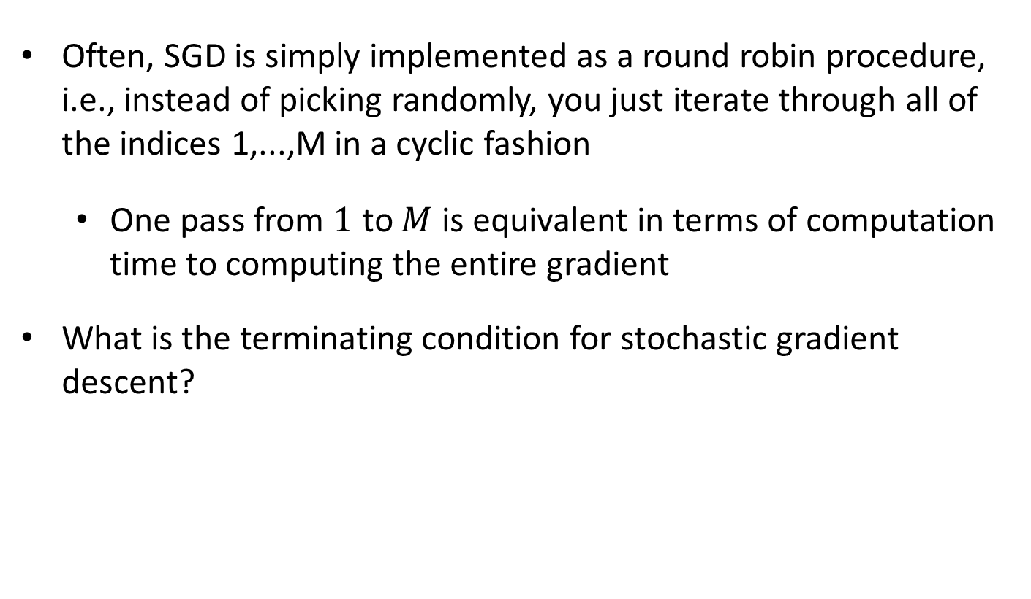
Stochastic Gradient Descent
Often, SGD is simply implemented as a round robin procedure, i.e., instead of picking randomly, you just iterate through all of the indices 1,...,M in a cyclic fashion
  One pass from $1$ to $M$ is equivalent in terms of computation time to computing the entire gradient
What is the terminating condition for stochastic gradient descent?

Slide 17

Logistic Regression
Given $x^{\left(1\right)},…,x^{\left(M\right)}∈ℝ^{n}$ and $y^{\left(1\right)},…,y^{\left(M\right)}∈\{−1,1\}$,
$$\min_{w∈ℝ^{n},b∈ℝ}{\sum_{m=1}^{M}{\left[\frac{y^{\left(m\right)}+1}{2}\left(w^{T}x^{(m)}+b\right)−\ln\left(1+\exp\left(w^{T}x^{\left(m\right)}+b\right)\right)\right]}}$$
What optimization strategies can we apply?

Slide 18
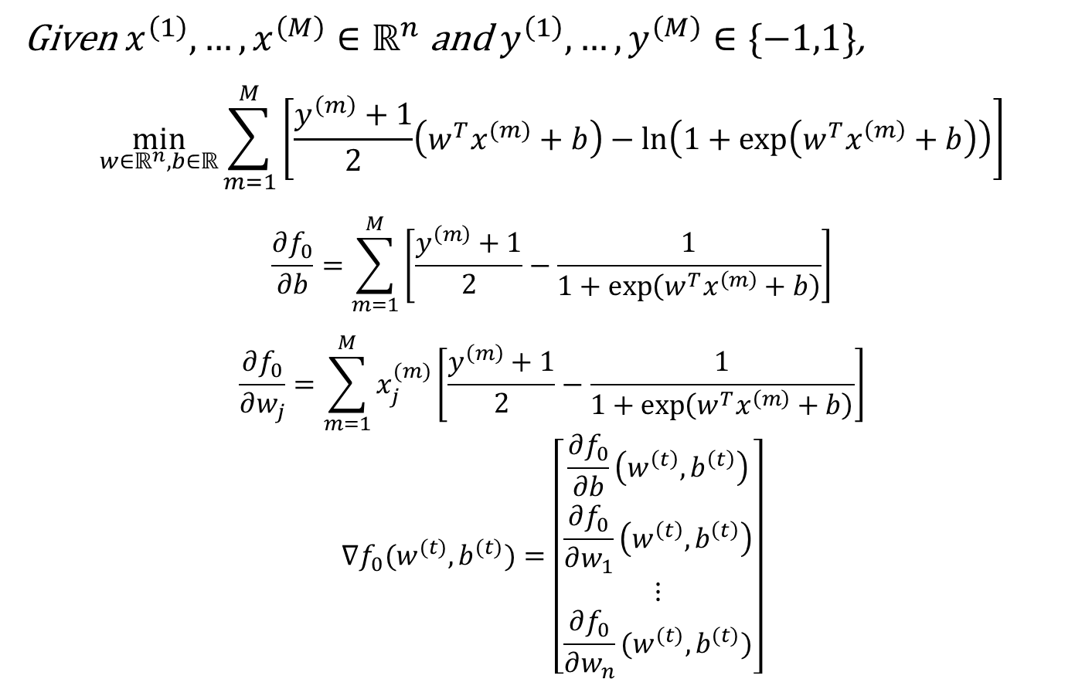
Logistic Regression
Given $x^{\left(1\right)},…,x^{\left(M\right)}∈ℝ^{n}$ and $y^{\left(1\right)},…,y^{\left(M\right)}∈\{−1,1\}$,
$$\min_{w∈ℝ^{n},b∈ℝ}{\sum_{m=1}^{M}{\left[\frac{y^{\left(m\right)}+1}{2}\left(w^{T}x^{(m)}+b\right)−\ln\left(1+\exp\left(w^{T}x^{\left(m\right)}+b\right)\right)\right]}}$$
$$\frac{∂f_{0}}{∂b}=\sum_{m=1}^{M}{\left[\frac{y^{\left(m\right)}+1}{2}−\frac{1}{1+\exp\left(w^{T}x^{\left(m\right)}+b\right)}\right]}$$
$$\frac{∂f_{0}}{∂w_{j}}=\sum_{m=1}^{M}{x_{j}^{(m)}\left[\frac{y^{\left(m\right)}+1}{2}−\frac{1}{1+\exp\left(w^{T}x^{\left(m\right)}+b\right)}\right]}$$
$$∇f_{0}(w^{(t)},b^{(t)})=\left[\begin{matrix}\frac{∂f_{0}}{∂b}\left(w^{\left(t\right)},b^{\left(t\right)}\right) \\ \frac{∂f_{0}}{∂w_{1}}\left(w^{\left(t\right)},b^{\left(t\right)}\right) \\ ⋮ \\ \frac{∂f_{0}}{∂w_{n}}(w^{(t)},b^{(t)})\end{matrix}\right]$$

Slide 19
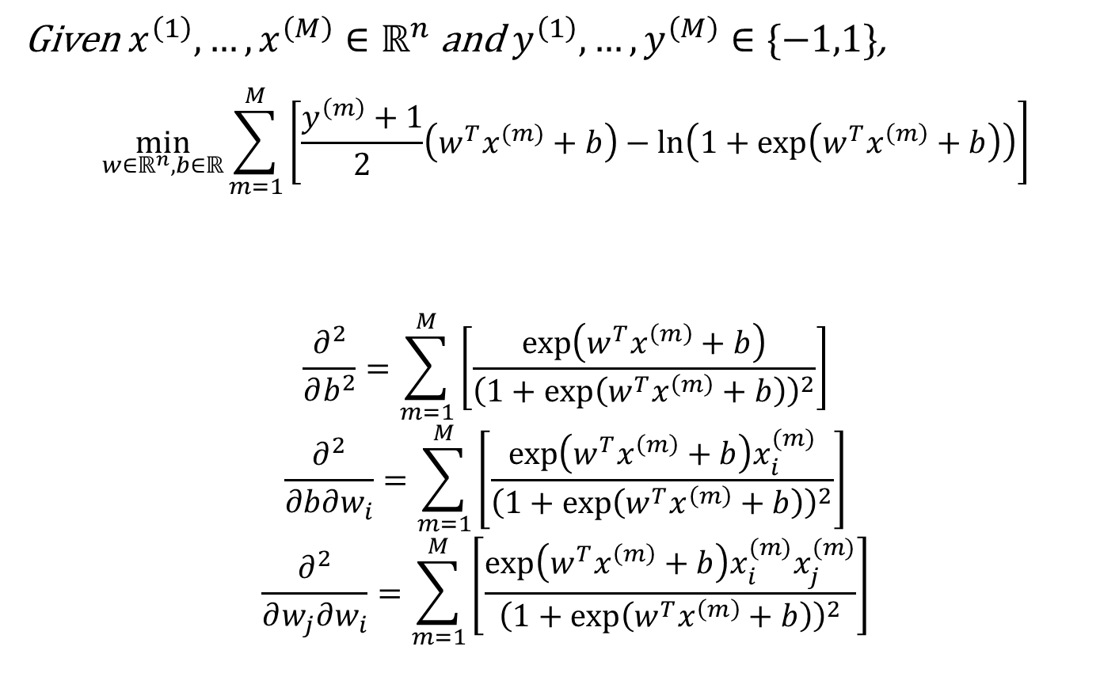
Logistic Regression
Given $x^{\left(1\right)},…,x^{\left(M\right)}∈ℝ^{n}$ and $y^{\left(1\right)},…,y^{\left(M\right)}∈\{−1,1\}$,
$$\min_{w∈ℝ^{n},b∈ℝ}{\sum_{m=1}^{M}{\left[\frac{y^{\left(m\right)}+1}{2}\left(w^{T}x^{(m)}+b\right)−\ln\left(1+\exp\left(w^{T}x^{\left(m\right)}+b\right)\right)\right]}}$$
$$\frac{∂^{2}}{∂b^{2}}=\sum_{m=1}^{M}{\left[\frac{\exp\left(w^{T}x^{\left(m\right)}+b\right)}{{\left(1+\exp\left(w^{T}x^{\left(m\right)}+b\right)\right)}^{2}}\right]}$$
$$\frac{∂^{2}}{∂b∂w_{i}}=\sum_{m=1}^{M}{\left[\frac{\exp\left(w^{T}x^{\left(m\right)}+b\right)x_{i}^{(m)}}{{\left(1+\exp\left(w^{T}x^{\left(m\right)}+b\right)\right)}^{2}}\right]}$$
$$\frac{∂^{2}}{∂w_{j}∂w_{i}}=\sum_{m=1}^{M}{\left[\frac{\exp\left(w^{T}x^{\left(m\right)}+b\right)x_{i}^{(m)}x_{j}^{(m)}}{{\left(1+\exp\left(w^{T}x^{\left(m\right)}+b\right)\right)}^{2}}\right]}$$
Newton’s Method:

Slide 20
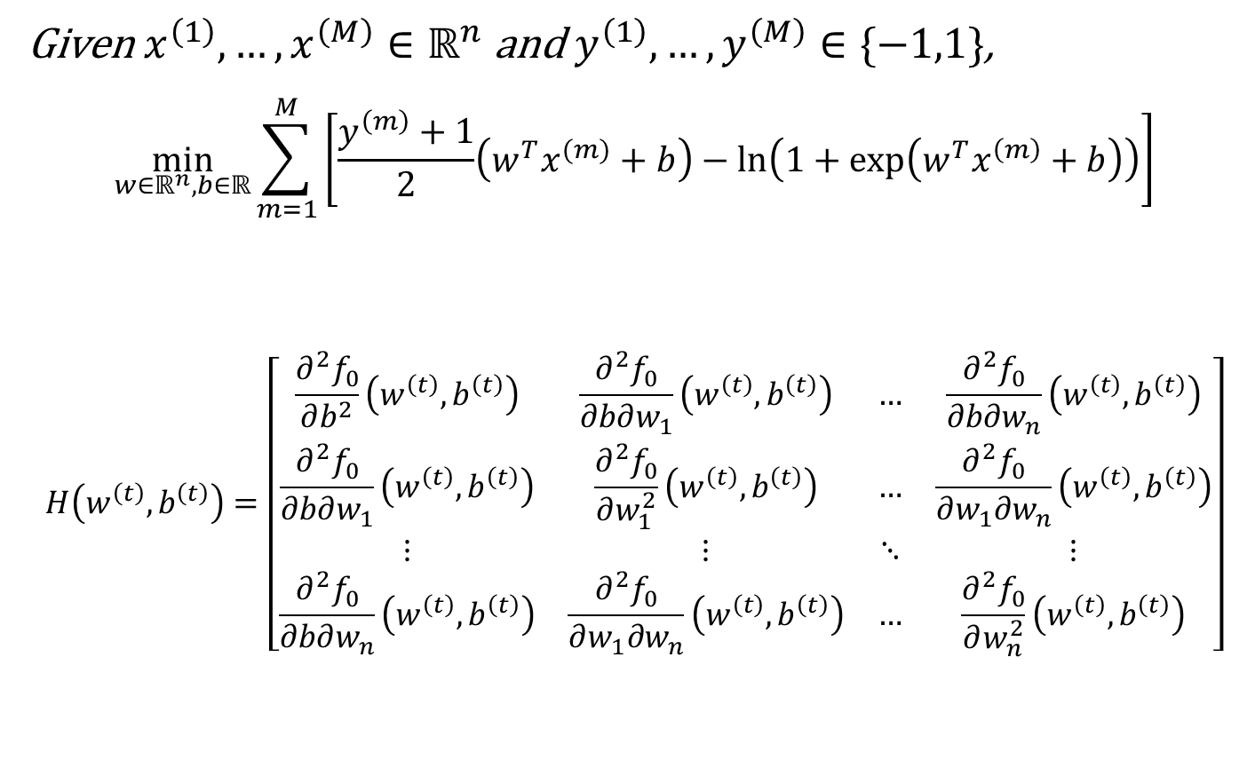
Logistic Regression
Given $x^{\left(1\right)},…,x^{\left(M\right)}∈ℝ^{n}$ and $y^{\left(1\right)},…,y^{\left(M\right)}∈\{−1,1\}$,
$$\min_{w∈ℝ^{n},b∈ℝ}{\sum_{m=1}^{M}{\left[\frac{y^{\left(m\right)}+1}{2}\left(w^{T}x^{(m)}+b\right)−\ln\left(1+\exp\left(w^{T}x^{\left(m\right)}+b\right)\right)\right]}}$$
$$H\left(w^{\left(t\right)},b^{\left(t\right)}\right)=\left[\begin{matrix}\frac{∂^{2}f_{0}}{∂b^{2}}\left(w^{\left(t\right)},b^{\left(t\right)}\right) & \frac{∂^{2}f_{0}}{∂b∂w_{1}}\left(w^{\left(t\right)},b^{\left(t\right)}\right) & … & \frac{∂^{2}f_{0}}{∂b∂w_{n}}\left(w^{\left(t\right)},b^{\left(t\right)}\right) \\ \frac{∂^{2}f_{0}}{∂b∂w_{1}}\left(w^{\left(t\right)},b^{\left(t\right)}\right) & \frac{∂^{2}f_{0}}{∂w_{1}^{2}}\left(w^{\left(t\right)},b^{\left(t\right)}\right) & … & \frac{∂^{2}f_{0}}{∂w_{1}∂w_{n}}\left(w^{\left(t\right)},b^{\left(t\right)}\right) \\ ⋮ & ⋮ & ⋱ & ⋮ \\ \frac{∂^{2}f_{0}}{∂b∂w_{n}}\left(w^{\left(t\right)},b^{\left(t\right)}\right) & \frac{∂^{2}f_{0}}{∂w_{1}∂w_{n}}\left(w^{\left(t\right)},b^{\left(t\right)}\right) & … & \frac{∂^{2}f_{0}}{∂w_{n}^{2}}\left(w^{\left(t\right)},b^{\left(t\right)}\right)\end{matrix}\right]$$
Newton’s Method:

Slide 21

Logistic Regression
Given $x^{\left(1\right)},…,x^{\left(M\right)}∈ℝ^{n}$ and $y^{\left(1\right)},…,y^{\left(M\right)}∈\{−1,1\}$,
$$\min_{w∈ℝ^{n},b∈ℝ}{\sum_{m=1}^{M}{\left[\frac{y^{\left(m\right)}+1}{2}\left(w^{T}x^{(m)}+b\right)−\ln\left(1+\exp\left(w^{T}x^{\left(m\right)}+b\right)\right)\right]}}$$
$$\left[\begin{matrix}b^{\left(t+1\right)} \\ w_{1}^{(t+1)} \\ ⋮ \\ w_{n}^{(t+1)}\end{matrix}\right]=\left[\begin{matrix}b^{\left(t\right)} \\ w_{1}^{(t)} \\ ⋮ \\ w_{n}^{(t)}\end{matrix}\right]−H{\left(w^{\left(t\right)},b^{\left(t\right)}\right)}^{−1}∇f_{0}(w^{(t)},b^{(t)})$$
Newton’s Method:

Slide 22
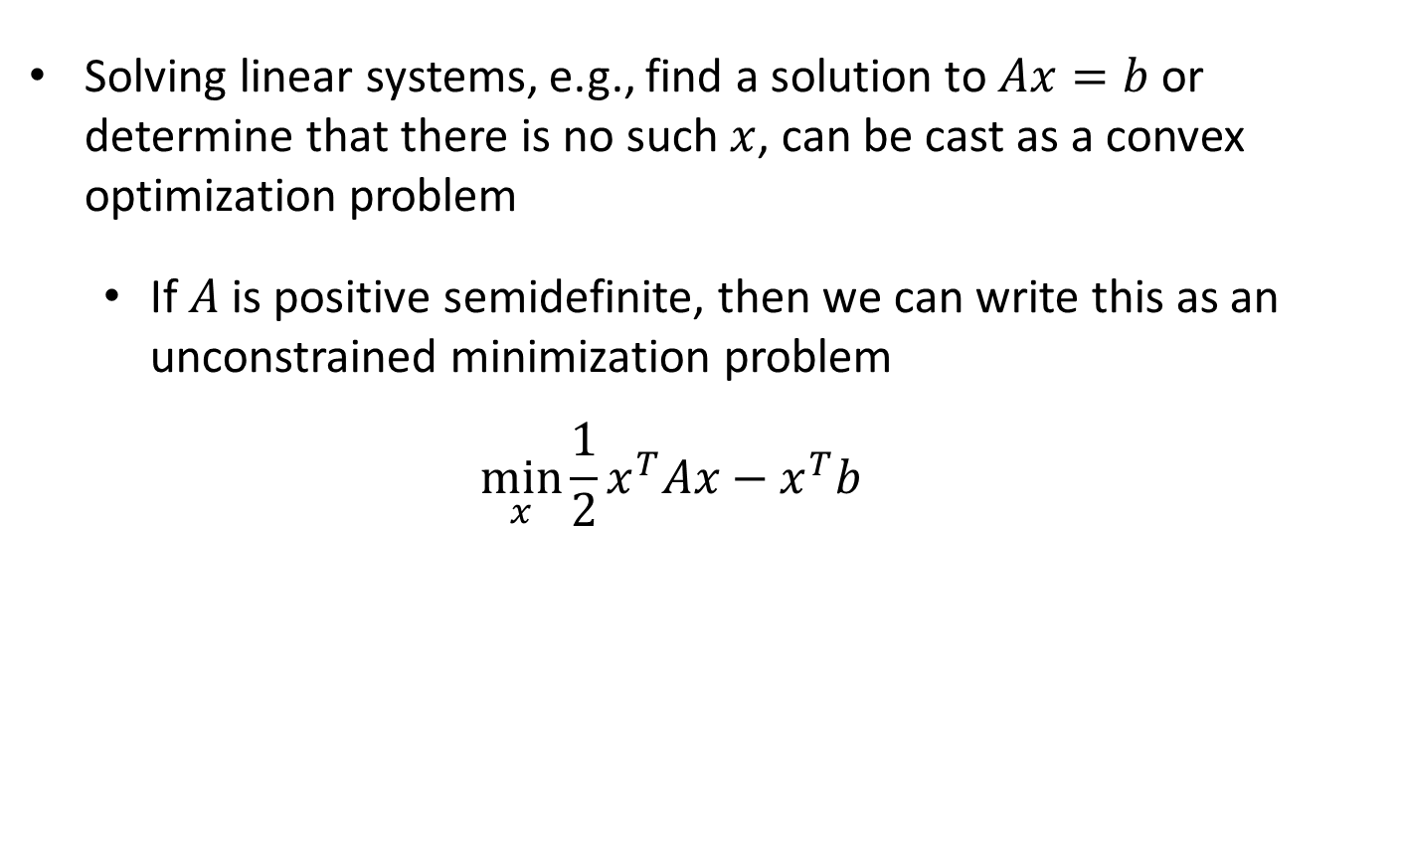
Solving Linear Systems
Solving linear systems, e.g., find a solution to $Ax=b$ or determine that there is no such $x$, can be cast as a convex optimization problem
  If $A$ is positive semidefinite, then we can write this as an unconstrained minimization problem
  $$\min_{x}{\frac{1}{2}x^{T}Ax−x^{T}b}$$
What optimization strategies can we apply?

Slide 23
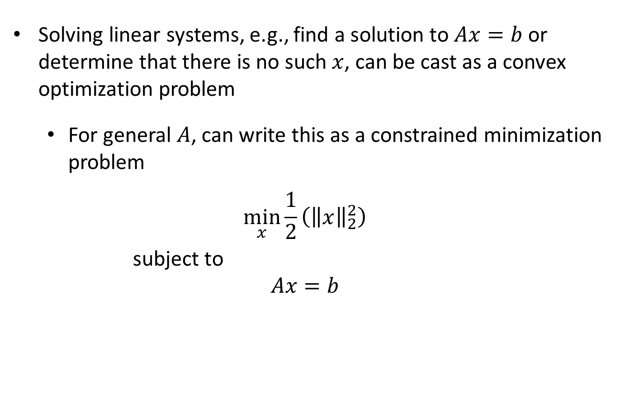
Solving Linear Systems
Solving linear systems, e.g., find a solution to $Ax=b$ or determine that there is no such $x$, can be cast as a convex optimization problem
  For general $A$, can write this as a constrained minimization problem
  $$\min_{x}{\frac{1}{2}\left({\left\|x\right\|}_{2}^{2}\right)}$$
  subject to
  $$Ax=b$$

Slide 24

Solving Linear Systems
  $$\min_{x}{\frac{1}{2}\left({\left\|x\right\|}_{2}^{2}\right)}$$
  subject to
  $$Ax=b$$
What optimization strategies can we apply?

Slide 25
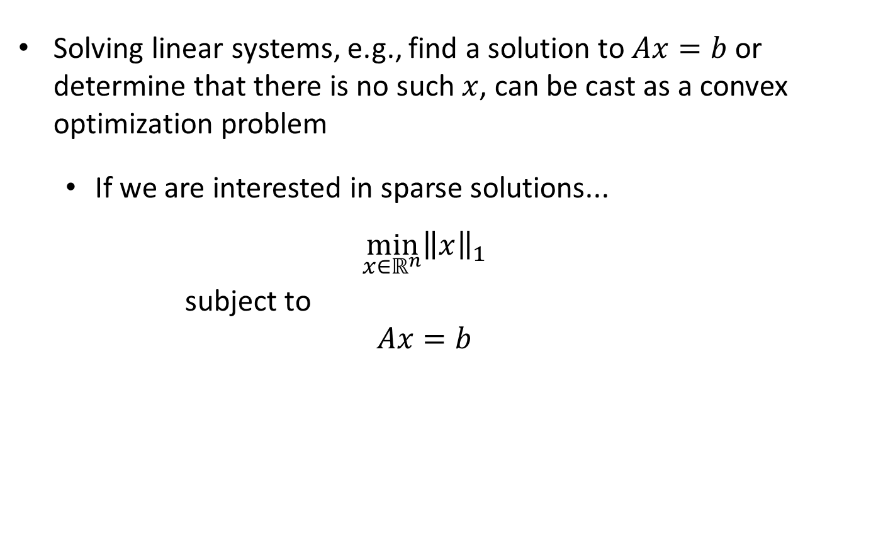
Sparse Linear Systems
Solving linear systems, e.g., find a solution to $Ax=b$ or determine that there is no such $x$, can be cast as a convex optimization problem
  If we are interested in sparse solutions...
  $$\min_{x∈ℝ^{n}}{{\left\|x\right\|}_{1}}$$
  subject to
  $$Ax=b$$
Called the basis pursuit problem

Slide 26
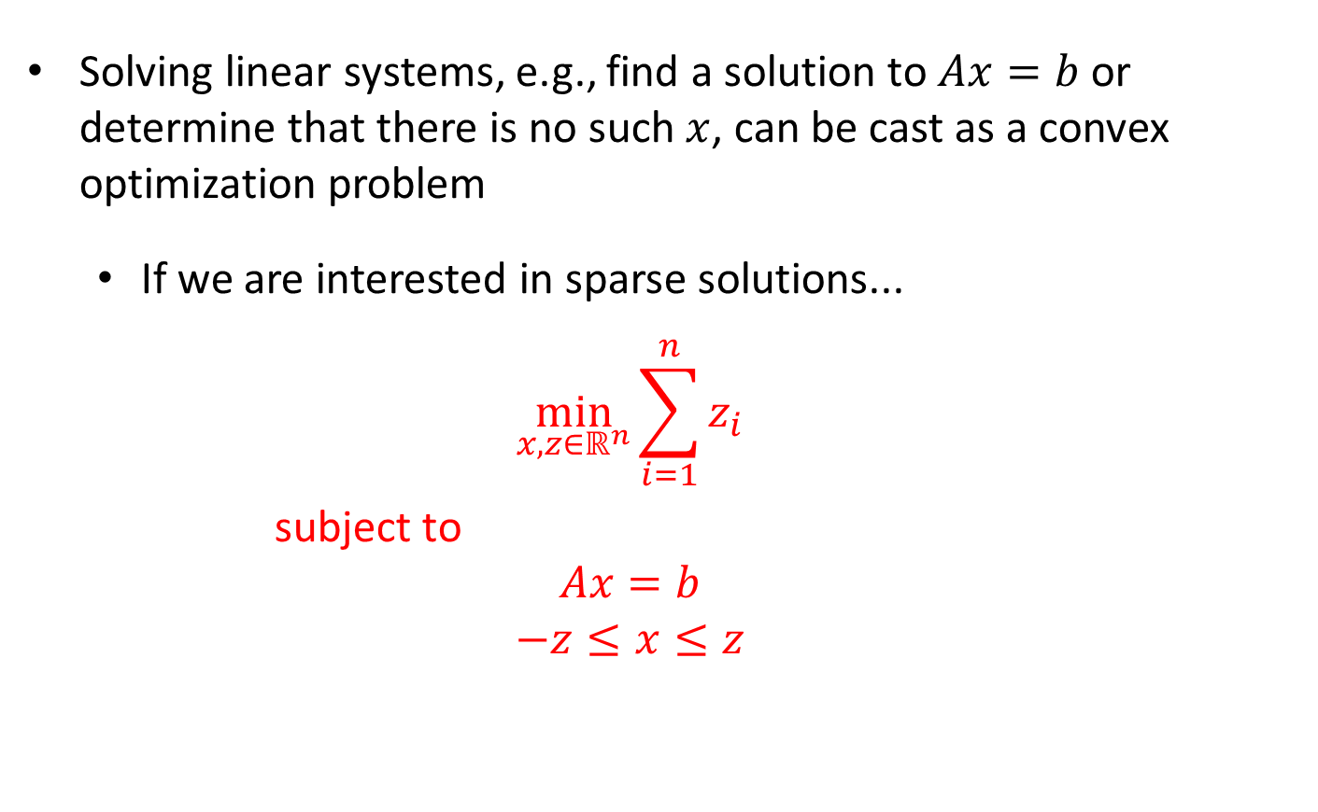
Sparse Linear Systems
Solving linear systems, e.g., find a solution to $Ax=b$ or determine that there is no such $x$, can be cast as a convex optimization problem
  If we are interested in sparse solutions...
  $$\min_{x,z∈ℝ^{n}}{\sum_{i=1}^{n}{z_{i}}}$$
  subject to
  $$Ax=b$$
  $$−z≤x≤z$$

