Slide 1
Low Rank Matrix Factorizations
Nicholas Ruozzi
University of Texas at Dallas

Slide 2
SVD Reformulated
Let $A∈ℝ^{m×n}$ with svd, $A=UΣV^{T}$
$A=\sum_{i=1}^{min⁡(m,n)}{σ_{i}u^{(i)}v^{{\left(i\right)}^{T}}}$
Without loss of generality, we can assume that the singular values are in decreasing order, i.e., $σ_{1}=Σ_{11}≥σ_{2}=Σ_{22}≥…≥σ_{n}=Σ_{nn}$
${\left\|A\right\|}_{F}^{2}=trace\left(A^{T}A\right)=\sum_{i}{σ_{i}^{2}}$

Slide 3
Applications of SVD: Low Rank Approximations
$$B^{∗}=\arg{\min_{B st. rank\left(B\right)=k}{{\left\|A−B\right\|}_{F}^{2}} }$$
$$A=UΣV^{T}=\sum_{i=1}^{min⁡(m,n)}{σ_{i}u^{(i)}v^{{\left(i\right)}^{T}}}$$
$$B^{∗}=\sum_{i=1}^{k}{σ_{i}u^{(i)}v^{{\left(i\right)}^{T}}}$$
Note: $σ^{′}s$ must be in decreasing order for this!

Slide 4
Applications of SVD: Low Rank Approximations
$$B^{∗}=\arg{\min_{B st. rank\left(B\right)=k}{{\left\|A−B\right\|}_{F}^{2}} }$$
$$B^{∗}=\sum_{i=1}^{k}{σ_{i}u^{(i)}v^{{\left(i\right)}^{T}}}=UΣ_{k}V^{T}$$
Each entry of ${\left(A\right)}_{ab}≈{\left(UΣ_{k}V^{T}\right)}_{ab}=\sum_{i=1}^{k}{σ_{i}u_{a}^{\left(i\right)}v_{b}^{\left(i\right)}}$
$b^{th}$ column of $A$ approximated as $\sum_{i=1}^{k}{σ_{i}v_{b}^{\left(i\right)}u^{(i)}}$
$a^{th}$ row of $A$ approximated as $\sum_{i=1}^{k}{σ_{i}u_{a}^{\left(i\right)}v^{{\left(i\right)}^{T}}}$

Slide 5
Computing the SVD
The SVD of an $n×m$ matrix can be computed in $O(\min\left(mn^{2},m^{2}n\right))$ floating point operations (FLOPs)
The truncated SVD that is computing only the top $k$ singular vectors and singular values can be computed in $O(mnk)$ FLOPs
Top $k$ means in order of magnitude of the singular values

Slide 6
Applications of SVD: Matrix Factorization
In applications, we might want to approximate the columns of the matrix $A$ by a collection of vectors in some lower dimensional space
This is common in machine learning applications where data might be high dimensional but be essentially low dimensional
For example, suppose $A$ has 1000 rows but all of its columns lie along a line
The columns of $A$ can then be represented accurately as points in a one dimensional space

Slide 7
Principal Component Analysis
Principle component analysis (PCA):
Assume that the matrix $A$ has as its columns a collection of data points $x^{(1)},…,x^{\left(n\right)}∈ℝ^{m}$
In PCA, a low-rank approximation of the sample covariance matrix is used to reduce the dimensionality of the data set
$C=BB^{T}$ where $B$ is the matrix formed by subtracting the mean of the columns of $A$ from each column of $A$
Use the low rank approximation $B≈UΣ_{k}V^{T}$ where $B=UΣV^{T}$ is the svd of $B$ and $Σ_{k}$ is the diagonal matrix whose non-zero entries correspond to the top-$k$ singular values

Slide 8
Principal Component Analysis
PCA interpretation:
Represent the columns of $B$, the mean adjusted data in terms of the top $k$ columns of $U$
These columns generate the best rank $k$ approximation of $BB^{T}$, the sample covariance matrix
More colloquially, these columns describe the directions that best describe the covariance of the data

Slide 9
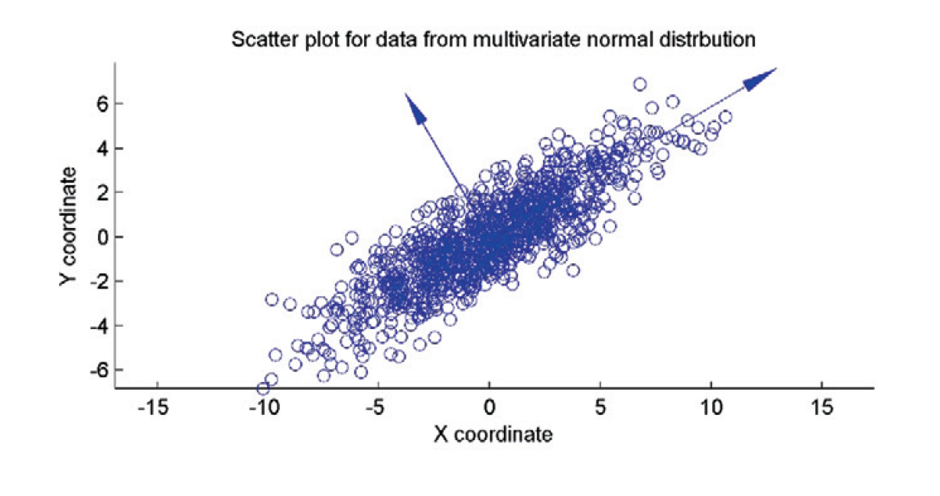
Principal Component Analysis
Michael W. Mahoney, Petros Drineas. "CUR matrix decompositions for improved data analysis." Proceedings of the National Academy of Sciences Jan 2009, 106 (3) 697-702

Slide 10
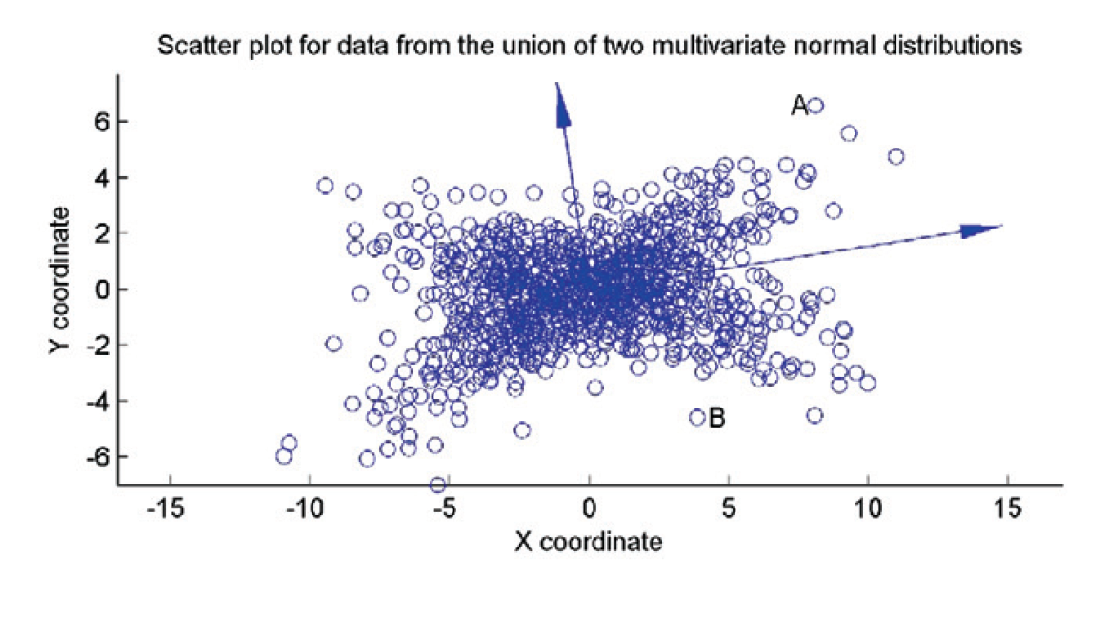
Principal Component Analysis
Michael W. Mahoney, Petros Drineas. "CUR matrix decompositions for improved data analysis." Proceedings of the National Academy of Sciences Jan 2009, 106 (3) 697-702

Slide 11
More General Decompositions
The problem with PCA: it describes the columns of the mean adjusted data matrix in terms of generic vectors
These vectors don't have any physical meaning as they simply correspond to directions along which the data has large variance
In practice, we might prefer decompositions that are more "interpretable"
Given $A∈ℝ^{m×n}$, compute an approximation $A≈CU$ for some matrix $C∈ℝ^{m×k}$ and $U∈ℝ^{k×n}$ where the columns of $C$ are chosen from the columns of $A$

Slide 12
More General Decompositions
Given $A∈ℝ^{m×n}$, compute an approximation $A≈CU$ for some matrix $C∈ℝ^{m×k}$ and $U∈ℝ^{k×n}$ where the columns of $C$ are chosen from the columns of $A$
If the matrix $U$ is unconstrained, that is it can be picked arbitrarily, then what is the $U$ that minimizes ${\left\|A−CU\right\|}_{2}^{2}$ for some fixed $C$?

Slide 13
CU Decompositions
Use top-$k$ singularvectors/singularvalues to weight each column of the matrix $A$
Recall that $b^{th}$ column of $A≈\sum_{i=1}^{k}{σ_{i}v_{b}^{\left(i\right)}u^{(i)}}$
Compute $π_{b}=\frac{1}{k}\sum_{i=1}^{k}{{\left(v_{b}^{\left(i\right)}\right)}^{2}}$
These define a probability distribution over the columns of $A$ because the eigenvectors are orthonormal
Think of $π_{b}$ as the importance of column $b$ for the low rank approximation

Slide 14
CU Decompositions
Fix $k∈\left\{1,…,n\right\}, ε>0,c=O\left(\frac{k}{ε^{2}}\log{k}\right)$
The algorithm:
Compute $π$ using the top-$k$ singularvectors/singularvalues from the SVD of $A$
For $b=1,…,n$
Generate a random $r∈[0,1]$
If $r<\min{(1,cπ_{b})}$, keep the $b^{th}$ column of $A$
Return the matrix $C$ consisting of the selected columns of $A$

Slide 15
CU Decompositions
Theorem[Mahoney & Drineas, 2009]: with probability at least 99%, the previous choice of columns satisfies
$${\left\|A−CC^{+}A\right\|}_{F}≤(2+ε){\left\|A−\sum_{i=1}^{k}{σ_{i}u^{(i)}v^{{\left(i\right)}^{T}}}\right\|}_{F}$$
More recent work has reduced the number of columns that you need to pick as well as the time complexity of finding a good CU decomposition

Slide 16
CUR Decompositions
Given $A∈ℝ^{m×n}$, compute an approximation $A≈CUR$ for some matrix $C∈ℝ^{m×k},$ $U∈ℝ^{k×k}, R∈ℝ^{k×n}$ where the columns of $C$ are chosen from the columns of $A$ and the rows of $R$ are chosen from the rows of $A$
Can apply a similar sampling strategy to find an approximately good decomposition of this form

Slide 17
Approximate Convex Hulls
Given $A∈ℝ^{m×n}$, compute an approximation $A≈CU$ for some matrix $C∈ℝ^{m×k}$ and $U∈ℝ^{k×n}$ where the columns of $C$ are chosen from the columns of $A$ and the columns of $U$ are nonnegative and sum to one
Finding a decomposition of this form that minimizes the Frobenius norm is equivalent to approximating the columns of $A$ with by the convex hull of the columns of $C$!
What would be the restriction on $U$ if we wanted conic hulls instead?

Slide 18
Approximate Conic Hulls
Given $A∈ℝ^{m×n}$, compute an approximation $A≈CU$ for some matrix $C∈ℝ^{m×k}$ and $U∈ℝ^{k×n}$ where the columns of $C$ are chosen from the columns of $A$ and the columns of $U$ are nonnegative
Finding a decomposition of this form that minimizes the Frobenius norm is equivalent to approximating the columns of $A$ with by the conic hull of the columns of $C$!

Slide 19
Nonnegative Matrix Factorization
Given $A∈ℝ^{m×n}$, compute an approximation $A≈CU$ for some matrix $C∈ℝ^{m×k}$ and $U∈ℝ^{k×n}$ where $C$ and $U$ are nonnegative matrices
$$\min_{C∈ℝ^{m×k}\text{,} U∈ℝ^{k×n}}{{\left\|A−CU\right\|}_{F}^{2}}$$
subject to
$$C≥0$$
$$U≥0$$
Is this a convex optimization problem?

Slide 20
Nonnegative Matrix Factorization
Given $A∈ℝ^{m×n}$, compute an approximation $A≈CU$ for some matrix $C∈ℝ^{m×k}$ and $U∈ℝ^{k×n}$ where $C$ and $U$ are nonnegative matrices
$$\min_{C∈ℝ^{m×k}\text{,} U∈ℝ^{k×n}}{{\left\|A−CU\right\|}_{F}^{2}}$$
subject to
$$C≥0$$
$$U≥0$$
No. This is an example of what is called a biconvex optimization problem

Slide 21
Biconvex Functions
A function $f:ℝ^{m}×ℝ^{n}→ℝ$ is biconvex if $f(⋅,y)$ is a convex function for each fixed $y∈ℝ^{n}$ and $f(x,⋅)$ is a convex function for each fixed $x∈ℝ^{m}$
These kinds of functions arise frequently in application domains
They are nonconvex in general, so applying gradient descent does not necessarily result in convergence to a global minimum

Slide 22
Block Coordinate Descent
Main idea: exploit the fact that $f$ is convex in each block of variables to try to find local optima
Pick an initial $x^{\left(0\right)},y^{(0)}$
Repeat until convergence
Choose $x^{(t+1)}∈\arg{\min_{x}{f(x,y^{\left(t\right)})}}$
Choose $y^{(t+1)}∈\arg{\min_{y}{f(x^{(t+1)},y)}}$
If $f$ is differentiable, this procedure must converge to a critical point – why?

Slide 23
Block Coordinate Descent
Main idea: exploit the fact that $f$ is convex in each block of variables to try to find local optima
Pick an initial $x^{\left(0\right)},y^{(0)}$
Repeat until convergence
Choose $x^{(t+1)}∈\arg{\min_{x}{f(x,y^{\left(t\right)})}}$
Choose $y^{(t+1)}∈\arg{\min_{y}{f(x^{(t+1)},y)}}$
What happens if $f$ isn’t differentiable?

Slide 24
Block Coordinate Descent
src: wikipedia

Slide 25
Block Coordinate Descent
$$x=4$$
$$y=4$$
Coordinate descent cannot make progress without changing both x and y
src: wikipedia

Slide 26
Nonnegative Matrix Factorization
$$\min_{C∈ℝ^{m×k}\text{,} U∈ℝ^{k×n}}{{\left\|A−CU\right\|}_{F}^{2}}$$
subject to
$$C≥0$$
$$U≥0$$
If $U$ is fixed, we get
$$\min_{C∈ℝ^{m×k}}{{\left\|A−CU\right\|}_{F}^{2}}$$
subject to
$$C≥0$$
This is a convex optimization problem!

Slide 27
Nonnegative Matrix Factorization
$$\min_{C∈ℝ^{m×k}}{{\left\|A−CU\right\|}_{F}^{2}}$$
subject to
$$C≥0$$

Slide 28
Matrix Completion
Matrix factorization can also be used for matrix completion problems
Given a matrix $M$, which need not be completely specified, find a completion of $M$ that has certain properties
E.g., complete $M$ to a positive definite matrix
E.g., low rank approximations

Slide 29
Matrix Completion
[from slides of Alex Smola]

Slide 30
Matrix Completion
[from slides of Alex Smola]

Slide 31
Matrix Factorization
[from slides of Alex Smola]

Slide 32
Matrix Completion
We can express finding the “closest” low-rank matrix product as an optimization problem
$$\min_{C∈ℝ^{m×k}\text{,} U∈ℝ^{k×n}}{\sum_{\left(i,j\right):A_{ij}≠?}{{\left(A_{ij}−{\left(CU\right)}_{ij}\right)}^{2}}}$$
This is the square of the Frobenius norm for the entries of $A$ that are given

Slide 33
Matrix Completion
We can express finding the “closest” matrix as an optimization problem
$$\min_{C∈ℝ^{m×k}\text{,} U∈ℝ^{k×n}}\left[\sum_{\left(i,j\right):A_{ij}≠?}{{\left(A_{ij}−{\left(CU\right)}_{ij}\right)}^{2}}\right]+λ\left({\left\|C\right\|}_{F}^{2}+{\left\|U\right\|}_{F}^{2}\right)$$
The term at the end is a called a regularizer and is often used in ML applications to encourage more well-behaved solutions

Slide 34
Matrix Completion
We can express finding the “closest” matrix as an optimization problem
$$\min_{C∈ℝ^{m×k}\text{,} U∈ℝ^{k×n}}\left[\sum_{\left(i,j\right):A_{ij}≠?}{{\left(A_{ij}−{\left(CU\right)}_{ij}\right)}^{2}}\right]+λ\left({\left\|C\right\|}_{F}^{2}+{\left\|U\right\|}_{F}^{2}\right)$$
This is a non-convex problem: how to (approximately) solve it?

Slide 35
Matrix Completion
We can express finding the “closest” matrix as an optimization problem
$$\min_{C∈ℝ^{m×k}\text{,} U∈ℝ^{k×n}}\left[\sum_{\left(i,j\right):A_{ij}≠?}{{\left(A_{ij}−{\left(CU\right)}_{ij}\right)}^{2}}\right]+λ\left({\left\|C\right\|}_{F}^{2}+{\left\|U\right\|}_{F}^{2}\right)$$
How would you (approximately) solve it if $m$ and $n$ are large?

