Slide 1
Alternating Projections
Nicholas Ruozzi
University of Texas at Dallas

Slide 2
Motivation
When picking an initial point for a descent method we need to find one that satisfies the constraints
If the constraints are linear, we could use an existing LP solver – how?
Is there any way to find a point that satisfies more complicated constraints?

Slide 3
Intersections of Convex Sets
Recall that the intersection of convex sets is convex (we’ve been implicitly using this in our convex optimization problems when we combine constraints)
Problem of interest: given two convex sets with a non-empty intersection, can we find a point that is in both of them?
$$x$$

Slide 4

Alternating Projection
Given two convex sets $C$ and $D$
Pick an initial $x^{(0)}$
For $t=1,2,…$
$y^{(t)}=Proj_{C}(x^{\left(t\right)})$
$x^{(t+1)}=Proj_{D}(y^{\left(t\right)})$

Slide 5
Alternating Projection
Given two convex sets $C$ and $D$
Pick an initial $x^{(0)}$
For $t=1,2,…$
$y^{(t)}=Proj_{C}(x^{\left(t\right)})$
$x^{(t+1)}=Proj_{D}(y^{\left(t\right)})$
Note: there does not necessarily exist a finite $t$ such that $x^{(t)}∈C∩D$

Slide 6
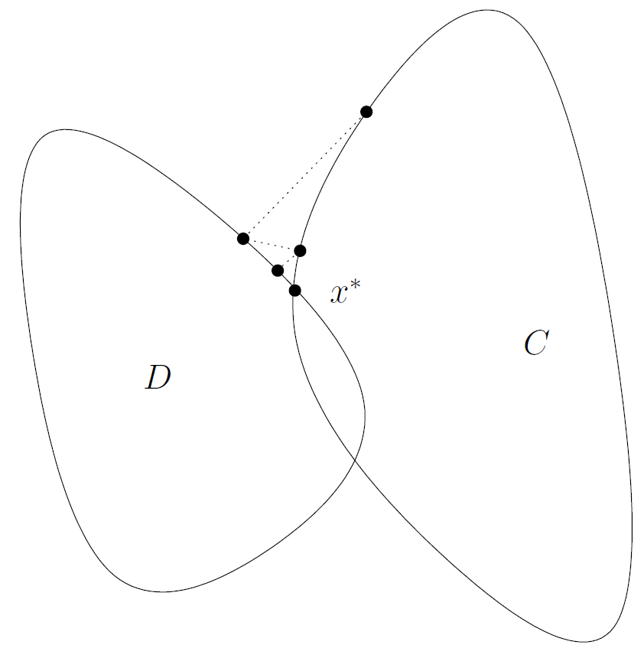
Alternating Projection
$$x^{(0)}$$
$$x^{(1)}$$
$$y^{(0)}$$
$$y^{(1)}$$
image: Stephen Boyd and Jon Dattorro lecture notes

Slide 7
General Alternating Projection
Given convex sets $C_{1},…,C_{k}$
Pick an initial $x^{(0)}$
For $t=1,2,…$
Select an integer $s∈\{1,…,k\}$
$x^{(t+1)}=Proj_{C_{s}}(x^{\left(t\right)})$
Selection can be round-robin or at random

Slide 8

Projection Onto Linear Constraints
$$Ax≤b$$
What is the projection onto each of the constraints?

Slide 9
Doubly Stochastic Matrices
Suppose that we wanted to project onto the set of $n×n$ doubly stochastic matrices, i.e., nonnegative matrices whose row and column sums are equal to one
$$A≥0$$
$$∀i,\sum_{j=1}^{n}{A_{ij}}=1$$
$$∀j,\sum_{i=1}^{n}{A_{ij}}=1$$
What is the projection onto each of the constraints?

Slide 10

Projection Onto DSMs
$$\min_{x∈ℝ^{n}}{{\left\|q−x\right\|}_{2}^{2}}$$
such that
$$\sum_{i}{x_{i}}=1$$

Slide 11

Projection onto SDP Constraints
$$A≽0$$
For $i=1,…,k, trace\left(AC^{(i)}\right)=b_{i}$
What is the projection onto each of the constraints?

