Slide 1
Proximal Gradient Descent
Nicholas Ruozzi
University of Texas at Dallas

Slide 2
Gradient Descent
Method to find local optima of differentiable a function $f$
Intuition: gradient tells us direction of greatest increase, negative gradient gives us direction of greatest decrease
Take steps in directions that reduce the function value
Definition of derivative guarantees that if we take a small enough step in the direction of the negative gradient, the function will decrease in value
How small is small enough?

Slide 3
Gradient Descent
Gradient Descent Algorithm for a differentiable function $f$:
Pick an initial point $x_{0}$
Iterate until convergence
$$x_{t+1}=x_{t}−γ_{t}∇f(x_{t})$$
where $γ_{t}$ is the $t^{th}$ step size (sometimes called learning rate)

Slide 4
Gradient Descent
Gradient Descent Algorithm:
Pick an initial point $x_{0}$
Iterate until convergence
$$x_{t+1}=x_{t}−γ_{t}∇f(x_{t})$$
where $γ_{t}$ is the $t^{th}$ step size (sometimes called learning rate)
When do we stop?

Slide 5
Gradient Descent
Gradient Descent Algorithm:
Pick an initial point $x_{0}$
Iterate until convergence
$$x_{t+1}=x_{t}−γ_{t}∇f(x_{t})$$
where $γ_{t}$ is the $t^{th}$ step size (sometimes called learning rate)
Iterate until $\left\|∇f(x_{t})\right\|≤ε$ for some $ε>0$

Slide 6
Gradient Descent
Later in the course, we saw second order methods
Note, however, that the gradient descent update
$$x^{(t+1)}=x^{(t)}−γ∇f(x^{(t)})$$
is equivalent to
$$x^{(t+1)}∈\arg{\min_{x}\left[f\left(x^{(t)}\right)+∇f{\left(x^{\left(t\right)}\right)}^{T}\left(x−x^{\left(t\right)}\right)+\frac{1}{2γ}{\left\|x−x^{\left(t\right)}\right\|}_{2}^{2}\right]}$$
This actually corresponds to a quadratic approximation around $x^{(t)}$!

Slide 7
Non-differentiable Objectives
Can apply a similar strategy even when the convex function to be minimized is of the form $f\left(x\right)+h(x)$, where $f$ is differentiable but $h$ can be non-differentiable
Key idea: use the derivative information as before, but add $h$ in the minimum
$$f\left(x^{\left(t\right)}\right)+∇f{\left(x^{\left(t\right)}\right)}^{T}\left(x−x^{\left(t\right)}\right)+\frac{1}{2γ}{\left\|x−x^{\left(t\right)}\right\|}_{2}^{2}+h\left(x\right)$$
$$=∇f{\left(x^{\left(t\right)}\right)}^{T}\left(x−x^{\left(t\right)}\right)+\frac{1}{2γ}{\left(x−x^{\left(t\right)}\right)}^{T}\left(x−x^{\left(t\right)}\right)+\frac{γ}{2}∇f{\left(x^{\left(t\right)}\right)}^{T}∇f\left(x^{(t)}\right)+h(x)$$
$$=\frac{1}{2γ}{\left\|x−\left(x^{(t)}−γ∇f\left(x^{(t)}\right)\right)\right\|}_{2}^{2}+h(x)$$

Slide 8
Non-differentiable Objectives
Can apply a similar strategy even when the convex function to be minimized is of the form $f\left(x\right)+h(x)$, where $f$ is differentiable but $h$ can be non-differentiable
Key idea: use the derivative information as before, but add $h$ in the minimum
$$\arg{\min_{x}\left[\frac{1}{2γ}{\left\|x−\left(x^{(t)}−γ∇f\left(x^{(t)}\right)\right)\right\|}_{2}^{2}+h(x) \right]}$$

Slide 9
Proximal Gradient Descent
Define the “prox” operator as
$$prox_{γ}\left(x\right)=\arg{\min_{z}\left[\frac{1}{2γ}{\left\|z−x\right\|}_{2}^{2}+h(z) \right]}$$
Proximal gradient descent:
$$x^{(t+1)}=prox_{γ}\left(x^{(t)}−γ∇f\left(x^{\left(t\right)}\right)\right)$$
Guaranteed to converge to a global minimum for convex $f$ and $h$
Like projected gradient and Frank-Wolfe, the efficacy of this approach depends on how easy it is to compute the optimization in the prox operator

Slide 10
Proximal Gradient Descent
$$prox_{γ}\left(x\right)=\arg{\min_{z}\left[\frac{1}{2γ}{\left\|z−x\right\|}_{2}^{2}+h(z) \right]}$$
If $h$ is differentiable, solve for $z$:
$$\frac{1}{ γ}\left(z−x\right)+∇h\left(z\right)=0$$
Same is true for non-differentiable $h$ where the gradient is replaced with subgradients, i.e., zero must be in the subgradient

Slide 11
Differentiable $h$
$$h\left(z\right)=\frac{λ}{2}{\left\|z\right\|}_{2}^{2}$$
Gradient of $\frac{1}{2γ}{\left\|z−x\right\|}_{2}^{2}+h(z)$ is then
$$\frac{1}{γ}\left(z−x\right)+λz$$
So, we need $z=\frac{x}{\frac{1}{γ}+λ}$
$$x^{(t+1)}=\frac{x^{(t)}−γ∇f\left(x^{\left(t\right)}\right)}{\frac{1}{γ}+λ}$$

Slide 12
Differentiable $h$
$$h\left(z\right)=\frac{λ}{2}{\left\|z\right\|}_{2}^{2}$$
Gradient of $\frac{1}{2γ}{\left\|z−x\right\|}_{2}^{2}+h(z)$ is then
$$\frac{1}{γ}\left(z−x\right)+λz$$
So, we need $z=\frac{x}{\frac{1}{γ}+λ}$
$$x^{(t+1)}=\frac{x^{(t)}−γ∇f\left(x^{\left(t\right)}\right)}{\frac{1}{γ}+λ} vs.x^{(t)}−γ∇f\left(x^{\left(t\right)}\right)−γλx^{(t)}$$

Slide 13
$l_{1}$ Norms
$$h\left(z\right)=λ{\left\|z\right\|}_{1}$$
Set of subgradients of $\frac{1}{2γ}{\left\|z−x\right\|}_{2}^{2}+h(z)$ are then
$$\frac{1}{γ}\left(z−x\right)+λd$$
where $d_{i}=\left\{\begin{aligned}\begin{matrix}1 & if z_{i}>0\end{matrix} \\ \begin{matrix}−1 & if{ z}_{i}<0 \end{matrix} \\ \begin{matrix}∈[−1,1] & otherwise \end{matrix}\end{aligned}\right.$

Slide 14
$l_{1}$ Norms
$$h\left(z\right)=λ{\left\|z\right\|}_{1}$$
Set of subgradients of $\frac{1}{2γ}{\left\|z−x\right\|}_{2}^{2}+h(z)$ are then
$$\frac{1}{γ}\left(z−x\right)+λd$$
where $d_{i}=\left\{\begin{aligned}\begin{matrix}1 & if z_{i}>0\end{matrix} \\ \begin{matrix}−1 & if{ z}_{i}<0 \end{matrix} \\ \begin{matrix}∈[−1,1] & otherwise \end{matrix}\end{aligned}\right.$
So, at an optimum, we need $z_{i}=x_{i}−γλd_{i}$
$$z_{i}=\left\{\begin{aligned}\begin{matrix}x_{i}−γλ & if x_{i}>γλ \end{matrix} \\ \begin{matrix}0 & if−γλ≤{ x}_{i}≤γλ\end{matrix} \\ \begin{matrix}x_{i}+γλ & if x_{i}<−γλ\end{matrix} \end{aligned}\right.$$

Slide 15
Some Examples
$$prox_{γ}(x)=\left\{\begin{aligned}\begin{matrix}x_{i}−γλ & if x_{i}>γλ \end{matrix} \\ \begin{matrix}0 & if−γλ≤{ x}_{i}≤γλ\end{matrix} \\ \begin{matrix}x_{i}+γλ & if x_{i}<−γλ\end{matrix} \end{aligned}\right.$$
For example, $f\left(w,b\right)=\sum_{m=1}^{M}{{\left(y^{\left(m\right)}−w^{T}x−b\right)}^{2}}$, $h\left(w\right)=λ{\left\|w\right\|}_{1}$
Corresponds to $l_{1}$ penalized regression (called LASSO)
Compare:
$prox_{γ}\left(w^{\left(t\right)}−γ∇f\left(w^{\left(t\right)}\right)\right)$
$w^{(t)}−γ\left(∇f\left(w^{\left(t\right)}\right)+λ⋅sign(w)\right)$

Slide 16
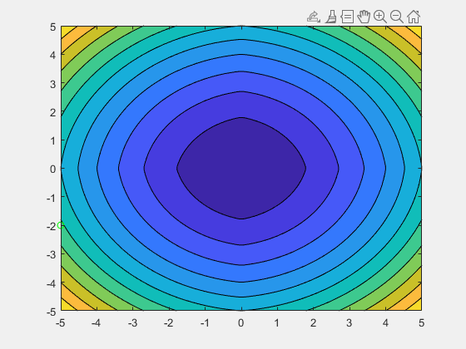
Subgradient Descent
$$f\left(x\right)=x_{1}^{2}+x_{2}^{2}, h\left(x\right)=\left|x_{1}\right|+|x_{2}|$$
$$x^{(t)}−γ_{t}\left(∇f\left(x^{\left(t\right)}\right)+λ⋅sign(x)\right)$$
$$γ_{t}=\frac{2}{2+t}$$

Slide 17
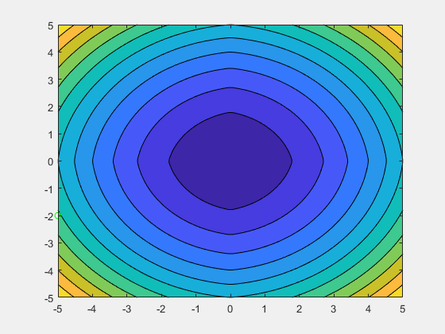
Proximal Gradient
$$f\left(x\right)=x_{1}^{2}+x_{2}^{2}, h\left(x\right)=\left|x_{1}\right|+|x_{2}|$$
$$prox_{γ}\left(x^{\left(t\right)}−γ∇f\left(x^{\left(t\right)}\right)\right)$$
$$γ=.1$$

Slide 18
Proximal Gradient Descent
Gradient descent is a special case of proximal gradient descent with $h\left(x\right)=0$
$$prox_{γ}\left(x\right)=\arg{\min_{z}\left[\frac{1}{2γ}{\left\|z−x\right\|}_{2}^{2}\right]}$$
$$=x$$
Proximal gradient descent:
$$x^{(t+1)}=prox_{γ}\left(x^{(t)}−γ∇f\left(x^{\left(t\right)}\right)\right)$$
$$=x^{(t)}−γ∇f\left(x^{\left(t\right)}\right)$$

Slide 19
Proximal Gradient Descent
Projected gradient descent is a special case of proximal gradient descent with $h\left(x\right)={ind}_{C}$ the indicator of the convex set $C$ ($=0$ if $x∈C$, $=∞$ otherwise)
$$prox_{γ}\left(x\right)=\arg{\min_{z}\left[\frac{1}{2γ}{\left\|z−x\right\|}_{2}^{2}+1_{C}(z) \right]}$$
$$=\arg{\min_{z∈C}\left[{\left\|z−x\right\|}_{2}^{2}\right]}$$
Proximal gradient descent:
$$x^{(t+1)}=prox_{γ}\left(x^{(t)}−γ∇f\left(x^{\left(t\right)}\right)\right)$$
$$=proj_{C}\left(x^{(t)}−γ∇f\left(x^{\left(t\right)}\right)\right)$$

