Slide 1
Convergence of Gradient Methods
Nicholas Ruozzi
University of Texas at Dallas

Slide 2
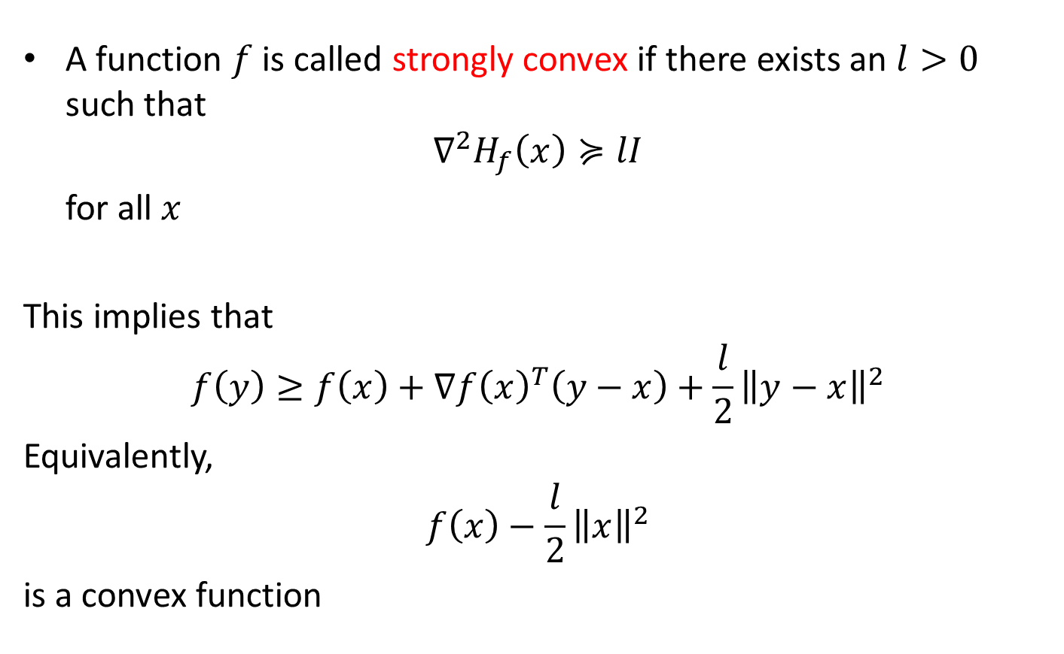
Strong Convexity
A function $f$ is called strongly convex if there exists an $l>0$ such that
$$∇^{2}H_{f}\left(x\right)≽lI$$
for all $x$
This implies that
$$f\left(y\right)≥f\left(x\right)+∇f{\left(x\right)}^{T}\left(y−x\right)+\frac{l}{2}{\left\|y−x\right\|}^{2}$$
Equivalently,
$$f\left(x\right)−\frac{l}{2}{\left\|x\right\|}^{2}$$
is a convex function

Slide 3

Implications of Strong Convexity
Let $p^{∗}=\inf_{x}{f\left(x\right)}$
For any $x,y$
$$f\left(y\right)≥f\left(x\right)+∇f{\left(x\right)}^{T}\left(y−x\right)+\frac{l}{2}{\left\|y−x\right\|}^{2}$$
$$≥f\left(x\right)+∇f{\left(x\right)}^{T}\left(\hat{y}−x\right)+\frac{l}{2}{\left\|\hat{y}−x\right\|}^{2}$$
where $\hat{y}=x−\frac{∇f\left(x\right)}{l}$

Slide 4

Implications of Strong Convexity
Let $p^{∗}=\inf_{x}{f\left(x\right)}$
For any $x,y$
$$f\left(y\right)≥f\left(x\right)+∇f{\left(x\right)}^{T}\left(y−x\right)+\frac{l}{2}{\left\|y−x\right\|}^{2}$$
$$≥f\left(x\right)+∇f{\left(x\right)}^{T}\left(\hat{y}−x\right)+\frac{l}{2}{\left\|\hat{y}−x\right\|}^{2}$$
$$=f\left(x\right)−∇f{\left(x\right)}^{T}∇f\left(x\right)\frac{1}{l}+\frac{1}{2l}∇f{\left(x\right)}^{T}∇f\left(x\right)$$

Slide 5

Implications of Strong Convexity
Let $p^{∗}=\inf_{x}{f\left(x\right)}$
For any $x,y$
$$f\left(y\right)≥f\left(x\right)+∇f{\left(x\right)}^{T}\left(y−x\right)+\frac{l}{2}{\left\|y−x\right\|}^{2}$$
$$≥f\left(x\right)+∇f{\left(x\right)}^{T}\left(\hat{y}−x\right)+\frac{l}{2}{\left\|\hat{y}−x\right\|}^{2}$$
$$=f\left(x\right)−\frac{1}{2l}∇f{\left(x\right)}^{T}∇f\left(x\right)$$

Slide 6

Implications of Strong Convexity
Let $p^{∗}=\inf_{x}{f\left(x\right)}$
For any $x,y$
$$f\left(y\right)≥f\left(x\right)+∇f{\left(x\right)}^{T}\left(y−x\right)+\frac{l}{2}{\left\|y−x\right\|}^{2}$$
$$≥f\left(x\right)+∇f{\left(x\right)}^{T}\left(\hat{y}−x\right)+\frac{l}{2}{\left\|\hat{y}−x\right\|}^{2}$$
$$=f\left(x\right)−\frac{1}{2l}∇f{\left(x\right)}^{T}∇f\left(x\right)$$
$$p^{∗}≥f\left(x\right)−\frac{1}{2l}∇f{\left(x\right)}^{T}∇f\left(x\right)$$

Slide 7
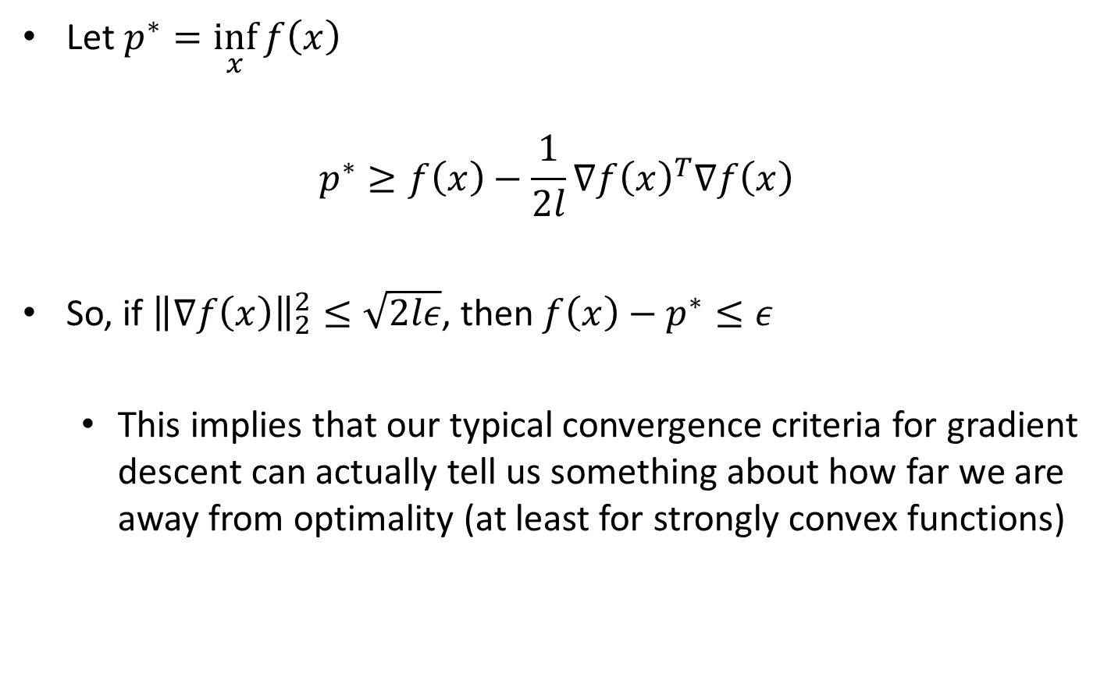
Implications of Strong Convexity
Let $p^{∗}=\inf_{x}{f\left(x\right)}$
$$p^{∗}≥f\left(x\right)−\frac{1}{2l}∇f{\left(x\right)}^{T}∇f\left(x\right)$$
So, if ${\left\|∇f\left(x\right)\right\|}_{2}^{2}≤\sqrt{2lε}$, then $f\left(x\right)−p^{∗}≤ε$
  This implies that our typical convergence criteria for gradient descent can actually tell us something about how far we are away from optimality (at least for strongly convex functions)

Slide 8
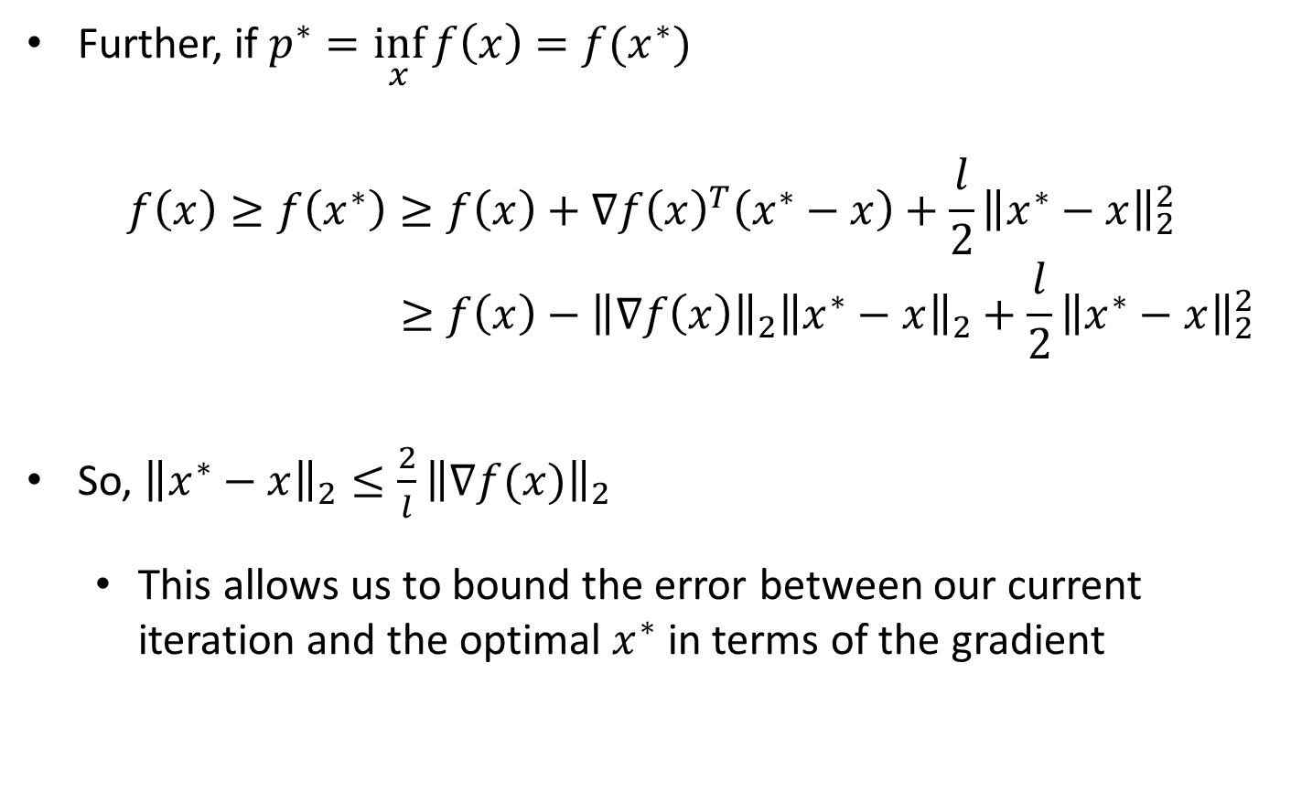
Implications of Strong Convexity
Further, if $p^{∗}=\inf_{x}{f\left(x\right)}=f(x^{∗})$
$$f\left(x\right)≥f\left(x^{∗}\right)≥f\left(x\right)+∇f{\left(x\right)}^{T}\left(x^{∗}−x\right)+\frac{l}{2}{\left\|x^{∗}−x\right\|}_{2}^{2}$$
$$≥f\left(x\right)−{\left\|∇f\left(x\right)\right\|}_{2}{\left\|x^{∗}−x\right\|}_{2}+\frac{l}{2}{\left\|x^{∗}−x\right\|}_{2}^{2}$$
So, ${\left\|x^{∗}−x\right\|}_{2}≤{\frac{2}{l}\left\|∇f(x)\right\|}_{2}$
  This allows us to bound the error between our current iteration and the optimal $x^{∗}$ in terms of the gradient

Slide 9
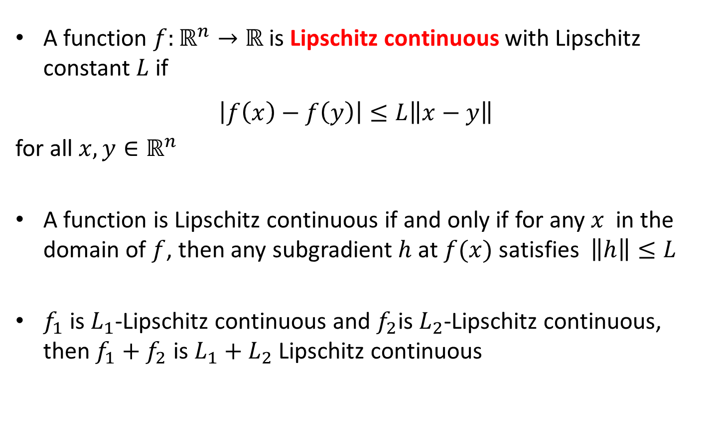
Lipschitz Continuity
A function $f:ℝ^{n}→ℝ$ is Lipschitz continuous with Lipschitz constant $L$ if
$$\left|f\left(x\right)−f\left(y\right)\right|≤L\left\|x−y\right\|$$
for all $x,y∈ℝ^{n}$
A function is Lipschitz continuous if and only if for any $x$ in the domain of $f$, then any subgradient $h$ at $f(x)$ satisfies $\left\|h\right\|≤L$
$f_{1}$ is $L_{1}$-Lipschitz continuous and $f_{2}$is $L_{2}$-Lipschitz continuous, then $f_{1}+f_{2}$ is $L_{1}+L_{2}$ Lipschitz continuous

Slide 10

Smooth Functions
A function is called smooth if its gradient is Lipschitz continuous
$$\left\|∇f\left(x\right)−∇f(y)\right\|≤L\left\|x−y\right\|$$
for all $x,y$
$$∇^{2}H_{f}\left(x\right)≼ LI$$

Slide 11
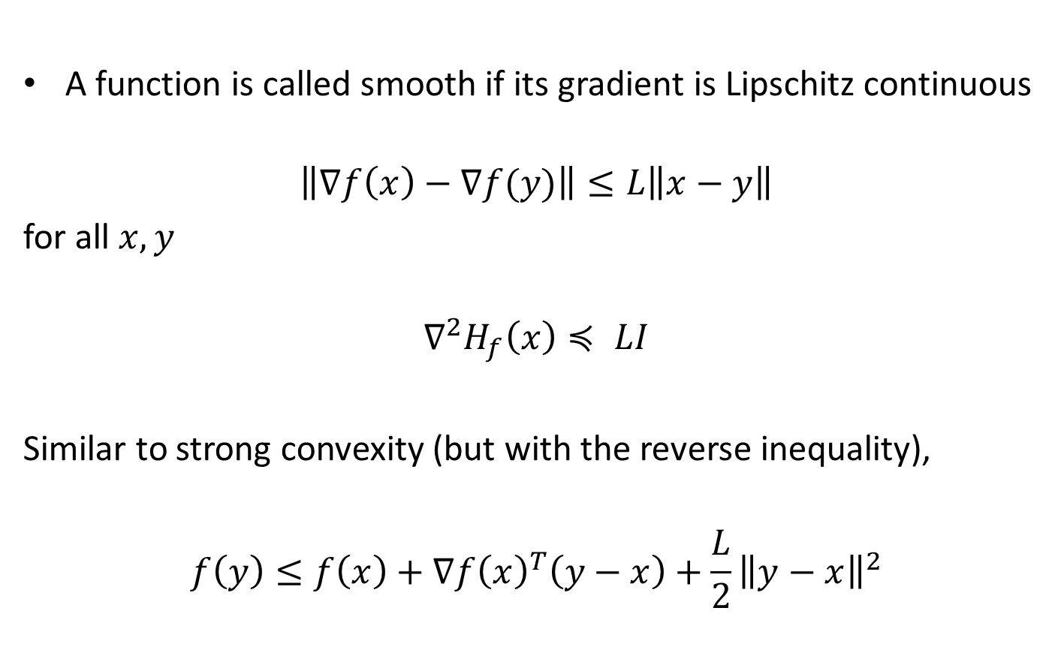
Smooth Functions
A function is called smooth if its gradient is Lipschitz continuous
$$\left\|∇f\left(x\right)−∇f(y)\right\|≤L\left\|x−y\right\|$$
for all $x,y$
$$∇^{2}H_{f}\left(x\right)≼ LI$$
Similar to strong convexity (but with the reverse inequality),
$$f\left(y\right)≤f\left(x\right)+∇f{\left(x\right)}^{T}\left(y−x\right)+\frac{L}{2}{\left\|y−x\right\|}^{2}$$

Slide 12
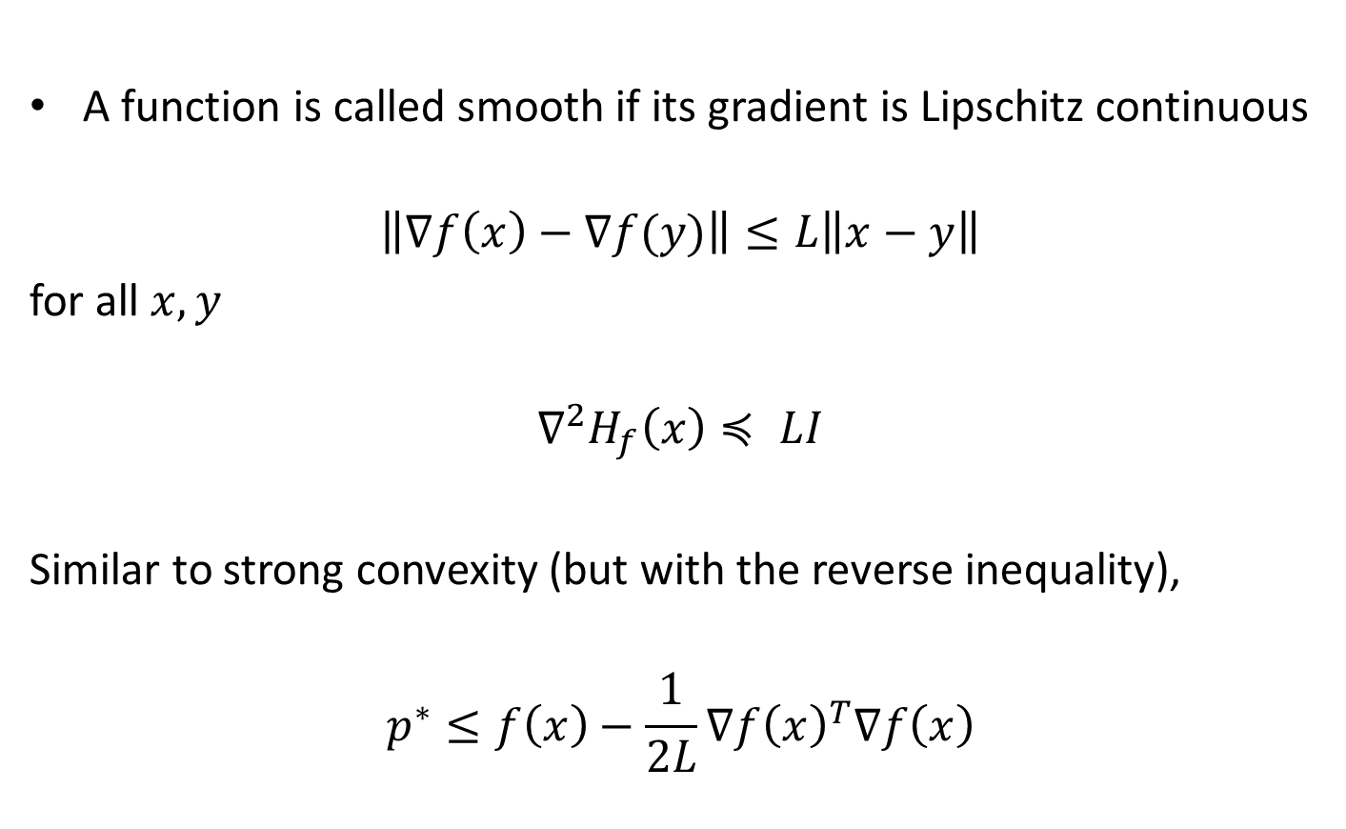
Smooth Functions
A function is called smooth if its gradient is Lipschitz continuous
$$\left\|∇f\left(x\right)−∇f(y)\right\|≤L\left\|x−y\right\|$$
for all $x,y$
$$∇^{2}H_{f}\left(x\right)≼ LI$$
Similar to strong convexity (but with the reverse inequality),
$$p^{∗}≤f\left(x\right)−\frac{1}{2L}∇f{\left(x\right)}^{T}∇f\left(x\right)$$

Slide 13

Convergence of Gradient Descent
Theorem: If $f$ is an $L$-smooth convex function and $γ≤1/L$, then
$$f\left(x^{\left(t\right)}\right)−f\left(x^{∗}\right)≤\frac{\left\|x^{(0)}−x^{∗}\right\|}{2tγ}$$

Slide 14

Convergence of Gradient Descent
Theorem: If $f$ is an $L$-smooth convex function and $γ≤1/L$, then
$$f\left(x^{\left(t\right)}\right)−f\left(x^{∗}\right)≤\frac{\left\|x^{(0)}−x^{∗}\right\|}{2tγ}$$
First, $x^{(t+1)}=x^{(t)}−γ∇f\left(x^{\left(t\right)}\right)$, i.e., $∇f\left(x^{\left(t\right)}\right)=\frac{x^{(t)}−x^{(t+1)}}{γ}$

Slide 15
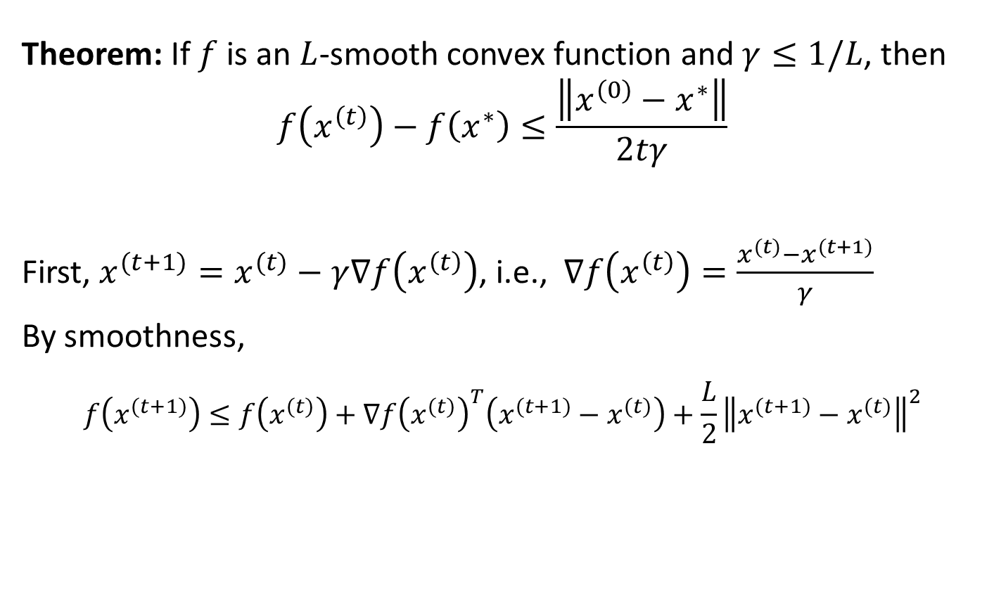
Convergence of Gradient Descent
Theorem: If $f$ is an $L$-smooth convex function and $γ≤1/L$, then
$$f\left(x^{\left(t\right)}\right)−f\left(x^{∗}\right)≤\frac{\left\|x^{(0)}−x^{∗}\right\|}{2tγ}$$
First, $x^{(t+1)}=x^{(t)}−γ∇f\left(x^{\left(t\right)}\right)$, i.e., $∇f\left(x^{\left(t\right)}\right)=\frac{x^{(t)}−x^{(t+1)}}{γ}$
By smoothness,
$$f\left(x^{(t+1)}\right)≤f\left(x^{(t)}\right)+∇f{\left(x^{(t)}\right)}^{T}\left(x^{(t+1)}−x^{(t)}\right)+\frac{L}{2}{\left\|x^{(t+1)}−x^{(t)}\right\|}^{2}$$

Slide 16
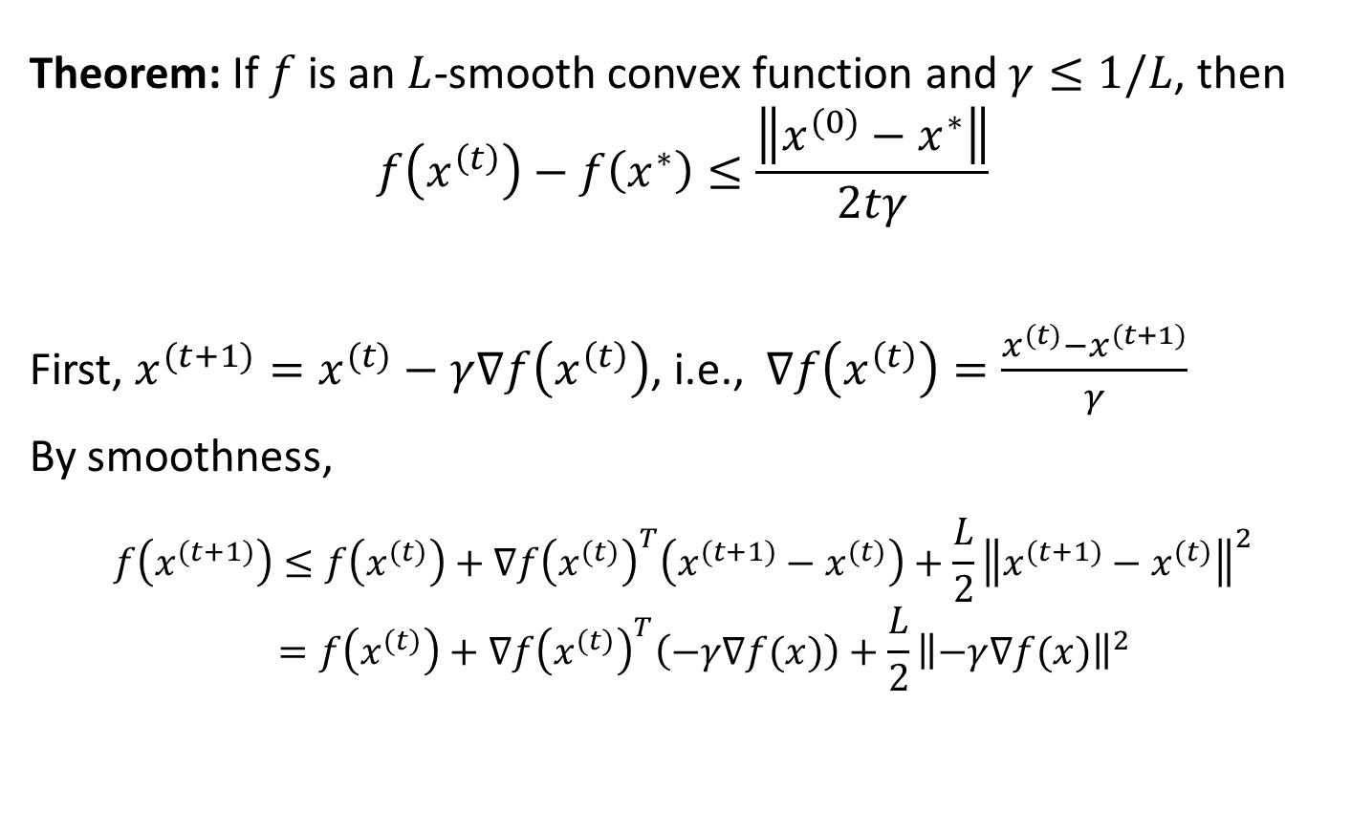
Convergence of Gradient Descent
Theorem: If $f$ is an $L$-smooth convex function and $γ≤1/L$, then
$$f\left(x^{\left(t\right)}\right)−f\left(x^{∗}\right)≤\frac{\left\|x^{(0)}−x^{∗}\right\|}{2tγ}$$
First, $x^{(t+1)}=x^{(t)}−γ∇f\left(x^{\left(t\right)}\right)$, i.e., $∇f\left(x^{\left(t\right)}\right)=\frac{x^{(t)}−x^{(t+1)}}{γ}$
By smoothness,
$$f\left(x^{(t+1)}\right)≤f\left(x^{(t)}\right)+∇f{\left(x^{(t)}\right)}^{T}\left(x^{(t+1)}−x^{(t)}\right)+\frac{L}{2}{\left\|x^{(t+1)}−x^{(t)}\right\|}^{2}$$
$$=f\left(x^{(t)}\right)+∇f{\left(x^{(t)}\right)}^{T}\left(−γ∇f(x)\right)+\frac{L}{2}{\left\|−γ∇f(x)\right\|}^{2}$$

Slide 17
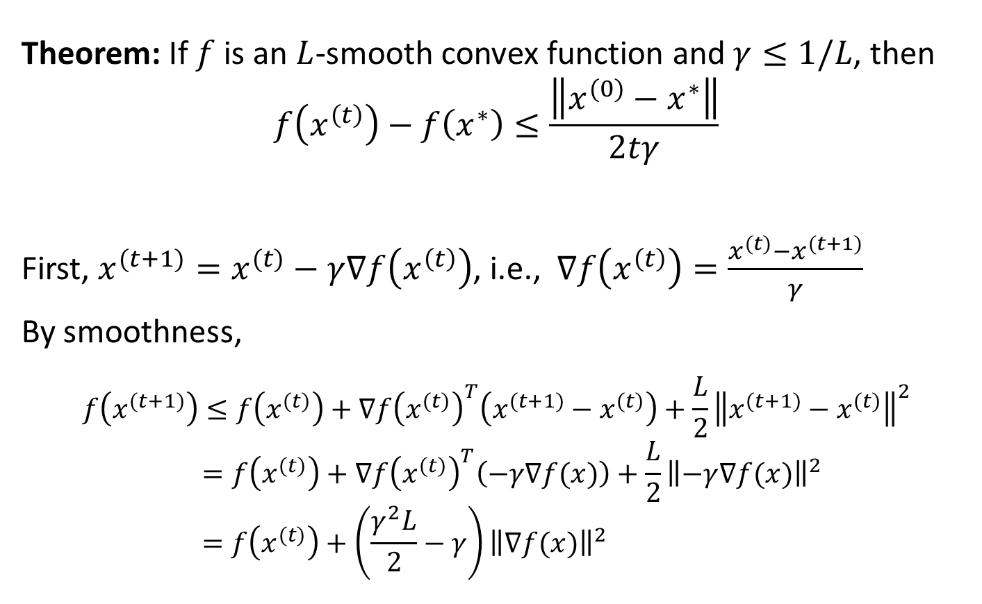
Convergence of Gradient Descent
Theorem: If $f$ is an $L$-smooth convex function and $γ≤1/L$, then
$$f\left(x^{\left(t\right)}\right)−f\left(x^{∗}\right)≤\frac{\left\|x^{(0)}−x^{∗}\right\|}{2tγ}$$
First, $x^{(t+1)}=x^{(t)}−γ∇f\left(x^{\left(t\right)}\right)$, i.e., $∇f\left(x^{\left(t\right)}\right)=\frac{x^{(t)}−x^{(t+1)}}{γ}$
By smoothness,
$$f\left(x^{(t+1)}\right)≤f\left(x^{(t)}\right)+∇f{\left(x^{(t)}\right)}^{T}\left(x^{(t+1)}−x^{(t)}\right)+\frac{L}{2}{\left\|x^{(t+1)}−x^{(t)}\right\|}^{2}$$
$$=f\left(x^{(t)}\right)+∇f{\left(x^{(t)}\right)}^{T}\left(−γ∇f(x)\right)+\frac{L}{2}{\left\|−γ∇f(x)\right\|}^{2}$$
$$=f\left(x^{(t)}\right)+\left(\frac{γ^{2}L}{2}−γ\right){\left\|∇f(x)\right\|}^{2}$$

Slide 18
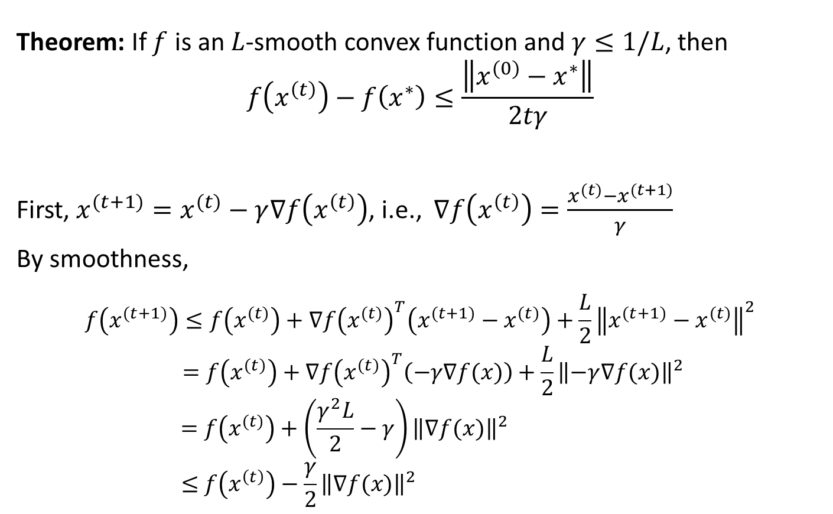
Convergence of Gradient Descent
Theorem: If $f$ is an $L$-smooth convex function and $γ≤1/L$, then
$$f\left(x^{\left(t\right)}\right)−f\left(x^{∗}\right)≤\frac{\left\|x^{(0)}−x^{∗}\right\|}{2tγ}$$
First, $x^{(t+1)}=x^{(t)}−γ∇f\left(x^{\left(t\right)}\right)$, i.e., $∇f\left(x^{\left(t\right)}\right)=\frac{x^{(t)}−x^{(t+1)}}{γ}$
By smoothness,
$$f\left(x^{(t+1)}\right)≤f\left(x^{(t)}\right)+∇f{\left(x^{(t)}\right)}^{T}\left(x^{(t+1)}−x^{(t)}\right)+\frac{L}{2}{\left\|x^{(t+1)}−x^{(t)}\right\|}^{2}$$
$$=f\left(x^{(t)}\right)+∇f{\left(x^{(t)}\right)}^{T}\left(−γ∇f(x)\right)+\frac{L}{2}{\left\|−γ∇f(x)\right\|}^{2}$$
$$=f\left(x^{(t)}\right)+\left(\frac{γ^{2}L}{2}−γ\right){\left\|∇f(x)\right\|}^{2}$$
$$≤f\left(x^{\left(t\right)}\right)−\frac{γ}{2}{\left\|∇f(x)\right\|}^{2}$$

Slide 19
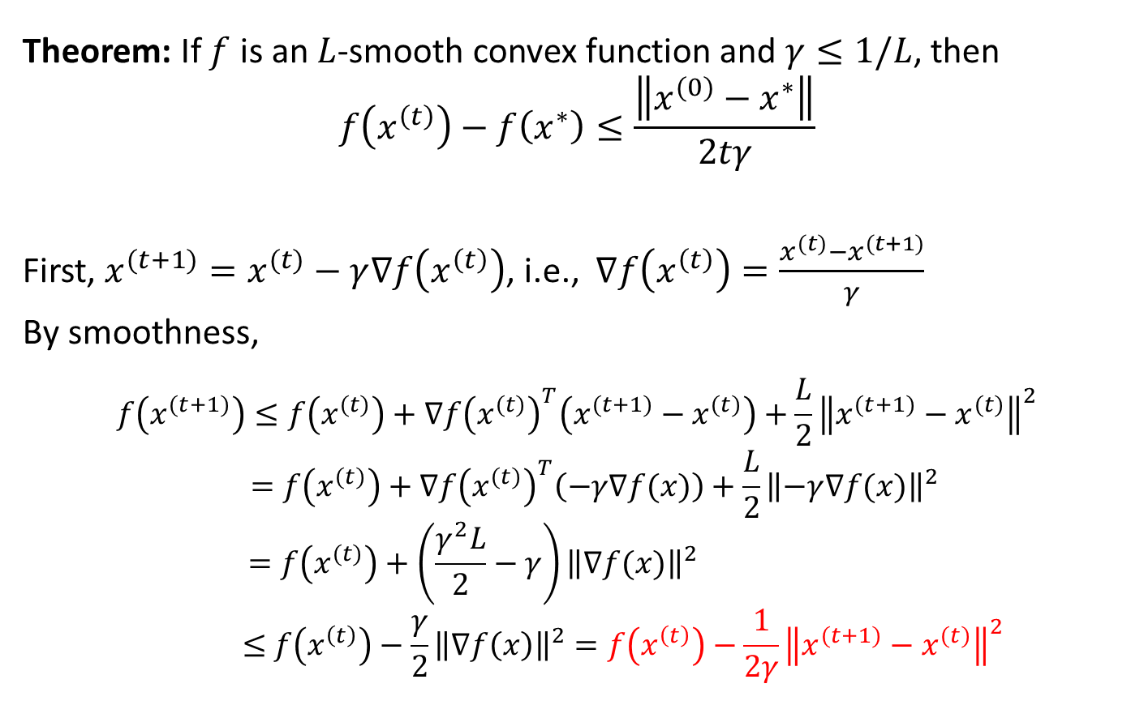
Convergence of Gradient Descent
Theorem: If $f$ is an $L$-smooth convex function and $γ≤1/L$, then
$$f\left(x^{\left(t\right)}\right)−f\left(x^{∗}\right)≤\frac{\left\|x^{(0)}−x^{∗}\right\|}{2tγ}$$
First, $x^{(t+1)}=x^{(t)}−γ∇f\left(x^{\left(t\right)}\right)$, i.e., $∇f\left(x^{\left(t\right)}\right)=\frac{x^{(t)}−x^{(t+1)}}{γ}$
By smoothness,
$$f\left(x^{(t+1)}\right)≤f\left(x^{(t)}\right)+∇f{\left(x^{(t)}\right)}^{T}\left(x^{(t+1)}−x^{(t)}\right)+\frac{L}{2}{\left\|x^{(t+1)}−x^{(t)}\right\|}^{2}$$
$$=f\left(x^{(t)}\right)+∇f{\left(x^{(t)}\right)}^{T}\left(−γ∇f(x)\right)+\frac{L}{2}{\left\|−γ∇f(x)\right\|}^{2}$$
$$=f\left(x^{(t)}\right)+\left(\frac{γ^{2}L}{2}−γ\right){\left\|∇f(x)\right\|}^{2}$$
$$≤f\left(x^{\left(t\right)}\right)−\frac{γ}{2}{\left\|∇f\left(x\right)\right\|}^{2}=f\left(x^{\left(t\right)}\right)−\frac{1}{2γ}{\left\|x^{(t+1)}−x^{(t)}\right\|}^{2}$$

Slide 20
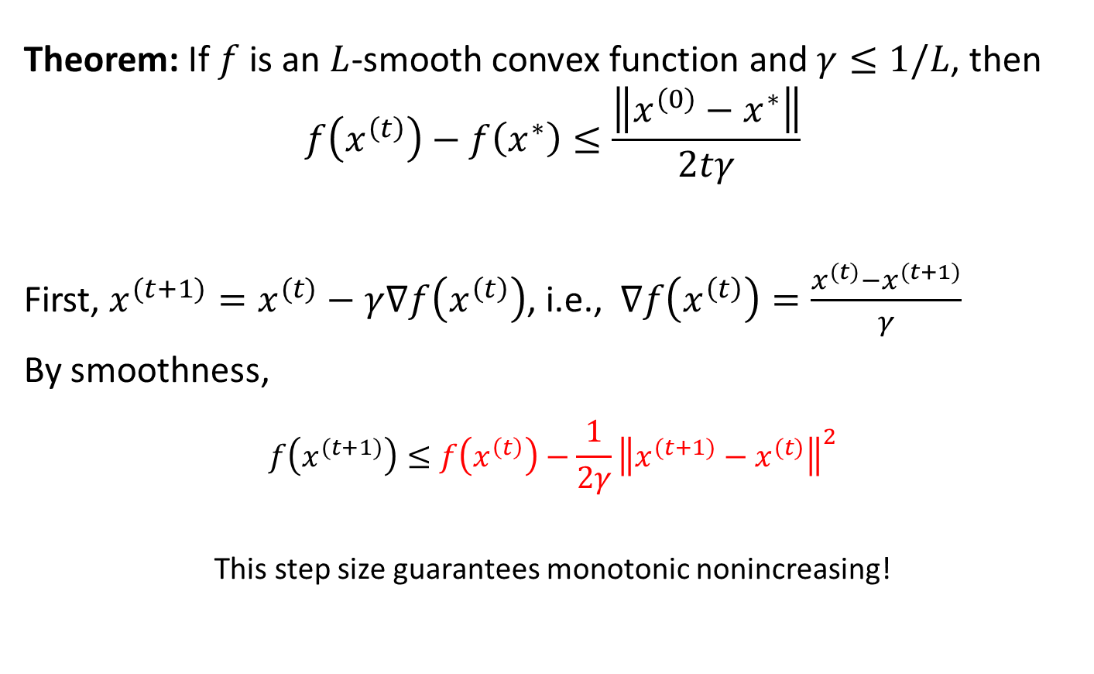
Convergence of Gradient Descent
Theorem: If $f$ is an $L$-smooth convex function and $γ≤1/L$, then
$$f\left(x^{\left(t\right)}\right)−f\left(x^{∗}\right)≤\frac{\left\|x^{(0)}−x^{∗}\right\|}{2tγ}$$
First, $x^{(t+1)}=x^{(t)}−γ∇f\left(x^{\left(t\right)}\right)$, i.e., $∇f\left(x^{\left(t\right)}\right)=\frac{x^{(t)}−x^{(t+1)}}{γ}$
By smoothness,
$$f\left(x^{(t+1)}\right)≤f\left(x^{\left(t\right)}\right)−\frac{1}{2γ}{\left\|x^{(t+1)}−x^{(t)}\right\|}^{2}$$
This step size guarantees monotonic nonincreasing!

Slide 21

Convergence of Gradient Descent
By smoothness,
$$f\left(x^{(t+1)}\right)≤f\left(x^{\left(t\right)}\right)−\frac{1}{2γ}{\left\|x^{(t+1)}−x^{(t)}\right\|}^{2}$$
By convexity,
$$f\left(x^{∗}\right)≥f\left(x\right)+∇f{\left(x\right)}^{T}(x^{∗}−x)$$
i.e.,
$$f\left(x\right)≤f\left(x^{∗}\right)+∇f{\left(x\right)}^{T}(x−x^{∗})$$

Slide 22
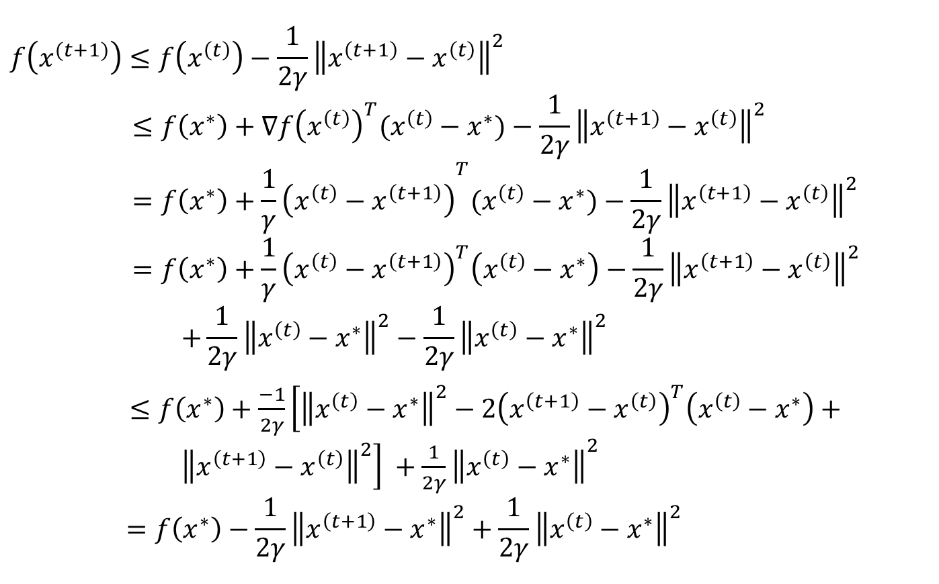
Convergence of Gradient Descent
$$f\left(x^{(t+1)}\right)≤f\left(x^{\left(t\right)}\right)−\frac{1}{2γ}{\left\|x^{\left(t+1\right)}−x^{\left(t\right)}\right\|}^{2}$$
$$≤f\left(x^{∗}\right)+∇f{\left(x^{\left(t\right)}\right)}^{T}(x^{\left(t\right)}−x^{∗})−\frac{1}{2γ}{\left\|x^{\left(t+1\right)}−x^{\left(t\right)}\right\|}^{2}$$
$$=f\left(x^{∗}\right)+{\frac{1}{γ}\left(x^{\left(t\right)}−x^{\left(t+1\right)}\right)}^{T}(x^{\left(t\right)}−x^{∗})−\frac{1}{2γ}{\left\|x^{\left(t+1\right)}−x^{\left(t\right)}\right\|}^{2}$$
$$=f\left(x^{∗}\right)+\frac{1}{γ}{\left(x^{\left(t\right)}−x^{\left(t+1\right)}\right)}^{T}\left(x^{\left(t\right)}−x^{∗}\right)−\frac{1}{2γ}{\left\|x^{\left(t+1\right)}−x^{\left(t\right)}\right\|}^{2} \\ +\frac{1}{2γ}{\left\|x^{\left(t\right)}−x^{∗}\right\|}^{2}−\frac{1}{2γ}{\left\|x^{\left(t\right)}−x^{∗}\right\|}^{2}$$
$≤f\left(x^{∗}\right)+\frac{−1}{2γ}\left[{\left\|x^{\left(t\right)}−x^{∗}\right\|}^{2}−2{\left(x^{\left(t+1\right)}−x^{\left(t\right)}\right)}^{T}\left(x^{\left(t\right)}−x^{∗}\right)+ {\left\|x^{\left(t+1\right)}−x^{\left(t\right)}\right\|}^{2}\right] +{\frac{1}{2γ}\left\|x^{\left(t\right)}−x^{∗}\right\|}^{2}$
$$=f\left(x^{∗}\right)−\frac{1}{2γ}{\left\|x^{\left(t+1\right)}−x^{∗}\right\|}^{2}+\frac{1}{2γ}{\left\|x^{\left(t\right)}−x^{∗}\right\|}^{2}$$

Slide 23
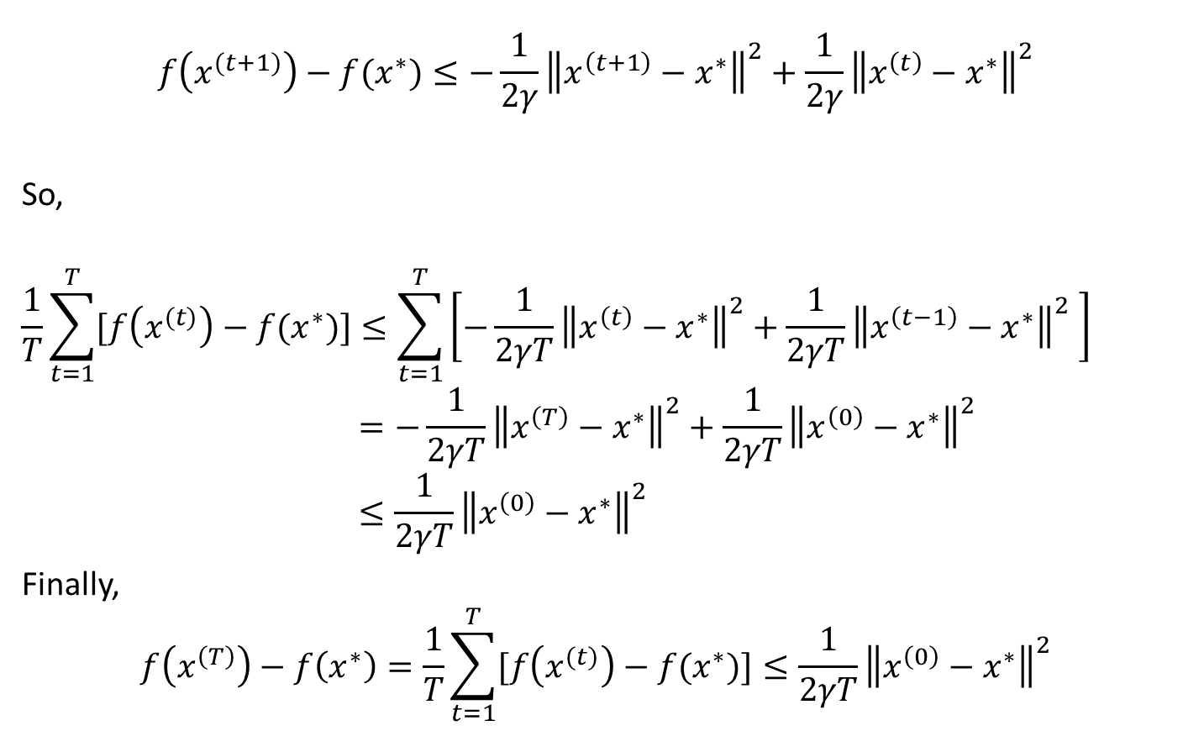
Convergence of Gradient Descent
$$f\left(x^{(t+1)}\right)−f(x^{∗})≤−\frac{1}{2γ}{\left\|x^{\left(t+1\right)}−x^{∗}\right\|}^{2}+\frac{1}{2γ}{\left\|x^{\left(t\right)}−x^{∗}\right\|}^{2}$$
So,
$$\frac{1}{T}\sum_{t=1}^{T}{[f\left(x^{(t)}\right)−f(x^{∗})]}≤\sum_{t=1}^{T}{\left[−\frac{1}{2γT}{\left\|x^{\left(t\right)}−x^{∗}\right\|}^{2}+\frac{1}{2γT}{\left\|x^{\left(t−1\right)}−x^{∗}\right\|}^{2} \right]}$$
$$=−\frac{1}{2γT}{\left\|x^{\left(T\right)}−x^{∗}\right\|}^{2}+\frac{1}{2γT}{\left\|x^{\left(0\right)}−x^{∗}\right\|}^{2}$$
$$≤\frac{1}{2γT}{\left\|x^{\left(0\right)}−x^{∗}\right\|}^{2}$$
Finally,
$$f\left(x^{\left(T\right)}\right)−f\left(x^{∗}\right)=\frac{1}{T}\sum_{t=1}^{T}{[f\left(x^{(t)}\right)−f(x^{∗})]}≤\frac{1}{2γT}{\left\|x^{\left(0\right)}−x^{∗}\right\|}^{2}$$

Slide 24

Convergence of Gradient Descent
$$f\left(x^{\left(T\right)}\right)−f\left(x^{∗}\right)=\frac{1}{T}\sum_{t=1}^{T}{[f\left(x^{(t)}\right)−f(x^{∗})]}≤\frac{1}{2γT}{\left\|x^{\left(0\right)}−x^{∗}\right\|}^{2}$$
In order to guarantee that $f\left(x^{\left(T\right)}\right)−f\left(x^{∗}\right)≤ε$, we need
$$T≥\frac{1}{2γε}{\left\|x^{\left(0\right)}−x^{∗}\right\|}^{2}$$
  In other words, gradient descent converges at a rate of $O\left(\frac{1}{ε}\right)$ for smooth functions

Slide 25

Convergence of Gradient Descent
Theorem: If $f$ is an $L$-smooth strongly $l$-convex function and $γ≤\frac{2}{l+L}$, then
$$f\left(x^{\left(t\right)}\right)−f\left(x^{∗}\right)≤\frac{c^{t}L\left\|x^{(0)}−x^{∗}\right\|}{2}$$
for some $c∈[0,1]$

