Slide 1
Alternating Direction Method of Multipliers
Nicholas Ruozzi
University of Texas at Dallas

Slide 2
Some Review
The alternating direction method of multipliers (ADMM) is a combination of several approaches that we saw earlier in the course: dual ascent and augmented Lagrangian
  The interest in this approach is that it often results in easily parallelizable optimization schemes

Slide 3

Dual Ascent
$$\min_{x∈ℝ^{n}}{f_{0}\left(x\right)}$$
subject to:
$$Ax=b$$
$$g(λ,ν)=\inf_{x}\left[f_{0}\left(x\right)+ν^{T}(Ax−b) \right]$$
Pick an initial $ν^{(0)}$
Iterate:
  $x^{(t)}∈\arg{\min_{x}\left[f_{0}\left(x\right)+ν^{T}(Ax−b)\right]}$
  $ν^{(t+1)}=ν^{(t)}+γ_{t}∇_{ν}L(x^{\left(t\right)},ν^{\left(t\right)})$

Slide 4

Dual Ascent
$$\min_{x∈ℝ^{n}}{f_{0}\left(x\right)}$$
subject to:
$$Ax=b$$
$$g(λ,ν)=\inf_{x}\left[f_{0}\left(x\right)+ν^{T}(Ax−b) \right]$$
Pick an initial $ν^{(0)}$
Iterate:
  $x^{(t)}∈\arg{\min_{x}\left[f_{0}\left(x\right)+ν^{T}(Ax−b)\right]}$
  $ν^{(t+1)}=ν^{(t)}+γ_{t}\left(Ax−b\right)$

Slide 5

Dual Decomposition
$$\min_{x_{i}∈ℝ^{n_{i}}}{\sum_{i=1}^{M}{f_{i}(x_{i})}}$$
subject to:
$$\sum_{i=1}^{M}{A_{i}x_{i}}=b$$
$$L\left(x,ν\right)=\sum_{i=1}^{M}{f_{i}(x_{i})}+ν^{T}(\sum_{i=1}^{M}{A_{i}x_{i}}−b)$$

Slide 6

Dual Decomposition
$$\min_{x_{i}∈ℝ^{n_{i}}}{\sum_{i=1}^{M}{f_{i}(x_{i})}}$$
subject to:
$$\sum_{i=1}^{M}{A_{i}x_{i}}=b$$
$$L\left(x,ν\right)=\sum_{i=1}^{M}{f_{i}(x_{i})}+ν^{T}(\sum_{i=1}^{M}{A_{i}x_{i}}−b)$$
$$x_{i}^{(t)}∈\arg{\min_{x_{i}}\left[f_{i}\left(x_{i}\right)+{ν^{(t)}}^{T}(A_{i}x_{i})\right]}$$
$$ν^{(t+1)}=ν^{(t)}+γ_{t}\left(\sum_{i=1}^{M}{A_{i}x_{i}^{(t)}}−b\right)$$
Can solve all of these subproblems in parallel!

Slide 7
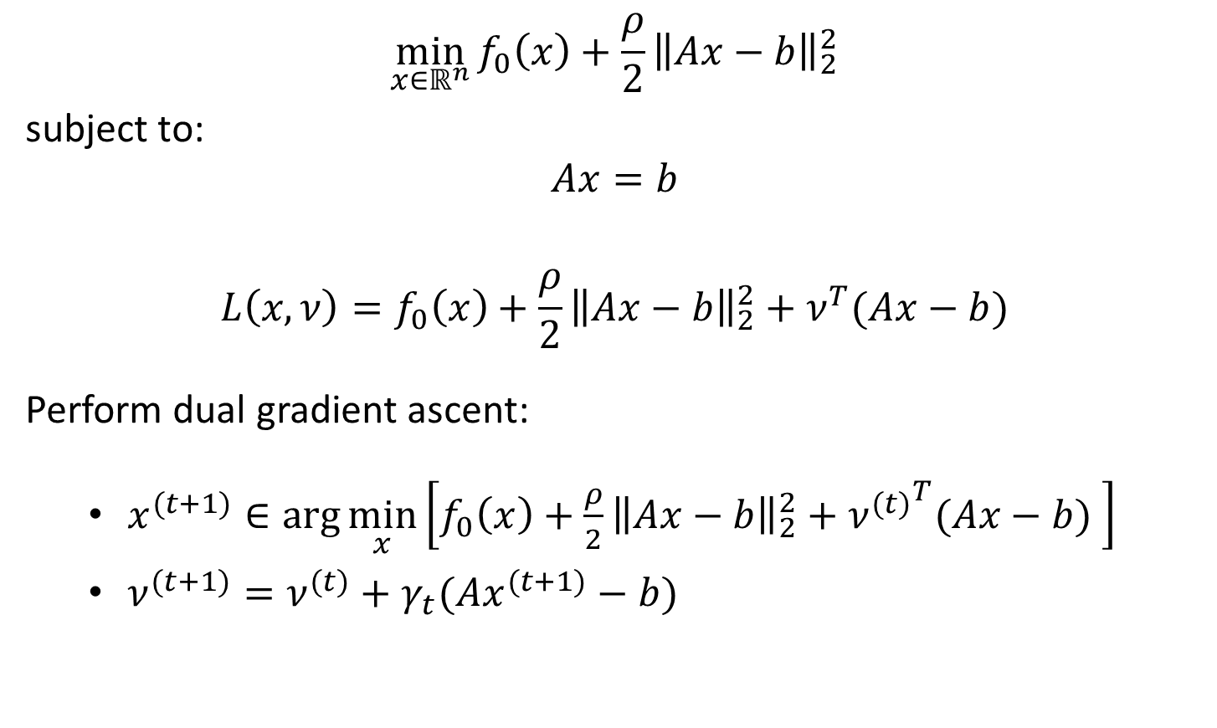
Augmented Lagrangian
$$\min_{x∈ℝ^{n}}{f_{0}\left(x\right)+\frac{ρ}{2}{\left\|Ax−b\right\|}_{2}^{2}}$$
subject to:
$$Ax=b$$
$$L\left(x,ν\right)=f_{0}\left(x\right)+\frac{ρ}{2}{\left\|Ax−b\right\|}_{2}^{2}+ν^{T}(Ax−b)$$
Perform dual gradient ascent:
  $x^{(t+1)}∈\arg{\min_{x}\left[f_{0}\left(x\right)+\frac{ρ}{2}{\left\|Ax−b\right\|}_{2}^{2}+{ν^{(t)}}^{T}(Ax−b) \right]}$
  $ν^{(t+1)}=ν^{(t)}+γ_{t}(Ax^{(t+1)}−b)$

Slide 8

Augmented Lagrangian
$$\min_{x∈ℝ^{n}}{f_{0}\left(x\right)+\frac{ρ}{2}{\left\|Ax−b\right\|}_{2}^{2}}$$
subject to:
$$Ax=b$$
$$L\left(x,ν\right)=f_{0}\left(x\right)+\frac{ρ}{2}{\left\|Ax−b\right\|}_{2}^{2}+ν^{T}(Ax−b)$$
Perform dual gradient ascent:
  $x^{(t+1)}∈\arg{\min_{x}\left[f_{0}\left(x\right)+\frac{ρ}{2}{\left\|Ax−b\right\|}_{2}^{2}+{ν^{(t)}}^{T}(Ax−b) \right]}$
  $ν^{(t+1)}=ν^{(t)}+γ_{t}(Ax^{(t+1)}−b)$
Even if $f_{0}$ is separable, the Lagrangian is not ☹

Slide 9
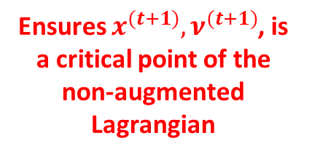
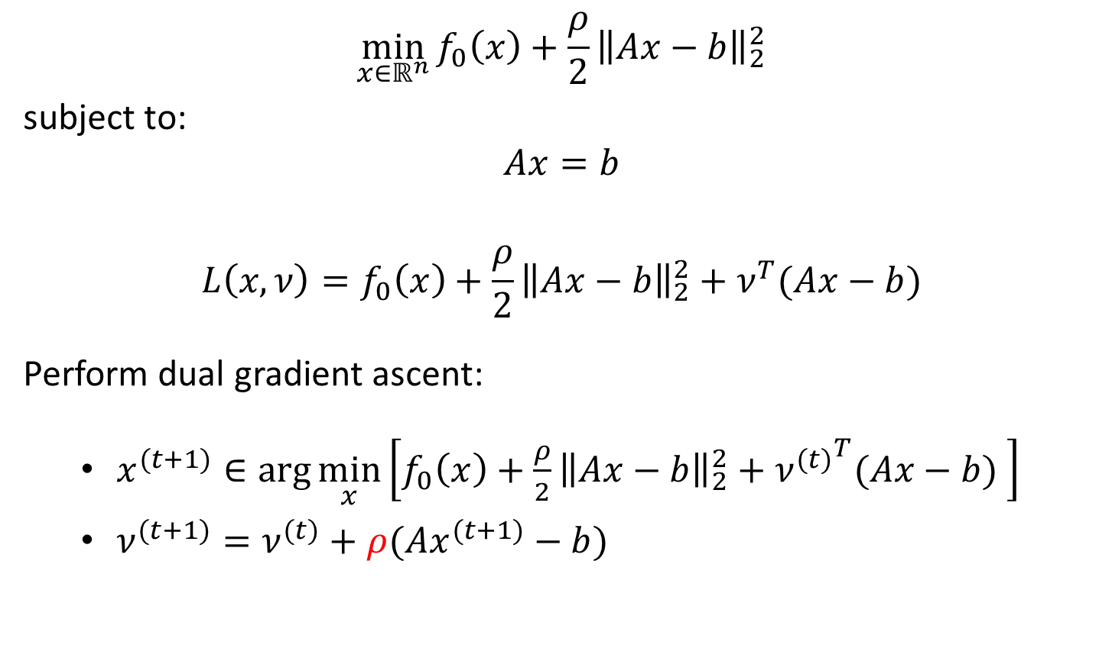
Augmented Lagrangian
$$\min_{x∈ℝ^{n}}{f_{0}\left(x\right)+\frac{ρ}{2}{\left\|Ax−b\right\|}_{2}^{2}}$$
subject to:
$$Ax=b$$
$$L\left(x,ν\right)=f_{0}\left(x\right)+\frac{ρ}{2}{\left\|Ax−b\right\|}_{2}^{2}+ν^{T}(Ax−b)$$
Perform dual gradient ascent:
  $x^{(t+1)}∈\arg{\min_{x}\left[f_{0}\left(x\right)+\frac{ρ}{2}{\left\|Ax−b\right\|}_{2}^{2}+{ν^{(t)}}^{T}(Ax−b) \right]}$
  $ν^{(t+1)}=ν^{(t)}+ρ(Ax^{(t+1)}−b)$
Ensures $x^{(t+1)}, ν^{(t+1)}$, is a critical point of the non-augmented Lagrangian

Slide 10

Alternating Direction Method of Multipliers
$$\min_{x∈ℝ^{n},z∈ℝ^{m}}{f\left(x\right)+g(z)}$$
subject to:
$$Ax+Bz=c$$
Assume that $f$ and $g$ are convex functions

Slide 11

Alternating Direction Method of Multipliers
$$\min_{x∈ℝ^{n},z∈ℝ^{m}}{f\left(x\right)+g(z)}$$
subject to:
$$Ax+Bz=c$$
Augmented Lagrangian:
$$L\left(x,z,ν\right)=f\left(x\right)+g\left(z\right)+\frac{ρ}{2}{\left\|Ax+Bz−c\right\|}_{2}^{2}+ν^{T}\left(Ax+Bz−c\right)$$

Slide 12
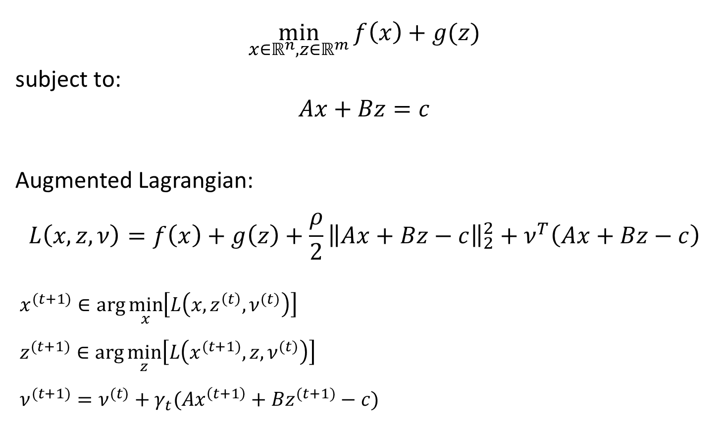
Alternating Direction Method of Multipliers
$$\min_{x∈ℝ^{n},z∈ℝ^{m}}{f\left(x\right)+g(z)}$$
subject to:
$$Ax+Bz=c$$
Augmented Lagrangian:
$$L\left(x,z,ν\right)=f\left(x\right)+g\left(z\right)+\frac{ρ}{2}{\left\|Ax+Bz−c\right\|}_{2}^{2}+ν^{T}\left(Ax+Bz−c\right)$$
$$x^{(t+1)}∈\arg{\min_{x}\left[L\left(x,z^{\left(t\right)},ν^{(t)}\right)\right]}$$
$$z^{(t+1)}∈\arg{\min_{z}\left[L\left(x^{(t+1)},z,ν^{(t)}\right)\right]}$$
$$ν^{(t+1)}=ν^{(t)}+γ_{t}(Ax^{\left(t+1\right)}+Bz^{(t+1)}−c)$$

Slide 13
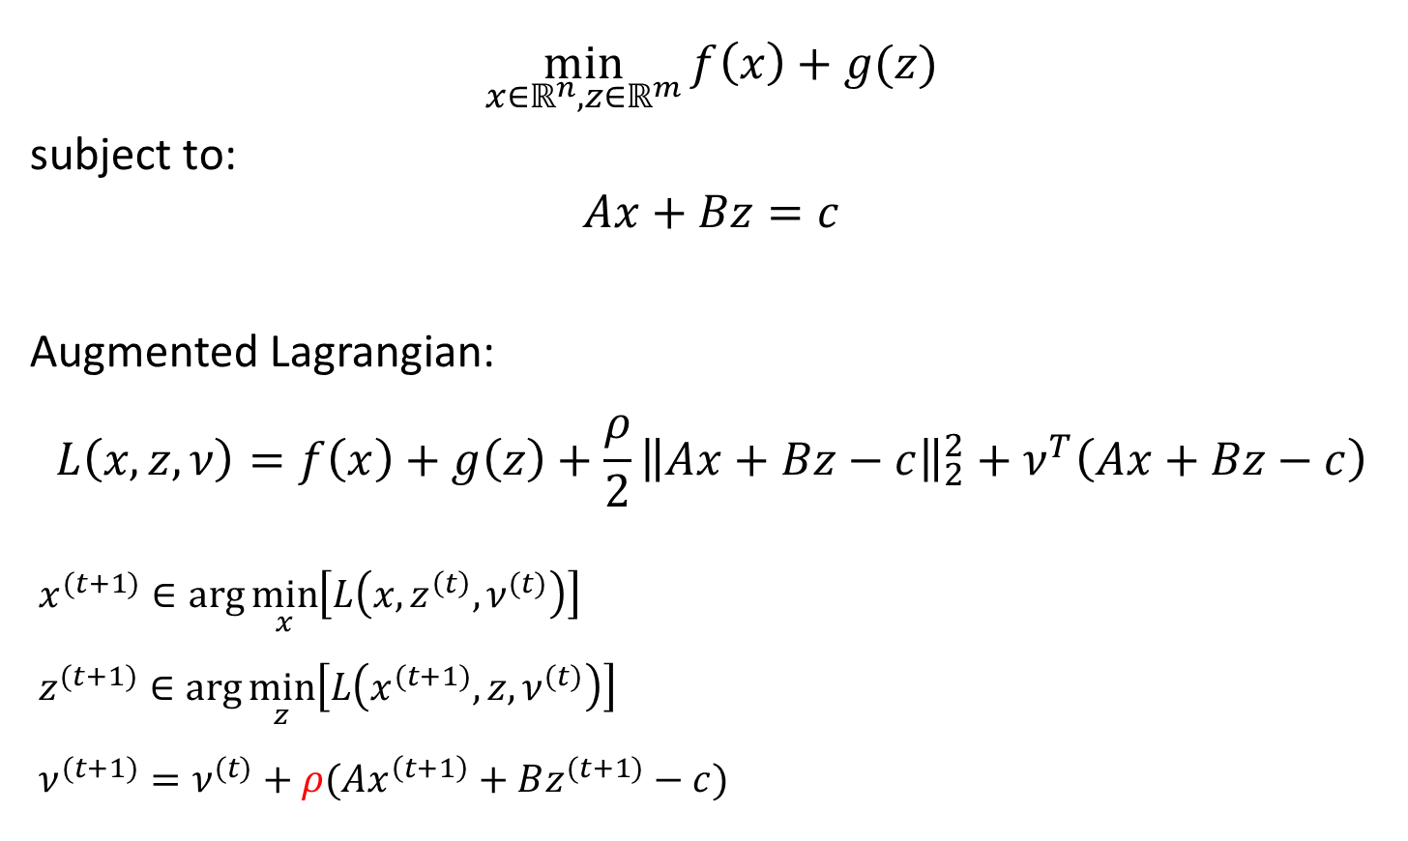
Alternating Direction Method of Multipliers
$$\min_{x∈ℝ^{n},z∈ℝ^{m}}{f\left(x\right)+g(z)}$$
subject to:
$$Ax+Bz=c$$
Augmented Lagrangian:
$$L\left(x,z,ν\right)=f\left(x\right)+g\left(z\right)+\frac{ρ}{2}{\left\|Ax+Bz−c\right\|}_{2}^{2}+ν^{T}\left(Ax+Bz−c\right)$$
$$x^{(t+1)}∈\arg{\min_{x}\left[L\left(x,z^{\left(t\right)},ν^{(t)}\right)\right]}$$
$$z^{(t+1)}∈\arg{\min_{z}\left[L\left(x^{(t+1)},z,ν^{(t)}\right)\right]}$$
$$ν^{(t+1)}=ν^{(t)}+ρ(Ax^{\left(t+1\right)}+Bz^{(t+1)}−c)$$

Slide 14

Scaled ADMM
Let $r=Ax+Bz−c$ and $u=\frac{1}{ρ}ν$
$$\frac{ρ}{2}{\left\|Ax+Bz−c\right\|}_{2}^{2}+ν^{T}\left(Ax+Bz−c\right)=\frac{ρ}{2}{\left\|r\right\|}_{2}^{2}+ν^{T}r$$
$$=\frac{ρ}{2}{\left\|r+\frac{1}{ ρ}ν\right\|}_{2}^{2}−\frac{1}{ 2ρ}{\left\|ν\right\|}_{2}^{2}$$
$$=\frac{ρ}{2}{\left\|r+u\right\|}_{2}^{2}−\frac{ρ}{ 2}{\left\|u\right\|}_{2}^{2}$$

Slide 15
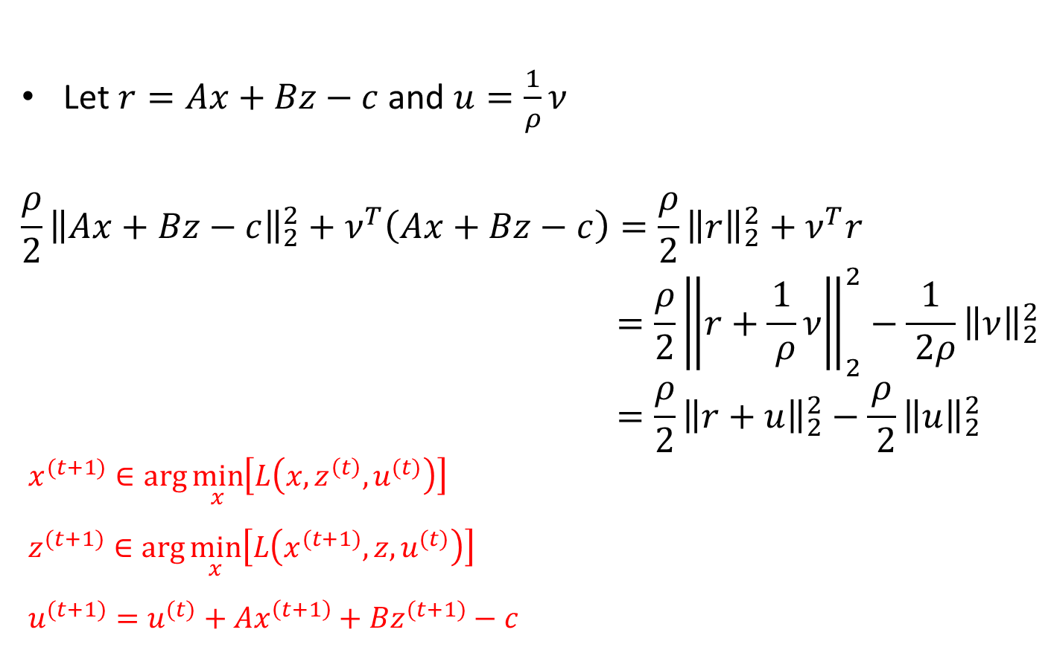
Scaled ADMM
Let $r=Ax+Bz−c$ and $u=\frac{1}{ρ}ν$
$$\frac{ρ}{2}{\left\|Ax+Bz−c\right\|}_{2}^{2}+ν^{T}\left(Ax+Bz−c\right)=\frac{ρ}{2}{\left\|r\right\|}_{2}^{2}+ν^{T}r$$
$$=\frac{ρ}{2}{\left\|r+\frac{1}{ ρ}ν\right\|}_{2}^{2}−\frac{1}{ 2ρ}{\left\|ν\right\|}_{2}^{2}$$
$$=\frac{ρ}{2}{\left\|r+u\right\|}_{2}^{2}−\frac{ρ}{ 2}{\left\|u\right\|}_{2}^{2}$$
$$x^{(t+1)}∈\arg{\min_{x}\left[L\left(x,z^{\left(t\right)},u^{(t)}\right)\right]}$$
$$z^{(t+1)}∈\arg{\min_{x}\left[L\left(x^{(t+1)},z,u^{(t)}\right)\right]}$$
$$u^{(t+1)}=u^{(t)}+Ax^{\left(t+1\right)}+Bz^{(t+1)}−c$$

Slide 16
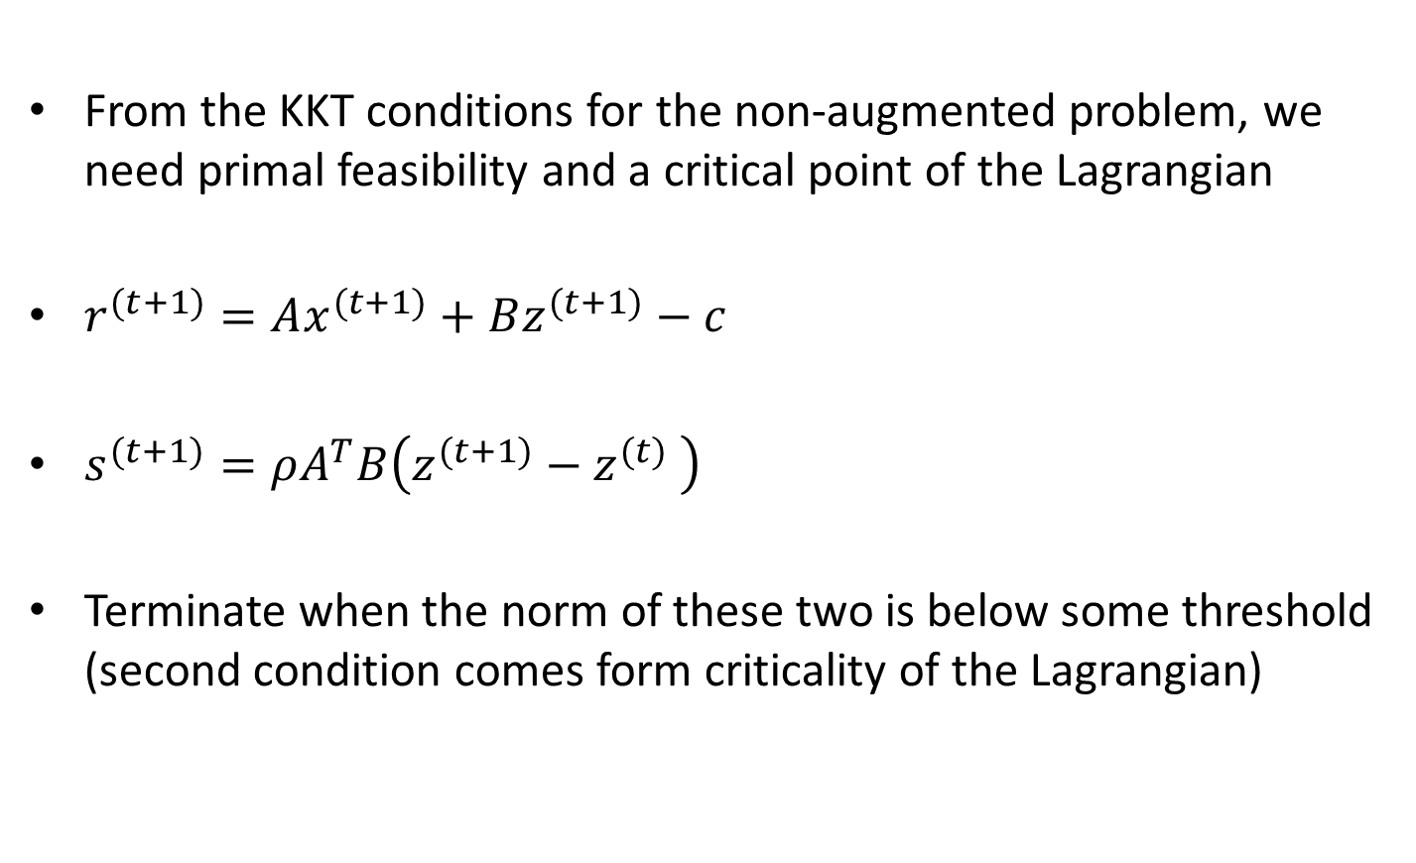
ADMM Stopping Criteria
From the KKT conditions for the non-augmented problem, we need primal feasibility and a critical point of the Lagrangian
$r^{(t+1)}=Ax^{(t+1)}+Bz^{(t+1)}−c$
$s^{(t+1)}=ρA^{T}B\left(z^{(t+1)}−z^{(t)} \right)$
Terminate when the norm of these two is below some threshold (second condition comes form criticality of the Lagrangian)

Slide 17

Alternating Projections
Find a point $x∈C∩D$ for two convex sets $C$ and $D$

Slide 18

Alternating Projections
Find a point $x∈C∩D$ for two convex sets $C$ and $D$
$$\min_{x∈ℝ^{n},z∈ℝ^{n}}{1_{C}\left(x\right)+1_{D}(z)}$$
subject to:
$$x=z$$

Slide 19
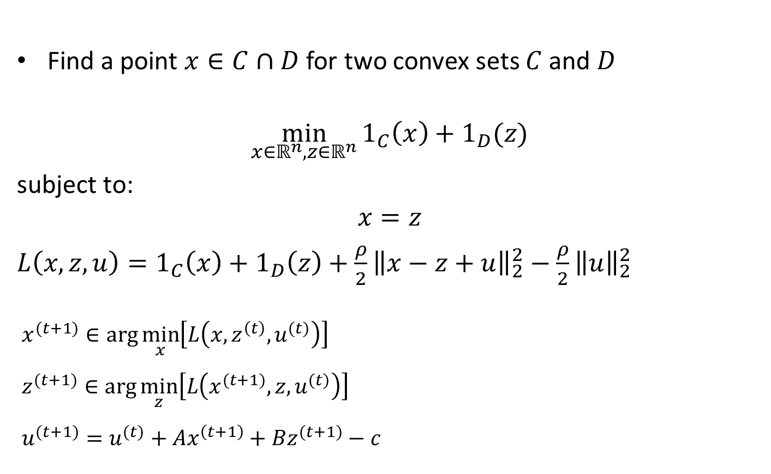
Alternating Projections
Find a point $x∈C∩D$ for two convex sets $C$ and $D$
$$\min_{x∈ℝ^{n},z∈ℝ^{n}}{1_{C}\left(x\right)+1_{D}(z)}$$
subject to:
$$x=z$$
$L\left(x,z,u\right)=1_{C}\left(x\right)+1_{D}\left(z\right)+\frac{ρ}{2}{\left\|x−z+u\right\|}_{2}^{2}−\frac{ρ}{2}{\left\|u\right\|}_{2}^{2}$
$$x^{(t+1)}∈\arg{\min_{x}\left[L\left(x,z^{\left(t\right)},u^{(t)}\right)\right]}$$
$$z^{(t+1)}∈\arg{\min_{z}\left[L\left(x^{(t+1)},z,u^{(t)}\right)\right]}$$
$$u^{(t+1)}=u^{(t)}+Ax^{\left(t+1\right)}+Bz^{(t+1)}−c$$

Slide 20
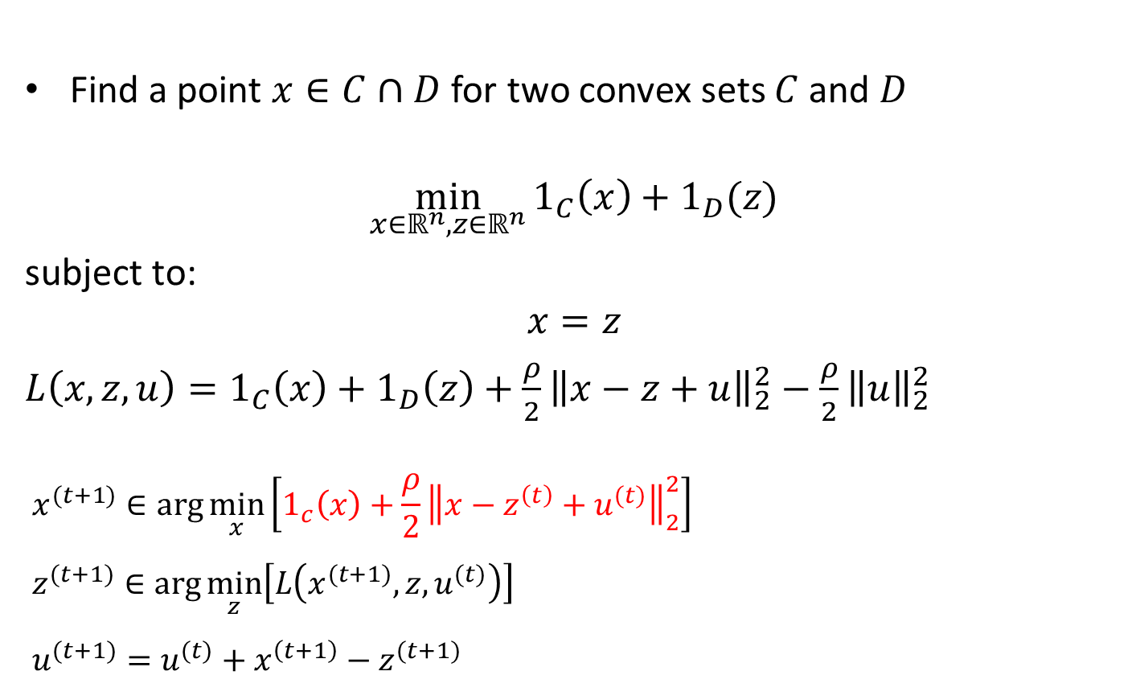
Alternating Projections
Find a point $x∈C∩D$ for two convex sets $C$ and $D$
$$\min_{x∈ℝ^{n},z∈ℝ^{n}}{1_{C}\left(x\right)+1_{D}(z)}$$
subject to:
$$x=z$$
$L\left(x,z,u\right)=1_{C}\left(x\right)+1_{D}\left(z\right)+\frac{ρ}{2}{\left\|x−z+u\right\|}_{2}^{2}−\frac{ρ}{2}{\left\|u\right\|}_{2}^{2}$
$$x^{(t+1)}∈\arg{\min_{x}\left[1_{c}\left(x\right)+\frac{ρ}{2}{\left\|x−z^{\left(t\right)}+u^{(t)}\right\|}_{2}^{2}\right]}$$
$$z^{(t+1)}∈\arg{\min_{z}\left[L\left(x^{(t+1)},z,u^{(t)}\right)\right]}$$
$$u^{(t+1)}=u^{(t)}+x^{\left(t+1\right)}−z^{(t+1)}$$

Slide 21
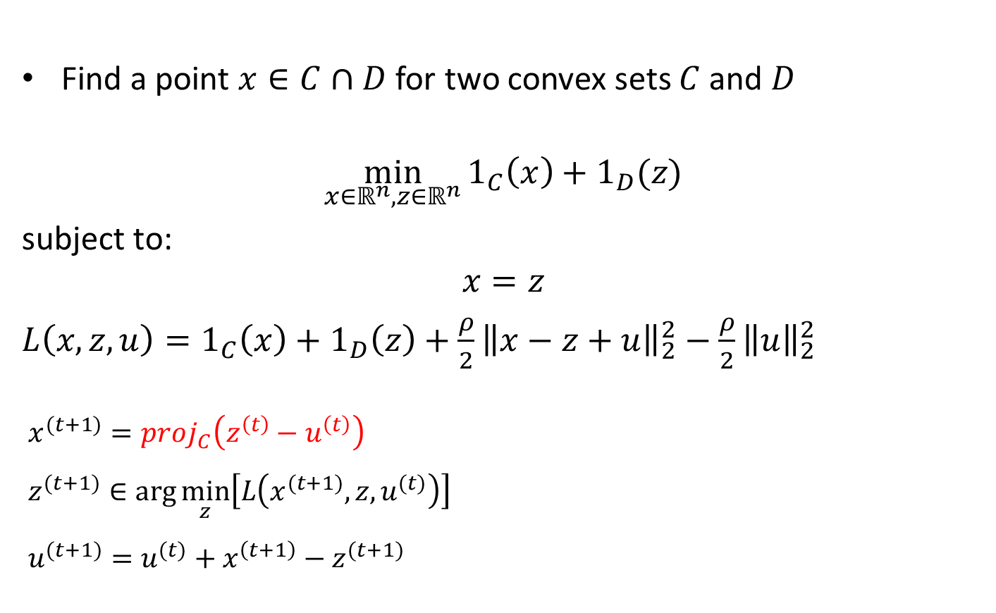
Alternating Projections
Find a point $x∈C∩D$ for two convex sets $C$ and $D$
$$\min_{x∈ℝ^{n},z∈ℝ^{n}}{1_{C}\left(x\right)+1_{D}(z)}$$
subject to:
$$x=z$$
$L\left(x,z,u\right)=1_{C}\left(x\right)+1_{D}\left(z\right)+\frac{ρ}{2}{\left\|x−z+u\right\|}_{2}^{2}−\frac{ρ}{2}{\left\|u\right\|}_{2}^{2}$
$$x^{(t+1)}=proj_{C}\left(z^{\left(t\right)}−u^{\left(t\right)}\right)$$
$$z^{(t+1)}∈\arg{\min_{z}\left[L\left(x^{(t+1)},z,u^{(t)}\right)\right]}$$
$$u^{(t+1)}=u^{(t)}+x^{\left(t+1\right)}−z^{(t+1)}$$

Slide 22
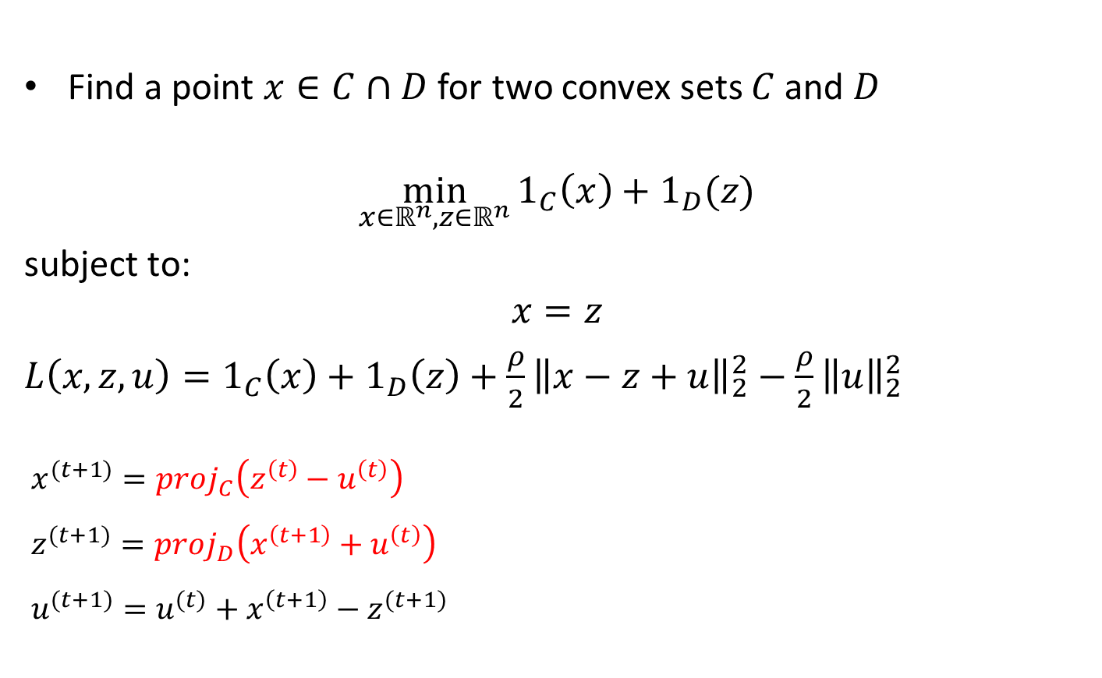
Alternating Projections
Find a point $x∈C∩D$ for two convex sets $C$ and $D$
$$\min_{x∈ℝ^{n},z∈ℝ^{n}}{1_{C}\left(x\right)+1_{D}(z)}$$
subject to:
$$x=z$$
$L\left(x,z,u\right)=1_{C}\left(x\right)+1_{D}\left(z\right)+\frac{ρ}{2}{\left\|x−z+u\right\|}_{2}^{2}−\frac{ρ}{2}{\left\|u\right\|}_{2}^{2}$
$$x^{(t+1)}=proj_{C}\left(z^{\left(t\right)}−u^{\left(t\right)}\right)$$
$$z^{(t+1)}=proj_{D}\left(x^{\left(t+1\right)}+u^{\left(t\right)}\right)$$
$$u^{(t+1)}=u^{(t)}+x^{\left(t+1\right)}−z^{(t+1)}$$

Slide 23

Parallel Projections
Find a point in $∩_{i=1}^{M}A_{i}$ for convex sets $A_{1},…,A_{m}∈ℝ^{n}$
Let $C=A_{1}×…×A_{M}$, $D=\{\left(x_{1},…,x_{M}\right)∈ℝ^{nM}:x_{1}=…=x_{M}\}$
$$x^{(t+1)}=proj_{C}\left(z^{\left(t\right)}−u^{\left(t\right)}\right)$$
$$z^{(t+1)}=proj_{D}\left(x^{\left(t+1\right)}+u^{\left(t\right)}\right)$$
$$u_{i}^{(t+1)}=u_{i}^{(t)}+x_{i}^{\left(t+1\right)}−z^{(t+1)}$$

Slide 24

Parallel Projections
Find a point in $∩_{i=1}^{M}A_{i}$ for convex sets $A_{1},…,A_{m}∈ℝ^{n}$
Let $C=A_{1}×…×A_{M}$, $D=\{\left(x_{1},…,x_{M}\right)∈ℝ^{nM}:x_{1}=…=x_{M}\}$
$$x_{i}^{(t+1)}=proj_{A_{i}}\left(z_{i}^{\left(t\right)}−u_{i}^{\left(t\right)}\right)$$
$$z^{(t+1)}=proj_{D}\left(x^{\left(t+1\right)}+u^{\left(t\right)}\right)$$
$$u_{i}^{(t+1)}=u_{i}^{(t)}+x_{i}^{\left(t+1\right)}−z^{(t+1)}$$

Slide 25

Parallel Projections
Find a point in $∩_{i=1}^{M}A_{i}$ for convex sets $A_{1},…,A_{m}∈ℝ^{n}$
Let $C=A_{1}×…×A_{M}$, $D=\{\left(x_{1},…,x_{M}\right)∈ℝ^{nM}:x_{1}=…=x_{M}\}$
$$x_{i}^{(t+1)}=proj_{A_{i}}\left(z_{i}^{\left(t\right)}−u_{i}^{\left(t\right)}\right)$$
$$z_{i}^{(t+1)}=1/M\sum_{i^{′}=1}^{M}{\left(x_{i^{′}}^{\left(t+1\right)}+u_{i^{′}}^{\left(t\right)}\right) }$$
$$u_{i}^{(t+1)}=u_{i}^{(t)}+x_{i}^{\left(t+1\right)}−z_{i}^{(t+1)}$$

Slide 26
Parallel Projections
Find a point in $∩_{i=1}^{M}A_{i}$ for convex sets $A_{1},…,A_{m}∈ℝ^{n}$
Let $C=A_{1}×…×A_{M}$, $D=\{\left(x_{1},…,x_{M}\right)∈ℝ^{nM}:x_{1}=…=x_{M}\}$
$$x_{i}^{(t+1)}=proj_{A_{i}}\left(z_{i}^{\left(t\right)}−u_{i}^{\left(t\right)}\right)$$
$$z_{i}^{(t+1)}=1/M\sum_{i^{′}=1}^{M}{\left(x_{i^{′}}^{\left(t+1\right)}+u_{i^{′}}^{\left(t\right)}\right) }$$
$$u_{i}^{(t+1)}=u_{i}^{(t)}+x_{i}^{\left(t+1\right)}−z_{i}^{(t+1)}$$
We can do all the projections in parallel!!!

Slide 27

Parallel Projections
Find a point in $∩_{i=1}^{M}A_{i}$ for convex sets $A_{1},…,A_{m}∈ℝ^{n}$
Let $C=A_{1}×…×A_{M}$, $D=\{\left(x_{1},…,x_{M}\right)∈ℝ^{nM}:x_{1}=…=x_{M}\}$
$$x_{i}^{(t+1)}∈proj_{A_{i}}\left(z^{\left(t\right)}−u_{i}^{\left(t\right)}\right)$$
$$z^{(t+1)}=1/M\sum_{i=1}^{M}{\left(x_{i}^{\left(t+1\right)}+u_{i}^{\left(t\right)}\right) }$$
$$u_{i}^{(t+1)}=u_{i}^{(t)}+x_{i}^{\left(t+1\right)}−z^{(t+1)}$$
Don’t need multiple z as they are all the same

Slide 28

Basis Pursuit
$$\min_{x∈ℝ^{n}}{{\left\|x\right\|}_{1}}$$
subject to:
$$Ax=b$$

Slide 29

Basis Pursuit
$$\min_{x,z∈ℝ^{n}}{1_{Ax=b}(x)+{\left\|z\right\|}_{1}}$$
subject to:
$$x=z$$

Slide 30

Basis Pursuit
$$\min_{x,z∈ℝ^{n}}{1_{Ax=b}(x)+{\left\|z\right\|}_{1}}$$
subject to:
$$x=z$$
$L\left(x,z,u\right)=1_{Ax=b}\left(x\right)+{\left\|z\right\|}_{1}+\frac{ρ}{2}{\left\|x−z+u\right\|}_{2}^{2}−\frac{ρ}{2}{\left\|u\right\|}_{2}^{2}$
$$x^{(t+1)}∈\arg{\min_{x}\left[L\left(x,z^{\left(t\right)},u^{(t)}\right)\right]}$$
$$z^{(t+1)}∈\arg{\min_{z}\left[L\left(x^{(t+1)},z,u^{(t)}\right)\right]}$$
$$u^{(t+1)}=u^{(t)}+x^{\left(t+1\right)}−z^{(t+1)}$$

Slide 31

Basis Pursuit
$$\min_{x,z∈ℝ^{n}}{1_{Ax=b}(x)+{\left\|z\right\|}_{1}}$$
subject to:
$$x=z$$
$L\left(x,z,u\right)=1_{Ax=b}\left(x\right)+{\left\|z\right\|}_{1}+\frac{ρ}{2}{\left\|x−z+u\right\|}_{2}^{2}−\frac{ρ}{2}{\left\|u\right\|}_{2}^{2}$
$$x^{(t+1)}=proj_{Ax=b}\left(z^{\left(t\right)}−u^{(t)}\right)$$
$$z^{(t+1)}∈\arg{\min_{z}\left[L\left(x^{(t+1)},z,u^{(t)}\right)\right]}$$
$$u^{(t+1)}=u^{(t)}+x^{\left(t+1\right)}−z^{(t+1)}$$

Slide 32
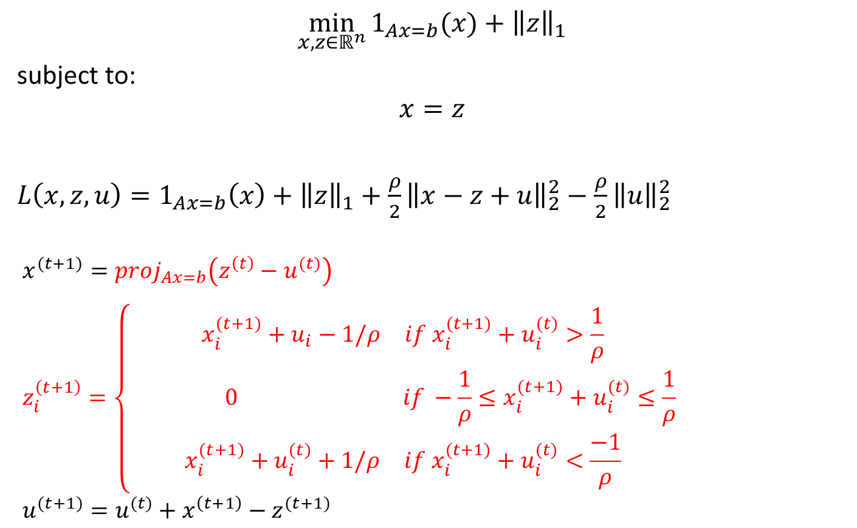
Basis Pursuit
$$\min_{x,z∈ℝ^{n}}{1_{Ax=b}(x)+{\left\|z\right\|}_{1}}$$
subject to:
$$x=z$$
$L\left(x,z,u\right)=1_{Ax=b}\left(x\right)+{\left\|z\right\|}_{1}+\frac{ρ}{2}{\left\|x−z+u\right\|}_{2}^{2}−\frac{ρ}{2}{\left\|u\right\|}_{2}^{2}$
$$x^{(t+1)}=proj_{Ax=b}\left(z^{\left(t\right)}−u^{(t)}\right)$$
$$z_{i}^{\left(t+1\right)}=\left\{\begin{matrix}\begin{matrix}{x_{i}^{(t+1)}+u}_{i}−1/ρ & if x_{i}^{(t+1)}+u_{i}^{(t)}>\frac{1}{ρ}\end{matrix} \\ \begin{matrix} 0 & if −\frac{1}{ρ}≤x_{i}^{(t+1)}+u_{i}^{(t)}≤\frac{1}{ρ}\end{matrix} \\ \begin{matrix}x_{i}^{(t+1)}+u_{i}^{(t)}+1/ρ & if x_{i}^{(t+1)}+u_{i}^{(t)}<\frac{−1}{ρ}\end{matrix}\end{matrix}\right.$$
$$u^{(t+1)}=u^{(t)}+x^{\left(t+1\right)}−z^{(t+1)}$$

Slide 33

Consensus
$$\min_{x∈ℝ^{n}}{\sum_{i=1}^{M}{f_{i}\left(x\right)}}$$

Slide 34

Consensus
$$\min_{x_{1},…,x_{M},z∈ℝ^{n}}{\sum_{i=1}^{M}{f_{i}\left(x_{i}\right)}}$$
subject to:
$$∀i, x_{i}=z$$

Slide 35

Consensus
$$\min_{x_{1},…,x_{M},z∈ℝ^{n}}{\sum_{i=1}^{M}{f_{i}\left(x_{i}\right)}}$$
subject to:
$$∀i, x_{i}=z$$
$L\left(x,z,u\right)=\sum_{i=1}^{M}{\left(f_{i}\left(x_{i}\right)+\frac{ρ}{2}{\left\|x_{i}−z+u_{i}\right\|}_{2}^{2}−\frac{ρ}{2}{\left\|u_{i}\right\|}_{2}^{2}\right)}$
$$x^{(t+1)}∈\arg{\min_{x}\left[L\left(x,z^{\left(t\right)},u^{(t)}\right)\right]}$$
$$z^{(t+1)}∈\arg{\min_{z}\left[L\left(x^{(t+1)},z,u^{(t)}\right)\right]}$$
$$u_{i}^{(t+1)}=u_{i}^{(t)}+x_{i}^{\left(t+1\right)}−z^{(t+1)}$$

Slide 36
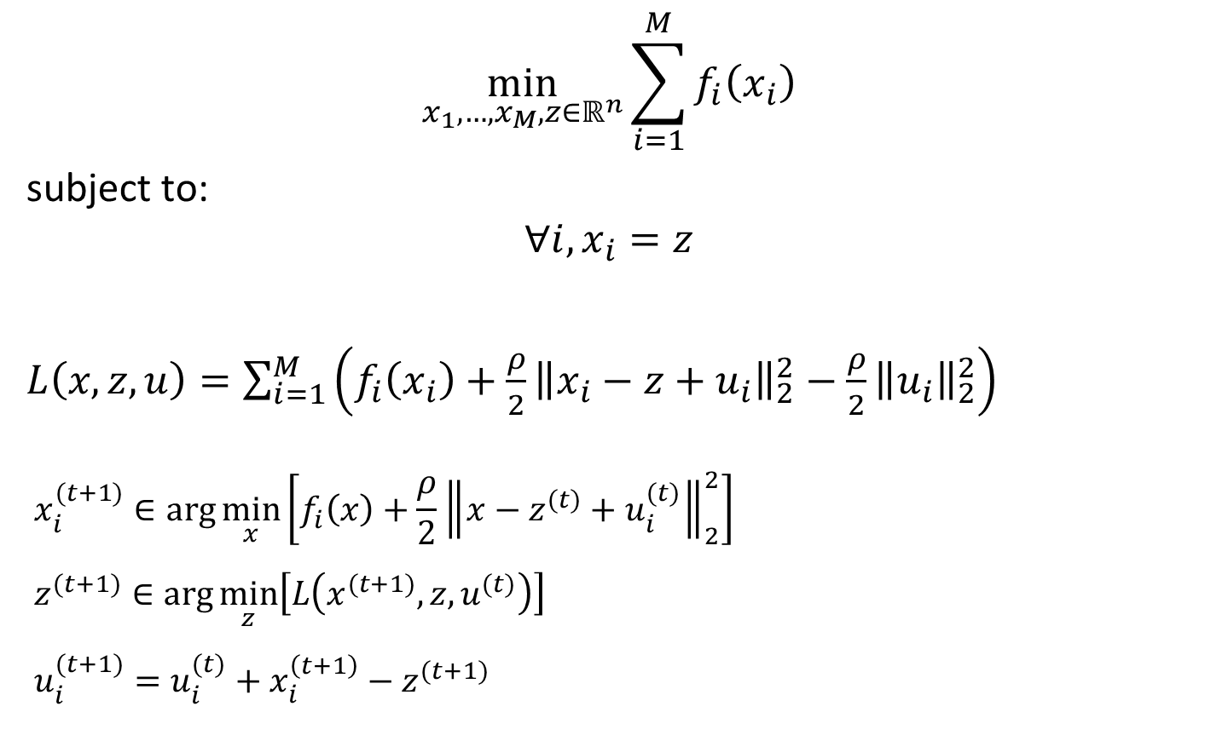
Consensus
$$\min_{x_{1},…,x_{M},z∈ℝ^{n}}{\sum_{i=1}^{M}{f_{i}\left(x_{i}\right)}}$$
subject to:
$$∀i, x_{i}=z$$
$L\left(x,z,u\right)=\sum_{i=1}^{M}{\left(f_{i}\left(x_{i}\right)+\frac{ρ}{2}{\left\|x_{i}−z+u_{i}\right\|}_{2}^{2}−\frac{ρ}{2}{\left\|u_{i}\right\|}_{2}^{2}\right)}$
$$x_{i}^{(t+1)}∈\arg{\min_{x}\left[f_{i}\left(x\right)+\frac{ρ}{2}{\left\|x−z^{(t)}+u_{i}^{(t)}\right\|}_{2}^{2}\right]}$$
$$z^{(t+1)}∈\arg{\min_{z}\left[L\left(x^{(t+1)},z,u^{(t)}\right)\right]}$$
$$u_{i}^{(t+1)}=u_{i}^{(t)}+x_{i}^{\left(t+1\right)}−z^{(t+1)}$$

Slide 37
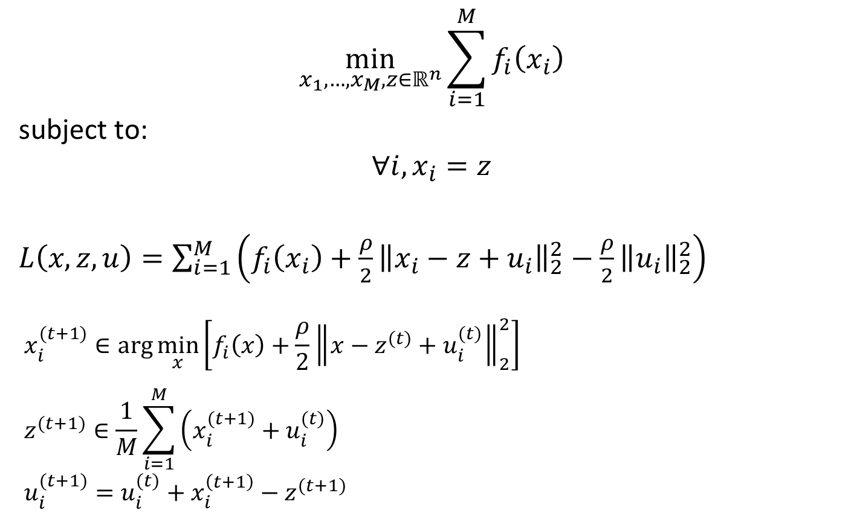
Consensus
$$\min_{x_{1},…,x_{M},z∈ℝ^{n}}{\sum_{i=1}^{M}{f_{i}\left(x_{i}\right)}}$$
subject to:
$$∀i, x_{i}=z$$
$L\left(x,z,u\right)=\sum_{i=1}^{M}{\left(f_{i}\left(x_{i}\right)+\frac{ρ}{2}{\left\|x_{i}−z+u_{i}\right\|}_{2}^{2}−\frac{ρ}{2}{\left\|u_{i}\right\|}_{2}^{2}\right)}$
$$x_{i}^{(t+1)}∈\arg{\min_{x}\left[f_{i}\left(x\right)+\frac{ρ}{2}{\left\|x−z^{(t)}+u_{i}^{(t)}\right\|}_{2}^{2}\right]}$$
$$z^{(t+1)}∈\frac{1}{M}\sum_{i=1}^{M}{\left(x_{i}^{(t+1)}+u_{i}^{(t)}\right)}$$
$$u_{i}^{(t+1)}=u_{i}^{(t)}+x_{i}^{\left(t+1\right)}−z^{(t+1)}$$

