Slide 1
Majorization
Nicholas Ruozzi
University of Texas at Dallas

Slide 2

A Motivating Problem
Let $g$ be an arbitrary convex function – What is the solution to the following optimization problem?
$$\min_{x∈ℝ^{n}}{\sum_{i=1}^{n}{g(x_{i})}}$$
such that
$$x≥0$$
$$\sum_{i=1}^{n}{x_{i}}=1$$

Slide 3
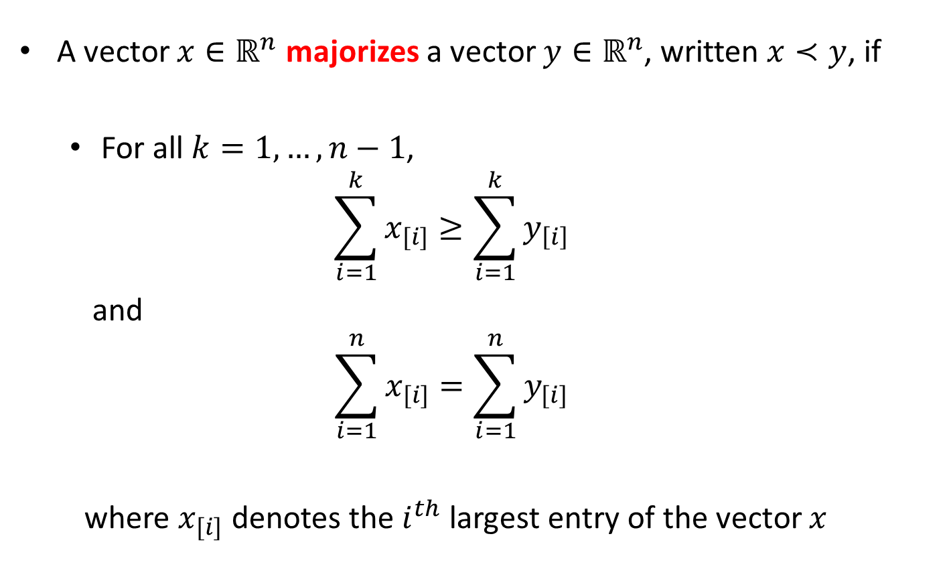
Vector Majorization
A vector $x∈ℝ^{n}$ majorizes a vector $y∈ℝ^{n}$, written $x≺y$, if
  For all $k=1,…,n−1$,
  $$\sum_{i=1}^{k}{x_{[i]}}≥\sum_{i=1}^{k}{y_{\left[i\right]}}$$
  and
  $$\sum_{i=1}^{n}{x_{[i]}}=\sum_{i=1}^{n}{y_{[i]}}$$
  where $x_{[i]}$ denotes the $i^{th}$ largest entry of the vector $x$

Slide 4
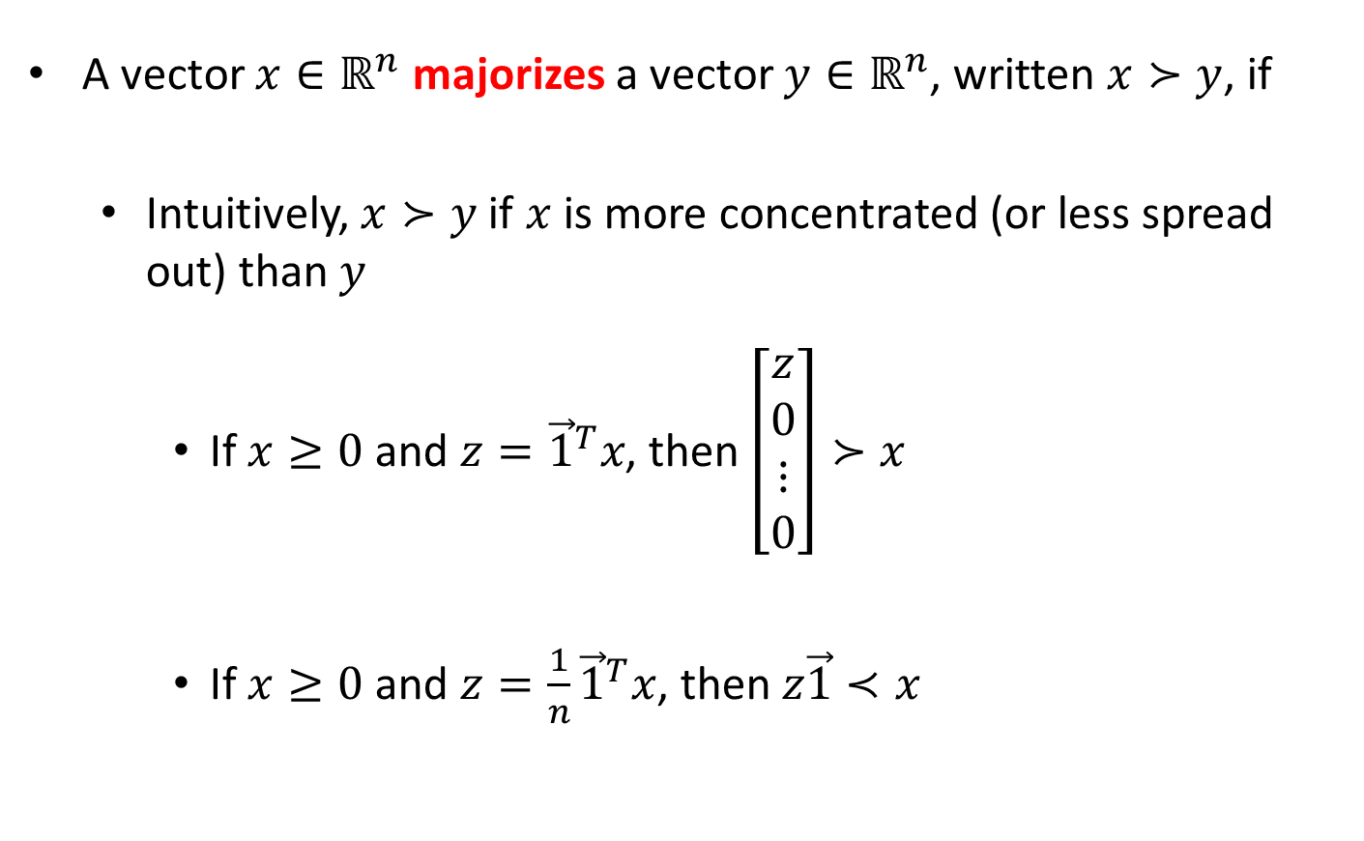
Vector Majorization
A vector $x∈ℝ^{n}$ majorizes a vector $y∈ℝ^{n}$, written $x≻y$, if
  Intuitively, $x≻y$ if $x$ is more concentrated (or less spread out) than $y$
    If $x≥0$ and $z={\vec{1}}^{T}x$, then $\left[\begin{aligned}z \\ 0 \\ ⋮ \\ 0\end{aligned}\right]≻x$
    If $x≥0$ and $z=\frac{1}{n}{\vec{1}}^{T}x$, then $z\vec{1}≺x$

Slide 5
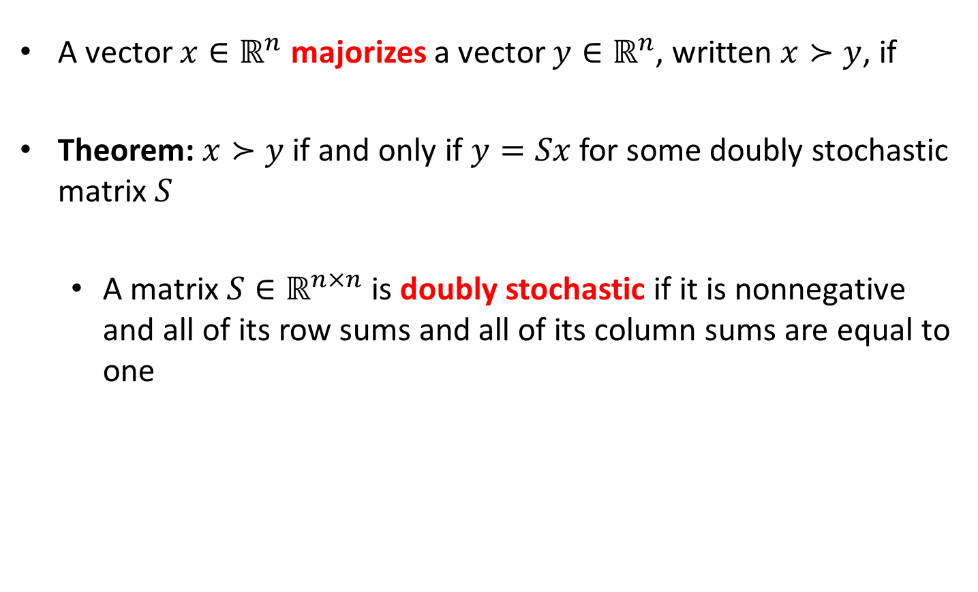
Vector Majorization
A vector $x∈ℝ^{n}$ majorizes a vector $y∈ℝ^{n}$, written $x≻y$, if
Theorem: $x≻y$ if and only if $y=Sx$ for some doubly stochastic matrix $S$
  A matrix $S∈ℝ^{n×n}$ is doubly stochastic if it is nonnegative and all of its row sums and all of its column sums are equal to one

Slide 6
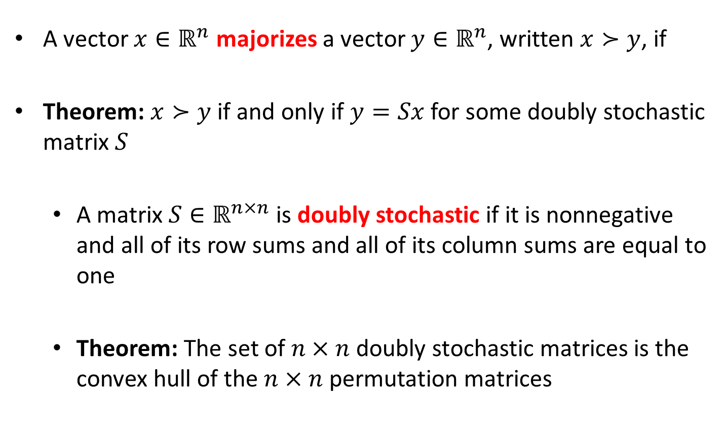
Vector Majorization
A vector $x∈ℝ^{n}$ majorizes a vector $y∈ℝ^{n}$, written $x≻y$, if
Theorem: $x≻y$ if and only if $y=Sx$ for some doubly stochastic matrix $S$
  A matrix $S∈ℝ^{n×n}$ is doubly stochastic if it is nonnegative and all of its row sums and all of its column sums are equal to one
  Theorem: The set of $n×n$ doubly stochastic matrices is the convex hull of the $n×n$ permutation matrices

Slide 7

Application: Symmetric Matrices
If $A$ is an $n×n$ symmetric matrix, then diagonal elements of $A$ are majorized by the eigenvalues

Slide 8
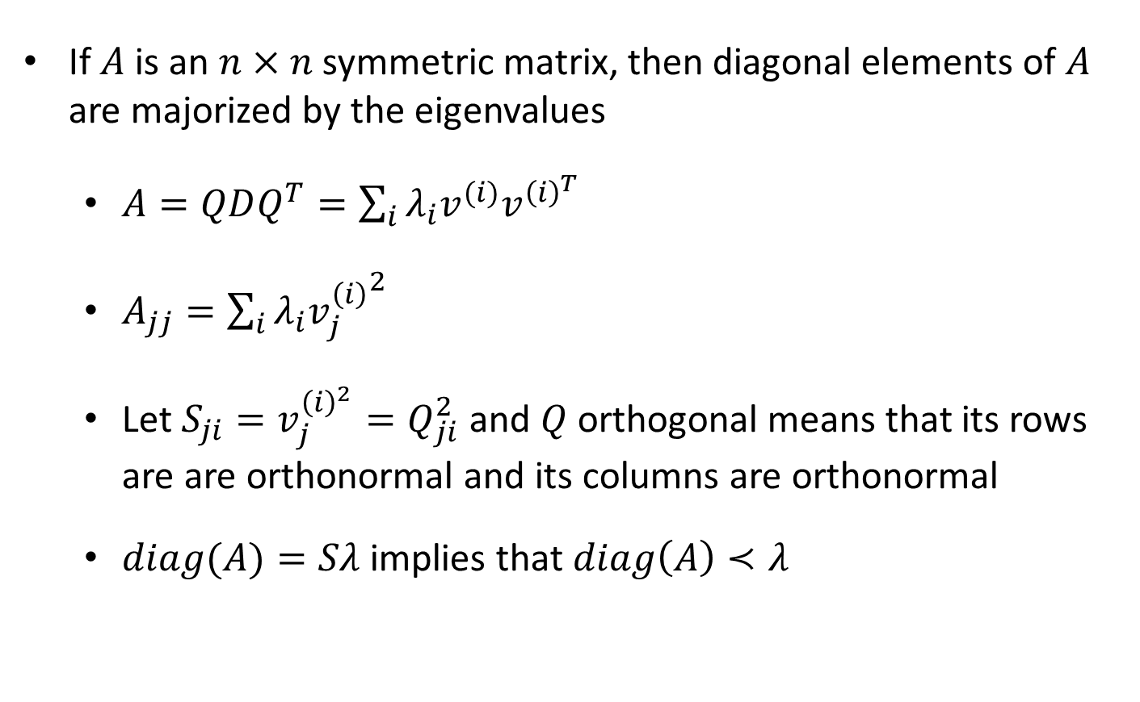
Application: Symmetric Matrices
If $A$ is an $n×n$ symmetric matrix, then diagonal elements of $A$ are majorized by the eigenvalues
  $A=QDQ^{T}=\sum_{i}{λ_{i}v^{(i)}v^{{\left(i\right)}^{T}}}$
  $A_{jj}=\sum_{i}{λ_{i}{v_{j}^{\left(i\right)}}^{2}}$
  Let $S_{ji}=v_{j}^{{\left(i\right)}^{2}}=Q_{ji}^{2}$ and $Q$ orthogonal means that its rows are are orthonormal and its columns are orthonormal
  $diag(A)=Sλ$ implies that $diag\left(A\right)≺λ$

Slide 9

Weak Vector Majorization
A vector $x∈ℝ^{n}$ weakly majorizes a vector $y∈ℝ^{n}$, written $x≻_{w}y$, if
  For all $k=1,…,n,$
  $$\sum_{i=1}^{k}{x_{[i]}}≥\sum_{i=1}^{k}{y_{\left[i\right]}}$$
  where $x_{[i]}$ denotes the $i^{th}$ largest entry of the vector $x$

Slide 10

Weak Vector Majorization
A vector $x∈ℝ^{n}$ weakly majorizes a vector $y∈ℝ^{n}$, written $x≻_{w}y$, if
  Theorem: $x≻_{w}y$ if and only if $y≤Sx$ for some doubly stochastic matrix $S$

Slide 11

Weak Vector Majorization
A vector $x∈ℝ^{n}$ weakly majorizes a vector $y∈ℝ^{n}$, written $x≻_{w}y$, if
Theorem: if $x≻y$, then for any convex function $g:ℝ→ℝ$
$${\left(g\left(x_{1}\right),…,g\left(x_{n}\right)\right)}^{T}≻_{w}{\left(g\left(y_{1}\right),…,g\left(y_{n}\right)\right)}^{T}$$

Slide 12
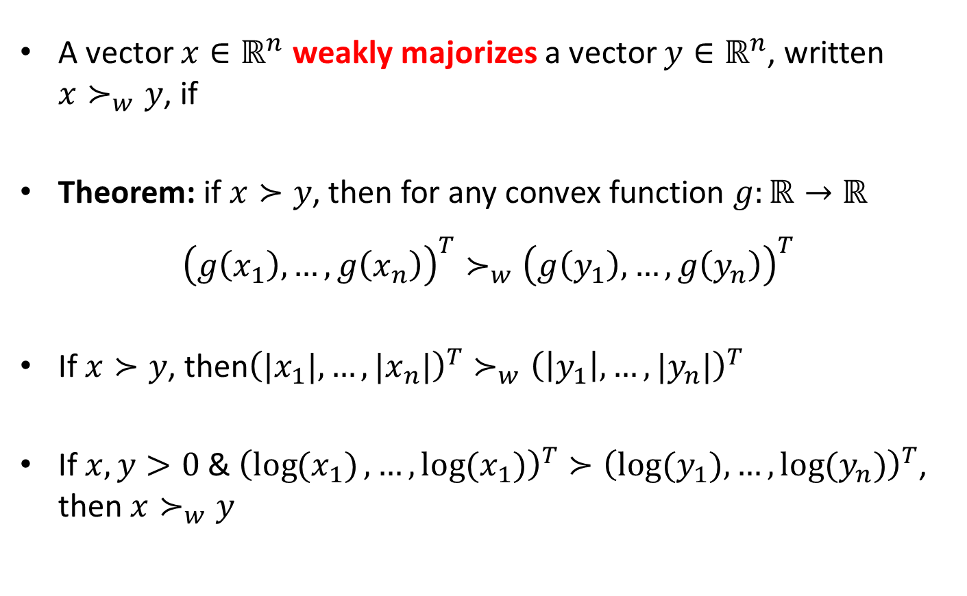
Weak Vector Majorization
A vector $x∈ℝ^{n}$ weakly majorizes a vector $y∈ℝ^{n}$, written $x≻_{w}y$, if
Theorem: if $x≻y$, then for any convex function $g:ℝ→ℝ$
$${\left(g\left(x_{1}\right),…,g\left(x_{n}\right)\right)}^{T}≻_{w}{\left(g\left(y_{1}\right),…,g\left(y_{n}\right)\right)}^{T}$$
If $x≻y$, then${\left(|x_{1}|,…,|x_{n}|\right)}^{T}≻_{w}{\left(\left|y_{1}\right|,…,|y_{n}|\right)}^{T}$
If $x,y>0$& ${\left(\log{(x_{1})},…,\log{(x_{1})}\right)}^{T}≻{\left(log⁡(y_{1}),…,\log{(y_{n})}\right)}^{T}$, then $x≻_{w}y$

Slide 13

Schur Convexity
A function $f:ℝ^{n}→ℝ$ is Schur convex if $x≺y$ implies $f\left(x\right)≤f\left(y\right)$

Slide 14
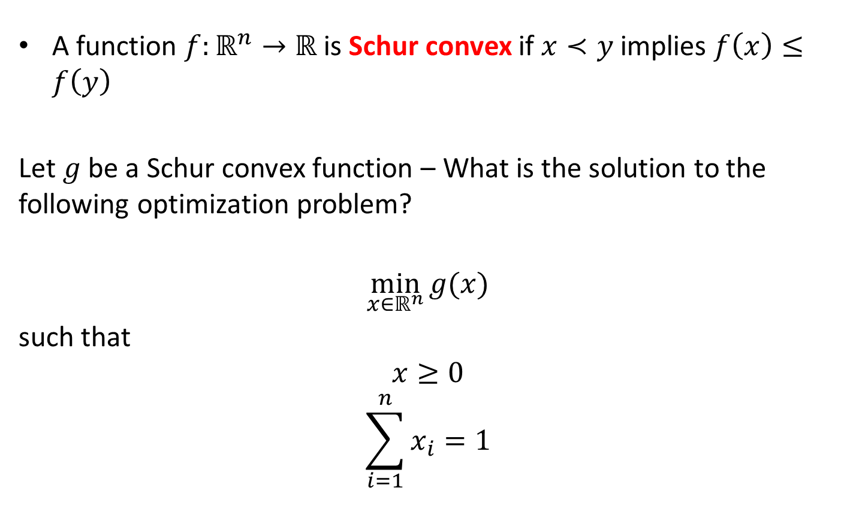
Schur Convexity
A function $f:ℝ^{n}→ℝ$ is Schur convex if $x≺y$ implies $f\left(x\right)≤f\left(y\right)$
Let $g$ be a Schur convex function – What is the solution to the following optimization problem?
$$\min_{x∈ℝ^{n}}{g(x)}$$
such that
$$x≥0$$
$$\sum_{i=1}^{n}{x_{i}}=1$$

Slide 15
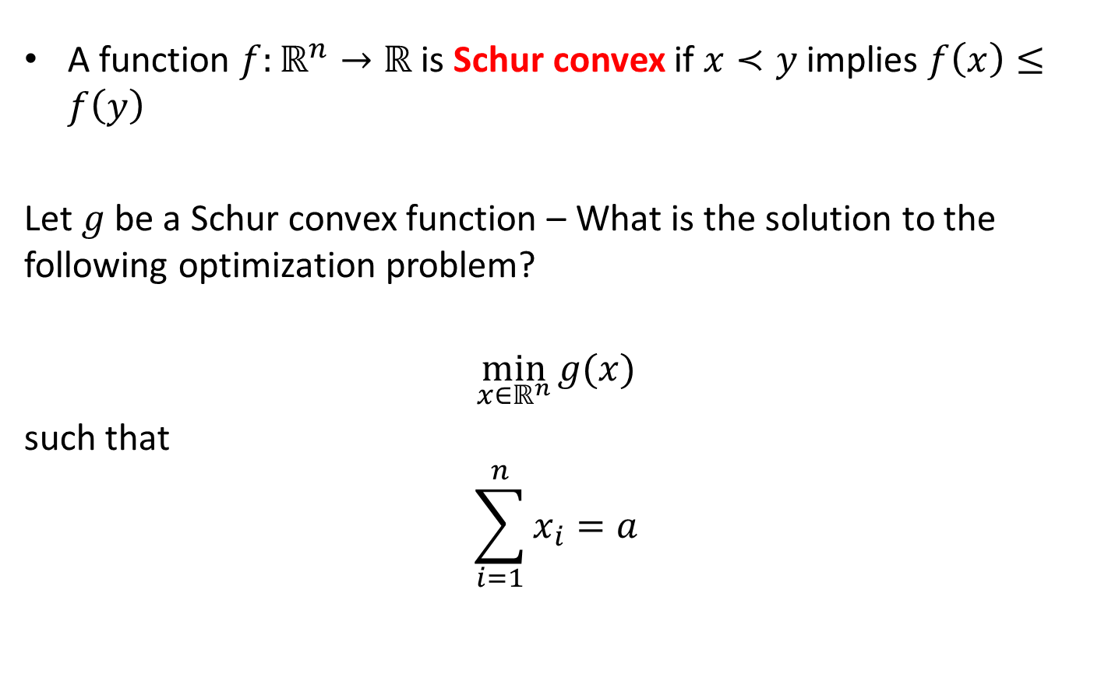
Schur Convexity
A function $f:ℝ^{n}→ℝ$ is Schur convex if $x≺y$ implies $f\left(x\right)≤f\left(y\right)$
Let $g$ be a Schur convex function – What is the solution to the following optimization problem?
$$\min_{x∈ℝ^{n}}{g(x)}$$
such that
$$\sum_{i=1}^{n}{x_{i}}=a$$

Slide 16
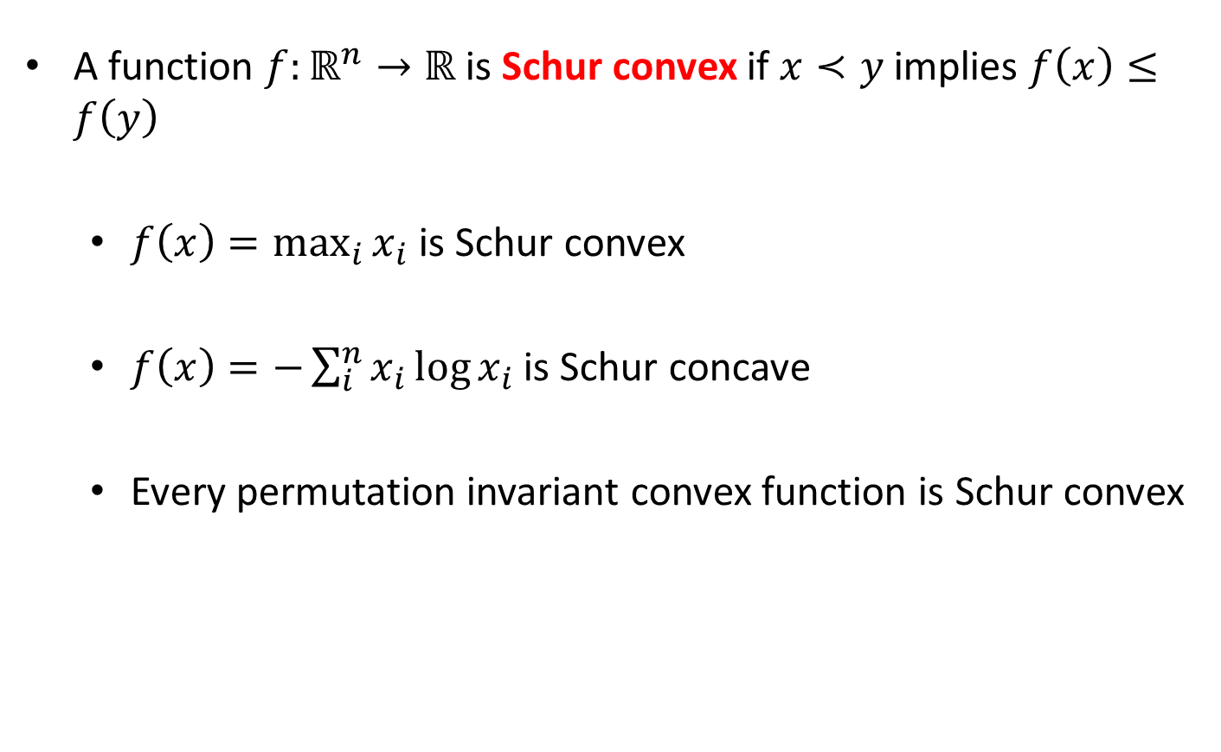
Schur Convexity
A function $f:ℝ^{n}→ℝ$ is Schur convex if $x≺y$ implies $f\left(x\right)≤f\left(y\right)$
  $f\left(x\right)=\max_{i}{x_{i}}$ is Schur convex
  $f\left(x\right)=−\sum_{i}^{n}{x_{i}\log{x_{i}}}$ is Schur concave
  Every permutation invariant convex function is Schur convex

Slide 17
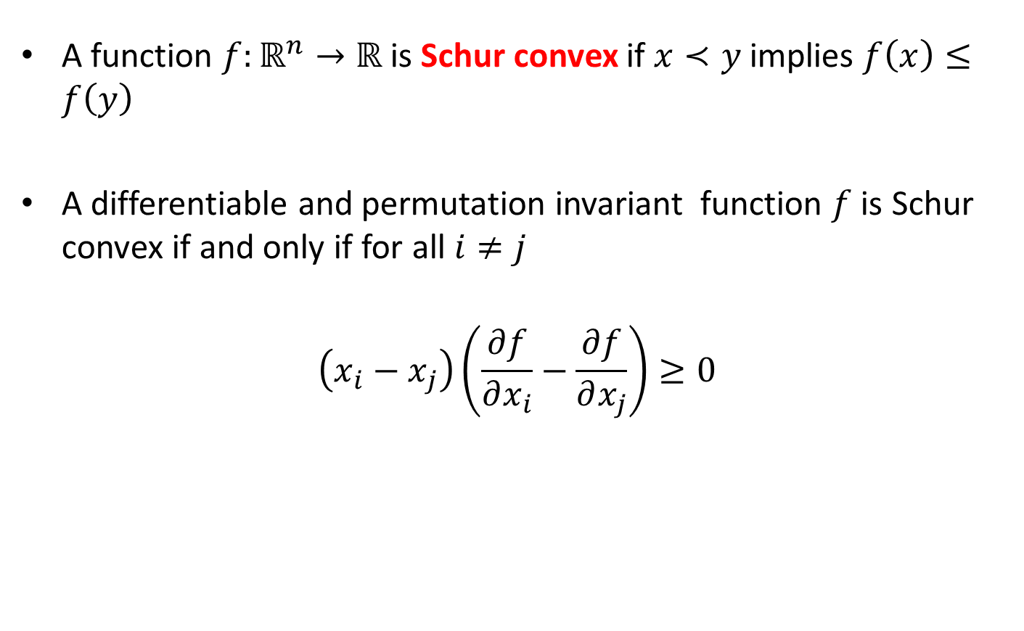
Schur Convexity
A function $f:ℝ^{n}→ℝ$ is Schur convex if $x≺y$ implies $f\left(x\right)≤f\left(y\right)$
A differentiable and permutation invariant function $f$ is Schur convex if and only if for all $i≠j$
$$\left(x_{i}−x_{j}\right)\left(\frac{∂f}{∂x_{i}}−\frac{∂f}{∂x_{j}}\right)≥0$$

