Slide 1
Convex Sets and Functions
Nicholas Ruozzi
University of Texas at Dallas

Slide 2
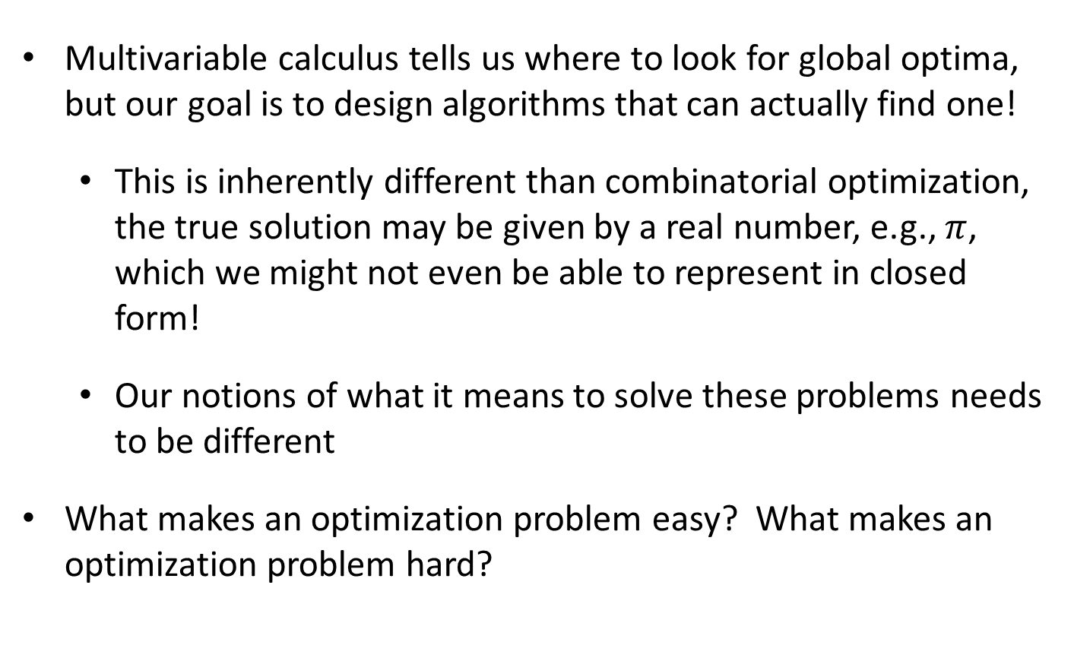
Where We’re Going
Multivariable calculus tells us where to look for global optima, but our goal is to design algorithms that can actually find one!
  This is inherently different than combinatorial optimization, the true solution may be given by a real number, e.g., $π$, which we might not even be able to represent in closed form!
  Our notions of what it means to solve these problems needs to be different
What makes an optimization problem easy? What makes an optimization problem hard?

Slide 3

Convex Sets
A set of points $C⊆ℝ^{n}$ is convex if for every pair of points $x,y∈C$, any point on the line segment between $x$ and $y$ is also in $C$
  That is, if $x,y∈C$, then $tx+\left(1−t\right)y∈C$ for all $t∈[0,1]$
Convex Set
Not a Convex Set

Slide 4
Convex Sets
A set of points $C⊆ℝ^{n}$ is convex if for every pair of points $x,y∈C$, any point on the line segment between $x$ and $y$ is also in $C$
  That is, if $x,y∈C$, then $tx+\left(1−t\right)y∈C$ for all $t∈[0,1]$
Convex Set
Not a Convex Set

Slide 5



Examples of Convex Sets
Line Segments: $C=\{x+t(y−x) :t∈[0,1]\}$ for some $x,y∈ℝ^{n}$
Lines, planes, hyperplanes, etc. also define convex sets
$$x$$
$$y$$

Slide 6


Examples of Convex Sets
Half spaces: $C=\{x∈ℝ^{n} :w^{T}x+b≤0\}$ for some $w∈ℝ^{n}$ and $b∈ℝ$
$$w^{T}x+b=0$$

Slide 7
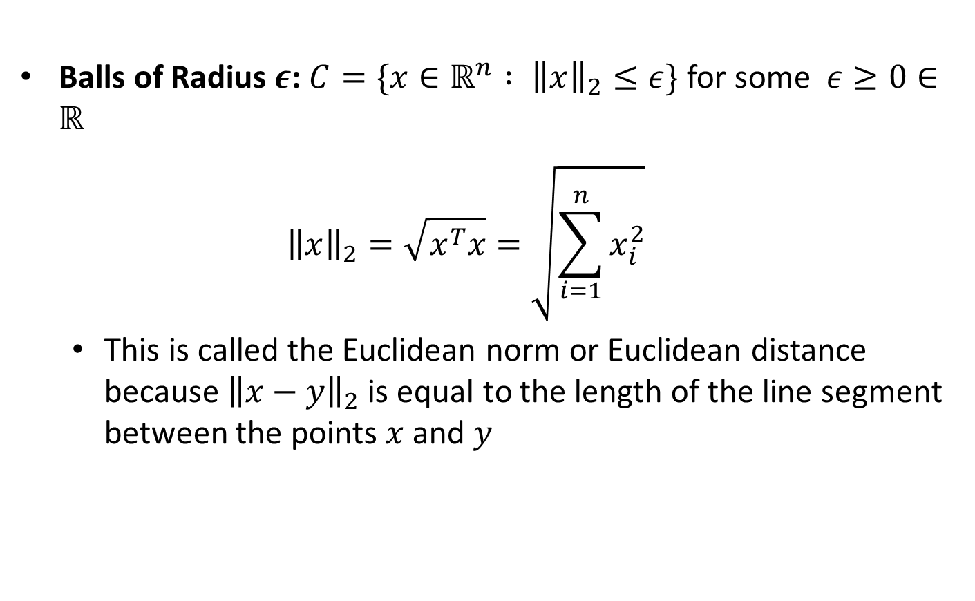
Examples of Convex Sets
Balls of Radius $ε$: $C=\{x∈ℝ^{n} : {\left\|x\right\|}_{2}≤ε\}$ for some $ε≥0∈ℝ$
  $${\left\|x\right\|}_{2}=\sqrt{x^{T}x}=\sqrt{\sum_{i=1}^{n}{x_{i}^{2}}}$$
  This is called the Euclidean norm or Euclidean distance because ${\left\|x−y\right\|}_{2}$ is equal to the length of the line segment between the points $x$ and $y$

Slide 8


Examples of Convex Sets
Balls of Radius $ε$: $C=\{x∈ℝ^{n} : {\left\|x\right\|}_{2}≤ε\}$ for some $ε≥0∈ℝ$
  $${\left\|x\right\|}_{2}=\sqrt{x^{T}x}=\sqrt{\sum_{i=1}^{n}{x_{i}^{2}}}$$
$$ϵ$$

Slide 9
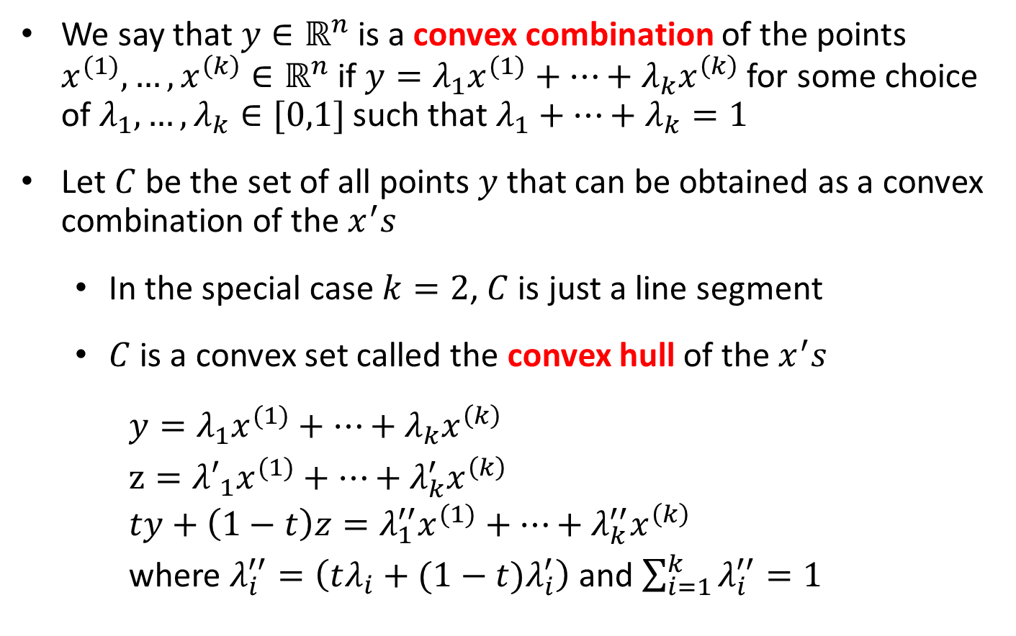
Convex Combinations
We say that $y∈ℝ^{n}$ is a convex combination of the points $x^{(1)},…,x^{\left(k\right)}∈ℝ^{n}$ if $y=λ_{1}x^{(1)}+…+λ_{k}x^{\left(k\right)}$ for some choice of $λ_{1},…,λ_{k}∈[0,1]$ such that $λ_{1}+…+λ_{k}=1$
Let $C$ be the set of all points $y$ that can be obtained as a convex combination of the $x^{′}s$
  In the special case $k=2$, $C$ is just a line segment
  $C$ is a convex set called the convex hull of the $x^{′}s$
    $y=λ_{1}x^{(1)}+…+λ_{k}x^{\left(k\right)}$
    $z={λ′}_{1}x^{(1)}+…+λ_{k}^{′}x^{\left(k\right)}$
    $$ty+\left(1−t\right)z=λ_{1}^{′′}x^{(1)}+…+λ_{k}^{′′}x^{\left(k\right)}$$
    where $λ_{i}^{′′}=\left(tλ_{i}+(1−t)λ_{i}^{′}\right)$ and $\sum_{i=1}^{k}{λ_{i}^{′′}}=1$

Slide 10
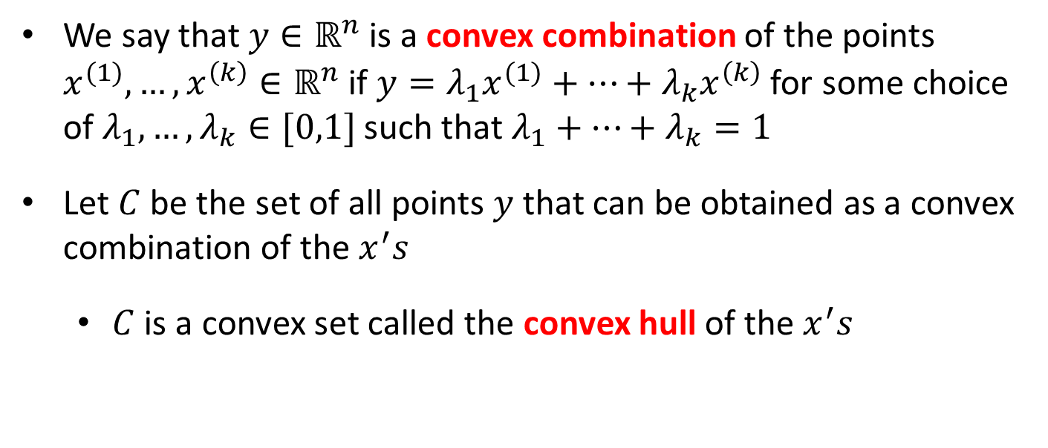
Convex Combinations
We say that $y∈ℝ^{n}$ is a convex combination of the points $x^{(1)},…,x^{\left(k\right)}∈ℝ^{n}$ if $y=λ_{1}x^{(1)}+…+λ_{k}x^{\left(k\right)}$ for some choice of $λ_{1},…,λ_{k}∈[0,1]$ such that $λ_{1}+…+λ_{k}=1$
Let $C$ be the set of all points $y$ that can be obtained as a convex combination of the $x^{′}s$
  $C$ is a convex set called the convex hull of the $x^{′}s$

Slide 11

Convex Functions
A function $f:C→ℝ^{n}$ is convex if $C$ is a convex set and
$$f\left(tx+\left(1−t\right)y\right)≤tf\left(x\right)+\left(1−t\right)f(y)$$
for all $x,y∈C$ and $t∈[0,1]$
  $f$ is called concave if $−f$ is convex

Slide 12

Convex Functions
A function $f:C→ℝ^{n}$ is convex if $C$ is a convex set and
$$f\left(tx+\left(1−t\right)y\right)≤tf\left(x\right)+\left(1−t\right)f(y)$$
for all $x,y∈C$ and $t∈[0,1]$

Slide 13
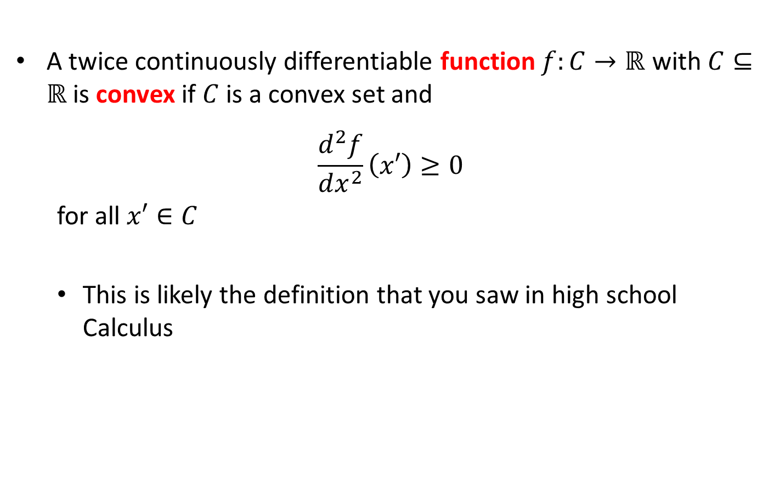
Convex Functions
A twice continuously differentiable function $f:C→ℝ$ with $C⊆ℝ$is convex if $C$ is a convex set and
$$\frac{d^{2}f}{dx^{2}}\left(x′\right)≥0$$
for all $x′∈C$
  This is likely the definition that you saw in high school Calculus

Slide 14

Convex Functions
Which of the following functions are convex?
  $\exp\left(x\right)$
  $exp⁡(−x)$
  $\log{(x)}$
  $\sin{(x)}$
  $x^{2}$
  $x^{8}$
  $\max{(x,0)}$
  $\sqrt{x}$
  $|x|$

Slide 15

Convex Functions
Which of the following functions are convex?
  $\exp\left(x\right)$
  $exp⁡(−x)$
  $\log{(x)}$
  $\sin{(x)}$
  $x^{2}$
  $x^{8}$
  $\max{(x,0)}$
  $\sqrt{x}$
  $|x|$

Slide 16

Operations Preserving Convexity
Nonnegative weighted sums of convex functions are convex, i.e., if $f_{1}:ℝ^{n}→ℝ$ and $f_{2}:ℝ^{n}→ℝ$ are convex functions and $c_{1},c_{2}≥0,$ then
$$g\left(x\right)=c_{1}f_{1}\left(x\right)+c_{2}f_{2}(x)$$
is a convex function.

Slide 17

Operations Preserving Convexity
Composition with an affine function, i.e., if $f:ℝ^{n}→ℝ$ is a convex function and $M∈ℝ^{n×m},b∈ℝ^{n}$, then $g:ℝ^{m}→ℝ$ given by
$$g\left(x\right)=f(Mx+b)$$
is a convex function.

Slide 18

Operations Preserving Convexity
Pointwise maximum of convex functions are convex, i.e., if $f_{1}:ℝ^{n}→ℝ$ and $f_{2}:ℝ^{n}→ℝ$ are convex functions$,$ then
$$g\left(x\right)=\max\left(f_{1}\left(x\right), f_{2}(x)\right)$$
is a convex function.

Slide 19

Operations Preserving Convexity
Pointwise supremum, i.e., if $f(x,y)$ is convex in $x∈ℝ^{n}$ for each fixed $y∈Y$ then
$$g\left(x\right)=\sup_{y∈Y}{f(x,y)}$$
is a convex function.

Slide 20
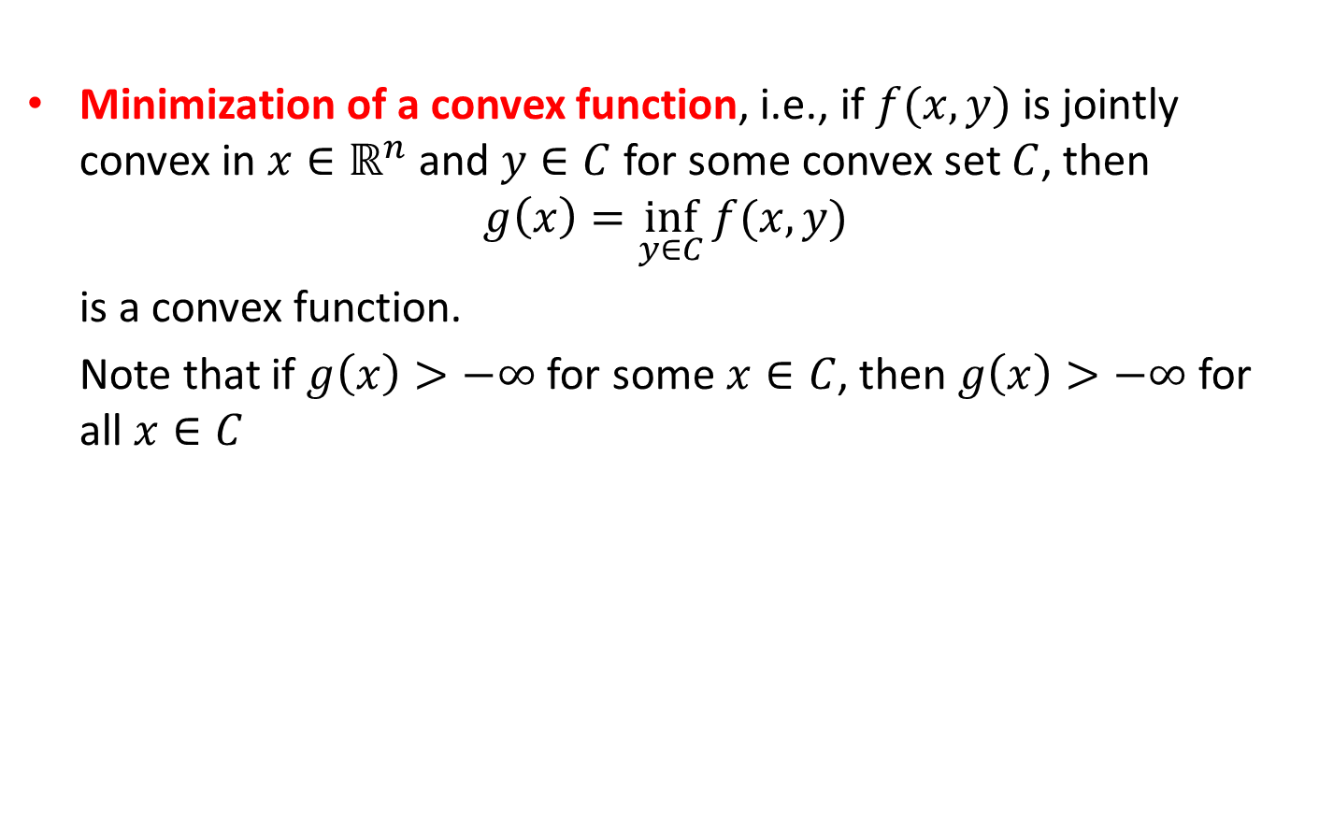
Operations Preserving Convexity
Minimization of a convex function, i.e., if $f(x,y)$ is jointly convex in $x∈ℝ^{n}$ and $y∈C$ for some convex set $C$, then
$$g\left(x\right)=\inf_{y∈C}{f(x,y)}$$
is a convex function.
Note that if $g\left(x\right)>−∞$ for some $x∈C$, then $g\left(x\right)>−∞$ for
all $x∈C$

Slide 21
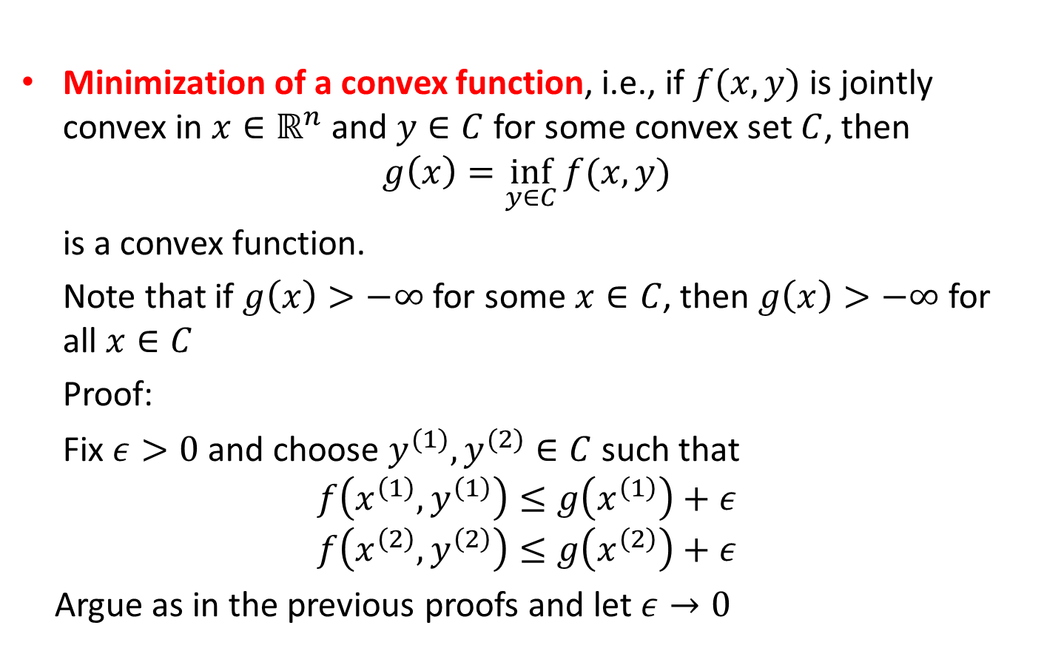
Operations Preserving Convexity
Minimization of a convex function, i.e., if $f(x,y)$ is jointly convex in $x∈ℝ^{n}$ and $y∈C$ for some convex set $C$, then
$$g\left(x\right)=\inf_{y∈C}{f(x,y)}$$
is a convex function.
Note that if $g\left(x\right)>−∞$ for some $x∈C$, then $g\left(x\right)>−∞$ for
all $x∈C$
Proof:
Fix $ε>0$ and choose $y^{(1)},y^{(2)}∈C$ such that
$$f\left(x^{\left(1\right)},y^{\left(1\right)}\right)≤g\left(x^{\left(1\right)}\right)+ε$$
$$f\left(x^{\left(2\right)},y^{\left(2\right)}\right)≤g\left(x^{\left(2\right)}\right)+ε$$
Argue as in the previous proofs and let $ε→0$

Slide 22

Other Characterizations of Convexity
A differentiable function $f:ℝ^{n}→ℝ$ is convex on a convex set $C$ if and only if
  $$f\left(x\right)≥f\left(y\right)+∇f{\left(y\right)}^{T}\left(x−y\right)$$
  for all $x,y∈C$
  Proof: see Boyd 3.3.1

Slide 23
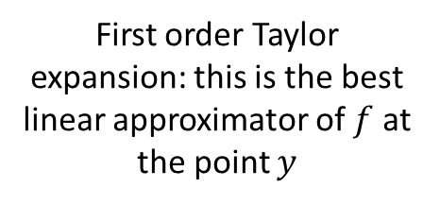

Other Characterizations of Convexity
A differentiable function $f:ℝ^{n}→ℝ$ is convex on a convex set $C$ if and only if
  $$f\left(x\right)≥f\left(y\right)+∇f{\left(y\right)}^{T}\left(x−y\right)$$
  for all $x,y∈C$
First order Taylor expansion: this is the best linear approximator of $f$ at the point $y$

Slide 24



Other Characterizations of Convexity
A differentiable function $f:ℝ^{n}→ℝ$ is convex on a convex set $C$ if and only if
  $$f\left(x\right)≥f\left(y\right)+∇f{\left(y\right)}^{T}\left(x−y\right)$$
  for all $x,y∈C$
$$f(x)$$
$$y$$
$$f\left(y\right)+f^{′}\left(y\right)(x−y)$$

Slide 25
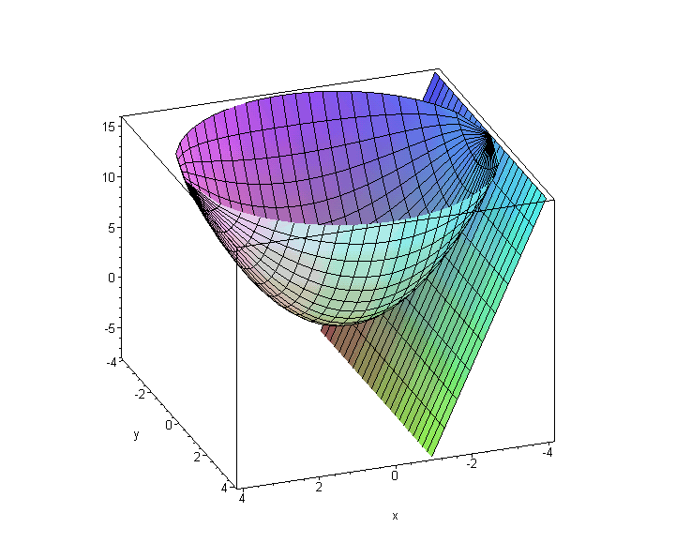
Other Characterizations of Convexity
A differentiable function $f:ℝ^{n}→ℝ$ is convex on a convex set $C$ if and only if
  $$f\left(x\right)≥f\left(y\right)+∇f{\left(y\right)}^{T}\left(x−y\right)$$
  for all $x,y∈C$
Image: Lane Vosbury, Seminole State College

Slide 26
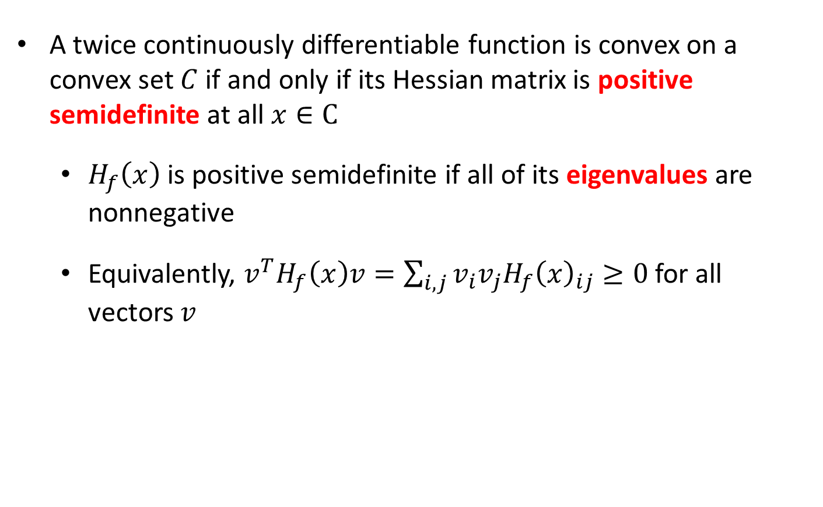
Other Characterizations of Convexity
A twice continuously differentiable function is convex on a convex set $C$ if and only if its Hessian matrix is positive semidefinite at all $x∈C$
  $H_{f}\left(x\right)$ is positive semidefinite if all of its eigenvalues are nonnegative
  Equivalently, $v^{T}H_{f}\left(x\right)v=\sum_{i,j}{v_{i}v_{j}H_{f}{\left(x\right)}_{ij}}≥0$ for all vectors $v$

