Slide 1
Lecture 7: Second Order Methods
Nicholas Ruozzi
University of Texas at Dallas

Slide 2

Gradient Descent
Gradient Descent Algorithm:
Pick an initial point $x_{0}$
Iterate until convergence
$$x_{t+1}=x_{t}−γ_{t}∇f(x_{t})$$
where $γ_{t}$ is the $t^{th}$ step size (sometimes called learning rate)

Slide 3
Gradient Descent
At a high level, gradient descent uses the first order Taylor expansion to approximate the function locally
Does not take into account the curvature of the function, i.e., how quickly the gradient is changing
  This means that it can dramatically overshoot the optimum with a fixed step size

Slide 4
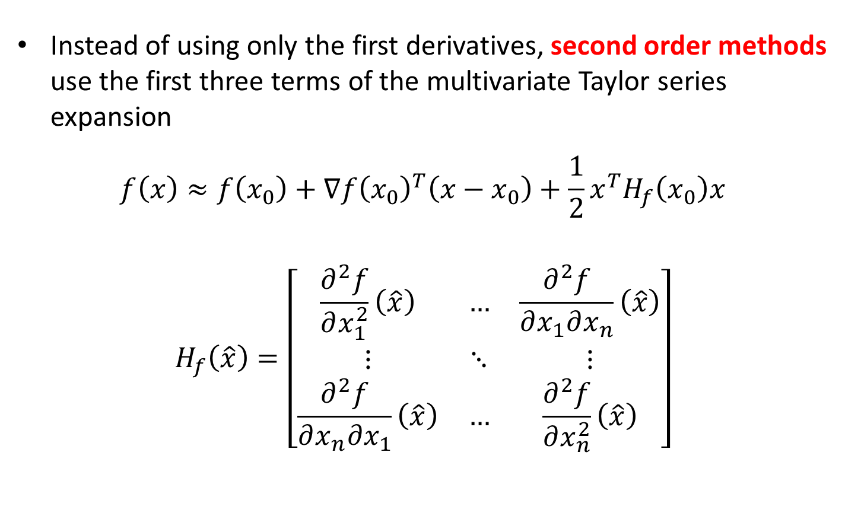
Second Order Methods
Instead of using only the first derivatives, second order methods use the first three terms of the multivariate Taylor series expansion
$$f\left(x\right)≈f\left(x_{0}\right)+∇f{\left(x_{0}\right)}^{T}\left(x−x_{0}\right)+\frac{1}{2}x^{T}H_{f}\left(x_{0}\right)x$$
$$H_{f}\left(\hat{x}\right)=\left[\begin{matrix}\frac{∂^{2}f}{∂x_{1}^{2}}\left(\hat{x}\right) & … & \frac{∂^{2}f}{∂x_{1}∂x_{n}}\left(\hat{x}\right) \\ ⋮ & ⋱ & ⋮ \\ \frac{∂^{2}f}{∂x_{n}∂x_{1}}\left(\hat{x}\right) & … & \frac{∂^{2}f}{∂x_{n}^{2}}\left(\hat{x}\right)\end{matrix}\right]$$

Slide 5

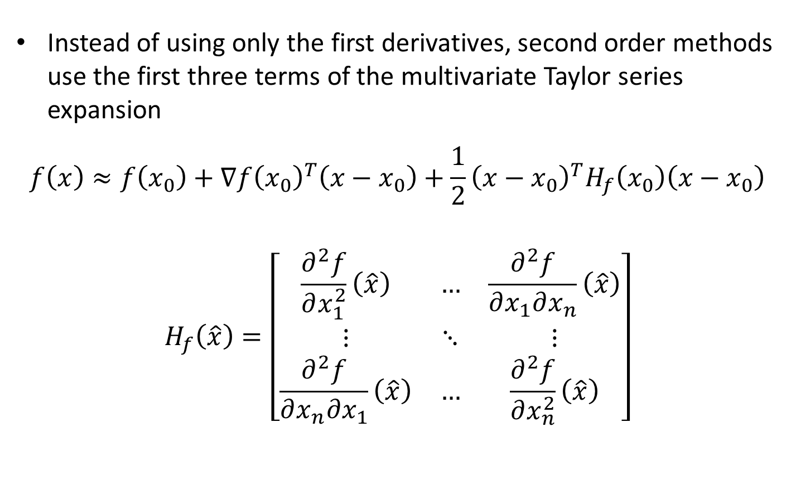
Second Order Methods
Instead of using only the first derivatives, second order methods use the first three terms of the multivariate Taylor series expansion
$$f\left(x\right)≈f\left(x_{0}\right)+∇f{\left(x_{0}\right)}^{T}\left(x−x_{0}\right)+\frac{1}{2}{\left(x−x_{0}\right)}^{T}H_{f}\left(x_{0}\right)\left(x−x_{0}\right)$$
$$H_{f}\left(\hat{x}\right)=\left[\begin{matrix}\frac{∂^{2}f}{∂x_{1}^{2}}\left(\hat{x}\right) & … & \frac{∂^{2}f}{∂x_{1}∂x_{n}}\left(\hat{x}\right) \\ ⋮ & ⋱ & ⋮ \\ \frac{∂^{2}f}{∂x_{n}∂x_{1}}\left(\hat{x}\right) & … & \frac{∂^{2}f}{∂x_{n}^{2}}\left(\hat{x}\right)\end{matrix}\right]$$
Sometimes written $∇^{2}f(\hat{x})$

Slide 6
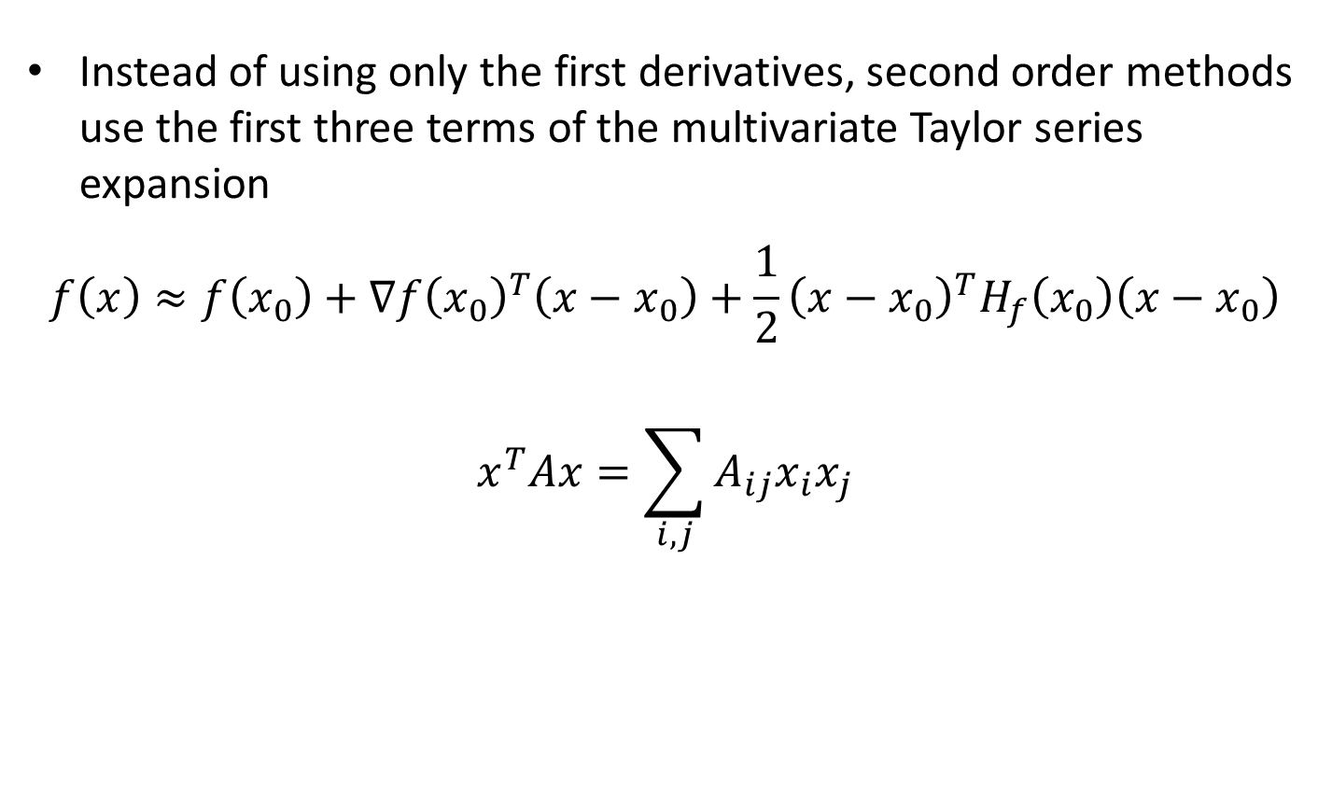
Second Order Methods
Instead of using only the first derivatives, second order methods use the first three terms of the multivariate Taylor series expansion
$$f\left(x\right)≈f\left(x_{0}\right)+∇f{\left(x_{0}\right)}^{T}\left(x−x_{0}\right)+\frac{1}{2}{\left(x−x_{0}\right)}^{T}H_{f}\left(x_{0}\right)\left(x−x_{0}\right)$$
$$x^{T}Ax=\sum_{i,j}{A_{ij}x_{i}x_{j}}$$

Slide 7
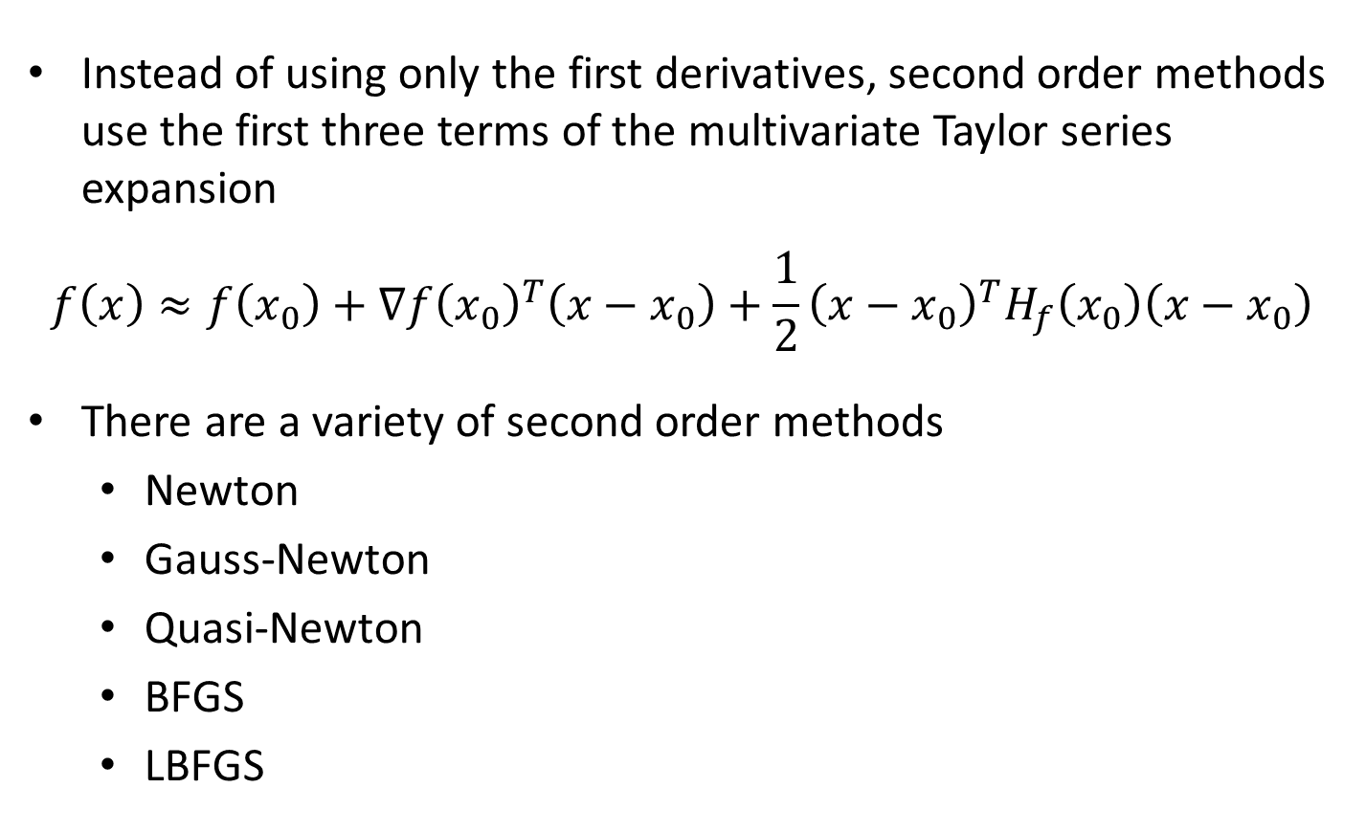
Second Order Methods
Instead of using only the first derivatives, second order methods use the first three terms of the multivariate Taylor series expansion
$$f\left(x\right)≈f\left(x_{0}\right)+∇f{\left(x_{0}\right)}^{T}\left(x−x_{0}\right)+\frac{1}{2}{\left(x−x_{0}\right)}^{T}H_{f}\left(x_{0}\right)\left(x−x_{0}\right)$$
There are a variety of second order methods
  Newton
  Gauss-Newton
  Quasi-Newton
  BFGS
  LBFGS

Slide 8
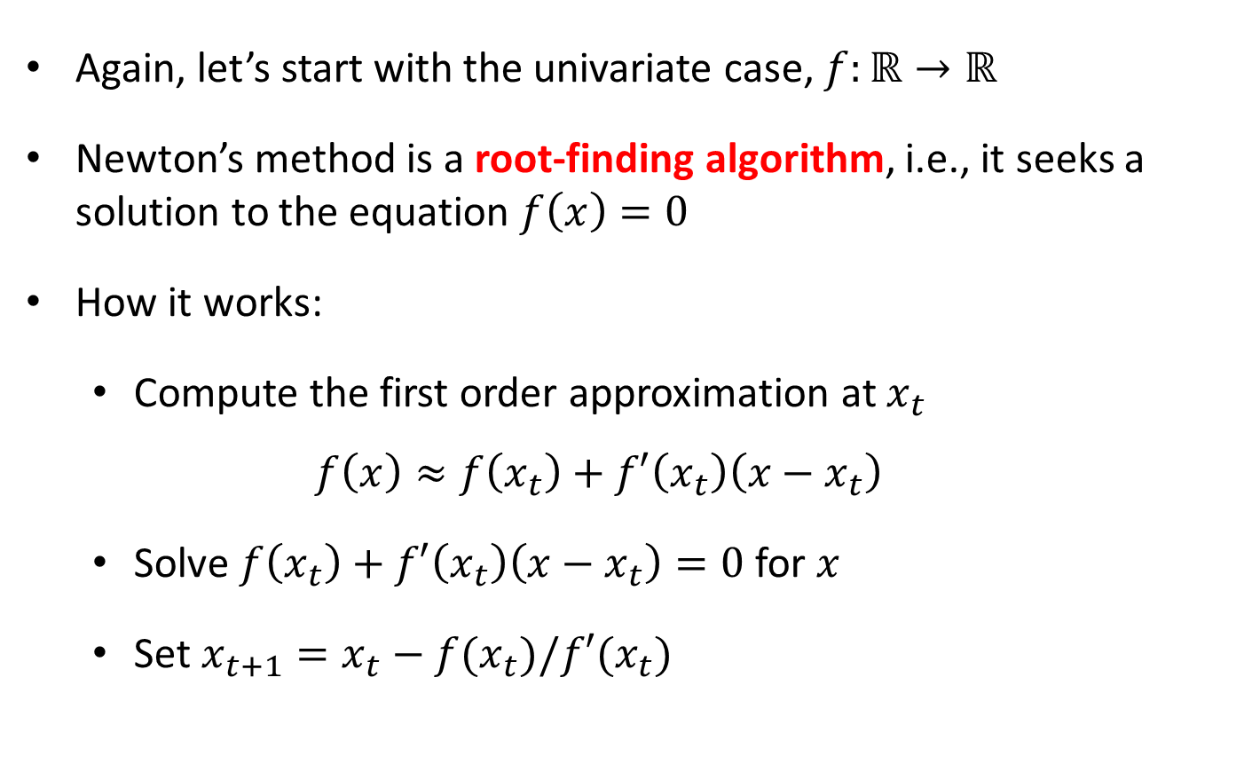
Newton’s Method
Again, let’s start with the univariate case, $f:ℝ→ℝ$
Newton’s method is a root-finding algorithm, i.e., it seeks a solution to the equation $f\left(x\right)=0$
How it works:
  Compute the first order approximation at $x_{t}$
  $$f\left(x\right)≈f\left(x_{t}\right)+f′\left(x_{t}\right)\left(x−x_{t}\right)$$
  Solve $f\left(x_{t}\right)+f′\left(x_{t}\right)\left(x−x_{t}\right)=0$ for $x$
  Set $x_{t+1}=x_{t}−f(x_{t})/f′(x_{t})$

Slide 9
Newton’s Method

Slide 10
Newton’s Method

Slide 11
Newton’s Method

Slide 12
Newton’s Method

Slide 13
Newton’s Method

Slide 14
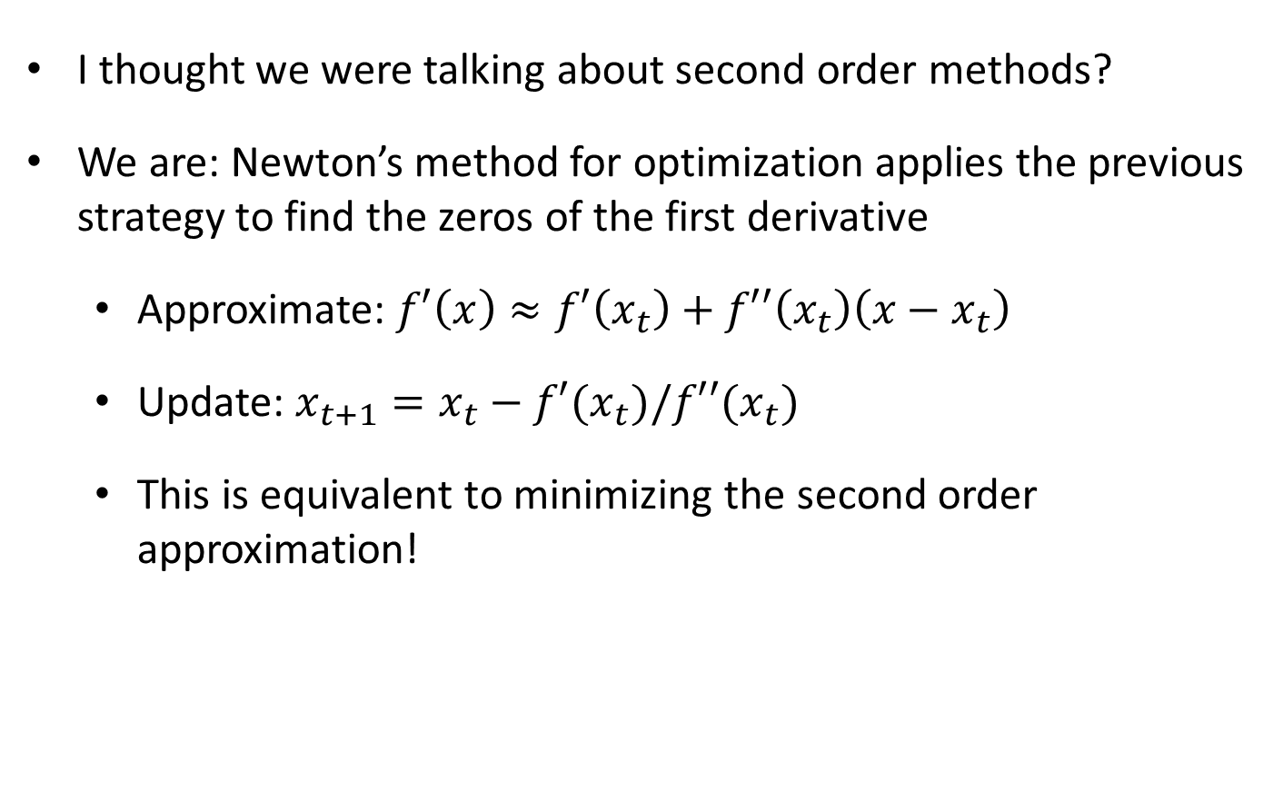
Newton’s Method
I thought we were talking about second order methods?
We are: Newton’s method for optimization applies the previous strategy to find the zeros of the first derivative
  Approximate: $f′\left(x\right)≈f′\left(x_{t}\right)+f′′\left(x_{t}\right)\left(x−x_{t}\right)$
  Update: $x_{t+1}=x_{t}−f′(x_{t})/f′′(x_{t})$
  This is equivalent to minimizing the second order approximation!

Slide 15
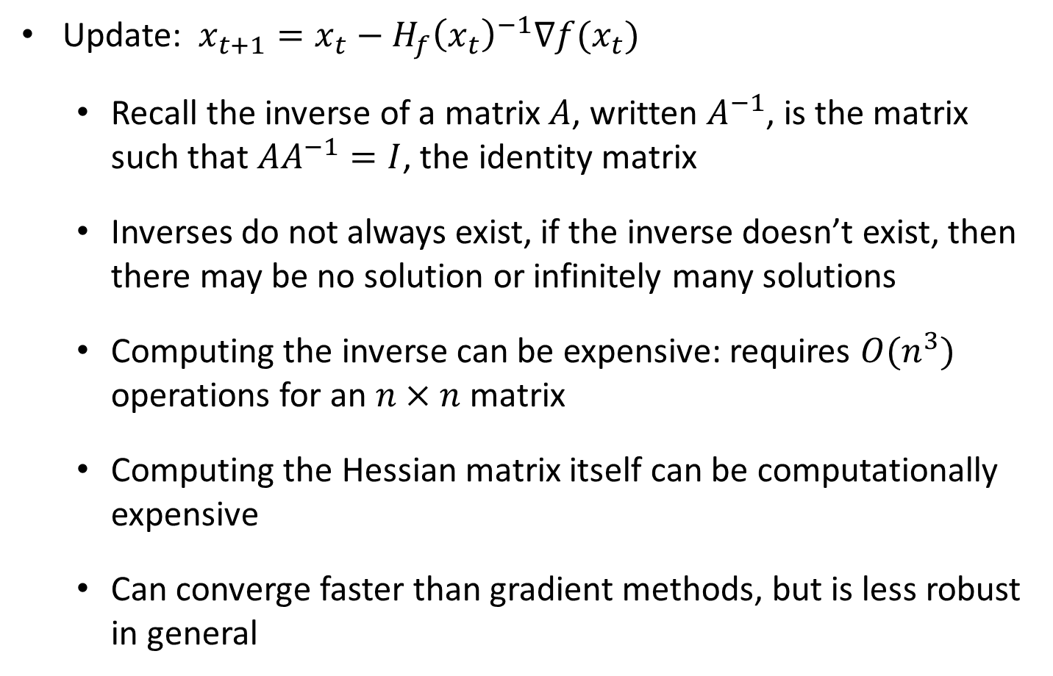
Multivariate Newton’s Method
Update: $x_{t+1}=x_{t}−H_{f}{\left(x_{t}\right)}^{−1}∇f(x_{t})$
  Recall the inverse of a matrix $A$, written $A^{−1}$, is the matrix such that ${AA}^{−1}=I$, the identity matrix
  Inverses do not always exist, if the inverse doesn’t exist, then there may be no solution or infinitely many solutions
  Computing the inverse can be expensive: requires $O(n^{3})$ operations for an $n×n$ matrix
  Computing the Hessian matrix itself can be computationally expensive
  Can converge faster than gradient methods, but is less robust in general

Slide 16
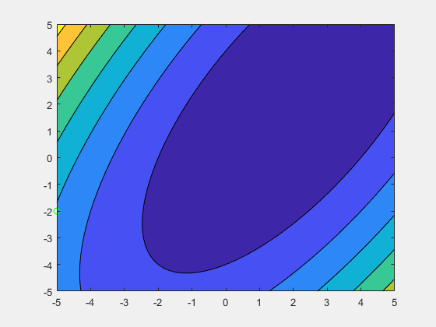
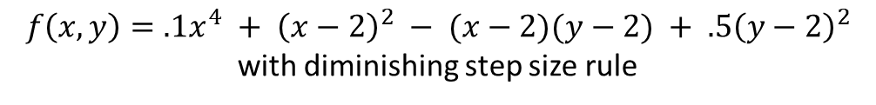
Gradient Descent
$$f\left(x,y\right)=.1x^{4} + {\left(x−2\right)}^{2} − (x−2)(y−2) + .5{\left(y−2\right)}^{2}$$
with diminishing step size rule

Slide 17

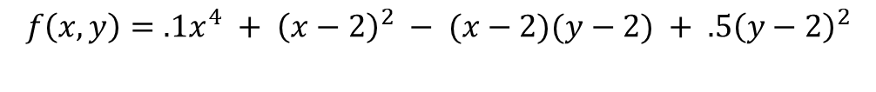
Newton’s Method
$$f\left(x,y\right)=.1x^{4} + {\left(x−2\right)}^{2} − (x−2)(y−2) + .5{\left(y−2\right)}^{2}$$

Slide 18
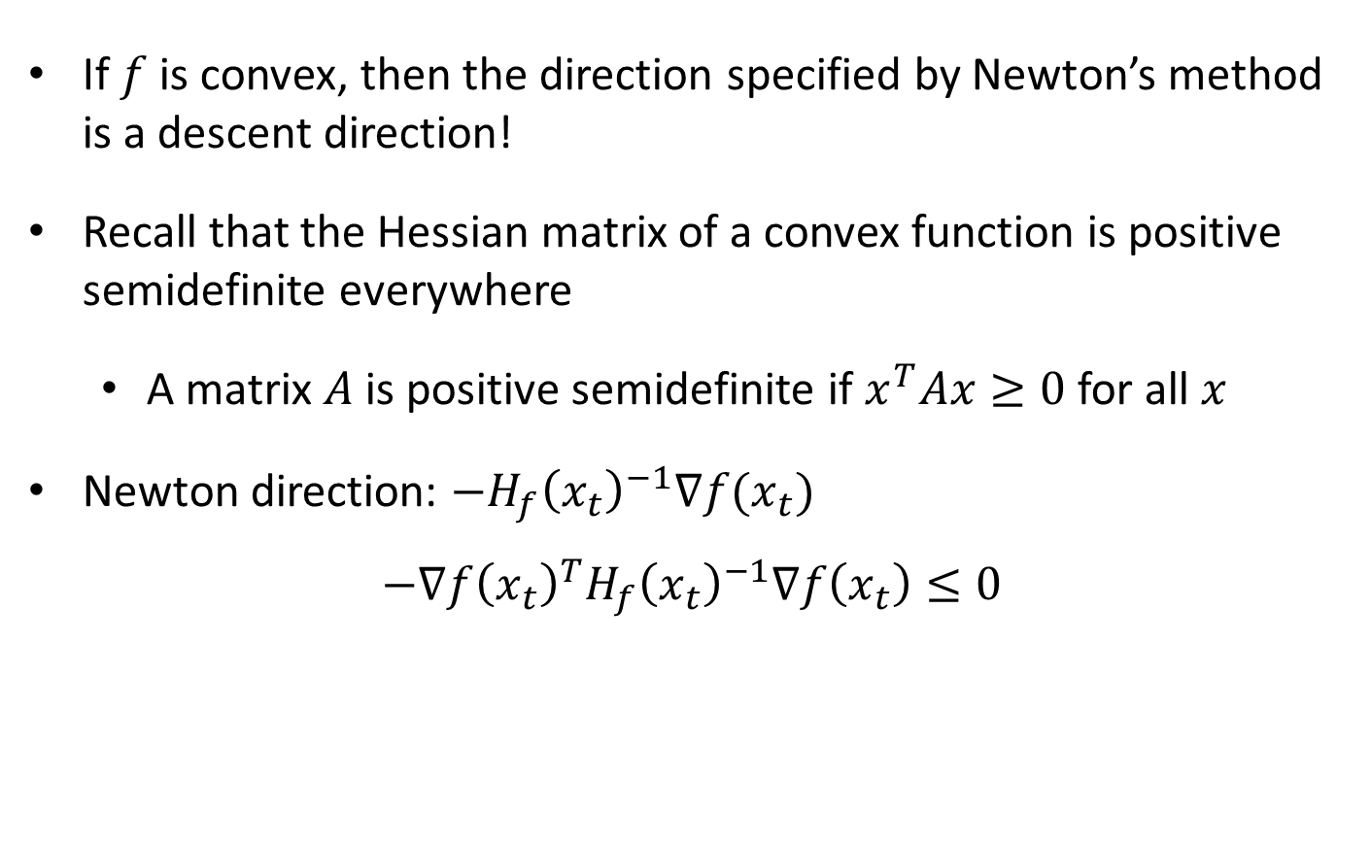
Newton Direction
If $f$ is convex, then the direction specified by Newton’s method is a descent direction!
Recall that the Hessian matrix of a convex function is positive semidefinite everywhere
  A matrix $A$ is positive semidefinite if $x^{T}Ax≥0$ for all $x$
Newton direction: $−H_{f}{\left(x_{t}\right)}^{−1}∇f(x_{t})$
$$−∇f{\left(x_{t}\right)}^{T}H_{f}{\left(x_{t}\right)}^{−1}∇f\left(x_{t}\right)≤0$$

Slide 19
Newton Direction
If $f$ is convex, then the direction specified by Newton’s method is a descent direction!
Recall that the Hessian matrix of a convex function is positive semidefinite everywhere
  A matrix $A$ is positive semidefinite if $x^{T}Ax≥0$ for all $x$
Newton direction: $−H_{f}{\left(x_{t}\right)}^{−1}∇f(x_{t})$
$$−∇f{\left(x_{t}\right)}^{T}H_{f}{\left(x_{t}\right)}^{−1}∇f\left(x_{t}\right)≤0$$
Can be used a stopping criteria: $∇f{\left(x_{t}\right)}^{T}H_{f}{\left(x_{t}\right)}^{−1}∇f\left(x_{t}\right)≤ε$

Slide 20
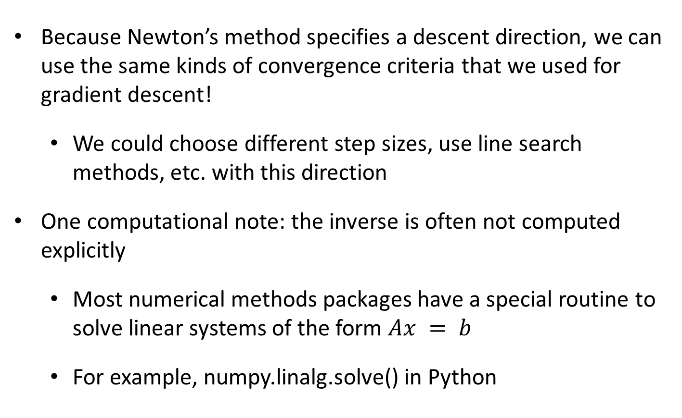
Convergence
Because Newton’s method specifies a descent direction, we can use the same kinds of convergence criteria that we used for gradient descent!
  We could choose different step sizes, use line search methods, etc. with this direction
One computational note: the inverse is often not computed explicitly
  Most numerical methods packages have a special routine to solve linear systems of the form $Ax = b$
  For example, numpy.linalg.solve() in Python

Slide 21
Equality Constrained Newton
Two different approaches:
  One based on duality
  One based on quadratic programming
Aim is just to make sure that the step taken via Newton’s method stays inside the constraint set

Slide 22

Equality Constrained Newton with Duality
$$\min_{x}{f_{0}(x)}$$
subject to
$$Ax=b$$
Dual problem:
$$g\left(ν\right)=\inf_{x}\left[f_{0}\left(x\right)+ν^{T}(Ax−b)\right]$$
$$=−ν^{T}b+\inf_{x}\left[f_{0}\left(x\right)+ν^{T}Ax\right]$$
$$=−ν^{T}b−\sup_{x}\left[−f_{0}\left(x\right)+{\left(−A^{T}ν\right)}^{T}x\right]$$

Slide 23
Equality Constrained Newton with Duality
$$\min_{x}{f_{0}(x)}$$
subject to
$$Ax=b$$
Dual problem:
$$g\left(ν\right)=\inf_{x}\left[f_{0}\left(x\right)+ν^{T}(Ax−b)\right]$$
$$=−ν^{T}b+\inf_{x}\left[f_{0}\left(x\right)+ν^{T}Ax\right]$$
$$=−ν^{T}b−\sup_{x}\left[−f_{0}\left(x\right)+{\left(−A^{T}ν\right)}^{T}x\right]$$
This function comes up frequently in convex optimization, gets a special name

Slide 24
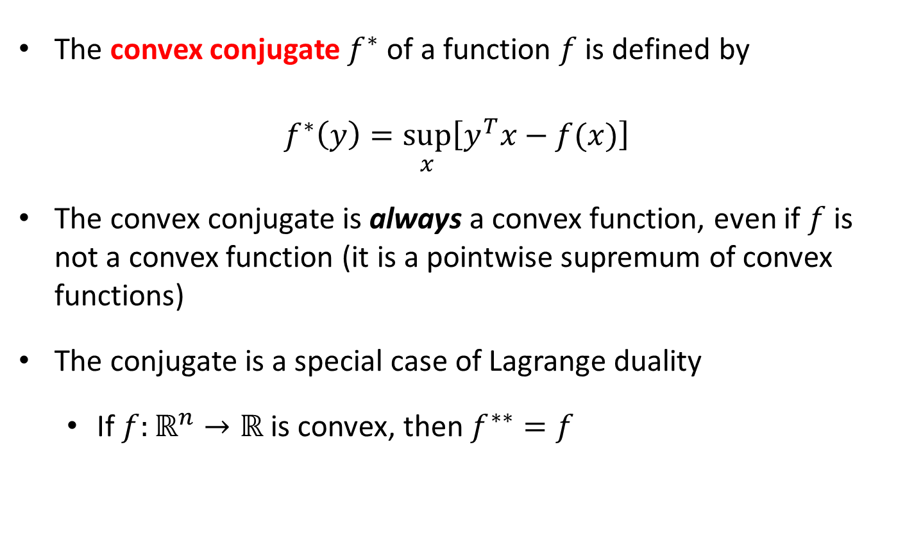
The Convex Conjugate
The convex conjugate $f^{∗}$ of a function $f$ is defined by
$$f^{∗}\left(y\right)=\sup_{x}\left[y^{T}x−f(x)\right]$$
The convex conjugate is always a convex function, even if $f$ is not a convex function (it is a pointwise supremum of convex functions)
The conjugate is a special case of Lagrange duality
  If $f:ℝ^{n}→ℝ$ is convex, then $f^{∗∗}=f$

Slide 25

Equality Constrained Newton with Duality
$$\min_{x}{f_{0}(x)}$$
subject to
$$Ax=b$$
Dual problem:
$$g\left(ν\right)=\inf_{x}\left[f_{0}\left(x\right)+ν^{T}(Ax−b)\right]$$
$$=−ν^{T}b+\inf_{x}\left[f_{0}\left(x\right)+ν^{T}Ax\right]$$
$$=−ν^{T}b−\sup_{x}\left[−f_{0}\left(x\right)+{\left(−A^{T}ν\right)}^{T}x\right]$$
$$=−ν^{T}b−f^{∗}\left(−A^{T}ν\right)$$
If this function is twice differentiable, we can apply Newton’s method to solve the dual

Slide 26
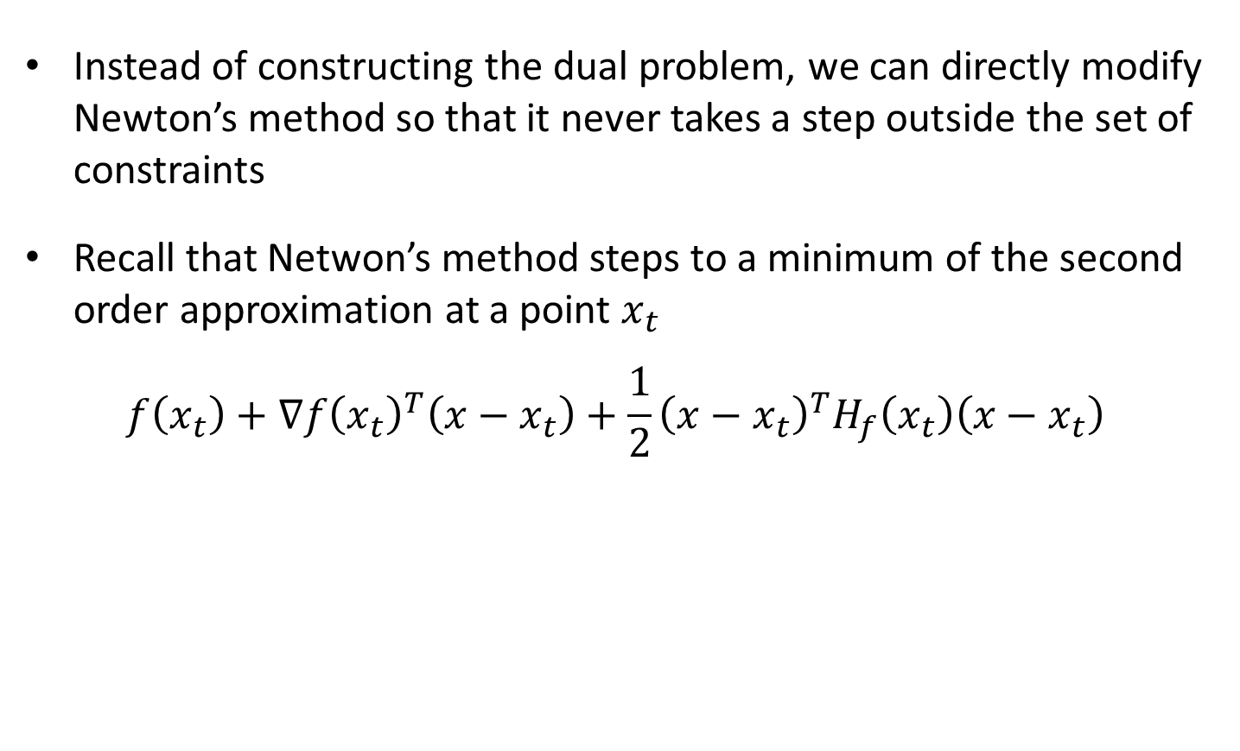
Equality Constrained Newton via QP/KKT
Instead of constructing the dual problem, we can directly modify Newton’s method so that it never takes a step outside the set of constraints
Recall that Netwon’s method steps to a minimum of the second order approximation at a point $x_{t}$
$$f\left(x_{t}\right)+∇f{\left(x_{t}\right)}^{T}\left(x−x_{t}\right)+\frac{1}{2}{\left(x−x_{t}\right)}^{T}H_{f}\left(x_{t}\right)\left(x−x_{t}\right)$$

Slide 27
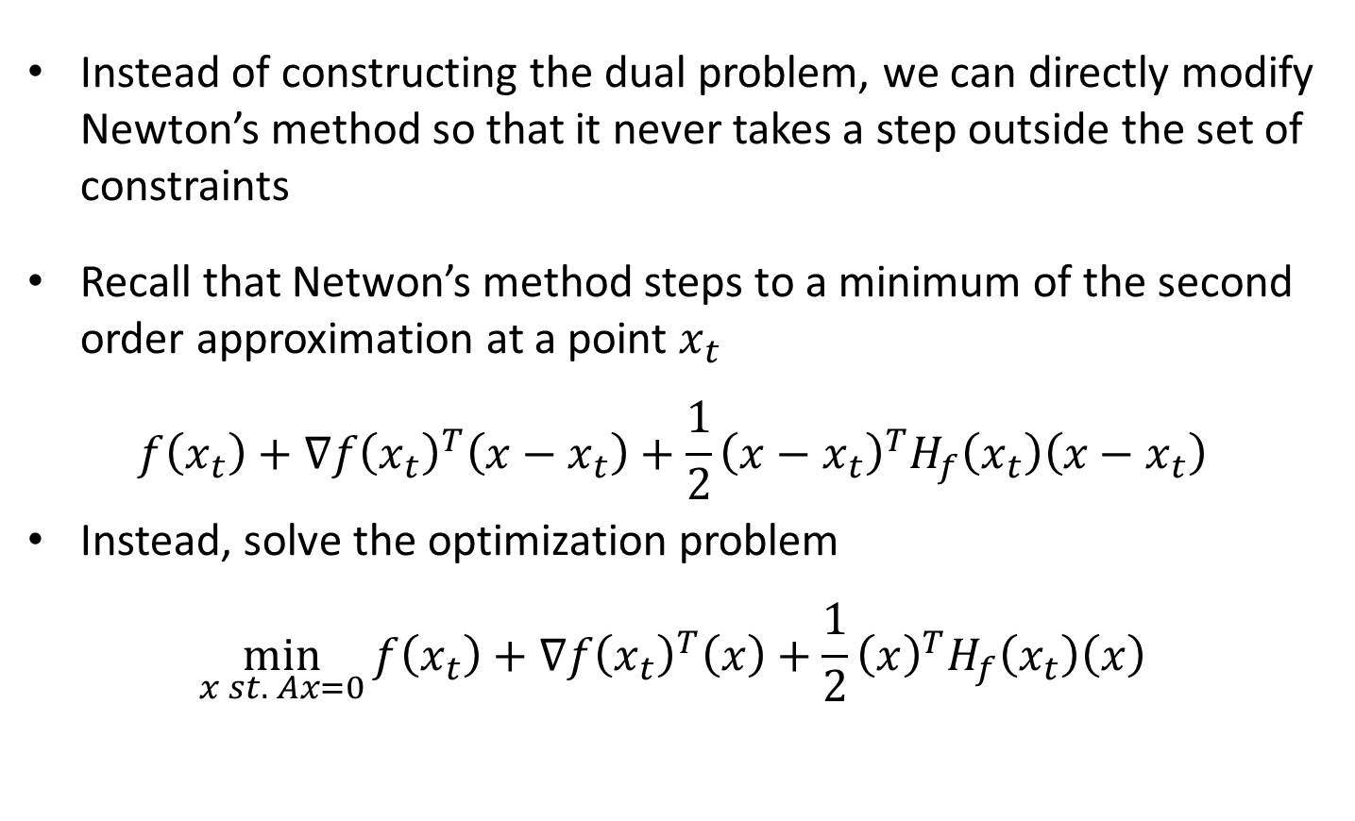
Equality Constrained Newton via QP/KKT
Instead of constructing the dual problem, we can directly modify Newton’s method so that it never takes a step outside the set of constraints
Recall that Netwon’s method steps to a minimum of the second order approximation at a point $x_{t}$
$$f\left(x_{t}\right)+∇f{\left(x_{t}\right)}^{T}\left(x−x_{t}\right)+\frac{1}{2}{\left(x−x_{t}\right)}^{T}H_{f}\left(x_{t}\right)\left(x−x_{t}\right)$$
Instead, solve the optimization problem
$$\min_{x st. Ax=0}{f\left(x_{t}\right)+∇f{\left(x_{t}\right)}^{T}\left(x\right)+\frac{1}{2}{\left(x\right)}^{T}H_{f}\left(x_{t}\right)\left(x\right)}$$

Slide 28

Equality Constrained Newton via QP/KKT
Pick an initial point $x_{0}$ such that $Ax_{0}=b$
Solve the optimization problem
$$\underset{x st. Ax=0}{x^{∗}∈argmin}{f\left(x_{t}\right)+∇f{\left(x_{t}\right)}^{T}\left(x\right)+\frac{1}{2}{\left(x\right)}^{T}H_{f}\left(x_{t}\right)\left(x\right)}$$
Update $x_{t+1}=x_{t}+γx^{∗}$

Slide 29

Equality Constrained Newton via QP/KKT
Pick an initial point $x_{0}$ such that $Ax_{0}=b$
Solve the optimization problem
$$\underset{x st. Ax=0}{x^{∗}∈argmin}{f\left(x_{t}\right)+∇f{\left(x_{t}\right)}^{T}\left(x\right)+\frac{1}{2}{\left(x\right)}^{T}H_{f}\left(x_{t}\right)(x) }$$
Update $x_{t+1}=x_{t}+γx^{∗}$
Note that $Ax_{t+1}=Ax_{t}+γAx^{∗}=Ax_{t}=…={Ax}_{0}=b$

Slide 30
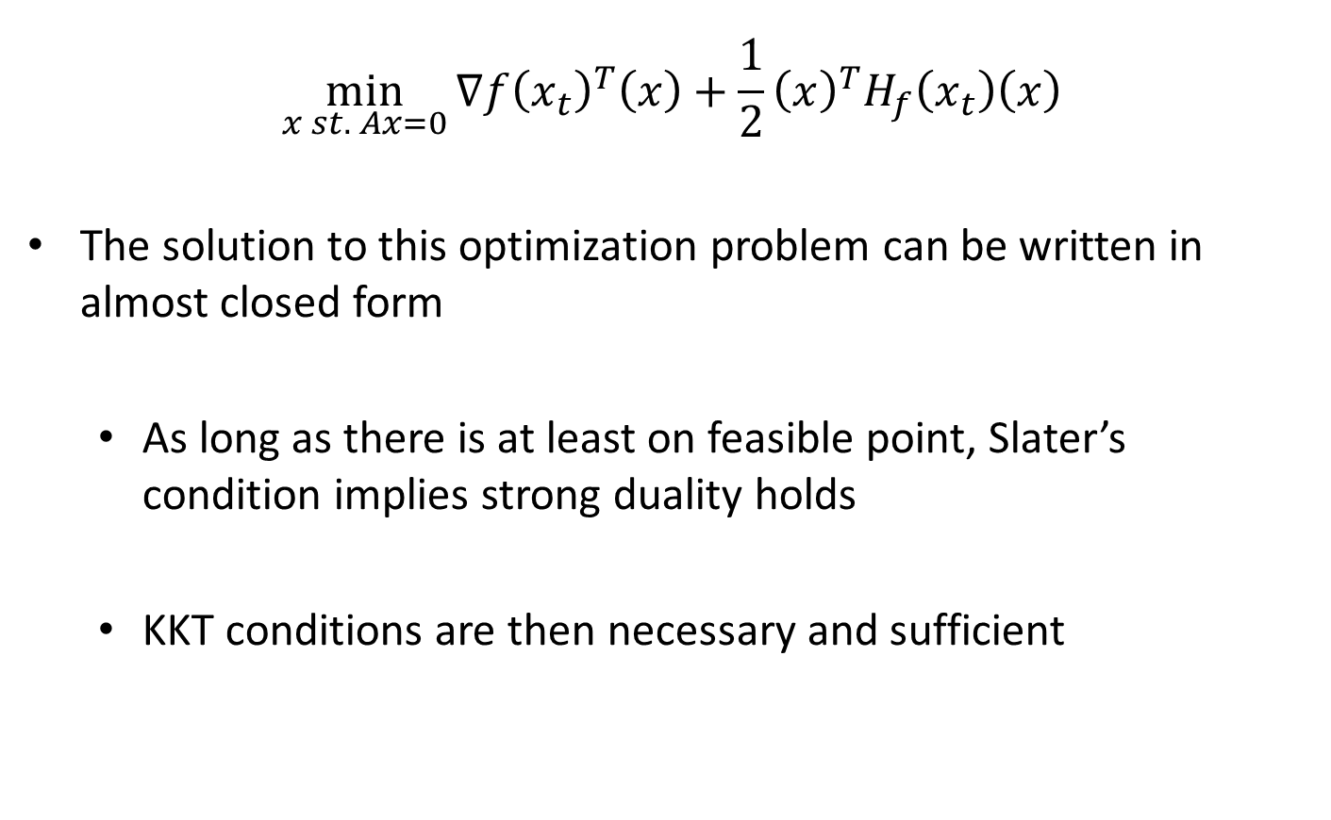
Equality Constrained Newton via QP/KKT
$$\min_{x st. Ax=0}{∇f{\left(x_{t}\right)}^{T}\left(x\right)+\frac{1}{2}{\left(x\right)}^{T}H_{f}\left(x_{t}\right)\left(x\right)}$$
The solution to this optimization problem can be written in almost closed form
  As long as there is at least on feasible point, Slater’s condition implies strong duality holds
  KKT conditions are then necessary and sufficient

Slide 31

Equality Constrained Newton via QP/KKT
$$\min_{x st. Ax=0}{∇f{\left(x_{t}\right)}^{T}\left(x\right)+\frac{1}{2}{\left(x\right)}^{T}H_{f}\left(x_{t}\right)\left(x\right)}$$
$∇_{x}L\left(x^{∗},ν^{∗}\right)=∇_{x}{\left[∇f{\left(x_{t}\right)}^{T}\left(x\right)+\frac{1}{2}{\left(x\right)}^{T}H_{f}\left(x_{t}\right)\left(x\right)+ν^{∗^{T}}\left(Ax\right)\right]}_{x=x^{∗}}=0$
$Ax^{∗}=0$

Slide 32

Equality Constrained Newton via QP/KKT
$$\min_{x st. Ax=0}{∇f{\left(x_{t}\right)}^{T}\left(x\right)+\frac{1}{2}{\left(x\right)}^{T}H_{f}\left(x_{t}\right)\left(x\right)}$$
$∇_{x}L\left(x^{∗},ν^{∗}\right)=∇f\left(x_{t}\right)+H_{f}\left(x_{t}\right)(x^{∗})+A^{T}ν^{∗}=0$
$Ax^{∗}=0$

Slide 33

Equality Constrained Newton via QP/KKT
$$\min_{x st. Ax=0}{∇f{\left(x_{t}\right)}^{T}\left(x\right)+\frac{1}{2}{\left(x\right)}^{T}H_{f}\left(x_{t}\right)\left(x\right)}$$
$∇_{x}L\left(x^{∗},ν^{∗}\right)=∇f\left(x_{t}\right)+H_{f}\left(x_{t}\right){(x}^{∗})+A^{T}ν^{∗}=0$
$Ax^{∗}=0$
$$\left[\begin{matrix}H_{f}(x_{t}) & A^{T} \\ A & 0\end{matrix}\right]\left[\begin{matrix}x^{∗} \\ ν^{∗}\end{matrix}\right]=\left[\begin{matrix}−∇f(x_{t}) \\ 0\end{matrix}\right]$$
Again, existing tools can be applied to solve these kinds of linear systems

Slide 34
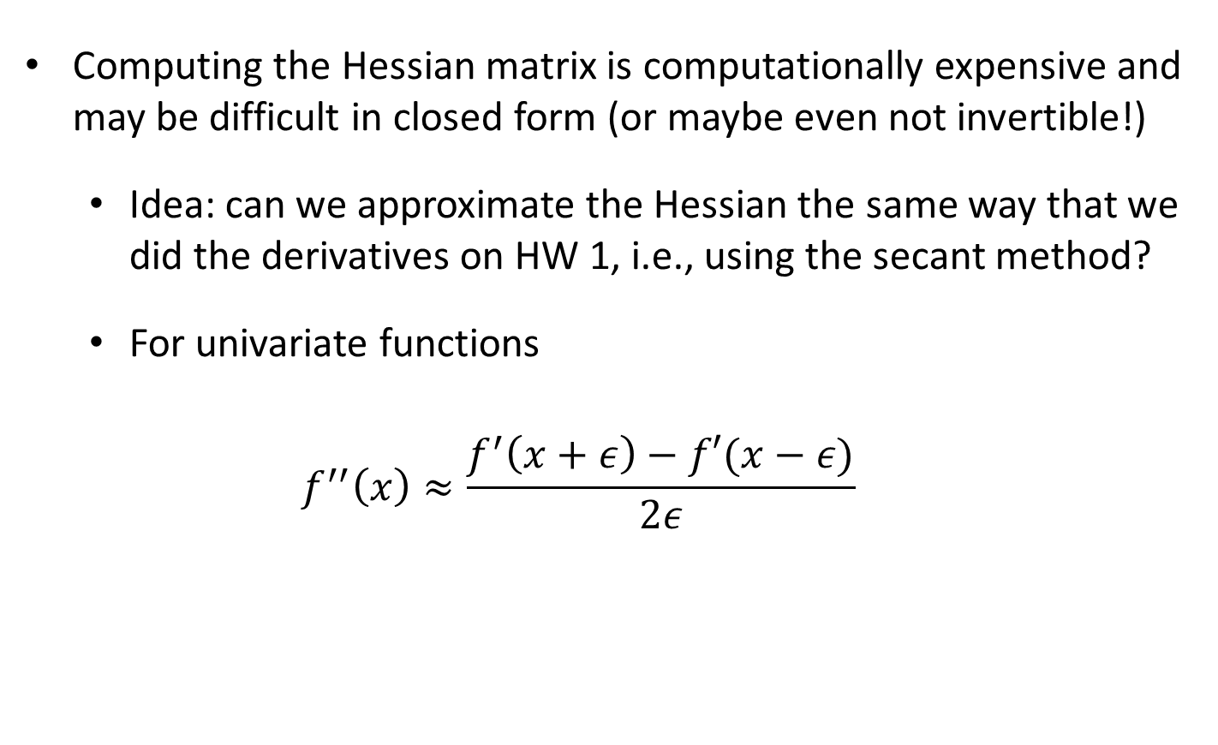
Approximate Newton
Computing the Hessian matrix is computationally expensive and may be difficult in closed form (or maybe even not invertible!)
  Idea: can we approximate the Hessian the same way that we did the derivatives on HW 1, i.e., using the secant method?
  For univariate functions
  $$f^{′′}\left(x\right)≈\frac{f^{′}\left(x+ε\right)−f′(x−ε)}{2ε}$$

Slide 35
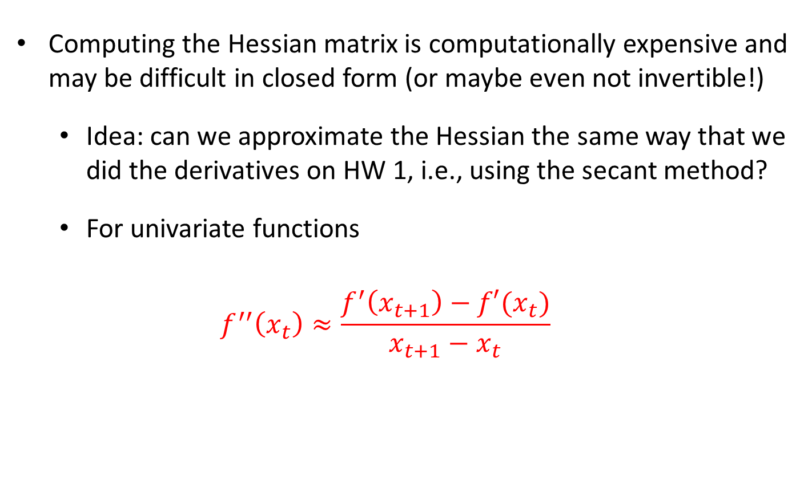
Approximate Newton
Computing the Hessian matrix is computationally expensive and may be difficult in closed form (or maybe even not invertible!)
  Idea: can we approximate the Hessian the same way that we did the derivatives on HW 1, i.e., using the secant method?
  For univariate functions
  $$f^{′′}\left(x_{t}\right)≈\frac{f^{′}\left(x_{t+1}\right)−f′(x_{t})}{x_{t+1}−x_{t}}$$
Use the sequence of iterates to approximate the 2nd derivative!

Slide 36
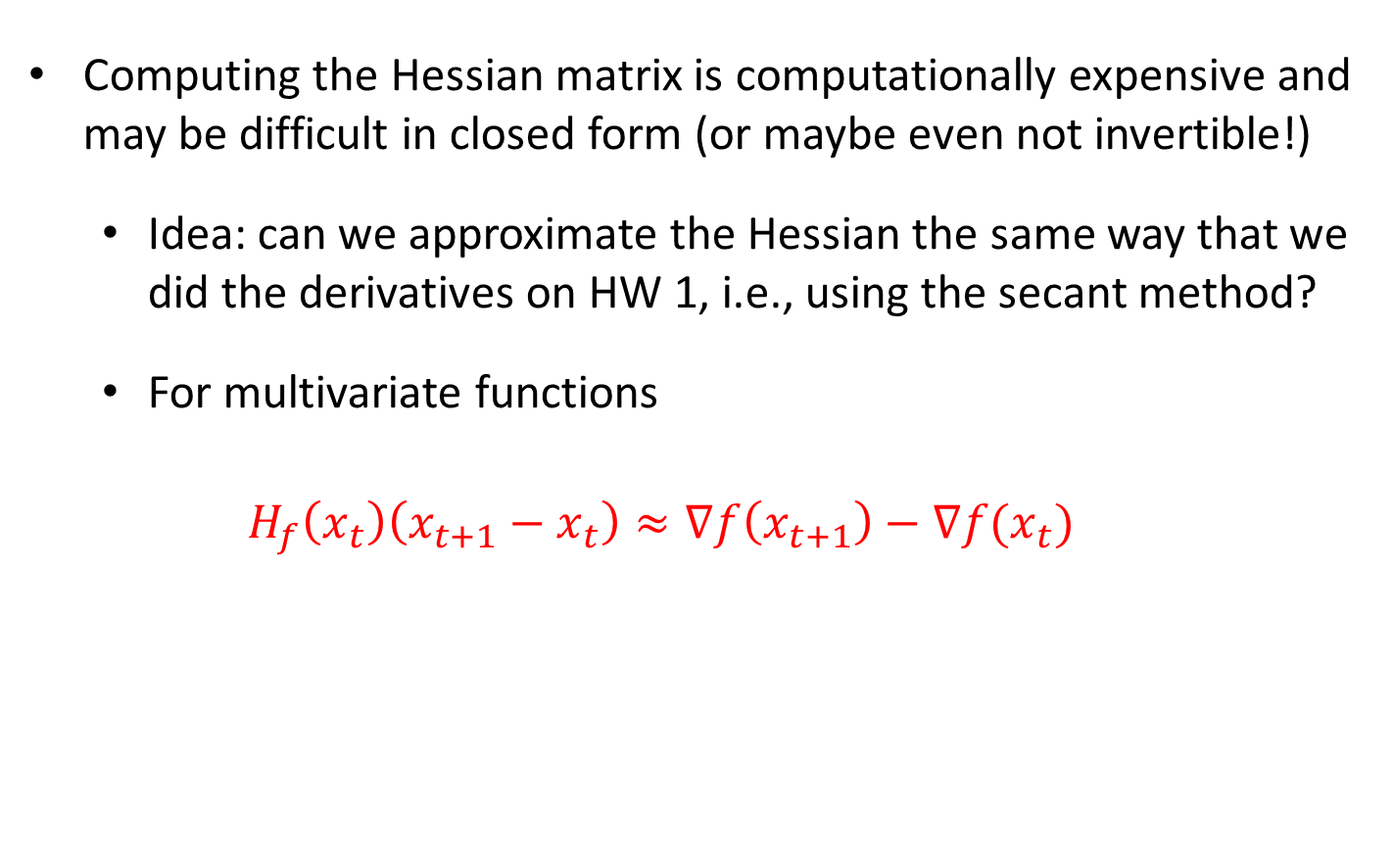
Approximate Newton
Computing the Hessian matrix is computationally expensive and may be difficult in closed form (or maybe even not invertible!)
  Idea: can we approximate the Hessian the same way that we did the derivatives on HW 1, i.e., using the secant method?
  For multivariate functions
  $$H_{f}\left(x_{t}\right)\left(x_{t+1}−x_{t}\right)≈∇f\left(x_{t+1}\right)−∇f(x_{t})$$
Use the sequence of iterates to approximate the 2nd derivative!

Slide 37

Approximate Newton
Computing the Hessian matrix is computationally expensive and may be difficult in closed form (or maybe even not invertible!)
  Idea: can we approximate the Hessian the same way that we did the derivatives on HW 1, i.e., using the secant method?
  For multivariate functions
  $$H_{f}\left(x_{t}\right)\left(x_{t+1}−x_{t}\right)≈∇f\left(x_{t+1}\right)−∇f(x_{t})$$
Key idea is to replace $H_{f}(x_{t})$ with a good approximation that is much easier to compute

Slide 38
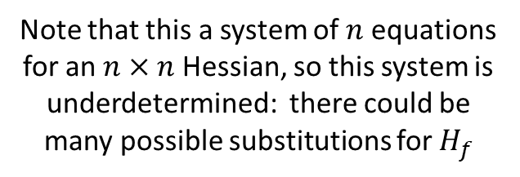
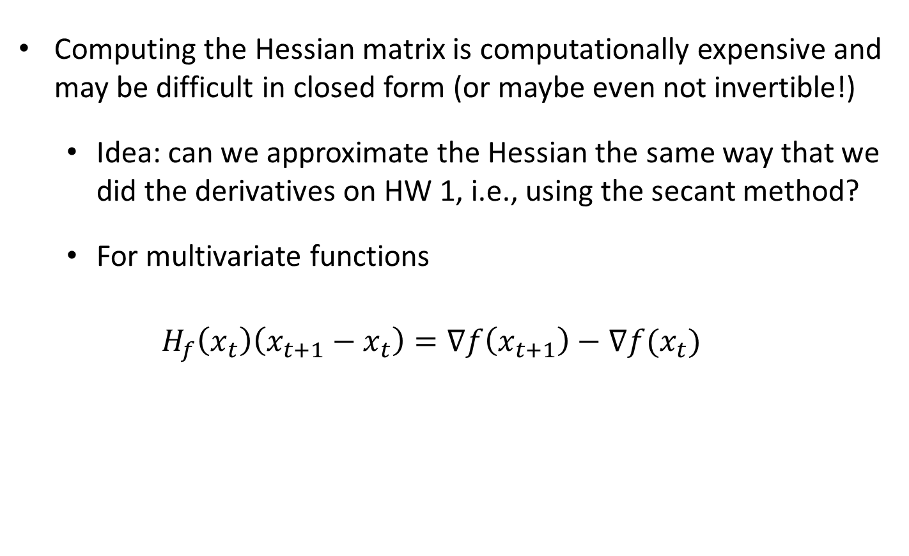
Approximate Newton
Computing the Hessian matrix is computationally expensive and may be difficult in closed form (or maybe even not invertible!)
  Idea: can we approximate the Hessian the same way that we did the derivatives on HW 1, i.e., using the secant method?
  For multivariate functions
  $$H_{f}\left(x_{t}\right)\left(x_{t+1}−x_{t}\right)=∇f\left(x_{t+1}\right)−∇f(x_{t})$$
Note that this a system of $n$ equations for an $n×n$ Hessian, so this system is underdetermined: there could be many possible substitutions for $H_{f}$

Slide 39

Quasi-Newton Methods
Using the previous approximation, Quasi-Newton methods seek to generate a series of approximate Hessian matrices $H_{0},H_{1},…$ such that the $t^{th}$ matrix only depends on the $t−1^{th}$ matrix and satisfies the constraint
$$H_{t+1}⋅\left(x_{t+1}−x_{t}\right)=∇f\left(x_{t+1}\right)−∇f(x_{t})$$

Slide 40
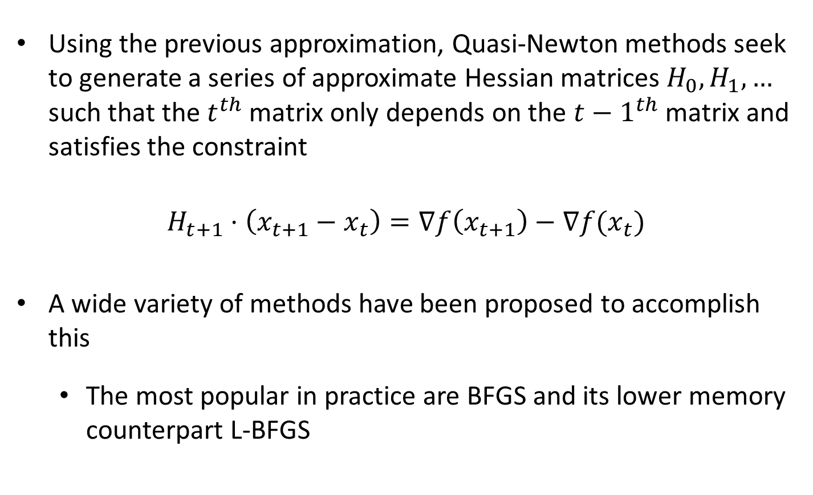
Quasi-Newton Methods
Using the previous approximation, Quasi-Newton methods seek to generate a series of approximate Hessian matrices $H_{0},H_{1},…$ such that the $t^{th}$ matrix only depends on the $t−1^{th}$ matrix and satisfies the constraint
$$H_{t+1}⋅\left(x_{t+1}−x_{t}\right)=∇f\left(x_{t+1}\right)−∇f(x_{t})$$
A wide variety of methods have been proposed to accomplish this
  The most popular in practice are BFGS and its lower memory counterpart L-BFGS

Slide 41

Broyden-Fletcher-Goldfarb-Shanno (BFGS)
Choose $H_{t+1}$ to be a symmetric positive definite matrix whose inverse $B_{t+1}$satisfies
$$\left(x_{t+1}−x_{t}\right)=B_{t+1}\left(∇f\left(x_{t+1}\right)−∇f(x_{t}) \right)$$
and ${\left\|B_{t+1} −B_{t}\right\|}_{F}^{2}$ is as small as possible

Slide 42
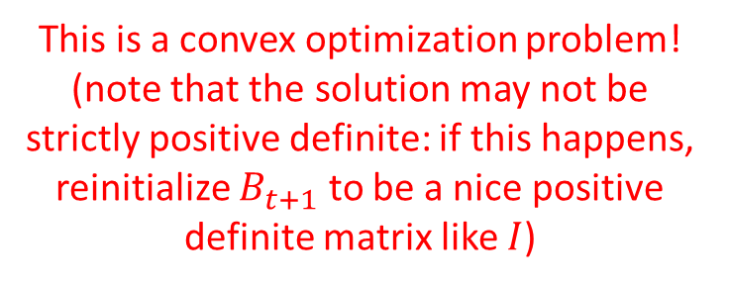

Broyden-Fletcher-Goldfarb-Shanno (BFGS)
$$\min_{B_{t+1}∈ℝ^{n×n}}{{\left\|B_{t+1} −B_{t}\right\|}_{F}^{2}}$$
such that
$$B_{t+1}=B_{t+1}^{T}$$
$$\left(x_{t+1}−x_{t}\right)=B_{t+1}\left(∇f\left(x_{t+1}\right)−∇f\left(x_{t}\right) \right)$$
$$x^{T}B_{t+1}x≥0 for all x$$
This is a convex optimization problem!
(note that the solution may not be strictly positive definite: if this happens, reinitialize $B_{t+1}$ to be a nice positive definite matrix like $I$)

Slide 43
Broyden-Fletcher-Goldfarb-Shanno (BFGS)
$$\min_{B_{t+1}∈ℝ^{n×n}}{{\left\|B_{t+1} −B_{t}\right\|}_{F}^{2}}$$
such that
$$B_{t+1}=B_{t+1}^{T}$$
$$\left(x_{t+1}−x_{t}\right)=B_{t+1}\left(∇f\left(x_{t+1}\right)−∇f\left(x_{t}\right) \right)$$
$$x^{T}B_{t+1}x≥0 for all x$$
Its solution is... messy...

Slide 44
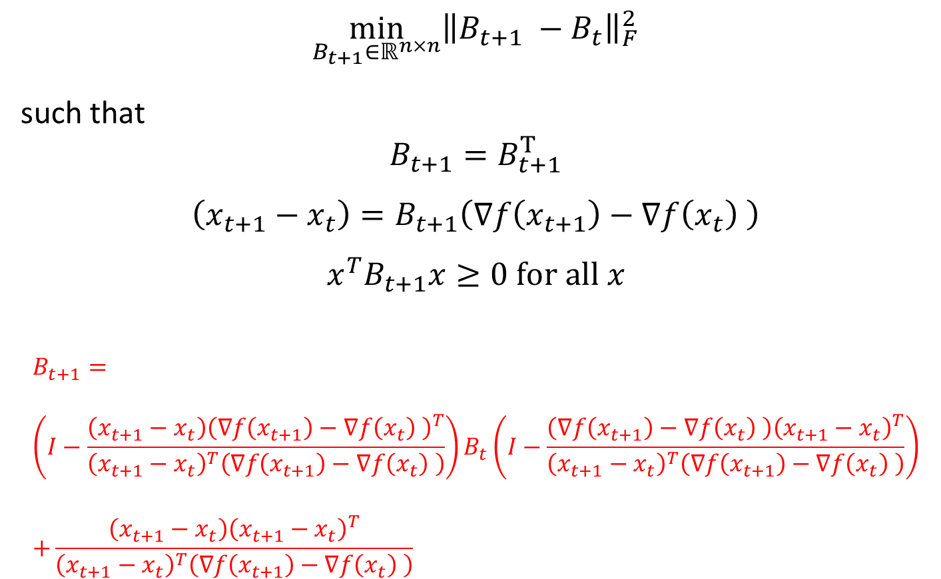
Broyden-Fletcher-Goldfarb-Shanno (BFGS)
$$\min_{B_{t+1}∈ℝ^{n×n}}{{\left\|B_{t+1} −B_{t}\right\|}_{F}^{2}}$$
such that
$$B_{t+1}=B_{t+1}^{T}$$
$$\left(x_{t+1}−x_{t}\right)=B_{t+1}\left(∇f\left(x_{t+1}\right)−∇f\left(x_{t}\right) \right)$$
$$x^{T}B_{t+1}x≥0 for all x$$
$$B_{t+1}= \\ \left(I−\frac{\left(x_{t+1}−x_{t}\right){\left(∇f\left(x_{t+1}\right)−∇f\left(x_{t}\right) \right)}^{T}}{{\left(x_{t+1}−x_{t}\right)}^{T}\left(∇f\left(x_{t+1}\right)−∇f\left(x_{t}\right) \right)}\right)B_{t}\left(I−\frac{\left(∇f\left(x_{t+1}\right)−∇f\left(x_{t}\right) \right){\left(x_{t+1}−x_{t}\right)}^{T}}{{\left(x_{t+1}−x_{t}\right)}^{T}\left(∇f\left(x_{t+1}\right)−∇f\left(x_{t}\right) \right)}\right) \\ +\frac{\left(x_{t+1}−x_{t}\right){\left(x_{t+1}−x_{t}\right)}^{T}}{{\left(x_{t+1}−x_{t}\right)}^{T}\left(∇f\left(x_{t+1}\right)−∇f\left(x_{t}\right) \right)}$$

