Slide 1
Lecture 9: Some Linear Algebra
Nicholas Ruozzi
University of Texas at Dallas

Slide 2
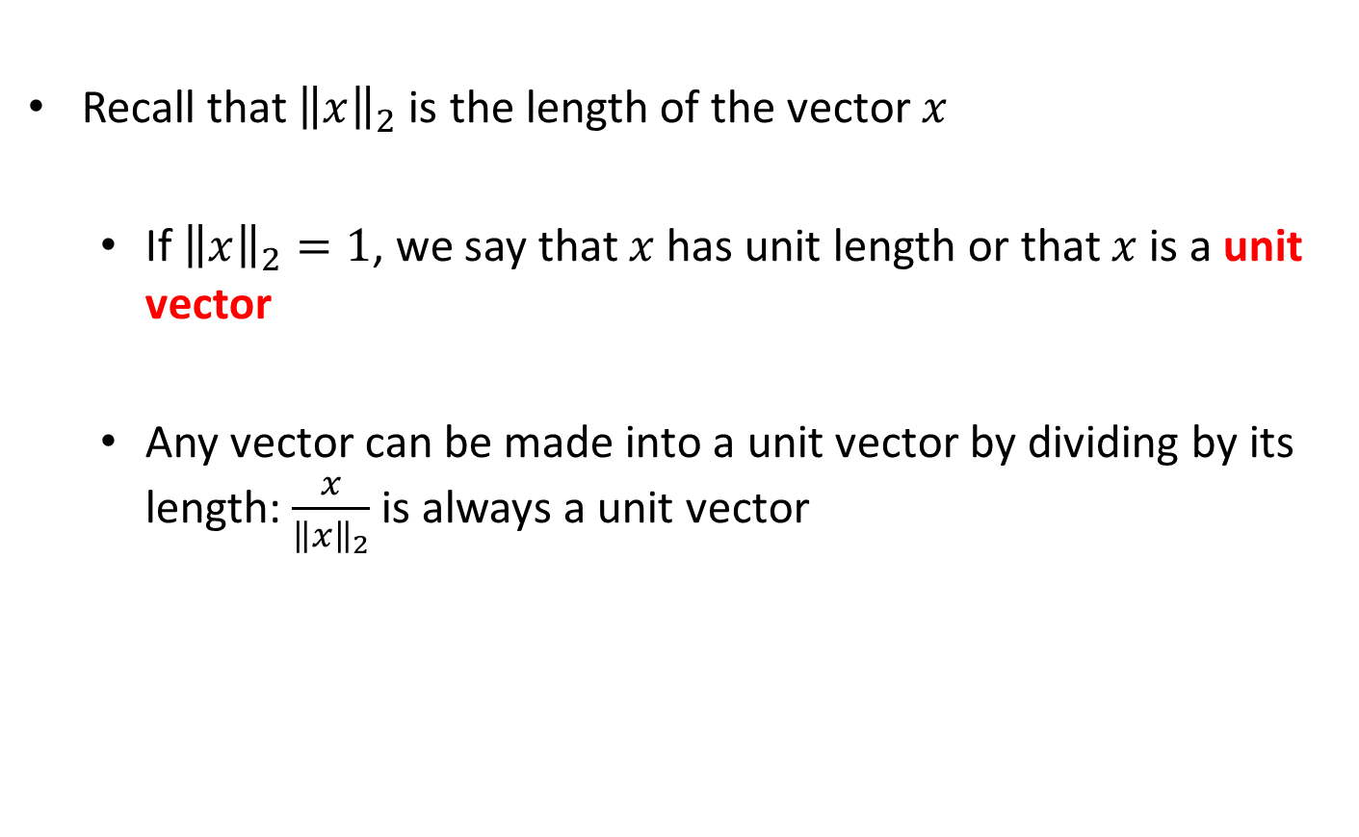
Length of Vectors
Recall that ${\left\|x\right\|}_{2}$ is the length of the vector $x$
  If ${\left\|x\right\|}_{2}=1$, we say that $x$ has unit length or that $x$ is a unit vector
  Any vector can be made into a unit vector by dividing by its length: $\frac{x}{{\left\|x\right\|}_{2}}$ is always a unit vector

Slide 3
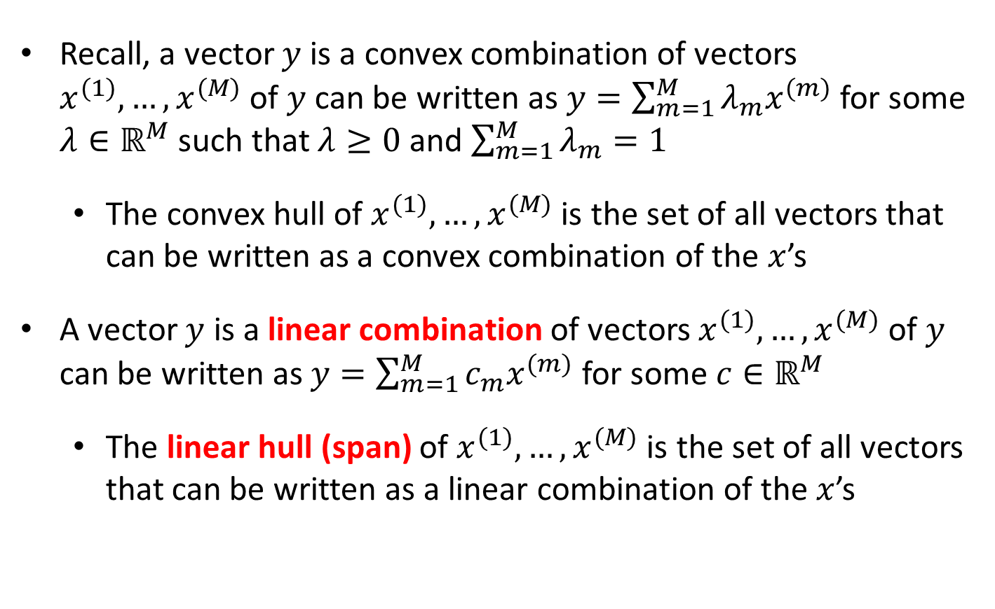
Linear Combinations
Recall, a vector $y$ is a convex combination of vectors $x^{(1)},…,x^{(M)}$ of $y$ can be written as $y=\sum_{m=1}^{M}{λ_{m}x^{(m)}}$ for some $λ∈ℝ^{M}$ such that $λ≥0$ and $\sum_{m=1}^{M}{λ_{m}}=1$
  The convex hull of $x^{(1)},…,x^{(M)}$ is the set of all vectors that can be written as a convex combination of the $x$’s
A vector $y$ is a linear combination of vectors $x^{(1)},…,x^{(M)}$ of $y$ can be written as $y=\sum_{m=1}^{M}{c_{m}x^{(m)}}$ for some $c∈ℝ^{M}$
  The linear hull (span) of $x^{(1)},…,x^{(M)}$ is the set of all vectors that can be written as a linear combination of the $x$’s

Slide 4
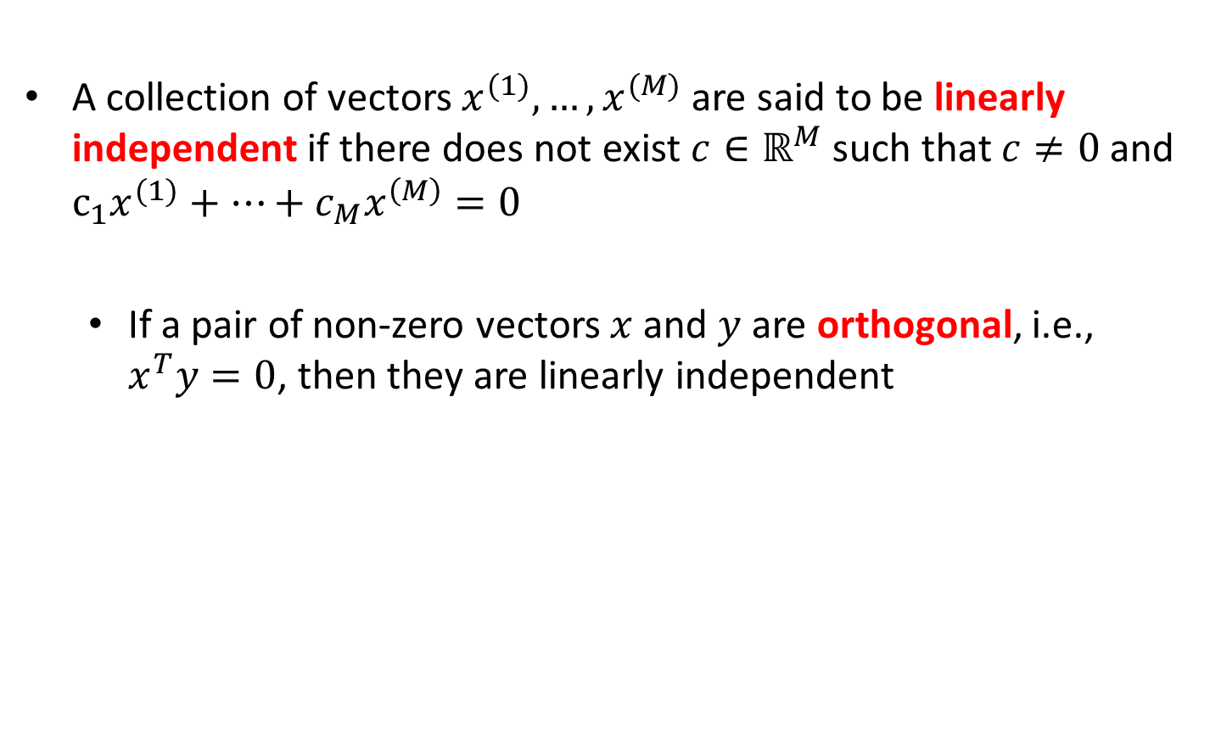
Linear Independence
A collection of vectors $x^{(1)},…,x^{(M)}$ are said to be linearly independent if there does not exist $c∈ℝ^{M}$ such that $c≠0$ and $c_{1}x^{(1)}+…+c_{M}x^{\left(M\right)}=0$
  If a pair of non-zero vectors $x$ and $y$ are orthogonal, i.e., $x^{T}y=0$, then they are linearly independent
Linearly independent vectors

Slide 5
Linear Independence
A collection of vectors $x^{(1)},…,x^{(M)}$ are said to be linearly independent if there does not exist $c∈ℝ^{M}$ such that $c≠0$ and $c_{1}x^{(1)}+…+c_{M}x^{\left(M\right)}=0$
  If a pair of non-zero vectors $x$ and $y$ are orthogonal, i.e., $x^{T}y=0$, then they are linearly independent
Linearly dependent vectors

Slide 6
Linear Independence
A collection of vectors $x^{(1)},…,x^{(M)}$ are said to be linearly independent if there does not exist $c∈ℝ^{M}$ such that $c≠0$ and $c_{1}x^{(1)}+…+c_{M}x^{\left(M\right)}=0$
  If a pair of non-zero vectors $x$ and $y$ are orthogonal, i.e., $x^{T}y=0$, then they are linearly independent
Orthogonal vectors

Slide 7
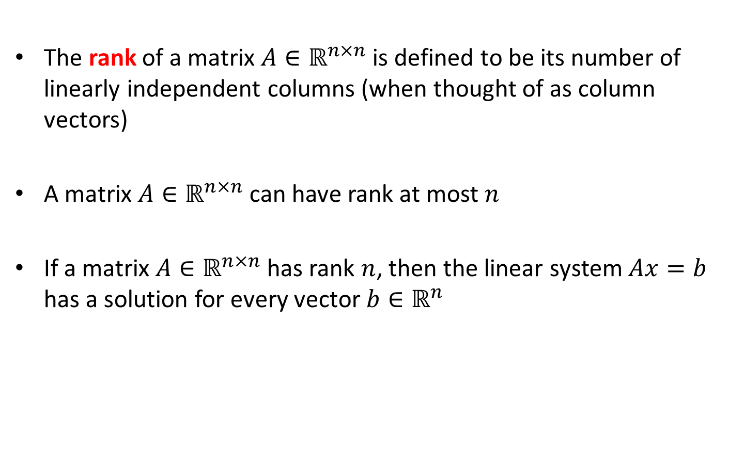
Matrix Rank
The rank of a matrix $A∈ℝ^{n×n}$ is defined to be its number of linearly independent columns (when thought of as column vectors)
A matrix $A∈ℝ^{n×n}$ can have rank at most $n$
If a matrix $A∈ℝ^{n×n}$ has rank $n$, then the linear system $Ax=b$ has a solution for every vector $b∈ℝ^{n}$

Slide 8
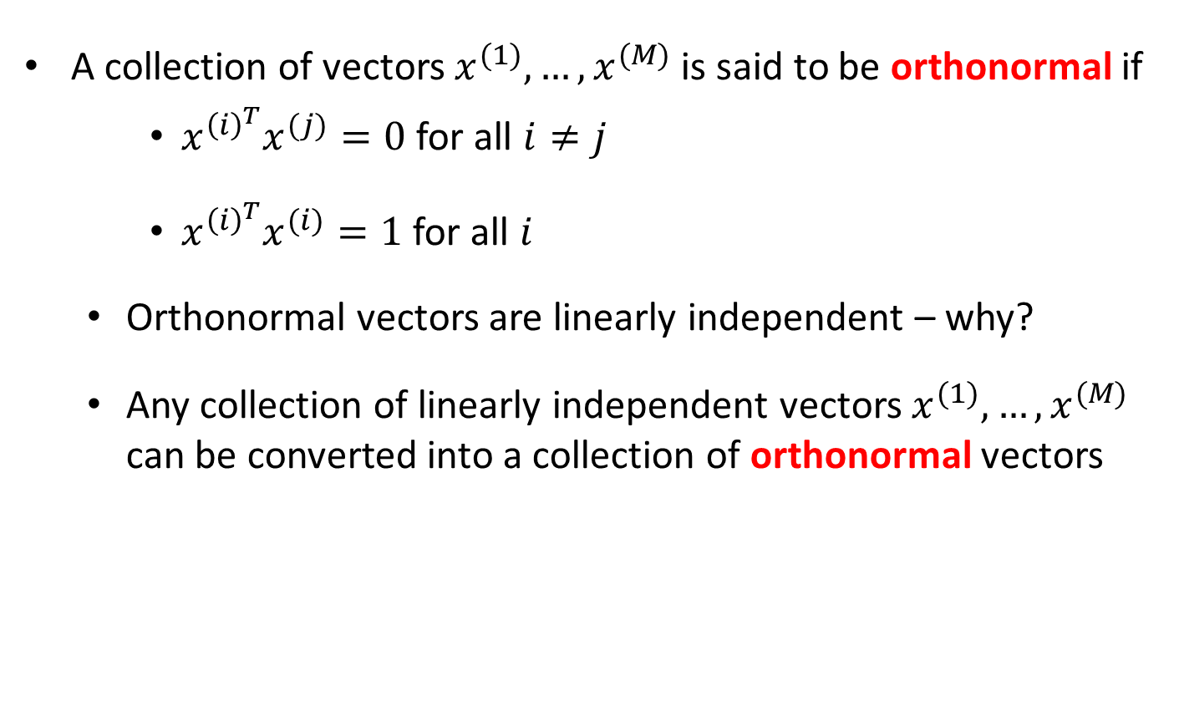
Orthonormal Vectors
A collection of vectors $x^{(1)},…,x^{(M)}$ is said to be orthonormal if
    $x^{{\left(i\right)}^{T}}x^{(j)}=0$ for all $i≠j$
    $x^{{\left(i\right)}^{T}}x^{(i)}=1$ for all $i$
  Orthonormal vectors are linearly independent – why?
  Any collection of linearly independent vectors $x^{(1)},…,x^{(M)}$ can be converted into a collection of orthonormal vectors

Slide 9
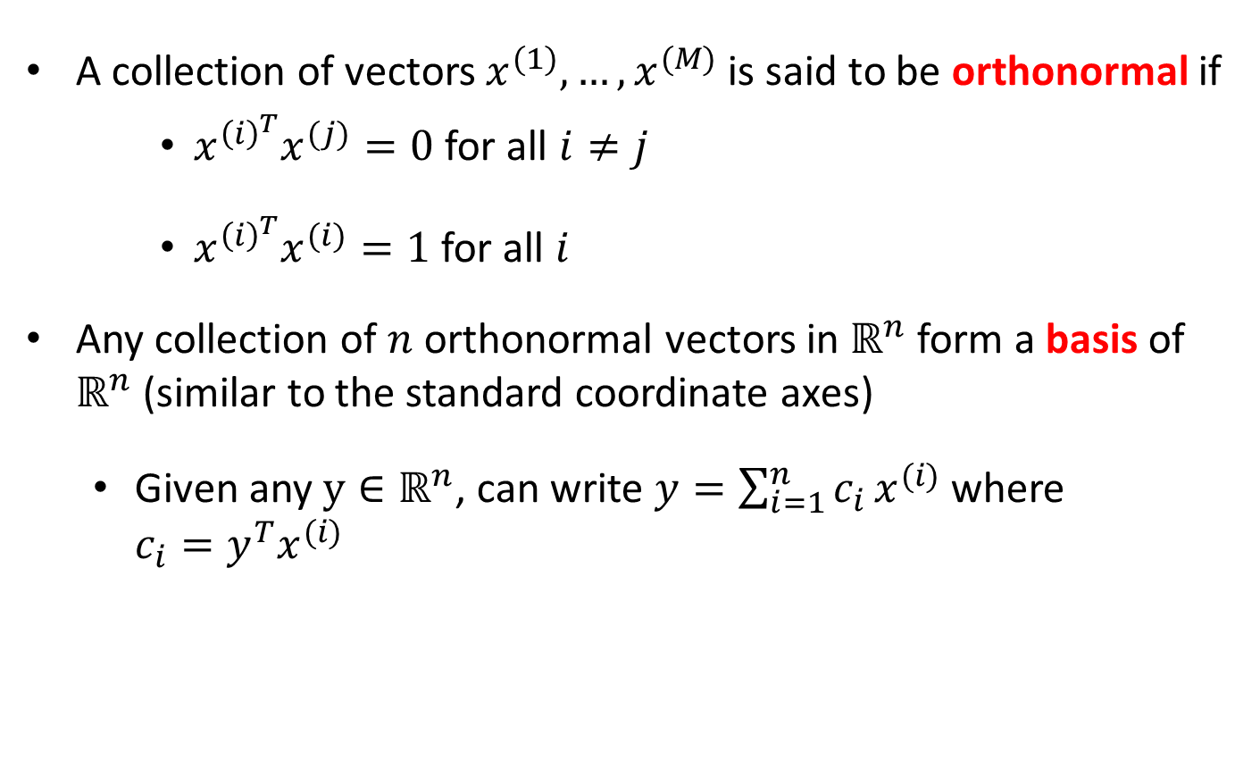
Orthonormal Vectors
A collection of vectors $x^{(1)},…,x^{(M)}$ is said to be orthonormal if
    $x^{{\left(i\right)}^{T}}x^{(j)}=0$ for all $i≠j$
    $x^{{\left(i\right)}^{T}}x^{(i)}=1$ for all $i$
Any collection of $n$ orthonormal vectors in $ℝ^{n}$ form a basis of $ℝ^{n}$ (similar to the standard coordinate axes)
  Given any $y∈ℝ^{n}$, can write $y=\sum_{i=1}^{n}{c_{i}}x^{(i)}$ where
  $c_{i}=y^{T}x^{(i)}$

Slide 10
Eigenvalues
$λ$ is an eigenvalue of a matrix $A∈ℝ^{n×n}$ if the linear system $Ax=λx$ has at least one non-zero solution
  If $Ax=λx$ we say that $λ$ is an eigenvalue of $A$ with corresponding eigenvector $x$
  Could be multiple eigenvectors for the same $λ$

Slide 11
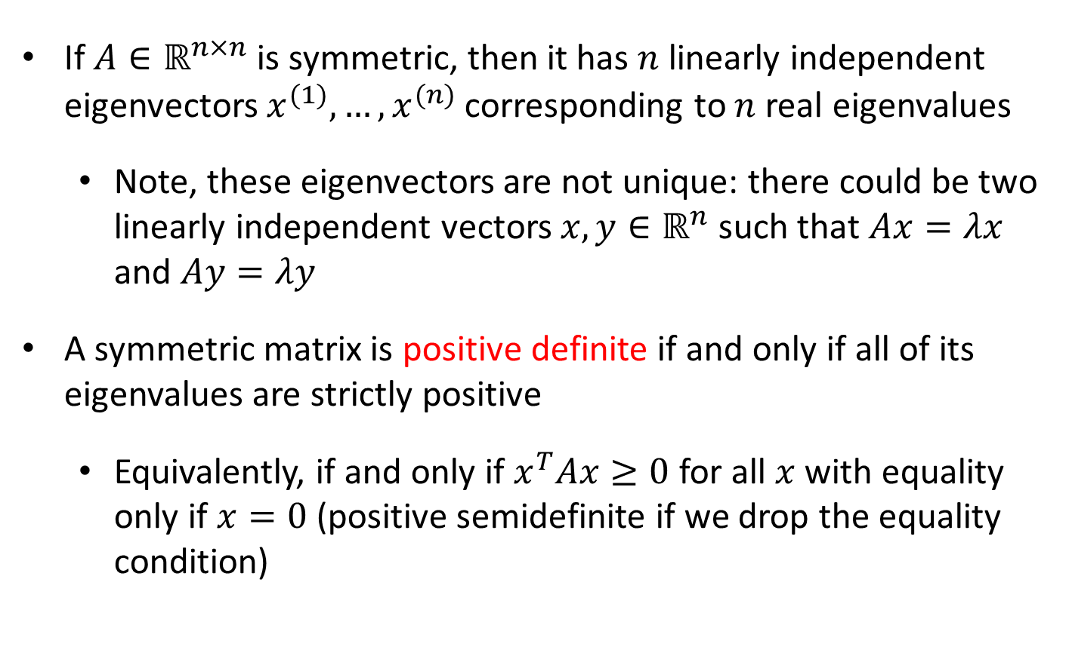
Eigenvalues of Symmetric Matrices
If $A∈ℝ^{n×n}$ is symmetric, then it has $n$ linearly independent eigenvectors $x^{(1)},…,x^{(n)}$ corresponding to $n$ real eigenvalues
  Note, these eigenvectors are not unique: there could be two linearly independent vectors $x,y∈ℝ^{n}$ such that $Ax=λx$ and $Ay=λy$
A symmetric matrix is positive definite if and only if all of its eigenvalues are strictly positive
  Equivalently, if and only if $x^{T}Ax≥0$ for all $x$ with equality only if $x=0$ (positive semidefinite if we drop the equality condition)

Slide 12
Examples
The 2x2 identity matrix has all of its eigenvalues equal to 1 (it is positive definite) with orthonormal eigenvectors $\left[\begin{matrix}1 \\ 0\end{matrix}\right]$ and $\left[\begin{matrix}0 \\ 1\end{matrix}\right]$
The matrix $\left[\begin{matrix}1 & 1 \\ 1 & 1\end{matrix}\right]$ has eigenvalues 0 and 2 with orthonormal eigenvectors $\left[\begin{matrix}\frac{−1}{\sqrt{2}} \\ \frac{1}{\sqrt{2}}\end{matrix}\right]$ and $\left[\begin{matrix}\frac{1}{\sqrt{2}} \\ \frac{1}{\sqrt{2}}\end{matrix}\right]$
The matrix $\left[\begin{matrix}2 & 1 \\ 1 & 2\end{matrix}\right]$ has eigenvalues 1 and 3 with orthonormal eigenvectors $\left[\begin{matrix}\frac{−1}{\sqrt{2}} \\ \frac{1}{\sqrt{2}}\end{matrix}\right]$ and $\left[\begin{matrix}\frac{1}{\sqrt{2}} \\ \frac{1}{\sqrt{2}}\end{matrix}\right]$

Slide 13

Eigen-decomposition
If $A∈ℝ^{n×n}$ is symmetric, then $A=\sum_{i=1}^{n}{λ_{i}x^{(i)}x^{{\left(i\right)}^{T}}}$, where $x^{(i)}$ and $λ_{i}$ are orthonormal eigenvectors of $A$ with corresponding eigenvalues $λ_{i}$
  Proof: this follows from the observation that the eigenvectors form a basis of $ℝ^{n}$

Slide 14
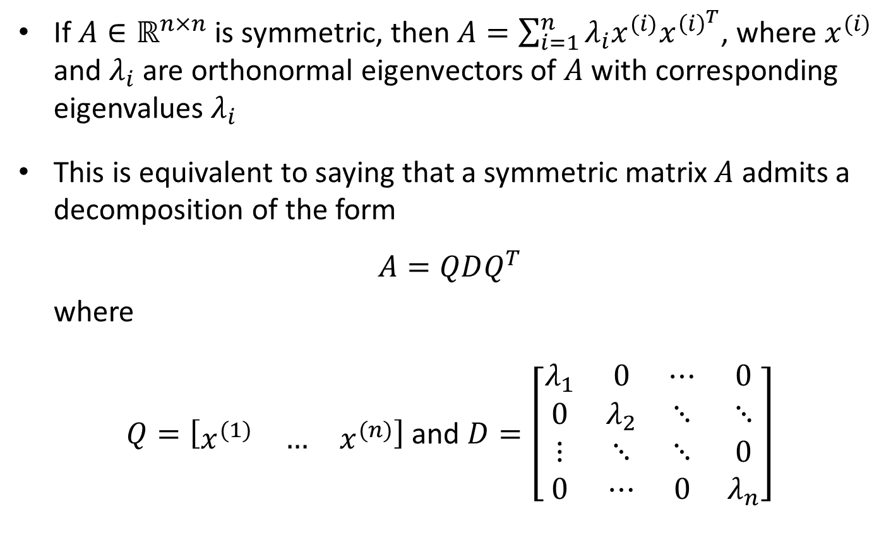
Eigen-decomposition
If $A∈ℝ^{n×n}$ is symmetric, then $A=\sum_{i=1}^{n}{λ_{i}x^{(i)}x^{{\left(i\right)}^{T}}}$, where $x^{(i)}$ and $λ_{i}$ are orthonormal eigenvectors of $A$ with corresponding eigenvalues $λ_{i}$
This is equivalent to saying that a symmetric matrix $A$ admits a decomposition of the form
$$A=QDQ^{T}$$
where
$Q=\left[\begin{matrix}x^{(1)} & … & x^{(n)}\end{matrix}\right]$ and $D=\left[\begin{matrix}λ_{1} & 0 & ⋯ & 0 \\ 0 & λ_{2} & ⋱ & ⋱ \\ ⋮ & ⋱ & ⋱ & 0 \\ 0 & ⋯ & 0 & λ_{n}\end{matrix}\right]$

Slide 15
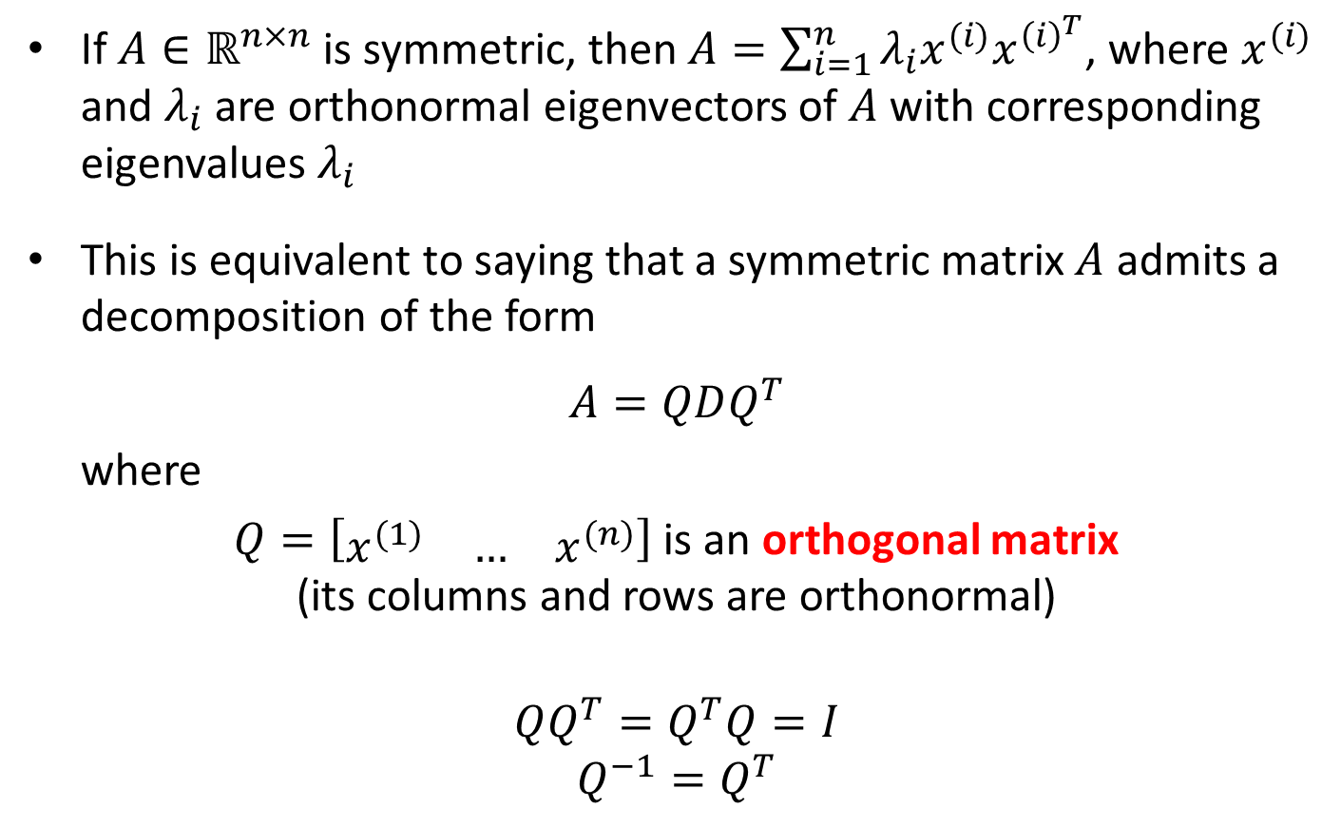
Eigen-decomposition
If $A∈ℝ^{n×n}$ is symmetric, then $A=\sum_{i=1}^{n}{λ_{i}x^{(i)}x^{{\left(i\right)}^{T}}}$, where $x^{(i)}$ and $λ_{i}$ are orthonormal eigenvectors of $A$ with corresponding eigenvalues $λ_{i}$
This is equivalent to saying that a symmetric matrix $A$ admits a decomposition of the form
$$A=QDQ^{T}$$
where
$Q=\left[\begin{matrix}x^{(1)} & … & x^{(n)}\end{matrix}\right]$ is an orthogonal matrix
(its columns and rows are orthonormal)
$$QQ^{T}=Q^{T}Q=I$$
$$Q^{−1}=Q^{T}$$

Slide 16

Useful Properties of Positive Semidefinite Matrices
For any matrix $A∈ℝ^{m×n}$, $AA^{T}$ and $A^{T}A$ are both positive semidefinite
  Proof: Set $y=A^{T}x$
      $x^{T}AA^{T}x=y^{T}y≥0$
      Same for $A^{T}A$

Slide 17
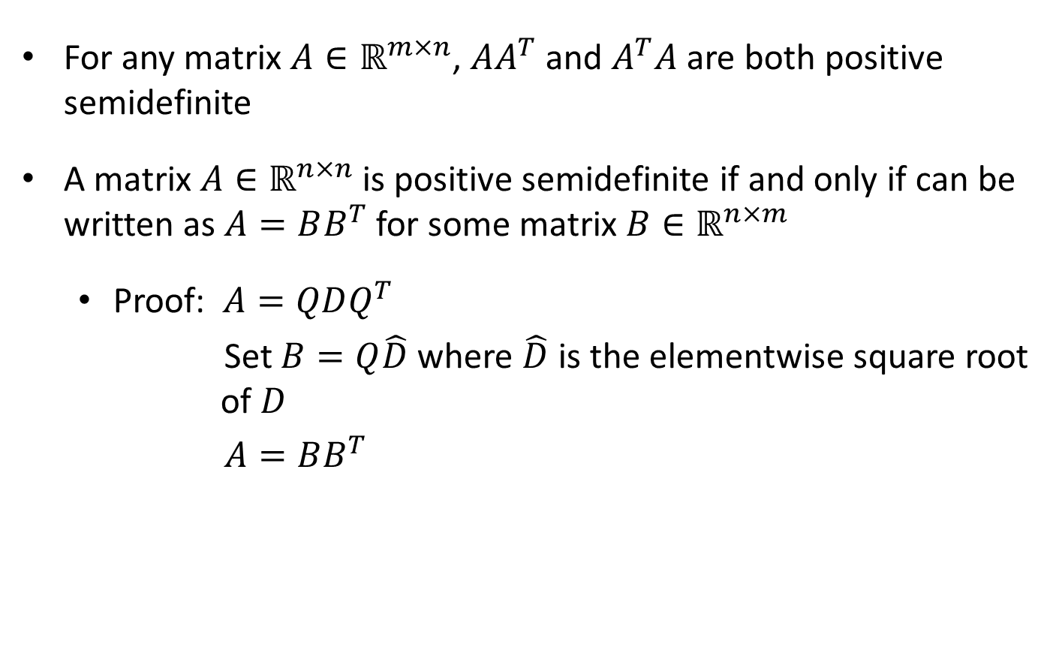
Useful Properties of Positive Semidefinite Matrices
For any matrix $A∈ℝ^{m×n}$, $AA^{T}$ and $A^{T}A$ are both positive semidefinite
A matrix $A∈ℝ^{n×n}$is positive semidefinite if and only if can be written as $A=BB^{T}$ for some matrix $B∈ℝ^{n×m}$
  Proof: $A=QDQ^{T}$
  Set $B=Q\hat{D}$ where $\hat{D}$ is the elementwise square root
  of $D$
  $A=BB^{T}$

Slide 18
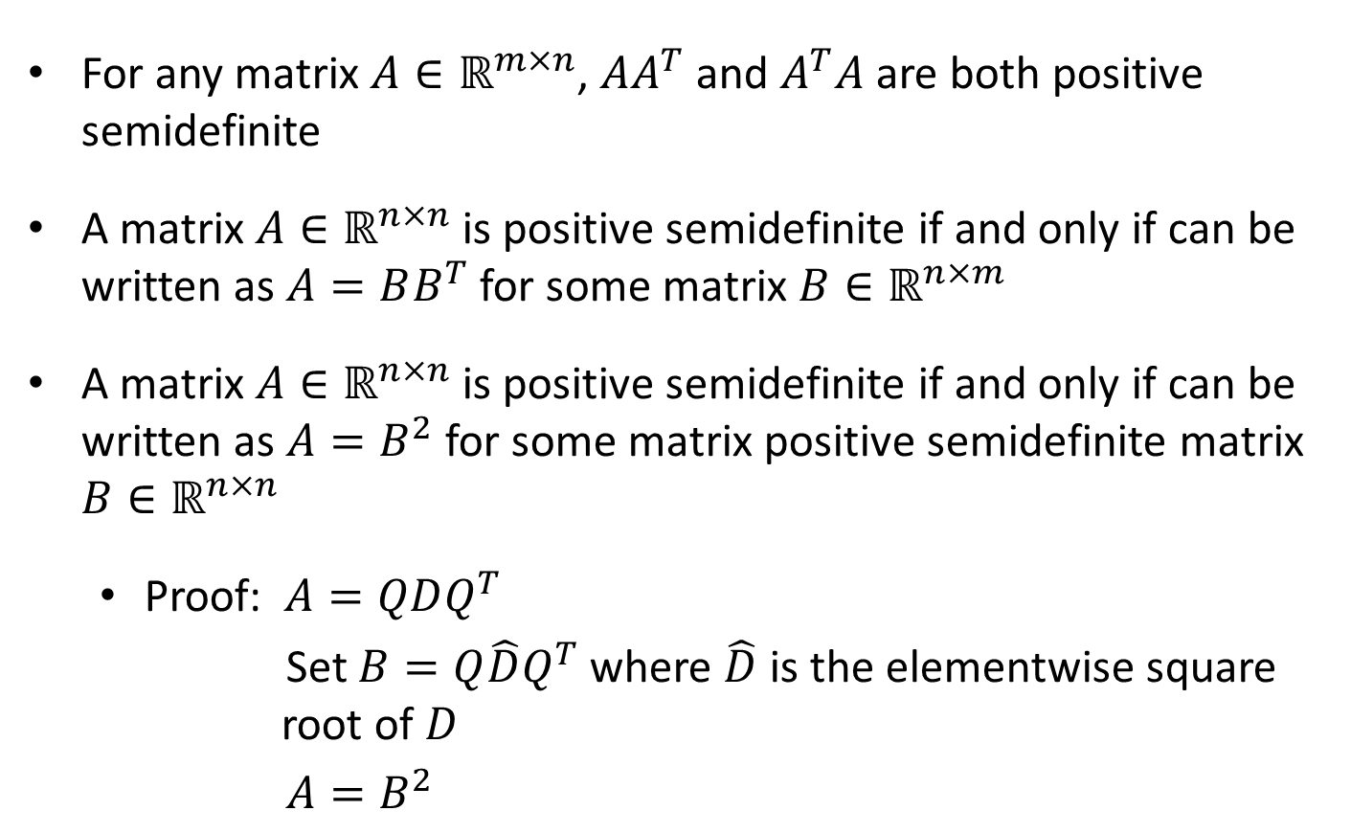
Useful Properties of Positive Semidefinite Matrices
For any matrix $A∈ℝ^{m×n}$, $AA^{T}$ and $A^{T}A$ are both positive semidefinite
A matrix $A∈ℝ^{n×n}$is positive semidefinite if and only if can be written as $A=BB^{T}$ for some matrix $B∈ℝ^{n×m}$
A matrix $A∈ℝ^{n×n}$is positive semidefinite if and only if can be written as $A=B^{2}$ for some matrix positive semidefinite matrix $B∈ℝ^{n×n}$
  Proof: $A=QDQ^{T}$
  Set $B=Q\hat{D}Q^{T}$ where $\hat{D}$ is the elementwise square
  root of $D$
  $A=B^{2}$

Slide 19

Least Square Solutions to Linear Systems
$$\min_{ x∈ℝ^{n}}{\frac{1}{2}{\left\|x\right\|}_{2}^{2}}$$
subject to
$$Ax=b$$
$$L\left(x,ν\right)=\frac{1}{2}x^{T}x+ν^{T}(Ax−b)$$
$$∇_{x}L=x+A^{T}ν=0$$
$$g\left(ν\right)=\frac{1}{2}ν^{T}AA^{T}ν−ν^{T}AA^{T}ν−ν^{T}b$$

Slide 20

Least Square Solutions to Linear Systems
$$\min_{ x∈ℝ^{n}}{\frac{1}{2}{\left\|x\right\|}_{2}^{2}}$$
subject to
$$Ax=b$$
$$L\left(x,ν\right)=\frac{1}{2}x^{T}x+ν^{T}(Ax−b)$$
$$∇_{x}L=x+A^{T}ν=0$$
$$g\left(ν\right)=−\frac{1}{2}ν^{T}AA^{T}ν−ν^{T}b$$
$$AA^{T}ν=−b$$

Slide 21

Least Square Solutions to Linear Systems
Can we solve $Mx=c$ for some positive semidefinite $M?$
We have, $M=QDQ^{T}$
$$QDQ^{T}x=c$$
$$DQ^{T}x=Q^{T}c$$

Slide 22
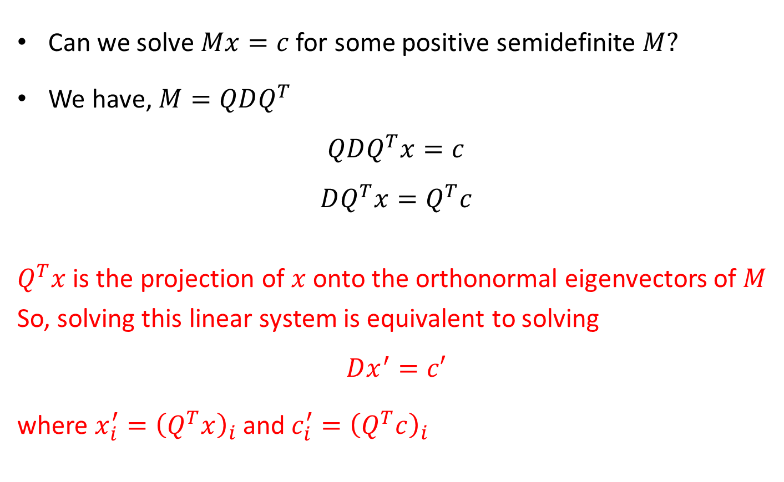
Least Square Solutions to Linear Systems
Can we solve $Mx=c$ for some positive semidefinite $M?$
We have, $M=QDQ^{T}$
$$QDQ^{T}x=c$$
$$DQ^{T}x=Q^{T}c$$
$Q^{T}x$ is the projection of $x$ onto the orthonormal eigenvectors of $M$
So, solving this linear system is equivalent to solving
$$Dx^{′}=c′$$
where $x_{i}^{′}={\left(Q^{T}x\right)}_{i}$ and$c_{i}^{′}={\left(Q^{T}c\right)}_{i}$

Slide 23
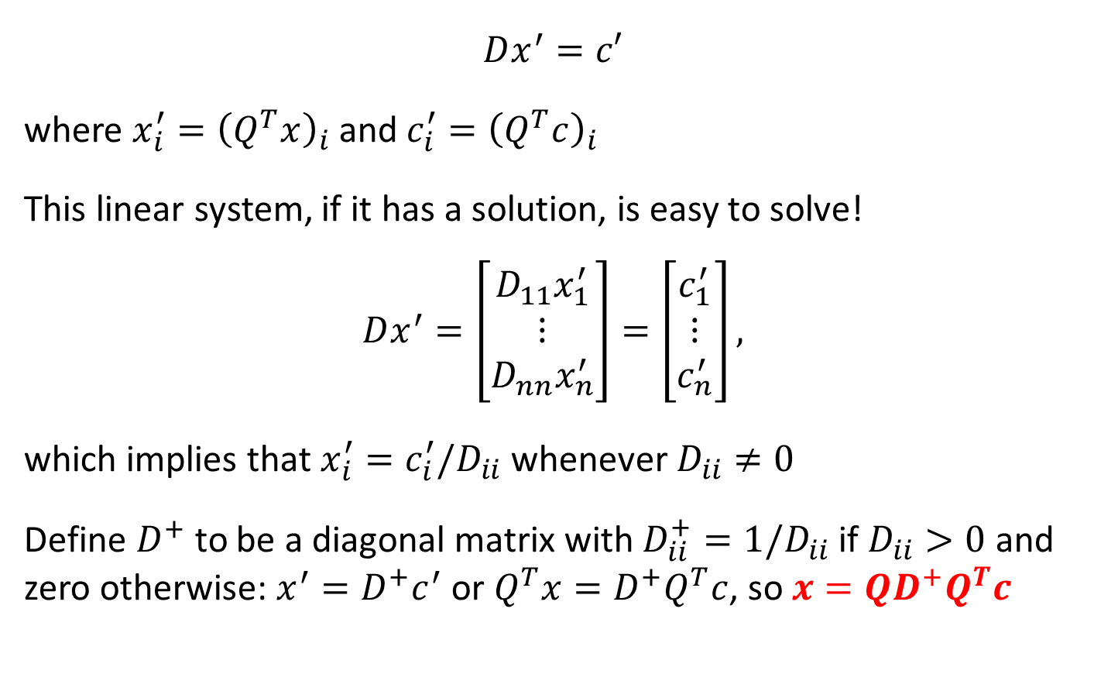
Least Square Solutions to Linear Systems
$$Dx^{′}=c′$$
where $x_{i}^{′}={\left(Q^{T}x\right)}_{i}$ and$c_{i}^{′}={\left(Q^{T}c\right)}_{i}$
This linear system, if it has a solution, is easy to solve!
$$Dx^{′}=\left[\begin{matrix}D_{11}x_{1}^{′} \\ ⋮ \\ D_{nn}x_{n}^{′}\end{matrix}\right]=\left[\begin{matrix}c_{1}^{′} \\ ⋮ \\ c_{n}^{′}\end{matrix}\right],$$
which implies that $x_{i}^{′}=c_{i}^{′}/D_{ii}$ whenever $D_{ii}≠0$
Define $D^{+}$ to be a diagonal matrix with $D_{ii}^{+}=1/D_{ii}$ if $D_{ii}>0$ and zero otherwise: $x^{′}=D^{+}c^{′}$ or $Q^{T}x=D^{+}Q^{T}c$, so $x=QD^{+}Q^{T}c$

Slide 24

Least Square Solutions to Linear Systems
$$\min_{ x∈ℝ^{n}}{\frac{1}{2}{\left\|x\right\|}_{2}^{2}}$$
subject to
$$Ax=b$$
$$L\left(x,ν\right)=\frac{1}{2}x^{T}x+ν^{T}(Ax−b)$$
$$∇_{x}L=x+A^{T}ν=0$$
$$g\left(ν\right)=−\frac{1}{2}ν^{T}AA^{T}ν−ν^{T}b$$
$$AA^{T}ν=−b$$
$ν=−QD^{+}Q^{T}b$, where $AA^{T}=QDQ^{T}$

Slide 25

Least Square Solutions to Linear Systems
$$\min_{ x∈ℝ^{n}}{\frac{1}{2}{\left\|x\right\|}_{2}^{2}}$$
subject to
$$Ax=b$$
$$L\left(x,ν\right)=\frac{1}{2}x^{T}x+ν^{T}(Ax−b)$$
$$∇_{x}L=x+A^{T}ν=0$$
$$x=A^{T}QD^{+}Q^{T}b$$
$ν=QD^{+}Q^{T}b$, where $AA^{T}=QDQ^{T}$
$$x=A^{T}QD^{+}Q^{T}b$$

Slide 26
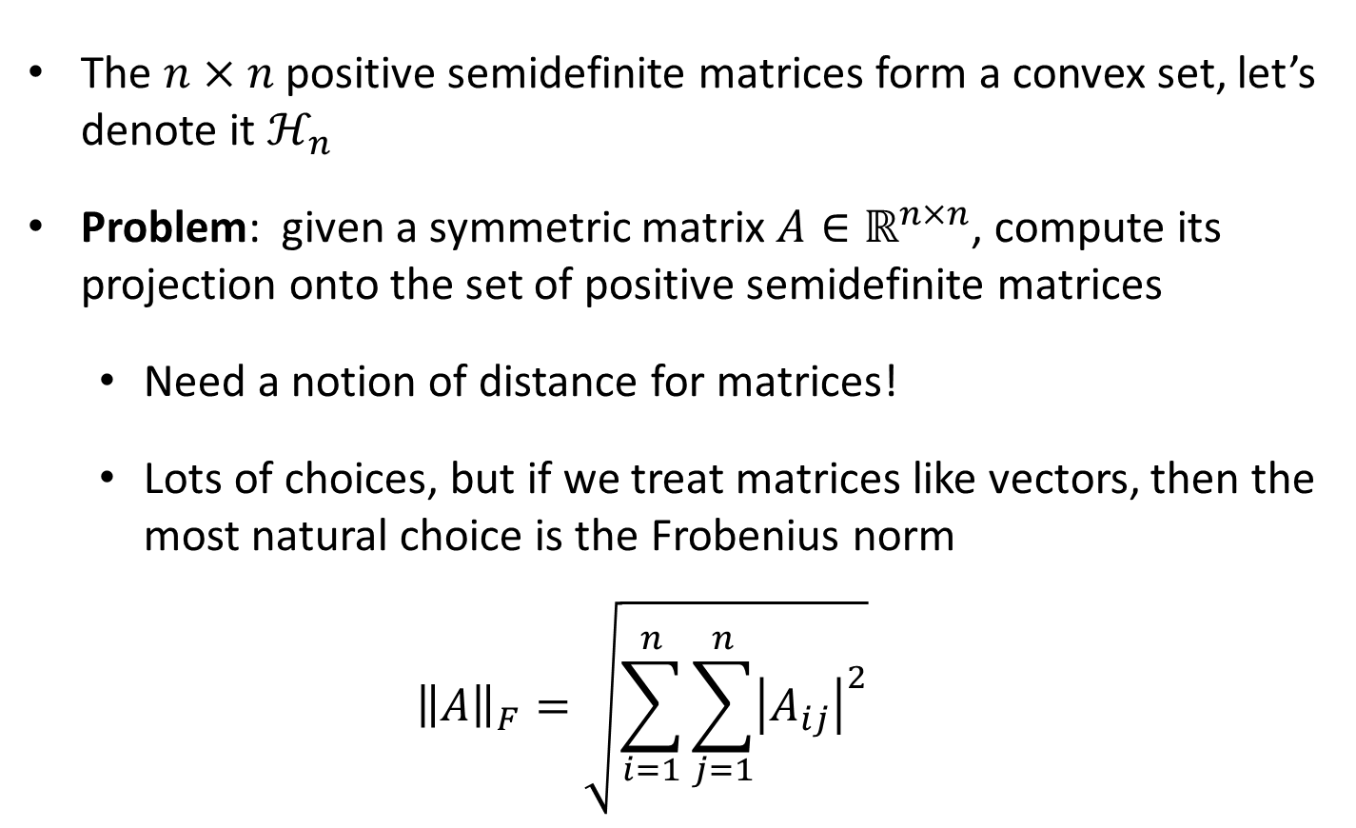
The Positive Semidefinite Matrices
The $n×n$ positive semidefinite matrices form a convex set, let’s denote it $ℋ_{n}$
Problem: given a symmetric matrix $A∈ℝ^{n×n}$, compute its projection onto the set of positive semidefinite matrices
  Need a notion of distance for matrices!
  Lots of choices, but if we treat matrices like vectors, then the most natural choice is the Frobenius norm
  $${\left\|A\right\|}_{F}=\sqrt{\sum_{i=1}^{n}{\sum_{j=1}^{n}{{\left|A_{ij}\right|}^{2}}}}$$

Slide 27

Projection on PSD Matrices
$${\min_{B∈ℝ_{sym}^{n×n}}\frac{1}{2}\left\|A−B\right\|}_{F}^{2}$$
subject to
$$x^{T}Bx≥0, for all x$$
This is an infinite number of constraints!

Slide 28

Projection on PSD Matrices
$${\min_{B∈ℝ_{sym}^{n×n}}\frac{1}{2}\left\|A−B\right\|}_{F}^{2}$$
subject to
$$B≽0$$
How do we solve this optimization problem?

Slide 29

Projection on PSD Matrices
$${\min_{B∈ℝ_{sym}^{n×n}}\frac{1}{2}\left\|A−B\right\|}_{F}^{2}$$
subject to
$$B≽0$$
Is there a notion of Lagrange duality for these kinds of convex constraints?

Slide 30

Projection on PSD Matrices
$${\min_{B∈ℝ_{sym}^{n×n}}\frac{1}{2}\left\|A−B\right\|}_{F}^{2}$$
subject to
$$B≽0$$
Is there a notion of Lagrange duality for these kinds of convex constraints?
Yes, but we need to prove some things first...

Slide 31
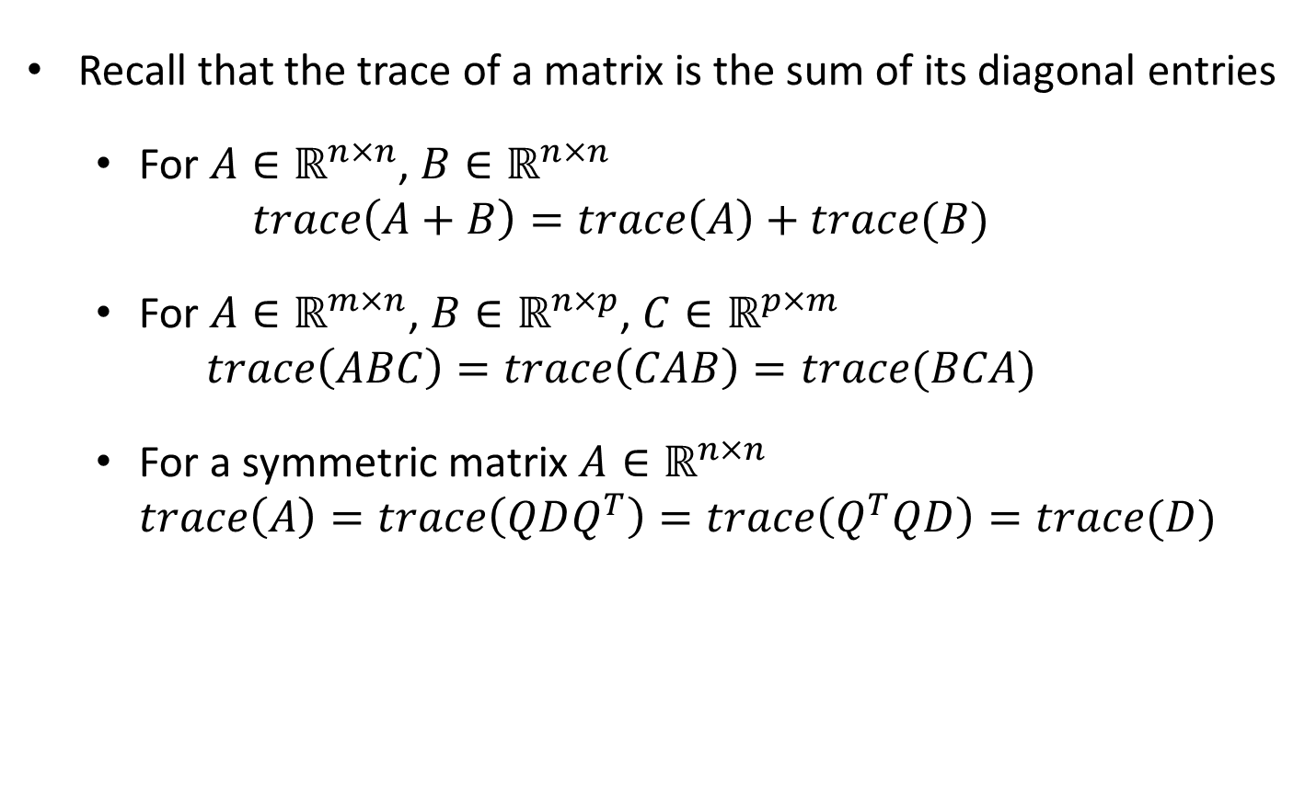
Inner Products for Matrices
Recall that the trace of a matrix is the sum of its diagonal entries
  For $A∈ℝ^{n×n}$, $B∈ℝ^{n×n}$
  $trace\left(A+B\right)=trace\left(A\right)+trace(B)$
  For $A∈ℝ^{m×n}$, $B∈ℝ^{n×p}$, $C∈ℝ^{p×m}$
  $$trace\left(ABC\right)=trace\left(CAB\right)=trace(BCA)$$
  For a symmetric matrix $A∈ℝ^{n×n}$
  $trace\left(A\right)=trace\left(QDQ^{T}\right)=trace\left(Q^{T}QD\right)=trace(D)$

Slide 32
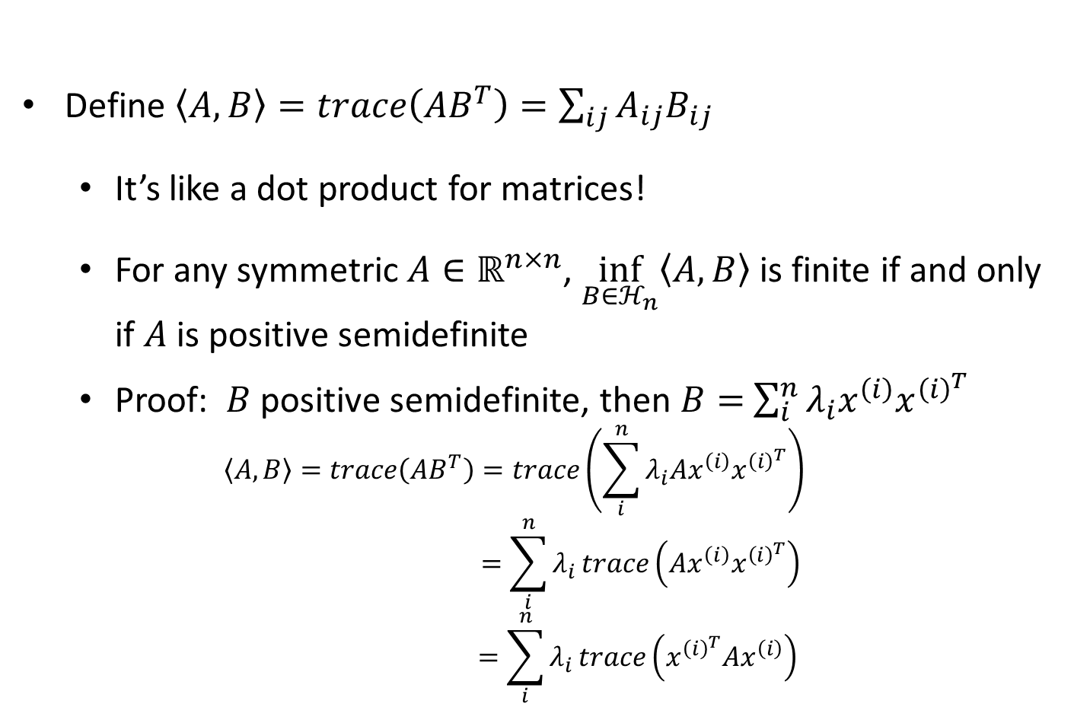
Inner Products for Matrices
Define $\left\langle A,B\right\rangle =trace\left(AB^{T}\right)=\sum_{ij}{A_{ij}B_{ij}}$
  It’s like a dot product for matrices!
  For any symmetric $A∈ℝ^{n×n}$, $\inf_{B∈ℋ_{n}}\left\langle A,B\right\rangle$ is finite if and only if $A$ is positive semidefinite
  Proof: $B$ positive semidefinite, then $B=$ $\sum_{i}^{n}{λ_{i}x^{\left(i\right)}x^{{\left(i\right)}^{T}}}$
  $$\left\langle A,B\right\rangle =trace\left(AB^{T}\right)=trace\left(\sum_{i}^{n}{λ_{i}Ax^{\left(i\right)}x^{{\left(i\right)}^{T}}}\right)$$
  $$=\sum_{i}^{n}{λ_{i}}trace\left(Ax^{\left(i\right)}x^{{\left(i\right)}^{T}}\right)$$
  $$=\sum_{i}^{n}{λ_{i}}trace\left(x^{{\left(i\right)}^{T}}Ax^{\left(i\right)}\right)$$

Slide 33


Projection on PSD Matrices
$${\min_{B∈ℝ_{sym}^{n×n}}\frac{1}{2}\left\|A−B\right\|}_{F}^{2}$$
subject to
$$B≽0$$
$$L\left(B,Λ\right)=\frac{1}{2}\left\langle A−B,A−B\right\rangle −\left\langle B,Λ\right\rangle$$
$Λ$ is a matrix of Lagrange multipliers!
$A$ is a given symmetric matrix

Slide 34

Projection on PSD Matrices
$${\min_{B∈ℝ_{sym}^{n×n}}\frac{1}{2}\left\|A−B\right\|}_{F}^{2}$$
subject to
$$B≽0$$
$$L\left(B,Λ\right)=\frac{1}{2}\left\langle A−B,A−B\right\rangle −\left\langle B,Λ\right\rangle$$
Check that $\inf_{B∈ℝ_{sym}^{n×n}}{\sup_{Λ≽0}{L(B,Λ)}}$ is equal to the above optimization problem
$A$ is a given symmetric matrix

Slide 35


Projection on PSD Matrices
$${\min_{B∈ℝ_{sym}^{n×n}}\frac{1}{2}\left\|A−B\right\|}_{F}^{2}$$
subject to
$$B≽0$$
$$L\left(B,Λ\right)=\frac{1}{2}\left\langle A−B,A−B\right\rangle −\left\langle B,Λ\right\rangle$$
$$g\left(Λ\right)=−\frac{1}{2}\left\langle Λ,Λ\right\rangle −\left\langle Λ,A\right\rangle$$
Dual problem: $\sup_{Λ≽0}{g(Λ)}$
$A$ is a given symmetric matrix
What is the optimal $B$?

Slide 36

Semidefinite Programming (SDP)
$$\min_{X}\left\langle C,X\right\rangle$$
subject to
$$\left\langle A^{(i)},X\right\rangle =b_{i}, for i=1,…,m$$
$$X≽0$$

Slide 37

Semidefinite Programming
$$\min_{X}\left\langle C,X\right\rangle$$
subject to
$$\left\langle A^{(i)},X\right\rangle =b_{i}, for i=1,…,m$$
$$X≽0$$
$$\max_{λ∈ℝ^{m}}{λ^{T}b}$$
subject to
$$C−\sum_{i=1}^{m}{λ_{i}}A_{i}≽0$$

Slide 38
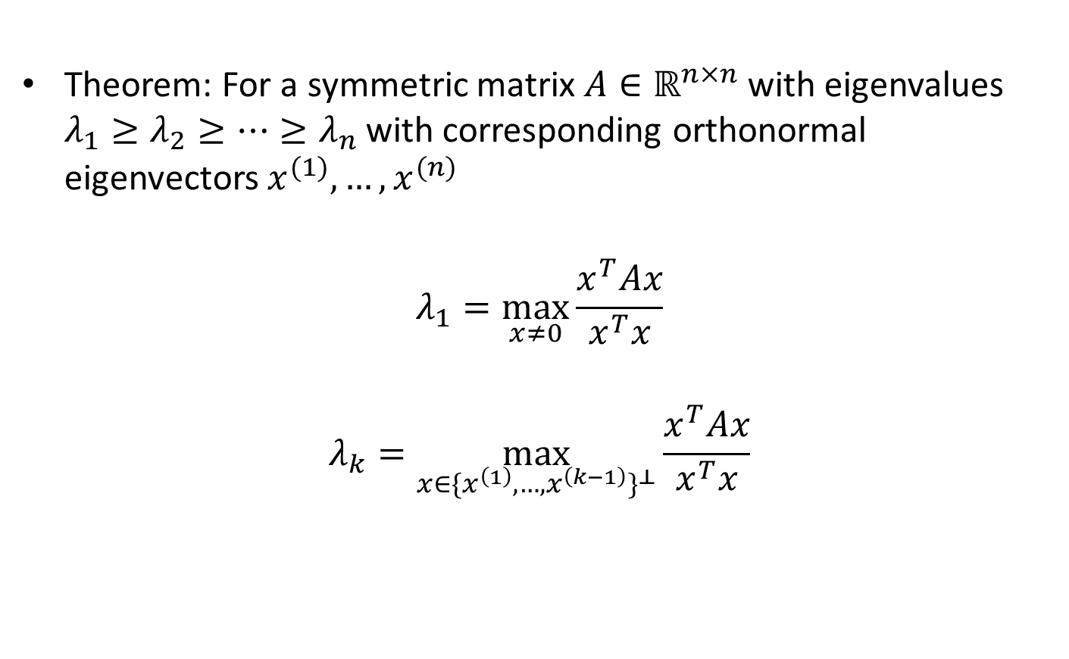
Rayleigh-Ritz Theorem
Theorem: For a symmetric matrix $A∈ℝ^{n×n}$ with eigenvalues $λ_{1}≥λ_{2}≥…≥λ_{n}$ with corresponding orthonormal eigenvectors $x^{(1)},…,x^{(n)}$
$$λ_{1}=\max_{x≠0}\frac{x^{T}Ax}{x^{T}x}$$
$$λ_{k}=\max_{x∈{\{x^{\left(1\right)},…,x^{\left(k−1\right)}\}}^{⊥}}{\frac{x^{T}Ax}{x^{T}x}}$$
Set of all vectors perpendicular to all $x^{\left(1\right)},…,x^{\left(k−1\right)}$

Slide 39
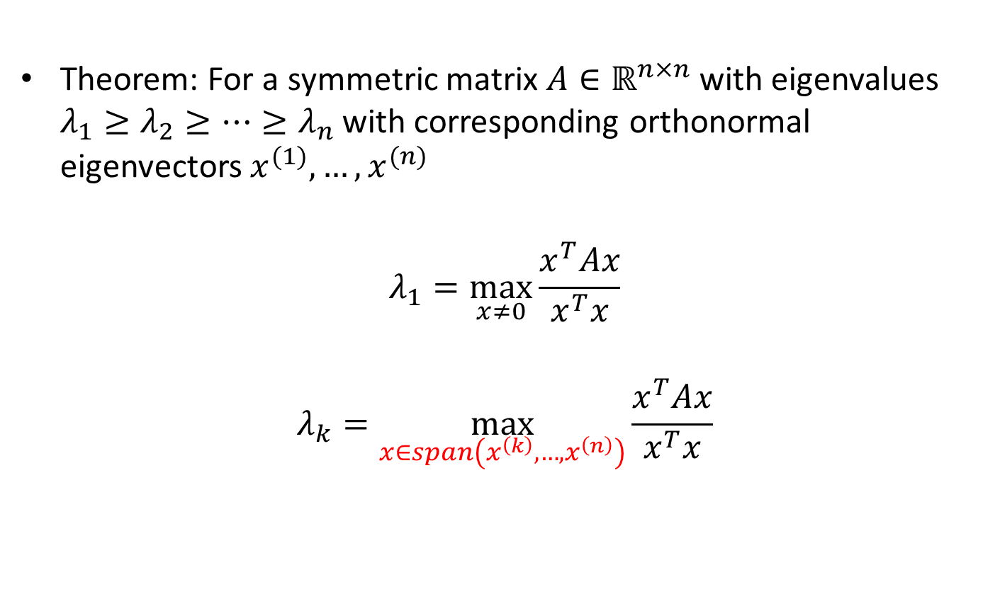
Rayleigh-Ritz Theorem
Theorem: For a symmetric matrix $A∈ℝ^{n×n}$ with eigenvalues $λ_{1}≥λ_{2}≥…≥λ_{n}$ with corresponding orthonormal eigenvectors $x^{(1)},…,x^{(n)}$
$$λ_{1}=\max_{x≠0}\frac{x^{T}Ax}{x^{T}x}$$
$$λ_{k}=\max_{x∈span\left(x^{\left(k\right)},…,x^{\left(n\right)}\right)}{\frac{x^{T}Ax}{x^{T}x}}$$

Slide 40
Computing Eigenvalues
There are a variety of methods for computing the eigenvalues/eigenvectors of a matrix
  Power iteration: an iterative method that only requires performing matrix multiplication and dot products
  QR factorization: based on Gram-Schmidt orthogonalization (we won’t cover it here, take a course in Numerical Analysis!)

Slide 41
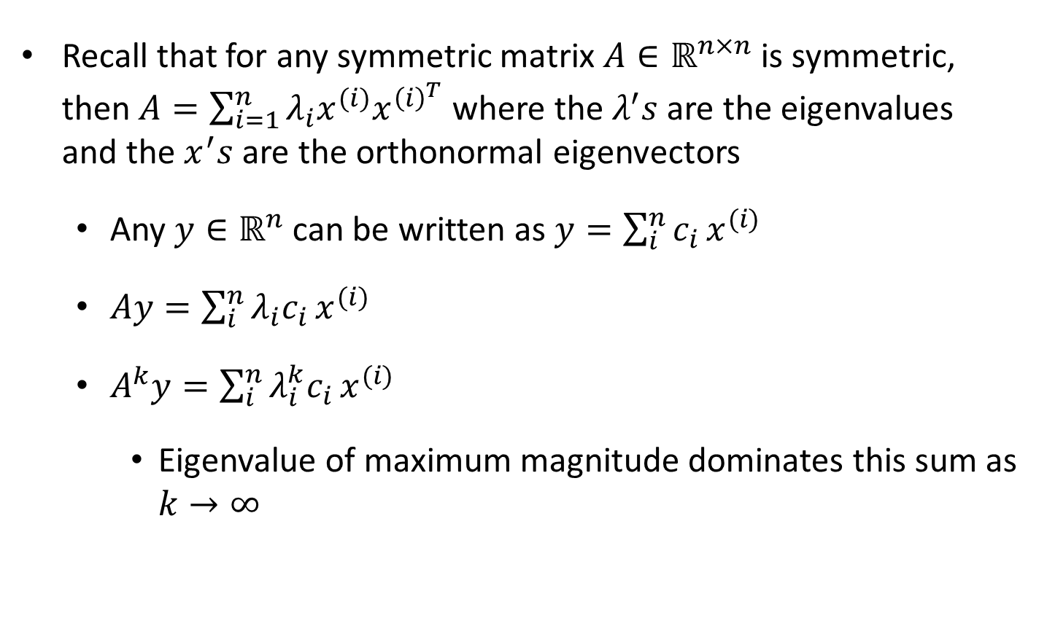
Power Iteration
Recall that for any symmetric matrix $A∈ℝ^{n×n}$ is symmetric, then $A=\sum_{i=1}^{n}{λ_{i}x^{(i)}x^{{\left(i\right)}^{T}}}$ where the $λ^{′}s$ are the eigenvalues and the $x^{′}s$ are the orthonormal eigenvectors
  Any $y∈ℝ^{n}$ can be written as $y=\sum_{i}^{n}{c_{i}}x^{(i)}$
  $Ay=\sum_{i}^{n}{λ_{i}c_{i}}x^{(i)}$
  $A^{k}y=\sum_{i}^{n}{λ_{i}^{k}c_{i}}x^{(i)}$
    Eigenvalue of maximum magnitude dominates this sum as $k→∞$

