Slide 1
Particle in a “box” : Quantum Dots
The color of light emitted by a semiconductor material is determined by the width of the energy gap separating the conduction and valence energy bands.
In bulk semiconductors, this gap width is fixed by the identity (i.e. composition) of the material. For example, the band gap energy of bulk CdSe is 1.77 eV at 300 K (infrared).
If you want a different wavelength of light to be emitted, you need to find a different material.
However, for nanoparticles the size of the particle imposes geometrical constraints on the electrons, which respond by adjusting their energy. This phenomenon is called the quantum size effect.
CdSe quantum dots emit in the visible region under UV illumination

Slide 2
Recall that a photon obeys
for the relationship between the energy gap and the frequency or wavelength
The quantum size effect can be approximately described by the “particle in a box” model. How good is this approximation?

Slide 3
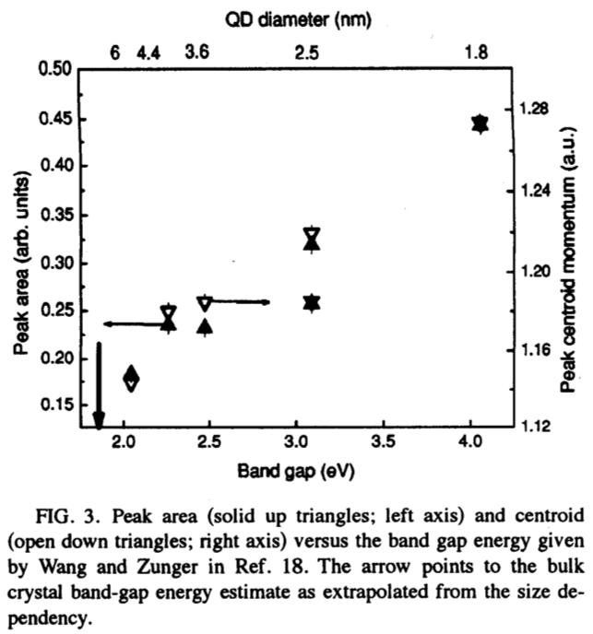
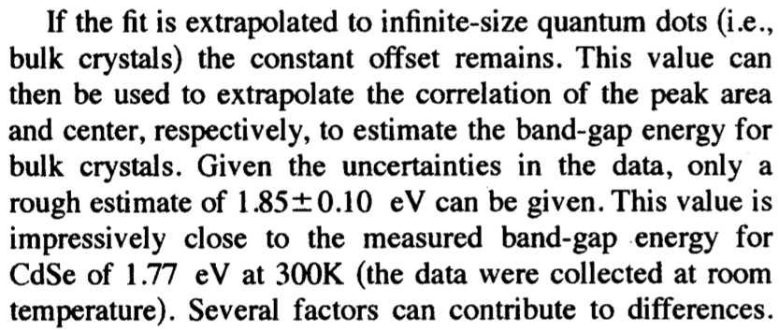

Slide 4
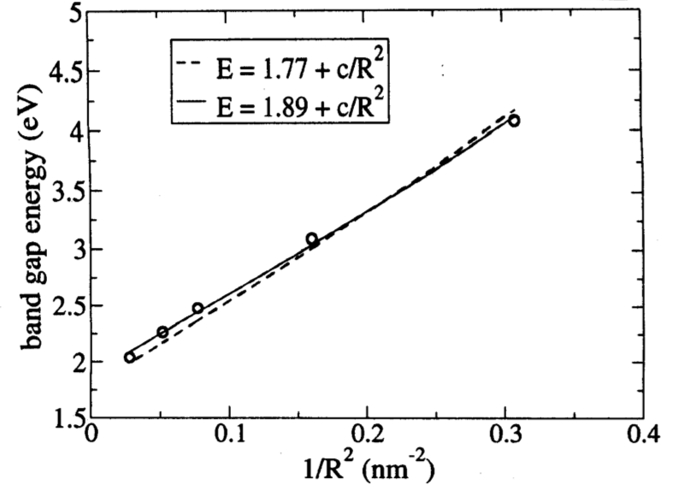
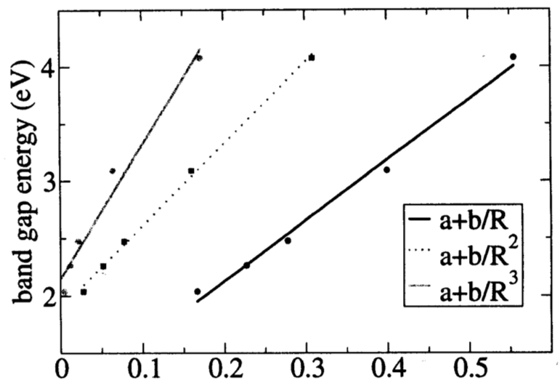

Slide 5
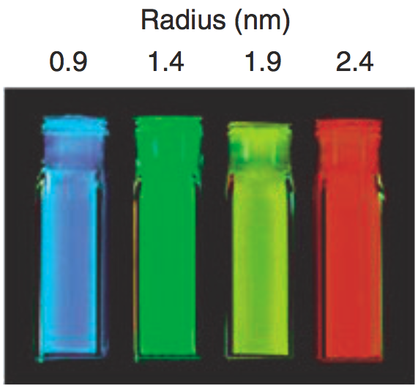
CdSe quantum dots emit in the visible region under UV illumination

Slide 6
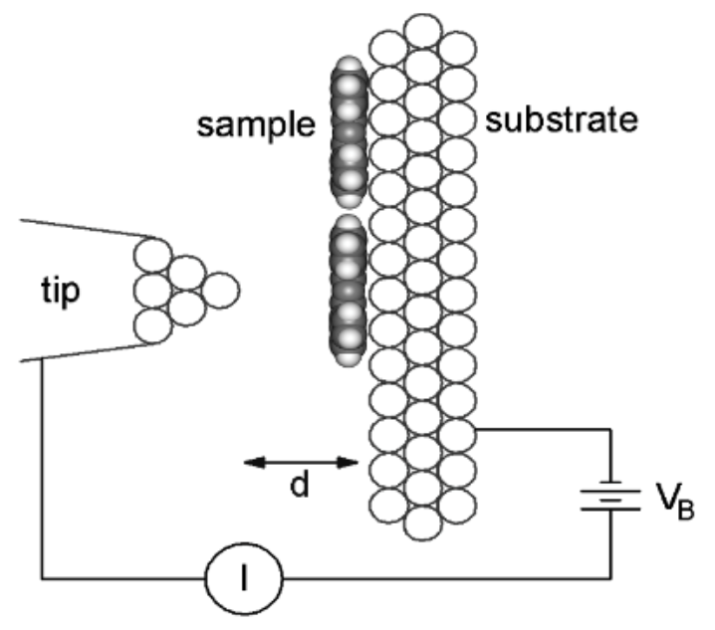
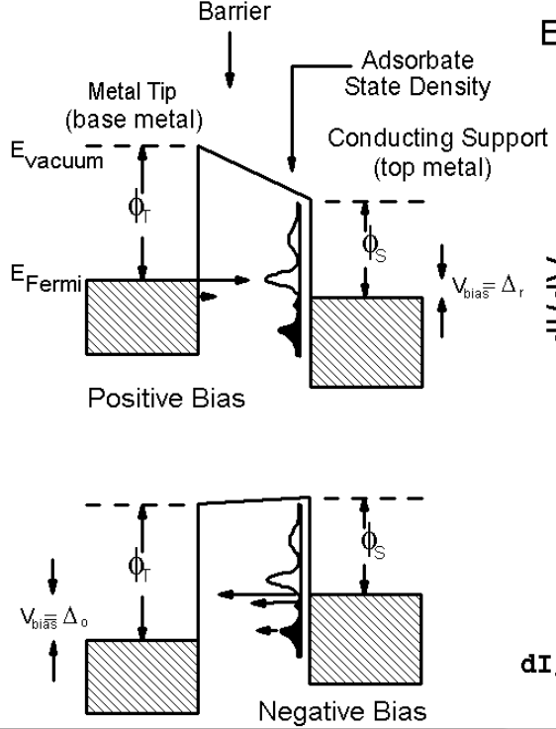
Scanning tunneling microscopy & spectroscopy (STM/ STS)
Platinum-iridium tip [80/20, Pt does not oxidize (noble metal), Ir for strength]
Substrate: gold-coated mica
50 to 250 mV potential difference (bias)
Current flows due to applied bias
Tunneling current:
Positive bias: sample is positive, hence probe LUMO of sample
Negative bias: sample is negative, hence probe HOMO of sample
Particle in a box
Particle in a box
barrier

Slide 7
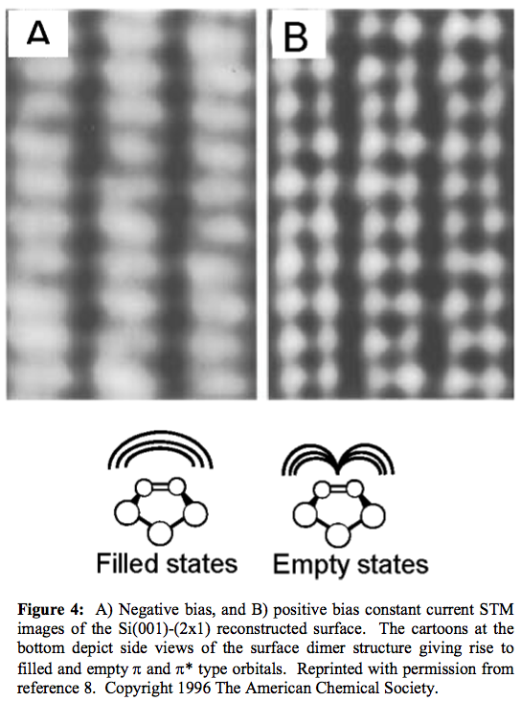

Slide 8
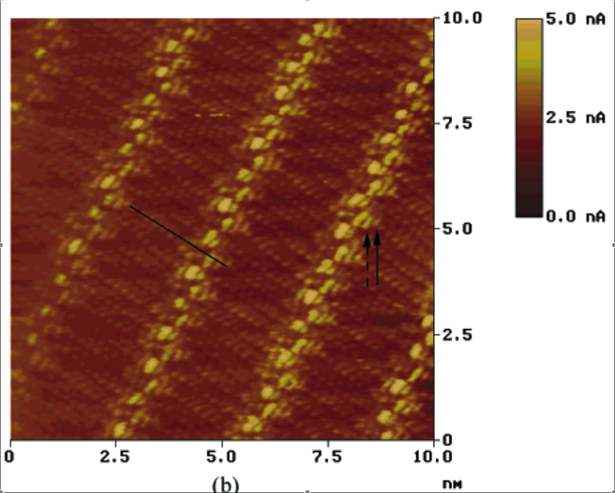
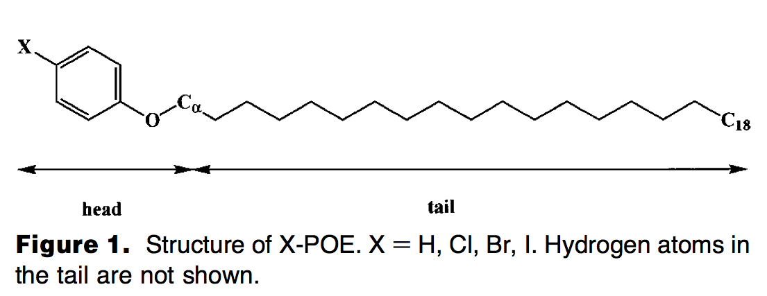
STM image of a monolayer of organic molecules
In STM the bias is fixed and the tip is scanned across the sample.
H.S. Lee, S. Iyengar, and I. H. Musselman, Anal. Chem. 2001, 73, 5532-5538

Slide 9
STM image of a monolayer of organic molecules
In STM the bias is fixed and the tip is scanned across the sample.

Slide 10
STM image of a monolayer of organic molecules
In STM the bias is fixed and the tip is scanned across the sample.

Slide 11
STM image of a monolayer of organic molecules
In STM the bias is fixed and the tip is scanned across the sample.

Slide 19
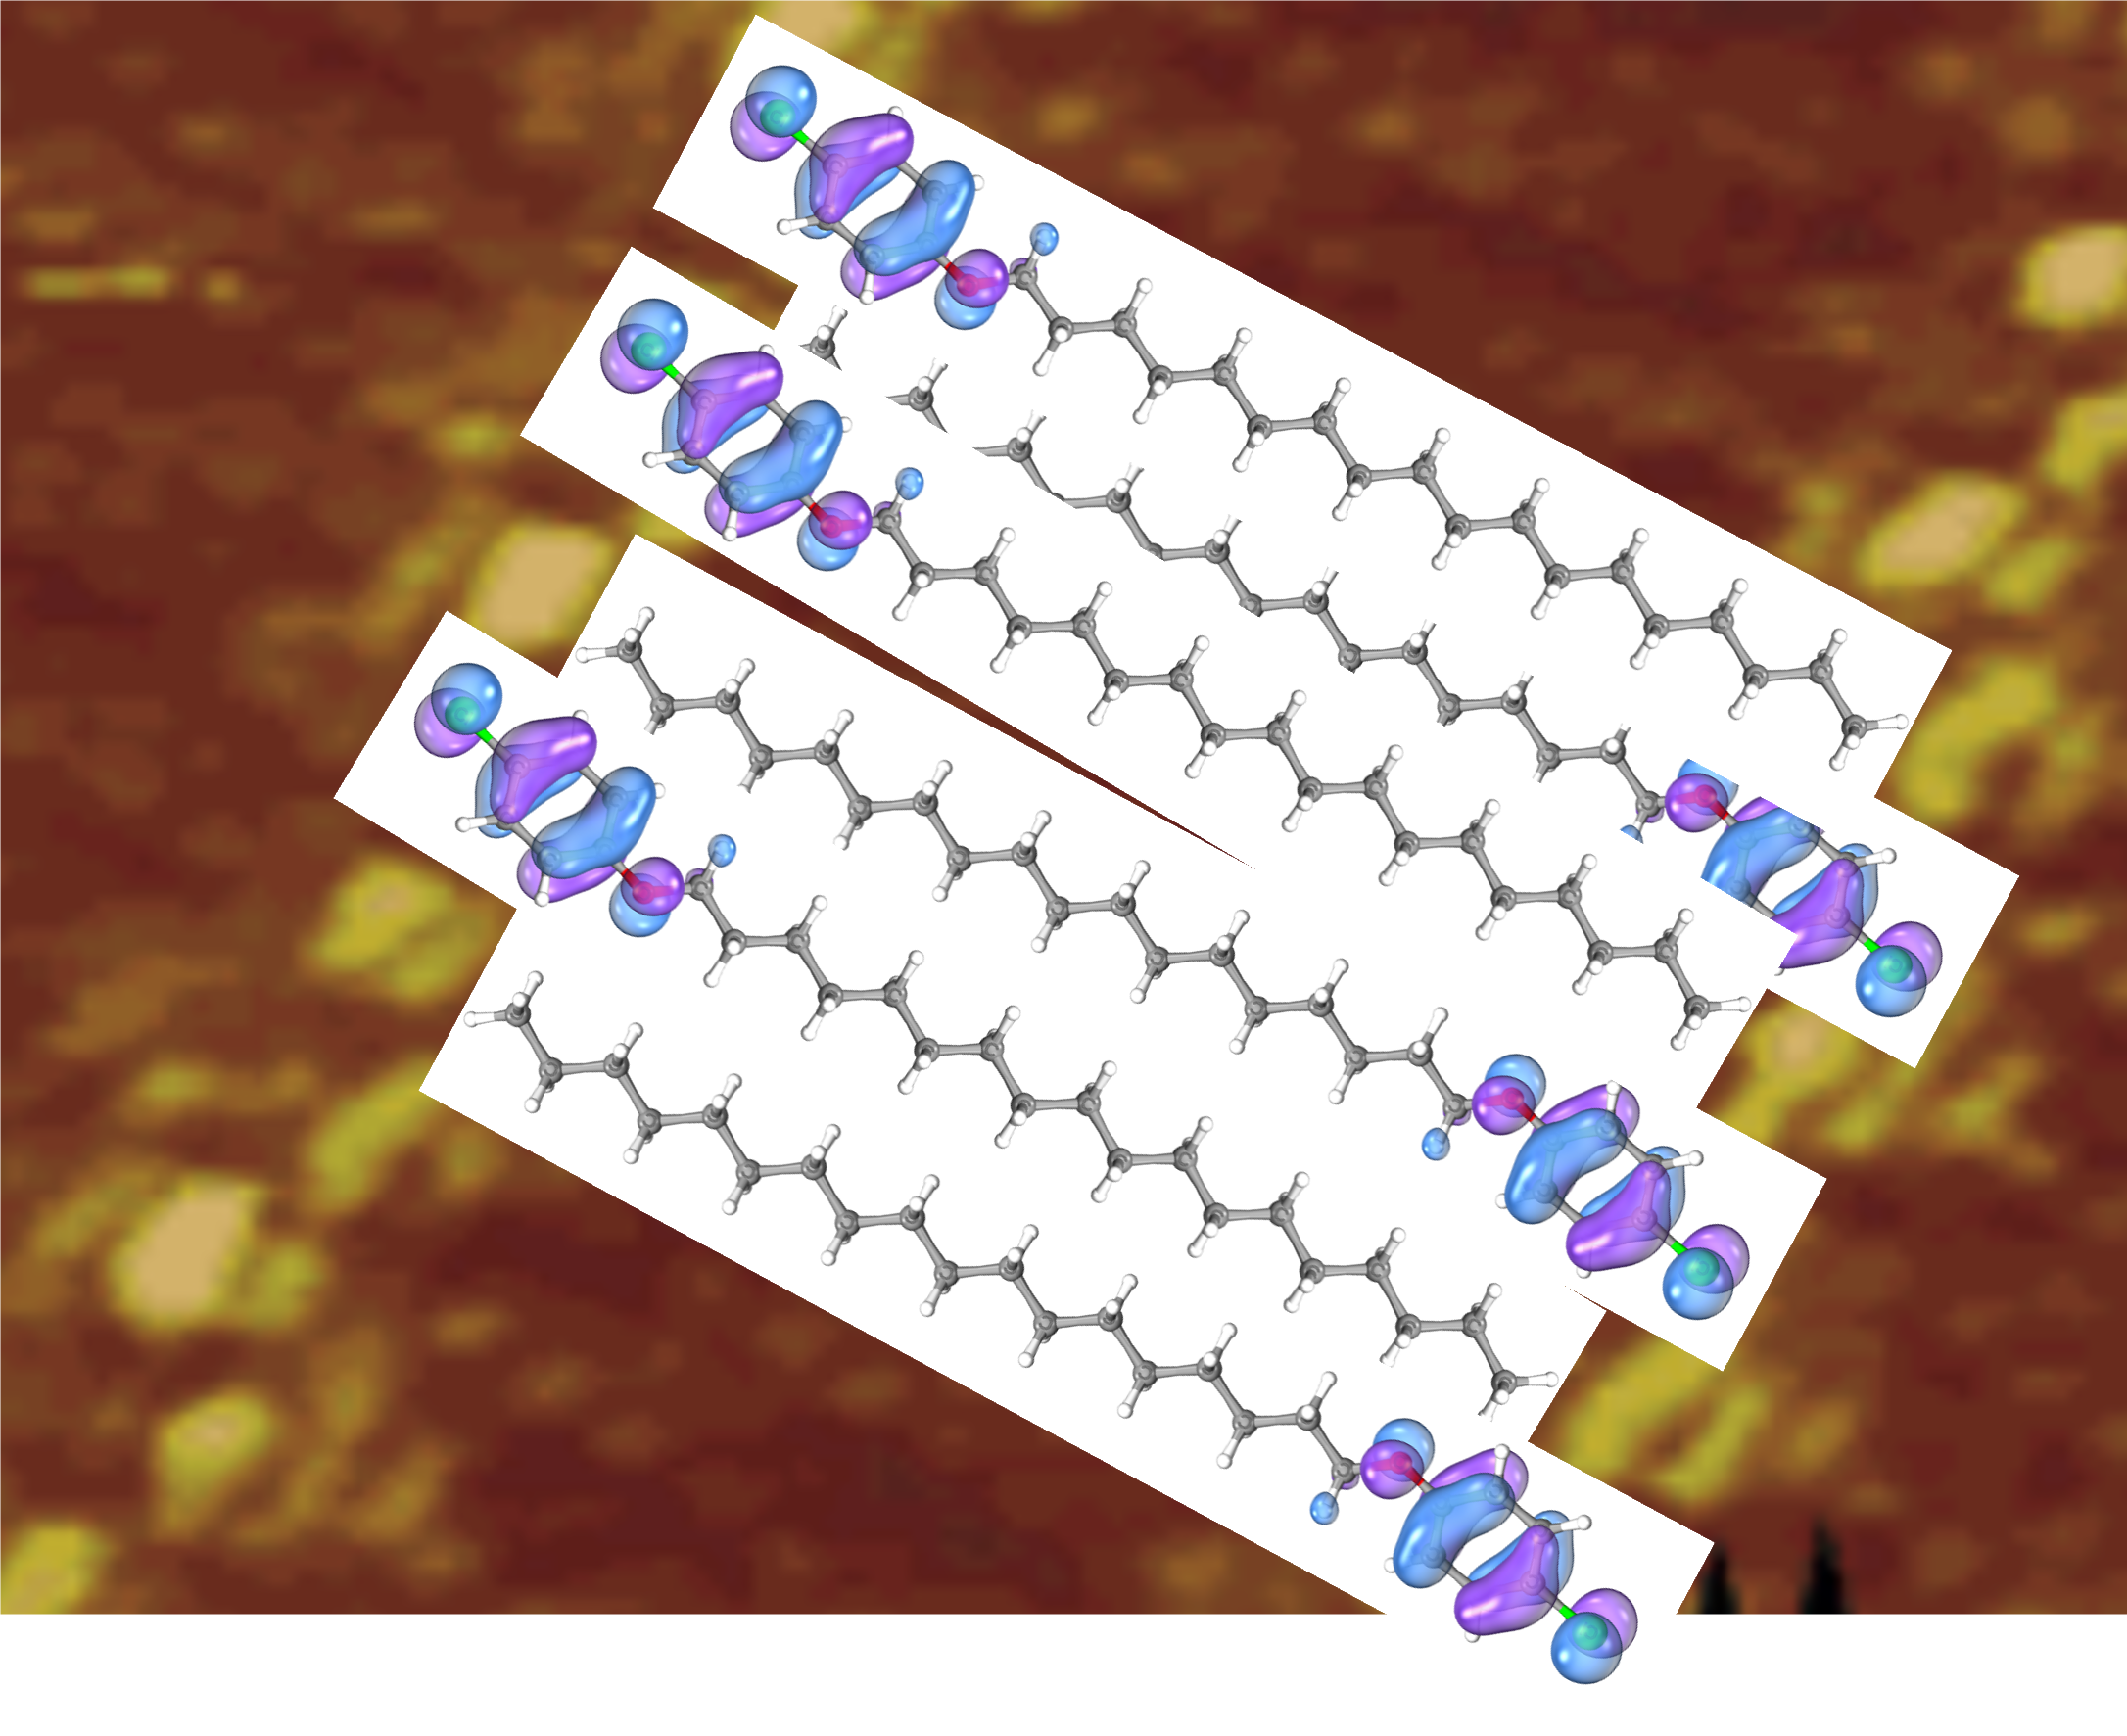

Slide 20
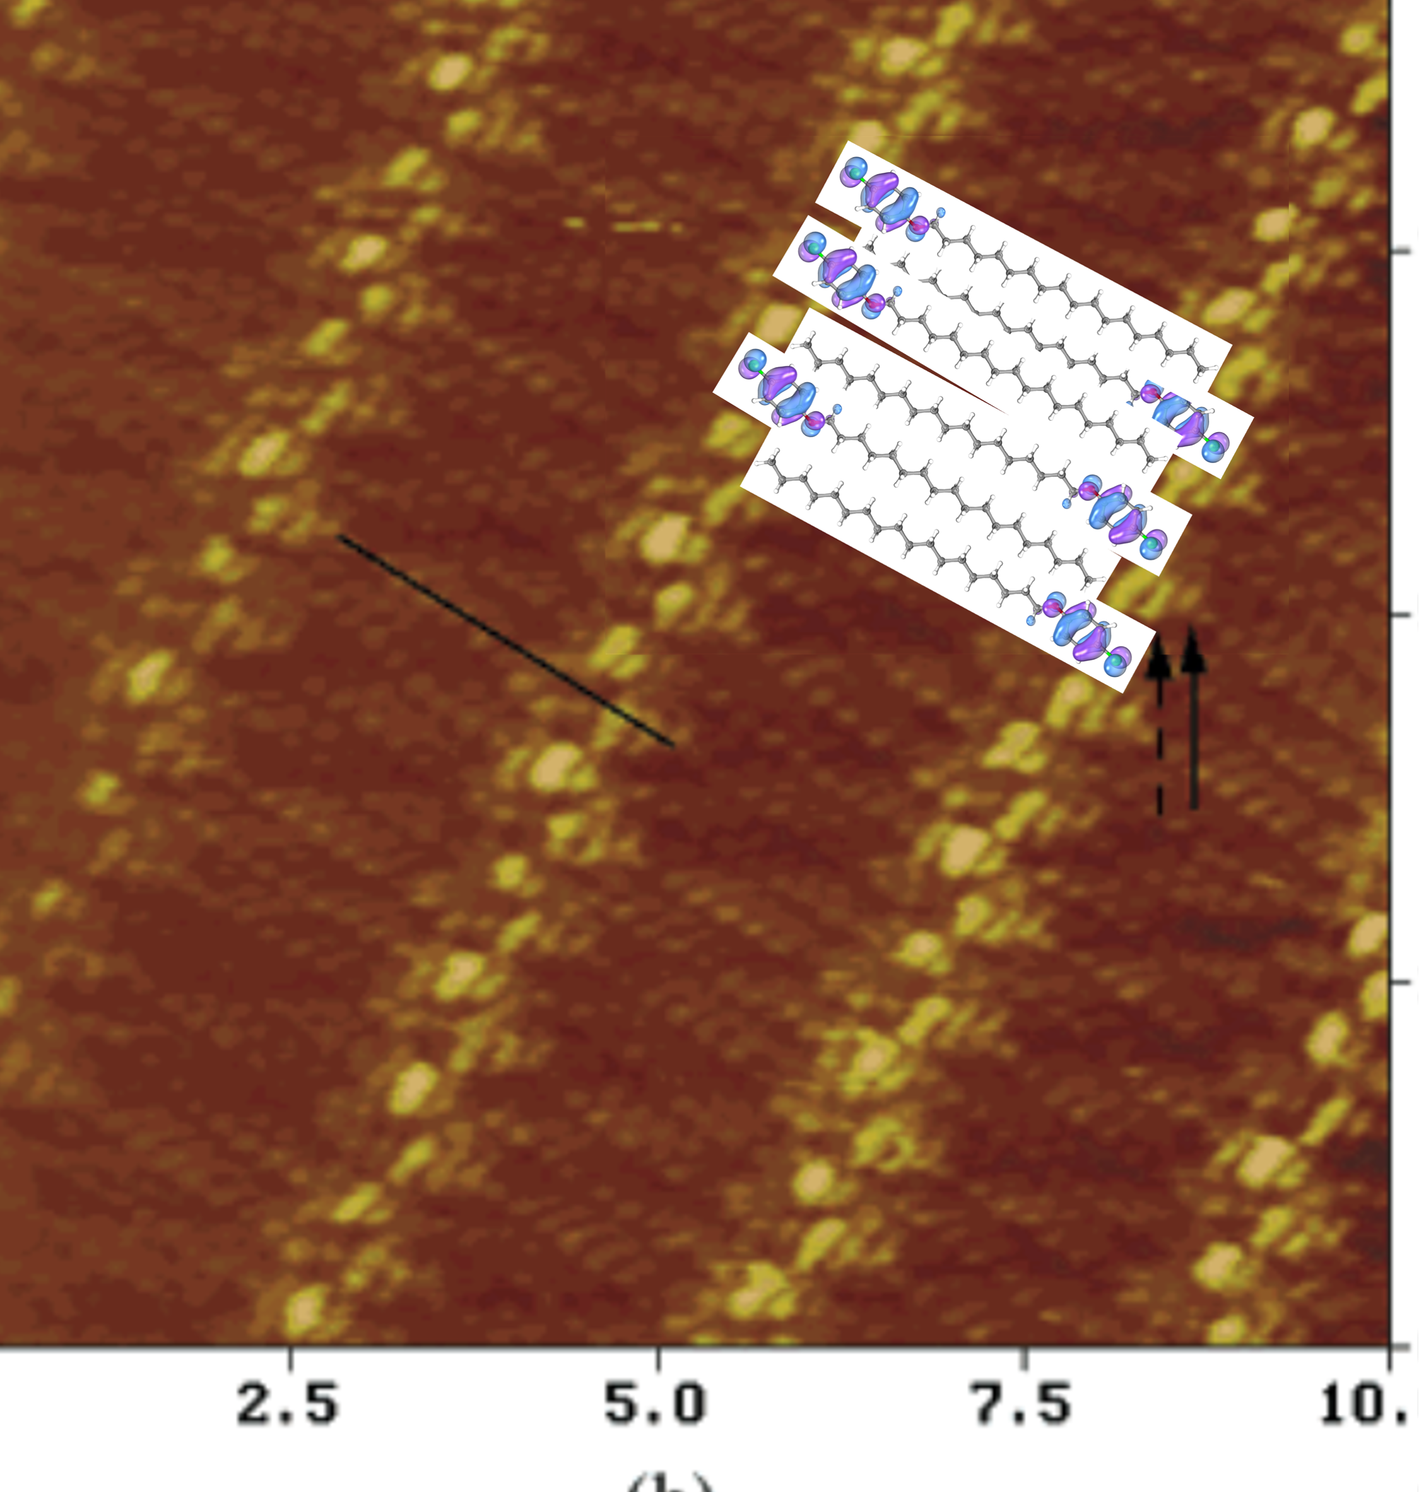
STM image of a monolayer of organic molecules
In STM the bias is fixed and the tip is scanned across the sample.
H.S. Lee, S. Iyengar, and I. H. Musselman, Anal. Chem. 2001, 73, 5532-5538

Slide 21
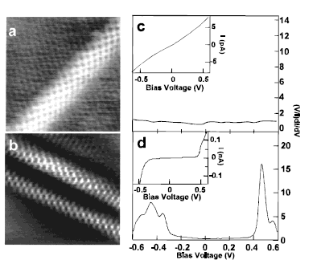
STM and STS of single wall carbon nanotubes
In STS the tip position is fixed and the bias is scanned.
The derivative of the current-voltage (I-V) curve gives the density of states and hence the bandgap for the semiconducting nanotube
Ohmic vs. rectifying behavior: metallic vs. semiconducting nanotube

Slide 22
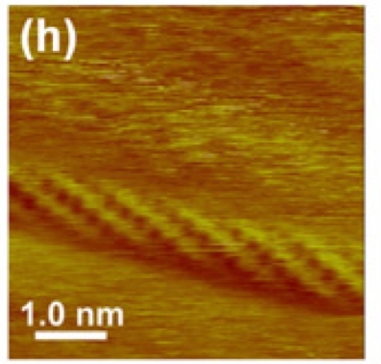
Dinushi Samarajeewa

