Slide 1
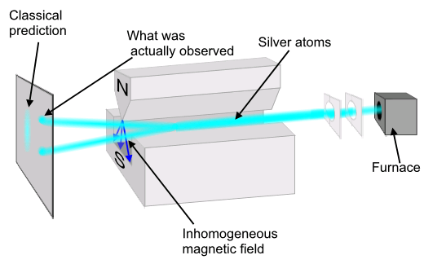
Quantum Mechanics: The Stern-Gerlach Experiment (1921)
a silver atom has an unpaired electron
(and a charged particle is deflected by a magnetic field)

Slide 2
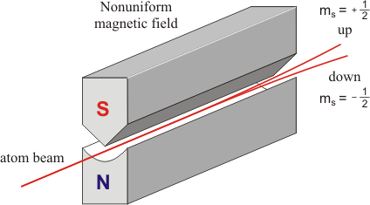

Slide 3
up = u
down = d
l
left =
right = r

Slide 4
u
up = u
up/down
measurement
d
down = d
l
l
left =
left/right
right = r
measurement
r

Slide 5
This device measures the up/down property by sending “up” atoms one way and “down” atoms another way.
But to learn the outcome you would have to put a fluorescent screen or something in the beam path:
u
(fluorescent screen lights up due to particle impact)
up/down
measurement
d

Slide 6
Are the up/down and left/right properties of an atom correlated?
50%
No: 50% of down atoms are left and 50% are right
l
d
left/right
50%
r
knowing the up/down property of an atom tells us nothing about its left/right property
(and no additional information helps [no hidden variables])

Slide 7
Now assume a down atom emerges from the right aperture of a left/right box (50% will do so).
Let us measure up/down

Slide 8
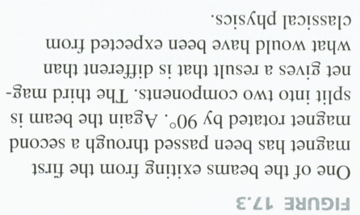

Slide 9
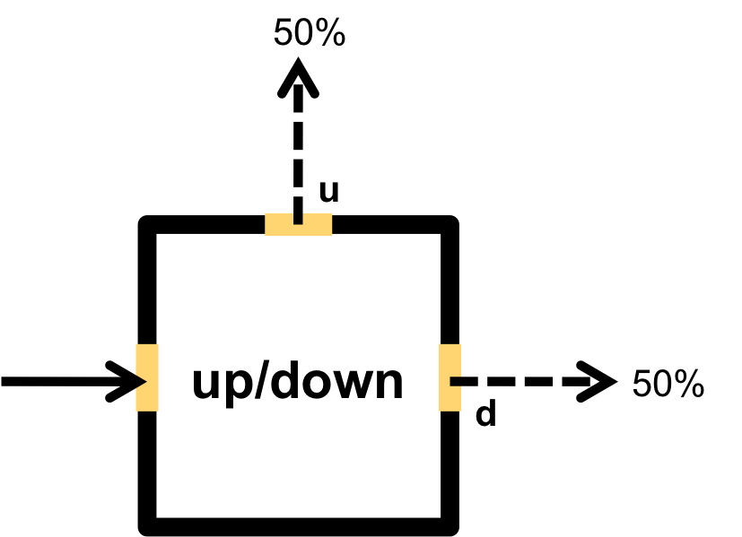
Now assume a down atom emerges from the right aperture of a left/right box (50% will do so).
somehow the left/right box has changed the up/down value !

Slide 10
introduce vector / matrix notation for all this
when performing a measurement, we must change to the “measurement” basis to learn about the outcomes, because of how quantum mechanics works (because of the postulates)
(need to discuss the postulates including collapse)

Slide 11
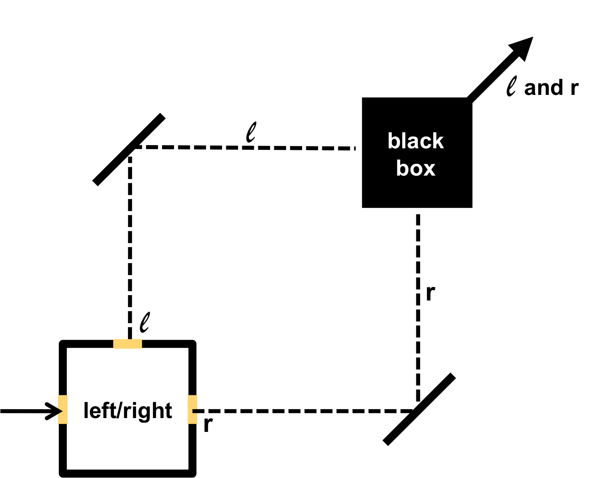
Now construct a more complicated apparatus
the “black box” is just a fancy mirror that makes the two paths coincide (recombines them)
If we feed an l (or an r) atom in, it emerges along the l and r path, unchanged.

Slide 12
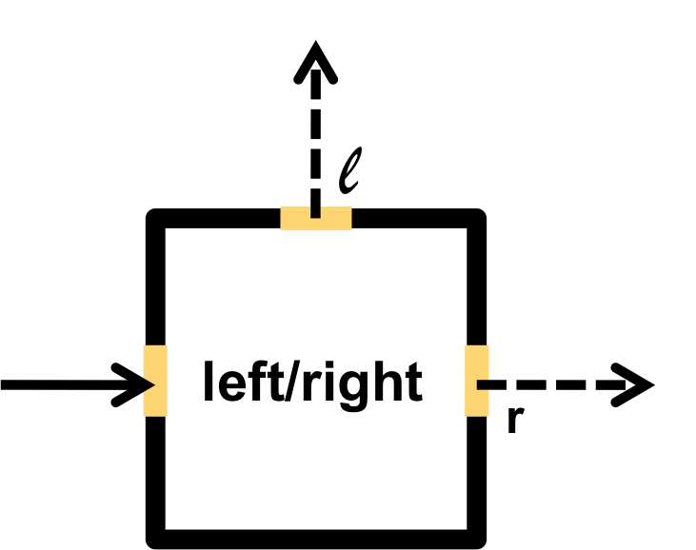
Use a down atom and measure left/right.
Find 50% l and 50% r
Note: “find” here means using this:
d
and this:

Slide 13
Use a left atom and measure up/down.
Find 50% u and 50% d
l

Slide 14
Use a down atom and measure up/down.
This device is just a fancy left/right box
(it is a left/right box with a few harmless mirrors), and we know a left/right measurement scrambles the up/down property.
d

Slide 15
Use a down atom and measure up/down.
Find 100% down !!!
d

Slide 16
Let us add a movable wall that absorbs atoms
d
Slide the wall into place:
1.) 50% reduction in the number of
atoms emerging from the apparatus
2.) Of the atoms that emerge, their up/down
property is now scrambled: 50% u and 50% d.
What can possibly be going on ?

Slide 17
d
Consider an atom which passes through the apparatus when the sliding wall is out.
Does it take route l ? No, because l atoms have 50/50 u/d statistics.
d
Does it take route r ? No, same reason.
Can it somehow have taken both routes ? No: if we look (use a fluorescent screen) to see where the atom is inside the
apparatus, we find that 50% of the time it is on route l, and 50% of the time it is on route r. We never find two atoms inside, or two halves of a single, split atom, or anything like that. There isn’t any sense in which the atom seems to be taking both routes.
Can it have taken neither route? No: if we put sliding walls in place to block both routes, nothing gets through at all.
But these are all the logical possibilities !

Slide 18
What can these atoms be doing?
We use the word (which is just a name for something we don’t understand) superposition.
What we say about an initially down atom which is now passing through our apparatus (with the wall out)
is that it’s not on path l and not on r and not on both and not on neither, but, rather, that it’s in a
superposition of being on l and being on r. And what this means (other than “none of the above”) we don’t know.

Slide 19
We know, by experiment, that atoms emerge from the left aperture of a left/right box if and only if they’re left atoms when they enter that box.
When a down atom is fed into a left/right box, it emerges neither through the left aperture nor through the right one nor through both nor through neither. So, it follows that a down atom can’t be a left one, or a right one, or (somehow) both, or neither. To say that an atom is down must be just the same as to say that it’s in a superposition of being left and right.
So what outcome can we expect of a left/right measurement?
Quantum mechanics must be a probabilistic theory !!

Slide 20
in Richard Feynman’s words
(Lectures on Physics, Vol. III, Page 1-1)
We choose to examine a phenomenon which is impossible, absolutely impossible, to explain in any classical way, and which has in it the heart of quantum mechanics. In reality, it contains the only mystery. We cannot make the mystery go away by “explaining” how it works. We will just tell you how it works.

Slide 21
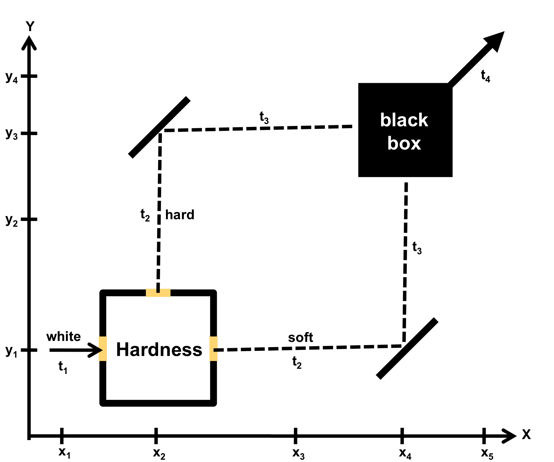
go through timeline writing out the state to see what happens
left
down
right
left / right

Slide 22
assign the Scientific American article “The Duality in Matter and Light” for reading, which among other things shows that the double-slit interference pattern emerges even if the photons are sent one at a time!

Slide 23
Quantum Cryptography:
how to communicate without eavesdropping
(from S.J. Lomonaco, Jr., http://www/csee.ubmc.edu/~lomonaco)
Key idea: How to determine if Eve is listening to Alice and Bob’s conversation?

Slide 24
Quantum Cryptography:
how to communicate without eavesdropping
(from S.J. Lomonaco, Jr., http://www/csee.ubmc.edu/~lomonaco)
Eve
Bob
Alice
Key idea: How to determine if Eve is listening to Alice and Bob’s conversation?

Slide 25
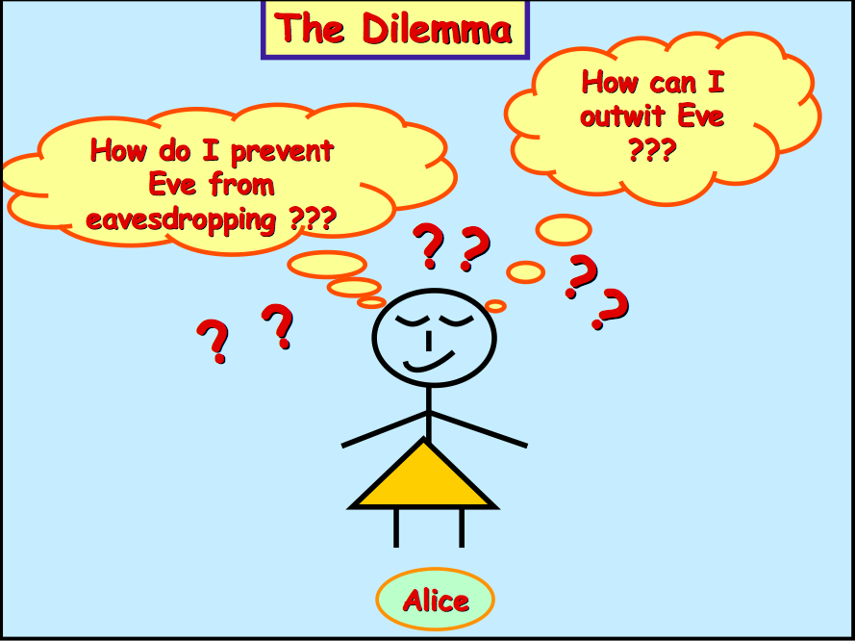

Slide 27
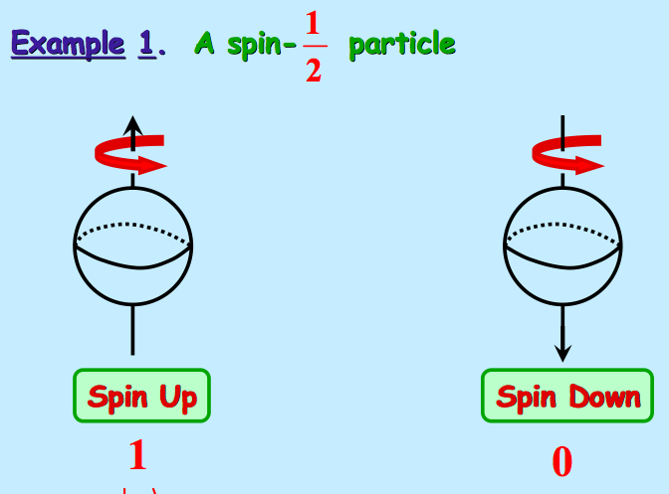

Slide 28
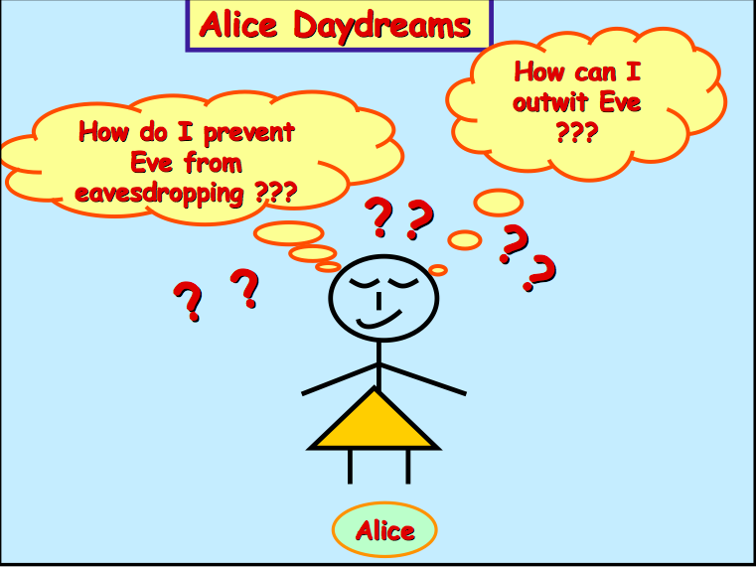

Slide 31
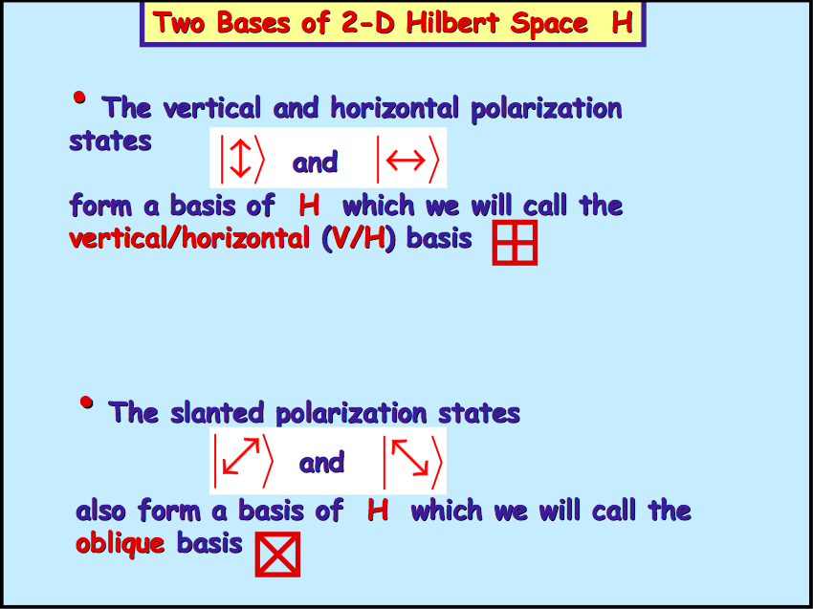
This is our left/right value
This is our up/down value

Slide 36
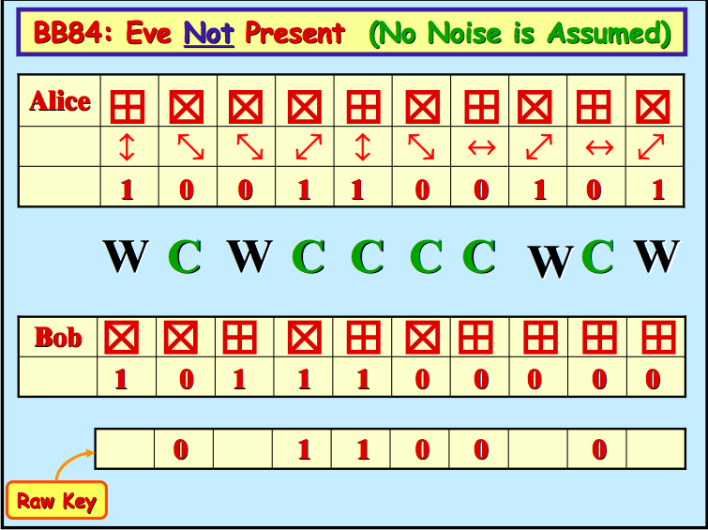

Slide 39
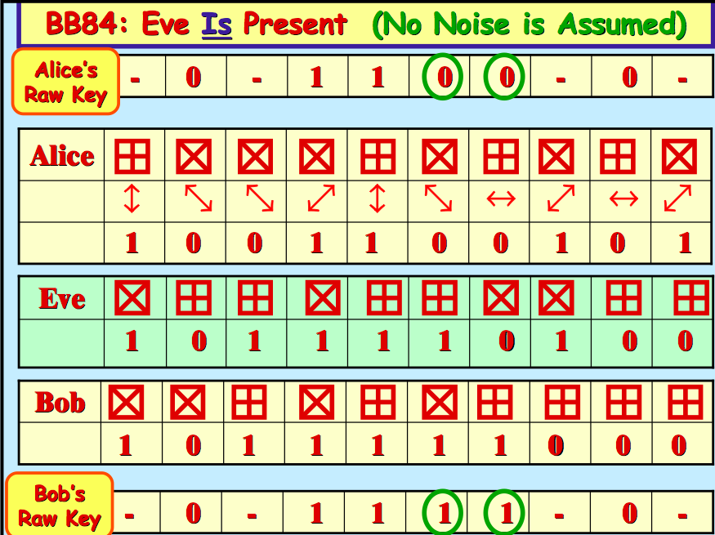

Slide 42
Quantum Computing
use quantum bits (qubits) to store information
use logic gates to manipulate the bits (just like classical computing):
NOT, AND, NAND, OR, NOR, XOR, …

Slide 48
credit: Lyle Zynda (now at IUSB), PHI 204, Princeton University, Spring 1994
Heisenberg and Von Neumann Interpretation
A physical system's observable properties always have definite values between measurement, but we can never know what those values are since the values can only be determined by measurement, which indeterministically disturbs the system.
This implies that the system was in a definite state before measurement, and that the quantum mechanical formalism gives an incomplete description of physical systems.
Bohr Interpretation (The Copenhagen Interpretation)
(the received view among physicists) (the orthodox interpretation)
It does not make sense to attribute definite values to a physical system's observable properties except relative to a particular kind of measurement procedure, and then it only makes sense when that measurement is actually being performed.
Famously, Bohr proposed an interpretation that denies that the description given by the quantum mechanical formalism is incomplete.

Slide 49
On Bohr’s view, the world is divided into two realms of existence, that of quantum systems, which behave according to the formalism of quantum mechanics and do not have definite observable values outside the context of measurement, and of “classical” measuring devices, which always have definite values but are not described within quantum mechanics itself. The line between the two realms is arbitrary.
There are several difficulties with this view, which together constitute the “measurement problem”.
To begin with, the orthodox interpretation gives no principled reason why physics should not be able to give a complete description of the measurement process. Indeed, the orthodox interpretation claims that whether a certain physical interaction is a “measurement” is arbitrary, i.e., a matter of choice on the part of the theorist modeling the interaction.

Slide 50
Schrödinger’s Cat
Schrödinger pointed out that the orthodox interpretation allows for inconsistent descriptions of the state of macroscopic systems, depending on whether we consider them measuring devices.
Put a cat in an enclosed box along with a device that will release poisonous gas if (and only if) a Geiger counter measures that a certain radium atom has decayed.
The radium atom is in a superposition of decaying and not decaying, and hence the Geiger counter and the cat should also be in a superposition (cat = dead + alive) if we do not consider the cat to be a measuring device.
On the other hand, if we consider the cat to be a measuring device, then according to the orthodox interpretation, the cat will either be definitely alive or definitely dead.

Slide 51
When does collapse occur?
Suppose that Alice has a theory about collapse:
collapse happens immediately after the electron exits the measurement box.
And suppose that Bob has another theory about collapse:
collapse happens later, for example when a human retina or optic nerve or brain gets involved.
Can we decide who is right empirically, that is, by performing some experiment?

Slide 52
incoming electron
ready
left
right
outgoing electron
-
-
e
e
left/right measurement

Slide 53
Can we decide who is right empirically, that is, by performing some experiment?
Here’s how to start: Feed a up electron into a left/right device and give it enough time to pass through. If Alice is right, the state of the system is now
either
(with 50% prob.)
or
(with 50% prob.)
whereas if Bob is right, the state of the system is currently
so all we need to do is to figure out a way to distinguish, by means of a measurement, these two cases: In one case the pointer points in a particular (but as yet unknown) direction, and in the other case the pointer isn’t pointing in any particular direction at all.

Slide 54
What if we measure the position of the tip of the pointer? That is, let’s measure where the pointer is pointing. This won’t work.
If Alice is right, of course we will find a 50/50 chance of finding the pointer “pointing-at-left” vs. “pointing-at-right”. This is because, according to Alice, the pointer is already in one of those two states.
But if Bob is right, then a measurement of the position of the tip of the pointer will have a 50% change of collapsing the wavefunction of the pointer onto the “pointing-at-left” state, and 50% change of collapsing it to “pointing-at-right”.
Therefore the probability of any given outcome of a measurement of the position of the pointer will be the same for both these theories; and so this isn’t the sort of measurement we are looking for.

Slide 55
What if we measure the up/down property of the atom?
This won’t work.
What if we measure the left/right property of the atom?
This won’t work.
These arguments establish that different conjectures about precisely where and precisely when collapse occurs cannot be empirically distinguished from one another.
And so the best we can do at present is to try to think of precisely where and precisely when collapses might possibly occur (that is, without contradicting what we do know to be true by experiment). But it turns out to be hard to do even that.

