Slide 1
Getting prepared for virtual hands-on workshop : “Enjoyable Introduction to Programming using Alice”
Review this presentation early and prepare for a successful workshop 1 week in advance!

Slide 2
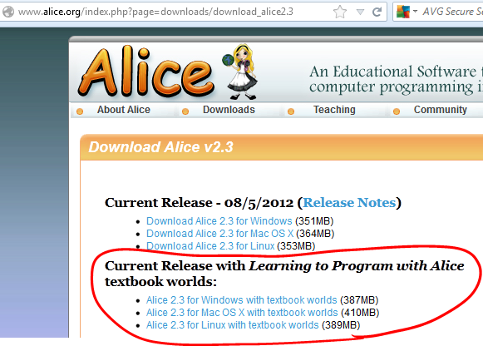
Alice 2.3 software

Slide 3
Software Installation
Download free Alice 2.3 software from www.alice.org 1 week early (at least a few days in advance) and test it out in a few machines in the lab to avoid any last-minute discovery of performance issues. Download the version with “textbook worlds”.
Alice is a graphics software, so it is CPU & memory intensive, it may not run well in old machines.
It is known to crash or freeze or misbehave randomly in older machines. While restarting the application may resolve occasional issues, it is not worth wasting time with older machines.

Slide 4
Video download
You may want to download all the videos to presentation PC prior to the workshop to avoid any last-minute disturbances like internet outage.
Download the complete package of materials from www.utdallas.edu/~jeyv/alice/workshop.zip
You can extract all the videos and resource files from this ZIP archive, then run the whole workshop from that PC – Internet access not required during the workshop.

Slide 5
Projector & Speakers
Test projector and speaker connectivity to presentation PC and ensure that every one in the lab can see and hear comfortably.
It is ok to double up students in each PC if there is enough space (but not enough PCs) in the lab. Ask them to take turns for each hands-on assignment.

Slide 6
2 to 3 parts in each segment
Workshop has been divided into several segments. A new concept is introduced in each segment.
Each segment involves
watching 10-15 minute video to solve a specific problem
students reproduce the solution to strengthen their understanding
students will do a new problem utilizing those concepts (optional, may not be available with each segment))

Slide 7
2 to 3 parts in each segment …
When students are reproducing a solution, you can replay the video if they are getting stuck.
Encourage the students to try to do the work individually first, but tell them it is ok to discuss and help each other if needed.

Slide 8
Workshop duration?
You can decide the pace of the workshop based on how fast the students are picking up & # of days you allocated for the workshop.
3 full-days are suggested for this workshop, though it is possible to rush through a bit & complete in 2 days, or take it easy and go slowly and utilize 4 full days to maximize the benefit.

Slide 9
Feedback
Please do provide a feedback to jeyv@utdallas.edu after the workshop is complete.
Please include the follwing information: Name & place of the college, # of students, # of days, what worked well, what need to be improved, etc. Thanks!

